Slide 1
Quiz Mania

Slide 2
Contents
Introduction
Module Description
Objective
Resource Requirement
Applicability
Limitation
Future Enhancements
Data Flow Diagram
System Output

Slide 3
Introduction
This 'QUIZ GAME' Project is designed for a question in which you can generate and manage a simple database for questions. The question number is automatically generated by the software and is stored in a binary file by the name 'QUESTION'. In this software the Question will be asked to the user & the user get 10 sec for answering the question. If the user is correct then he get 10 points on every question. If he is incorrect then he lost the game & game is closed.
This project is developed considering “QUIZ” information keeping context of the customer in mind.

Slide 4
Module Description
Administrator Module
  The Admin of the system will be able to add user i.e. he will be able to add Login Id and Password of user in the Database.
  The admin will also be able to add questions and their options in the database.
  Only the Admin will have the access to the database.

Slide 5
Module Description
Student Module
  He will be able to login using login Id and Password.
  The user (usually the student) will be able to take the Quiz

Slide 6
Objective
To reduce paper work,and provide more accurate and speedy operation.
Online Exam will save time.
Online will exam save manual work (i.e. Calculation of marks,Supervising etc.)
Provide Security.
Immediately Student can see their result.
To prepare question bank so that in future it can be used to design exam

Slide 7
Resource Requirement (cont..
Hardware Specification
CPU : Intel Premium 133 MHz
RAM : 16 MB or more
HARD DSIK : 1.2 GB (Min)
4.3 GB recommended
CATCH MEMORY : 64 kb
DISPLY MONITOR : 14” monitor with 256 + color at 640 * 480 Resolution

Slide 8
Resource Requirement (cont..
Software Specification
SERVER SIDE
  →OPERATING SYSTEM: Windows 95,98,2000,XP,server (Any One)
  →Microsoft Visual Studio 2005
  →IIS
  →.NET FRAMEWORK
  →Microsoft SQL Server 2005
  →INTERNET EXPLORER
CLIENT SIDE
  →Any Operating System with internet browsing facility

Slide 9
Resource Requirement
Tool Used
FRONT END TOOL:
MICROSOFT ASP .NET 2005 WITH C#
BACK END TOOL:
MICROSOFT SQL Server 2005 EXPRESS

Slide 10
Applicability
This system is generally applicable to any college, which uses Computers to conduct online exam.
Main users of the system are Administrator, Teachers and Students
Administrator can create and view Teachers and Students information.
Teacher can design exam efficiently and conduct online exam.
Student can give online exam and get result immediately

Slide 11
Limitations
This system capable of handling only objective type of question.
Teacher can not delete the question paper.
Marks and time per question facility is not included.
Cannot generate random sequence of questions.
No Allow back Facility.

Slide 12
Future Enhancement
Descriptive question can be added in this system.
Time per question and marks per question can be added.
The whole question paper will be display while exam will going.
Going to back question and move to any question facility can be added.
Question level (Low/Medium/High) can also be added.
Random sequence of Option can be generated

Slide 13
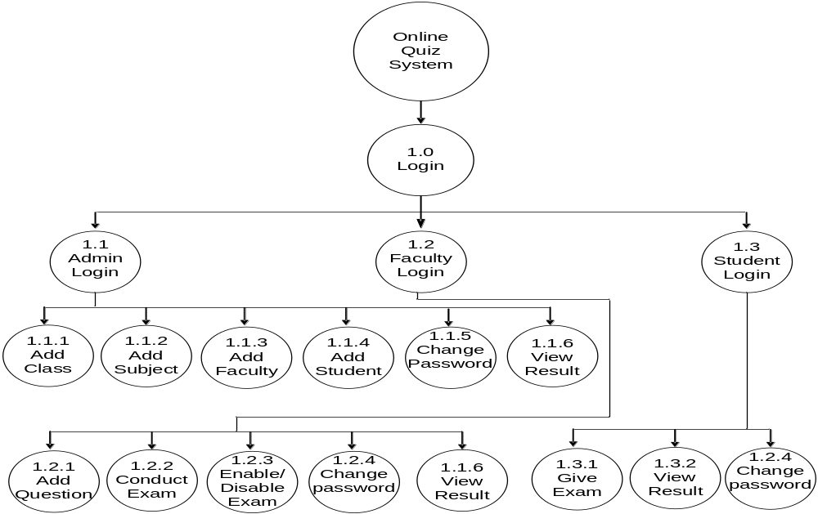
Process Chart

Slide 14
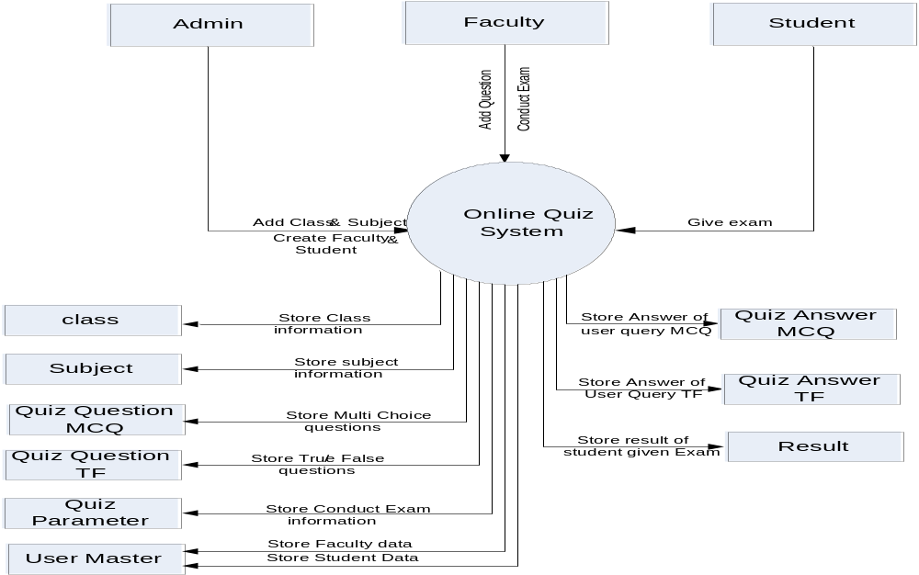
Context Level DFD

Slide 15
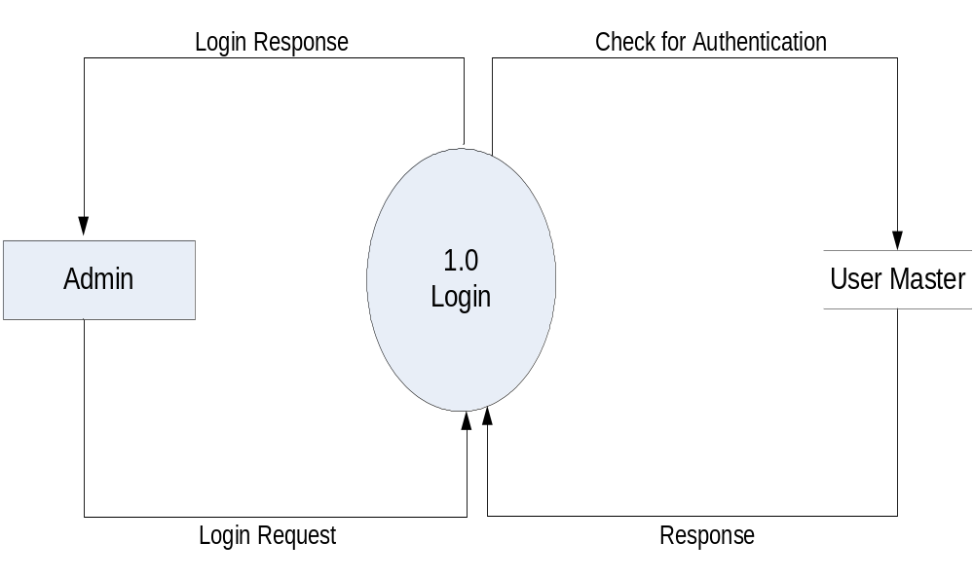
1-Level DFD

Slide 16

1-Level DFD

Slide 17

1-Level DFD

Slide 18
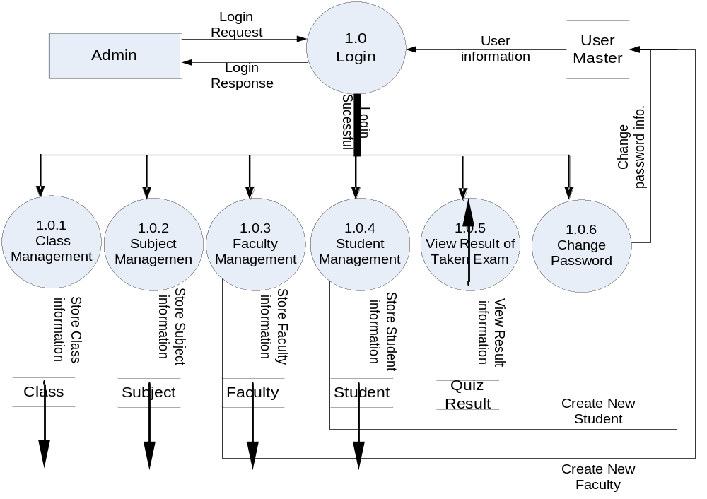
2-Level DFD For Process 1.0

Slide 19
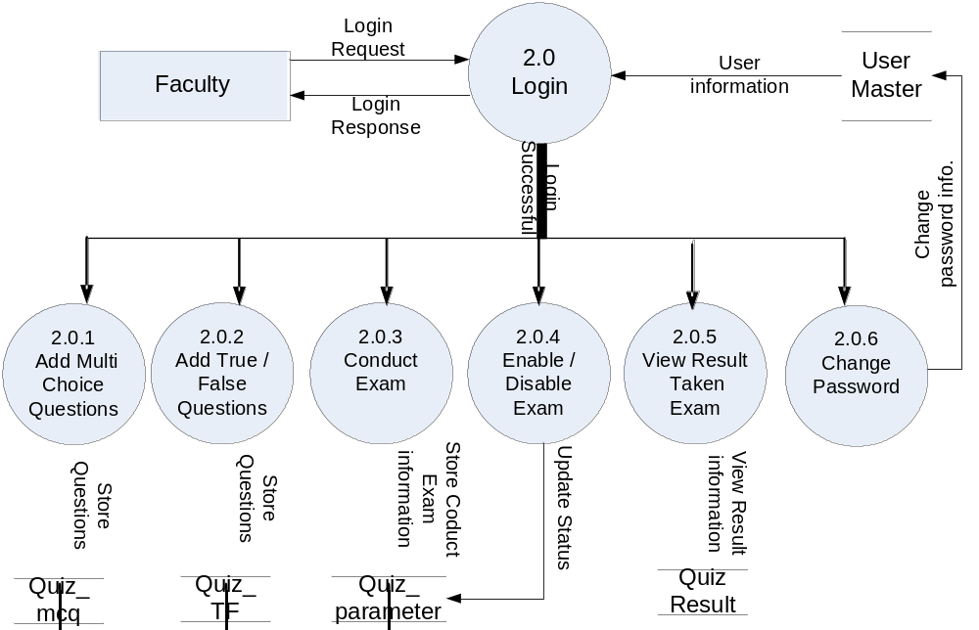
2-Level DFD For Process 2.0

Slide 20
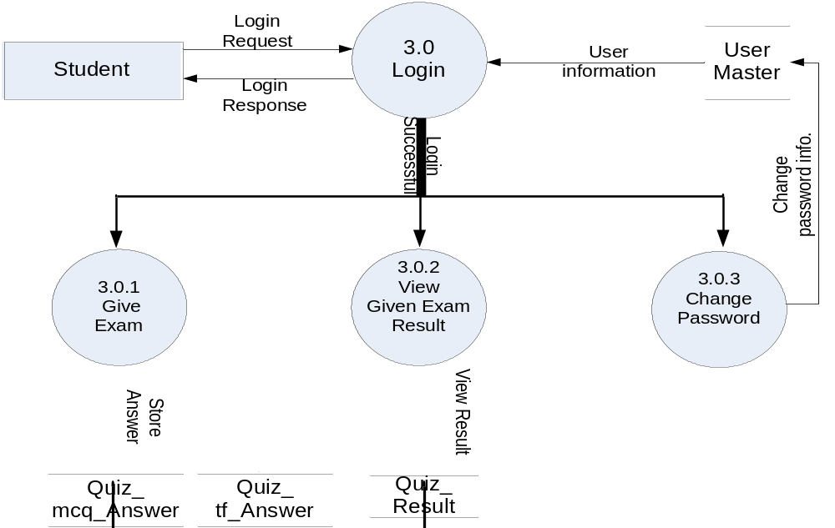
2-Level DFD For Process 3.0

Slide 21
Thank YOU

