Slide 1
Global Internet User Report
Fakhrie Nabil
June 2023

Slide 2
Overview
This report presents an analysis of global internet usage from 1980 to 2020. The dataset used in this analysis provides information on various aspects such as country names, codes, years, cellular subscriptions, internet penetration rates, number of internet users, and broadband subscriptions. The aim of this analysis is to gain insights into the trends and patterns of internet usage worldwide.

Slide 3
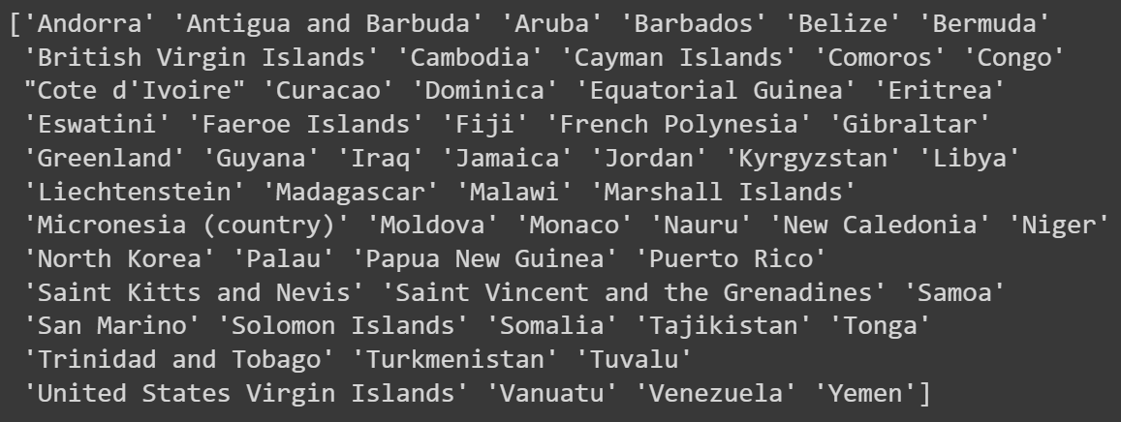
Disclaimer
Data for some countries may be unavailable or does not include information on internet users percentage.

Slide 4
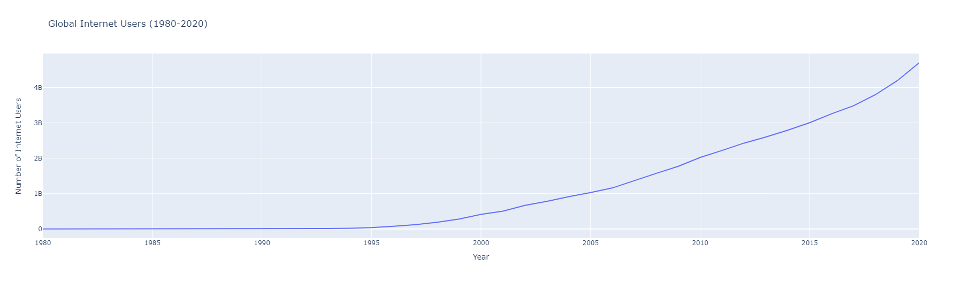
Global internet user growth.
There has been a significant growth in the adoption of internet usage worldwide.

Slide 5
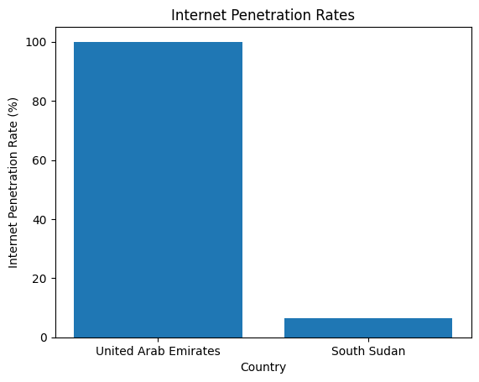
Highest and Lowest Internet Penetration Rates
United Arab Emirates has the highest internet penetration rate with a percentage of 100.0%. This indicates widespread internet adoption among its population.
Meanwhile, South Sudan has the lowest internet penetration rate (excluding 0%) with a percentage of 6.5%. This indicates a significant internet access gap in the country, which may be influenced by factors such as limited infrastructure or accessibility constraints in certain areas.

Slide 6
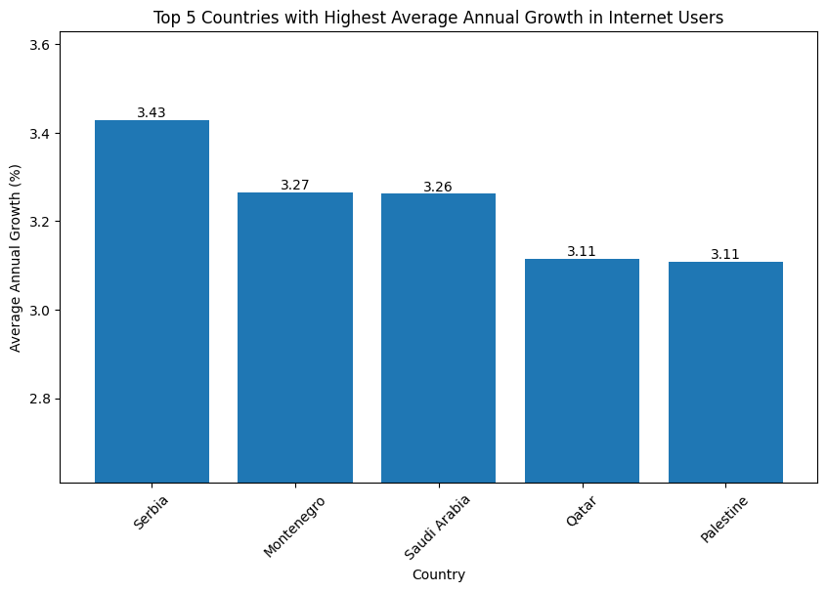
Highest Internet Growth Rate
It's important to note that internet users growth is not limited to developed countries.
Emerging economies can also experience significant advancements in internet access and usage through targeted efforts and investments.

Slide 7
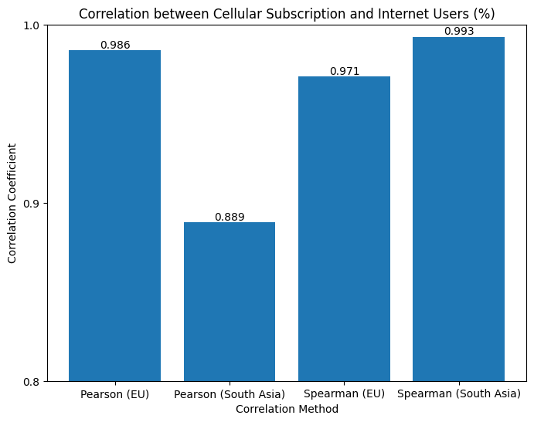
Correlation
The Pearson and Spearman correlation methods reveal a significant positive correlation in the EU and South Asia regions, indicating a strong relationship.
This suggests that higher cellular subscriptions are associated with a higher percentage of internet users in these regions.

Slide 8
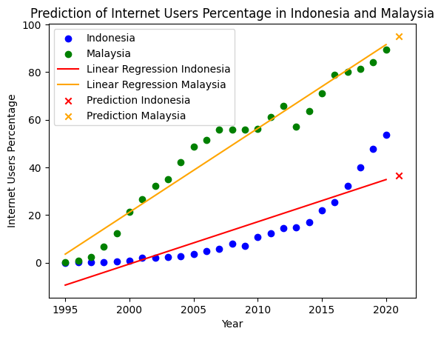
Can we predict future internet usage trends based on historical data and patterns?
Based on the sampled data from Malaysia and Indonesia,
Malaysia has a realistic prediction of an increasing trend, while Indonesia does not.
It is possible that predicting internet usage in Indonesia may require alternative methods beyond the linear regression model that I have yet to learn.

Slide 9
Thank you

