Slide 1
REAL PATIENT DATA · LEAVE-ONE-SUBJECT-OUT
Does the freeze detector work?
FoGNet 1-D CNN · Daphnet (10 Parkinson's patients) · ankle accelerometer
0.71
0.84
0.78
of real freezes caught
(sensitivity)
of walking correctly cleared
(specificity)
balanced accuracy
(sens + spec) / 2
CONFUSION MATRIX · n=8982
VERSUS BASELINES
true ↓ pred →
no-freeze
freeze
Approach | Sens | Spec
FoGNet (CNN) | 0.71 | 0.84
Freeze-Index | 0.002 | 0.994
Always 'no-freeze' | 0.00 | 1.00
no-freeze
6842
correct walk
1285
false alarm
freeze
248
MISSED freeze
607
caught freeze
Each held-out patient is scored once, then pooled — no patient is in both train and test.
Why not “accuracy”? A model that NEVER calls a freeze scores 90.5% accuracy — yet catches zero freezes and prevents zero falls. A missed freeze can mean a fall, so sensitivity & specificity are the honest metrics here, not accuracy.
DATASET & METHOD
8982 four-second windows (2 s hop), one ankle accelerometer @ 64 Hz
Freeze prevalence 9.5% (855 freeze / 8127 walk) — a rare, safety-critical event
Leave-One-Subject-Out across all 10 patients; metrics pooled over held-out windows
S04 & S10 have no freeze episodes → used for training only (sensitivity undefined as a test fold)
Per-patient sensitivity spans 0.45–0.98 (wide between-subject variability is expected for real Parkinson's gait; the pooled 0.71 is the headline).
Cadence — closed-loop gait garment
Results · page 1 of 2

Slide 2
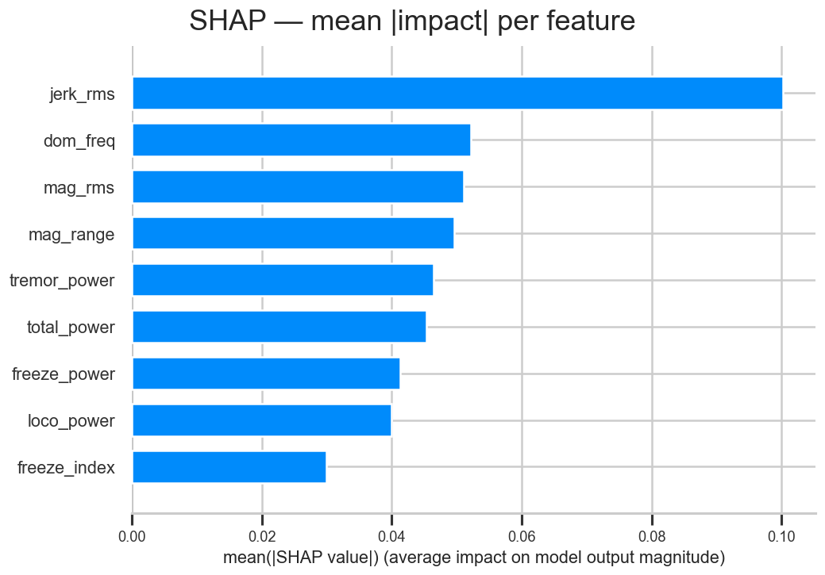
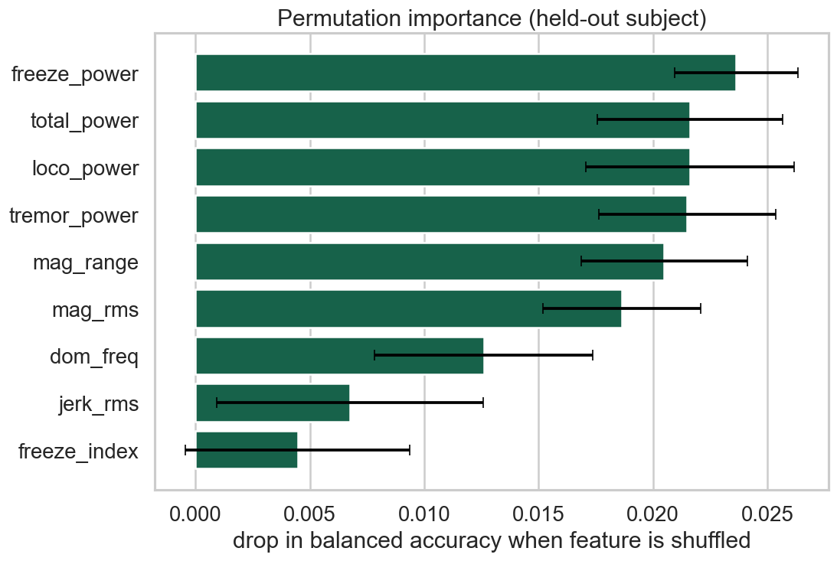
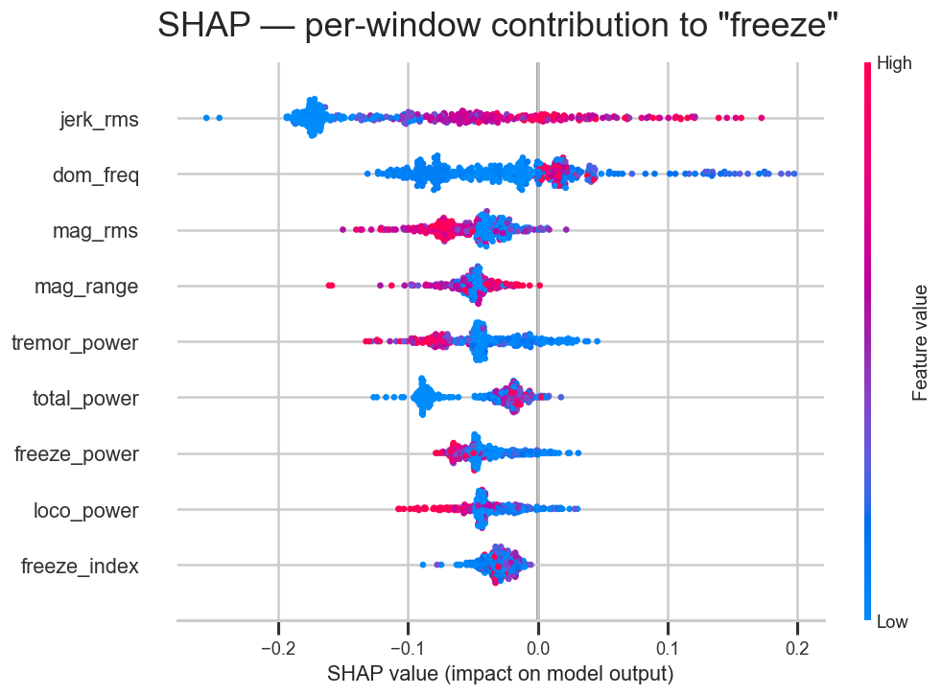
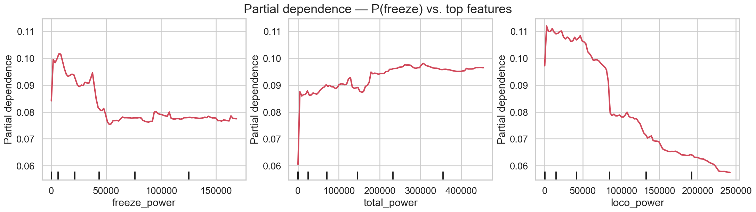
MODEL INTERPRETABILITY
Which signals flag a freeze?
RandomForest over 9 engineered features · held-out patient S05
Takeaway: both SHAP and permutation importance rank the classical Freeze-Index last of 9 features — so the dead FI baseline is explained, not just observed. Movement dynamics (jerk, dominant frequency, magnitude) carry the signal.
SHAP — mean impact per feature
Permutation importance — accuracy drop
SHAP beeswarm — red = high feature value
Partial dependence — P(freeze) vs. the three most influential features
Cadence — closed-loop gait garment
Interpretability · page 2 of 2

