Slide 1
Data Analytics
Amazon Stock Prediction
Name :Vinesh R SRN:PES1UG20CS504
Name :Srishti R SRN:PES1UG20CS329

Slide 2
Abstract and Scope
In our project, we have decided to predict the closing prices of amazon stock after training our model on test data.
Knowing the stock market and predicting the prices ,is a valuable skill in working in one of the biggest markets.

Slide 3
Implementation Details
pandas,numpy-calculations and reading the data.
matplotlib.pyplot-plot graphs
sklearn.linear_model-used for linear regression.
sklearn.model_selection-to split data into test and train data.
sklearn.metrics-to find mean squared error
pmdarima- for arima analysis
keras.layers- used to import lstm model

Slide 4
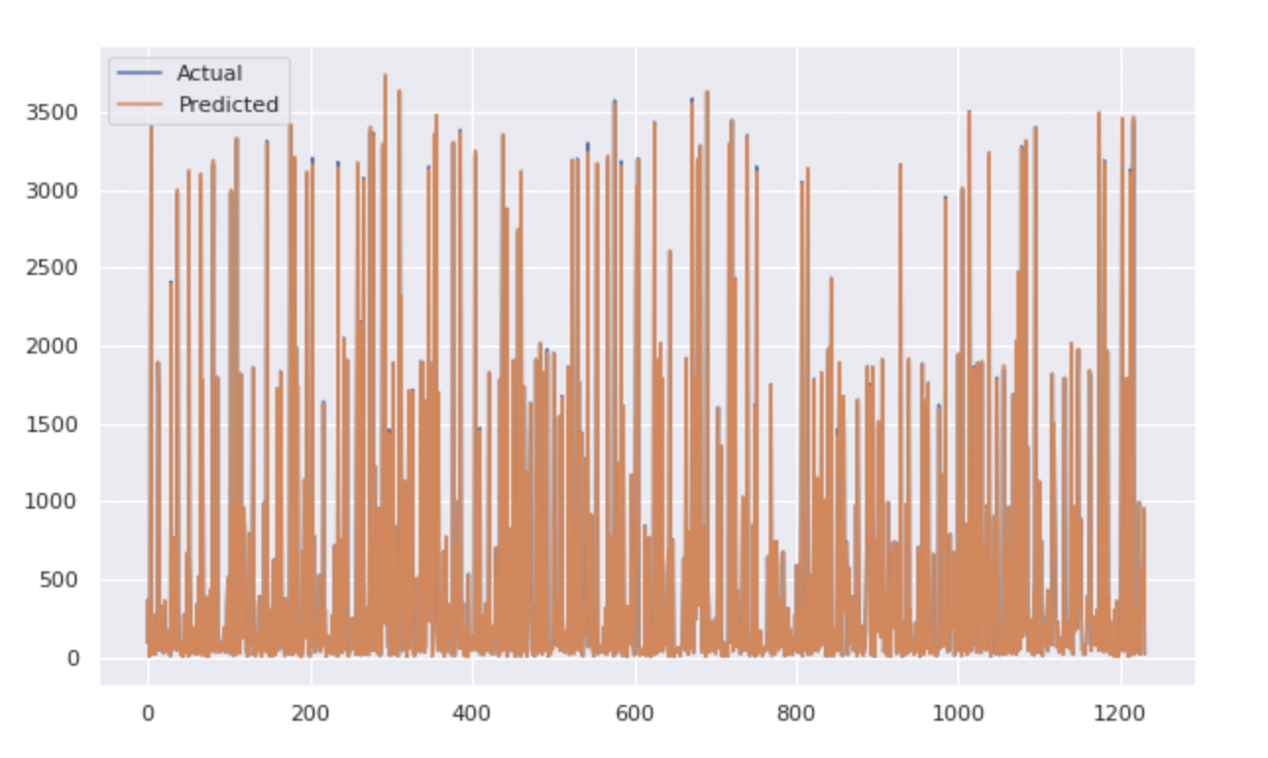
Project Demonstration
Exhibit the demonstration of the complete project.
It has to be complete in all aspects
Exhibit working of the project

Slide 5
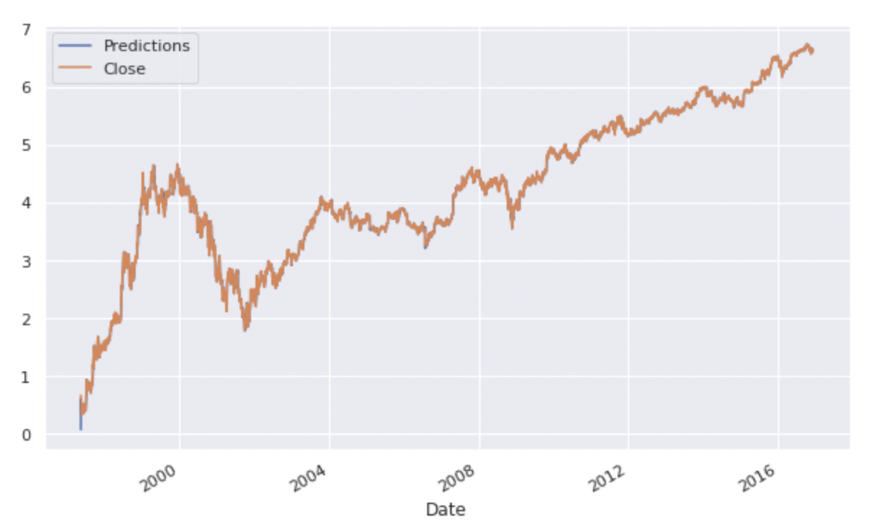
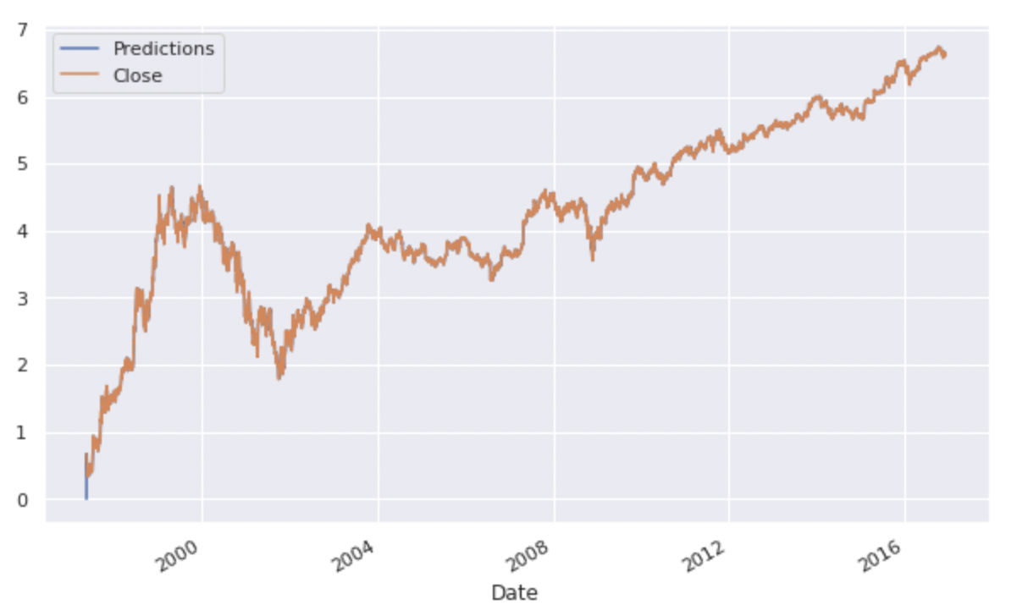

Slide 6
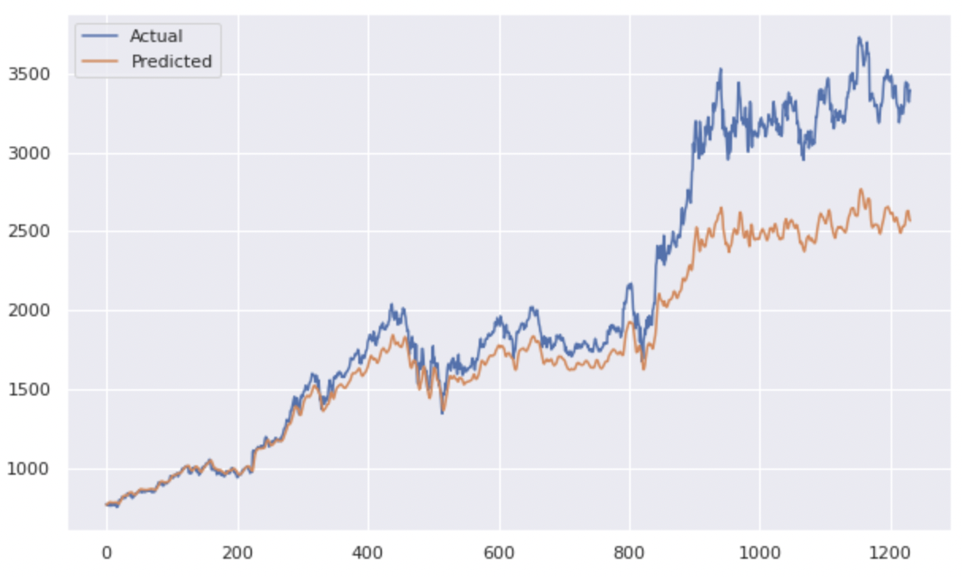
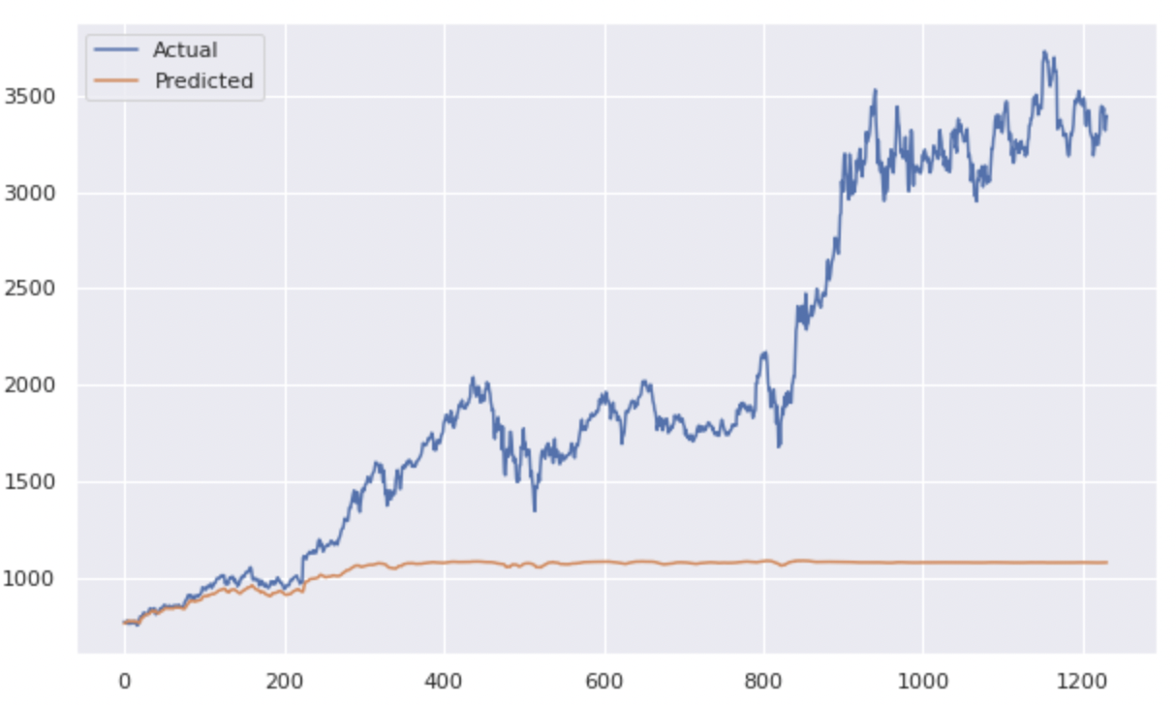

Slide 7
Results and Discussion
After trying out various models like LSTM, ARIMA and MLR , we choose the best model according to the RMSE value. Ranking our models from best to worst we have , ARIMAX, ARIMA , MLR, LSTM univariate and LSTM multivariate.
We can try to achieve more accuracy by trying different exogenous feature for ARIMAX model and other values of p, d and q. We can also implement deep learning algorithms with tensorflow to try models like RNN.
As of now , we were able to predict the closing prices of the stocks most accurately using the ARIMAX model.

Slide 8
Conclusion and Future work
We can visualise the predicted vs actual closing prices of our amazon stock according to our dataset.
In the future, we hope to be able to predict our closing values with correlation of more explanatory variables like high and low.
We also need to keep in mind the real world events that can affect the price of the stock.

Slide 9
References
[1]Tom Skehin, Martin Crane, Marija Bezbradica “Day Ahead Forecasting of FAANG Stocks Using ARIMA, LSTM Networks and Wavelets.”
[2] Matt Baughman, Christian Haas, Rich Wolski, Ian Foster, Kyle Chard “Predicting Amazon Spot Prices with LSTM Networks”
[3] Weiwei Lin, Pan Wang, Yanqiang Zhou , Xiongwen Pang “Stock Market Prediction based on Deep Long Short Term Memory Neural Network” 3rd International Conference on Complexity, Future Information Systems and Risk.
[4] Shubham Ekapure, Nuruddin Jiruwala, Sohan Patnaik, Indranil SenGupta “A data-science-driven short-term analysis of Amazon, Apple, Google, and Microsoft stocks”
[5] M Umer Ghania, M Awaisa, Muhammad Muzammula “Stock Market Prediction Using Machine Learning(ML) Algorithms”

Slide 10
Thank You

