Slide 1

Cyber risk assessment & threat intelligence platform
Paidimarry Sumanjali
Sikakollu vaibhavi

Slide 2
Manual vulnerability analysis is slow and inefficient
Raw scan data is difficult to interpret
No prioritization of risks
Threat landscape changes continuously
Lack of integrated tools for analysis
Problem Statement
Modern Network Security Challenges

Slide 3
Proposed Solution
The Cyber Risk Intelligence Platform automates the process of scanning a target system, analyzing vulnerabilities, and presenting the results in a clear and structured format.
It integrates Nmap for network scanning and VirusTotal for threat intelligence, enabling both technical and contextual analysis of security risks.
A custom risk scoring model is used to prioritize vulnerabilities based on their severity and potential impact.
The system provides an interactive dashboard, email notifications for critical issues, and PDF reports for documentation and sharing.

Slide 4
System Workflow
The user begins by entering a target domain or IP address, which acts as the input for the entire analysis process.
The system performs a network scan using Nmap to identify open ports, services, and versions running on the target system.
The scan results are then enriched using Virus Total API, which provides additional threat intelligence such as malicious reports and reputation scores.
The collected data is normalized and processed to calculate different risk metrics, which are then combined into a final risk score.
The output is displayed through a dashboard and also used to trigger email alerts and generate PDF reports.

Slide 5
Data Collection
Nmap is used to perform detailed network scanning, providing information such as IP address, port numbers, protocols, service names, and software versions running on the system.
This data helps in identifying which services are exposed and whether they may pose potential security risks.
VirusTotal is used to enrich the data by providing threat intelligence, including malicious reports, suspicious activity, harmless counts, and community reputation scores.
Additional contextual information such as country, network range, and threat categories is also collected to enhance analysis.

Slide 6
Risk Analysis Engine
The system calculates an Exposure Score based on how dangerous the open ports and services are, with higher scores assigned to risky services like Telnet or FTP.
A Threat Score is calculated using Virus Total data, where malicious and suspicious reports are given higher weight compared to harmless results.
A Context Score is used to include environmental factors such as geographic risk or known malicious categories associated with the IP.
The final Risk Score is calculated using a weighted formula that combines all three scores to provide a balanced and accurate risk assessment.
Based on the final score, the system classifies the severity into categories such as Low, Medium, High, and Critical.

Slide 7
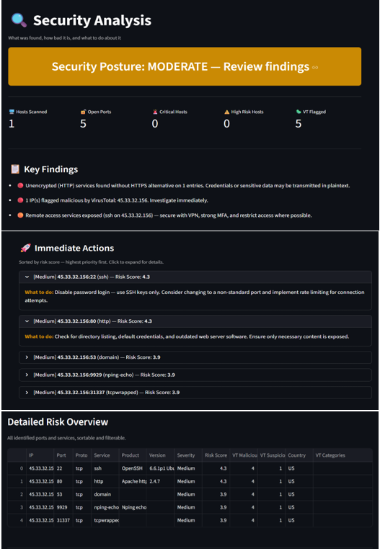
Dashboard Overview
The dashboard provides a clear and interactive interface that displays key metrics such as target IP, number of open ports, risk score, and threat score.
It helps users quickly understand the security posture of the system without needing to analyze raw data manually.
The interface is designed to be user-friendly, ensuring that even complex security data is presented in an understandable way.
The dashboard also lists all detected services, allowing users to identify which services are exposed and require attention.

Slide 8
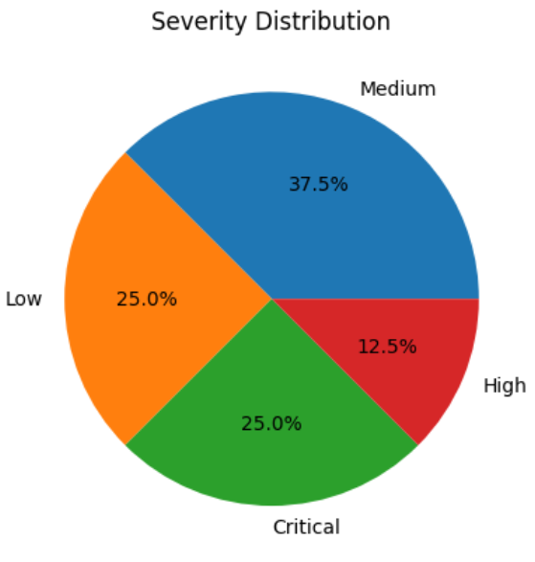
Risk Visualization
The severity distribution chart visually represents the proportion of Low, Medium, High, and Critical risks detected in the system.
This visualization helps users quickly assess the overall health of the network and identify whether immediate action is required.
By summarizing risk levels into percentages, the chart, provides a clear overview of how vulnerabilities are distributed across the system.

Slide 9
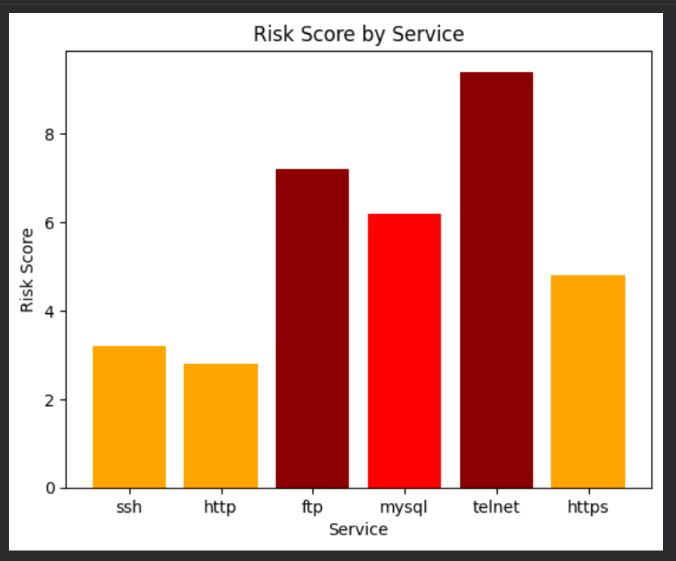
Service-Level Risk Analysis
The risk score by service chart provides a detailed comparison of how different services contribute to the overall risk of the system.
High-risk services such as Telnet and FTP are clearly highlighted, helping users prioritize which services need to be secured or disabled.
Lower-risk services like SSH and HTTP are also shown, allowing for a complete understanding of the system’s exposure.
This analysis helps in making informed decisions about service configurations and security improvements.

Slide 10
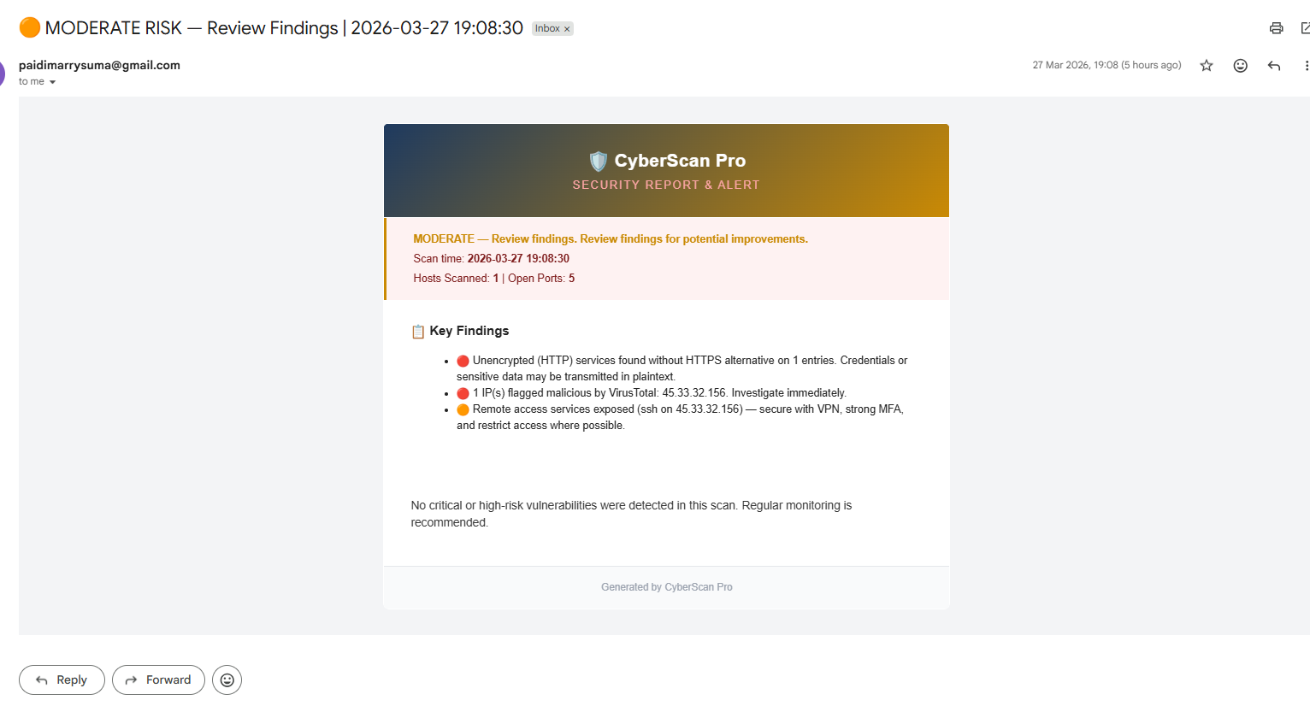
Final Output & Conclusion
The platform generates a comprehensive output that includes an interactive dashboard, historical scan tracking, and trend analysis for better decision-making.
Email alerts are automatically sent when critical vulnerabilities are detected, ensuring that users are notified immediately and can take quick action.
A detailed PDF report is generated, which can be used for documentation, sharing, and further analysis of security findings.
Overall, the system provides an efficient and automated way to identify, analyze, and prioritize security risks, making it a valuable tool for improving network security.

