Slide 1
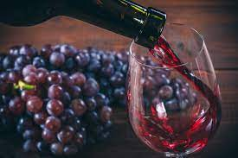
WINE QUALITY PREDICTION (RED WINE)
USING LINEAR REGRESSION
CONTENTS :
PROBLEM STATEMENT
LITERATURE SURVEY
ANALYSIS
RESULTS
OBSERVATION
NOVELITY
Name : Vinay Kenguva
Roll : 1901088
Instructor : Dr. Moumita Roy

Slide 2
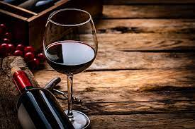
PROBLEM STATEMENT
We will have to predict the quality of wine on the basis of given features using the wine quality dataset from Kaggle. This dataset has the fundamental features which are responsible for affecting the quality of the wine. By the use of Machine learning model(Linear Regression), we will have to predict the quality of the wine. Here we will only deal with the Red type wine quality.
A proper analysis of results ,how each feature effect the quality,the accuracy and performance of model are to be noted. Also need to consider the impact of parameters and hyperparameters on final performance.

Slide 3
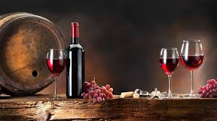

LITERATURE SURVEY
Wine is the most commonly used beverage globally, and its values are considered important in society. Quality of the wine is always important for its consumers, and mainly for producers in the present competitive market to raise the revenue. Historically, wine quality used to be determined by testing at the end of the production; to reach that level, one already spends lots of time and money.
If the quality is not good, then the various procedure needs to be implemented from the beginning, which is very costly. Every person has their own opinion about the taste, so identifying a quality based on a person’s taste is challenging. With the development of technology, the manufacturers started to rely on various devices for testing in development phases.

Slide 4
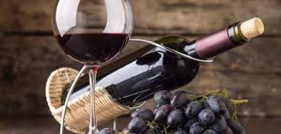
So, they can have a better idea about wine quality, which, of course, saves lots of money and time. In addition, this helped in accumulating lots of data with various parameters such as quantity of different chemicals and temperature used during the production, and the quality of the wine produced[1]. These data are available in various databases (UCL Machine Learning Repository, and Kaggle). With the rise of ML techniques and their success in the past decade, there have been various efforts in determining wine quality by using the available data.
During this process, one can tune the parameters that directly control the wine quality. This gives the manufacturer a better idea to tune the wine quality by tuning different parameters in the development process. Besides, this may result in wines with multiple tastes, and at last, may result in a new brand.

Slide 5
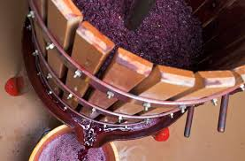
Hence, the analysis of the basic parameters that determine the wine quality is essential. In addition to humanitarian efforts, ML can be an alternative to identify the most important parameters that control the wine quality. [2]
Linear regression is easy and simple to implement practically for making predictions in many fields. Using linear regression, the correlation between the attributes was determined.
This helped in determining the important parameters with respect to quality. After data analysis, it was found that alcohol shows maximum variation than other parameters. Higher the concentration of alcohol leads to better quality of wine and lowest density [3].

Slide 6
REFERENCES
1.Li, H., Zhang Z. and Liu, Z.J. (2019) Application of Artificial Neural Networks for Catalysis: A Review. Catalysts, 7, 306.
2.Dahal, K. R., et al. "Prediction of Wine Quality Using Machine Learning Algorithms." Open Journal of Statistics 11.2 (2021): 278-289.
3. Gupta, Ujjawal, et al. "Wine quality analysis using machine learning algorithms." Micro-Electronics and Telecommunication Engineering. Springer, Singapore, 2020. 11-18.

Slide 7
Features :
Fixed Acidity: are non-volatile acids that do not evaporate readily
Volatile Acidity: are high acetic acid in wine which leads to an unpleasant vinegar taste
Citric Acid: acts as a preservative to increase acidity. When in small quantities, adds freshness and flavour to wines
Residual Sugar: is the amount of sugar remaining after fermentation stops.
Chlorides: the amount of salt in the wine
Free Sulphur Dioxide: it prevents microbial growth and the oxidation of wine
Total Sulphur Dioxide: is the amount of free + bound forms of SO2
Density: sweeter wines have a higher density

Slide 8
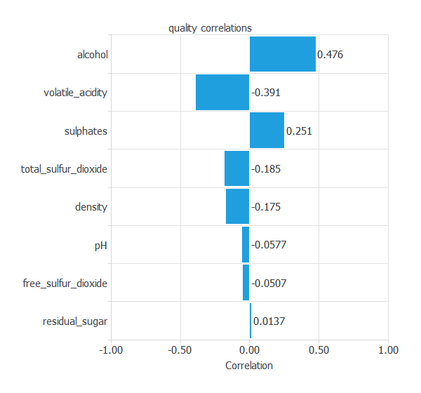
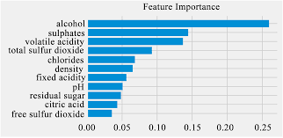
pH: describes the level of acidity on a scale of 0–14. Most wines are always between 3–4 on the pH scale
Alcohol: available in small quantities in wines makes the drinkers sociable
Sulphates: a wine additive that contributes to SO2 levels and acts as an antimicrobial and antioxidant
Quality: which is the output variable/predictor

Slide 9
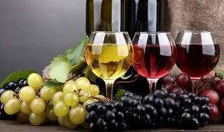
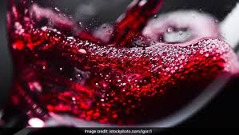
Analysis
Observation
Results

Slide 10
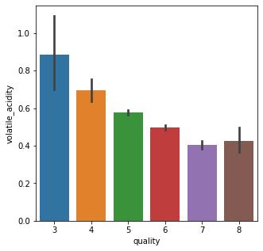
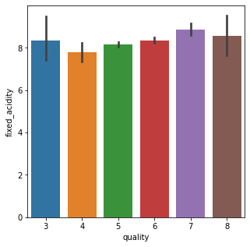
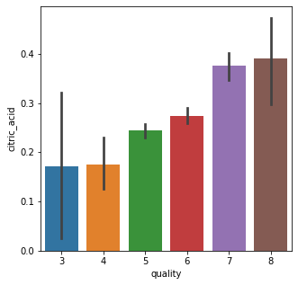
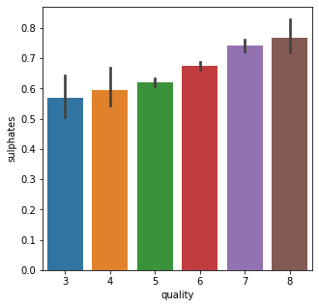
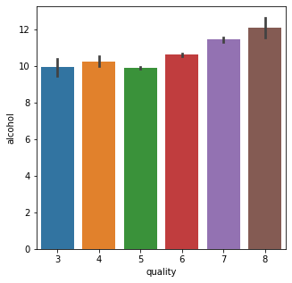
Relation between features and quality of red wine

Slide 11
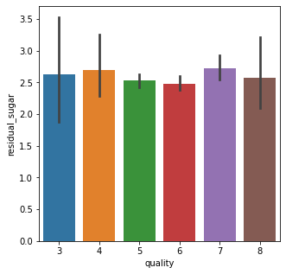
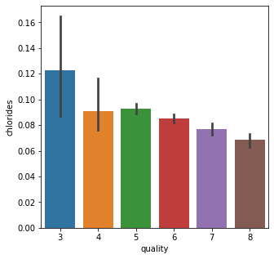
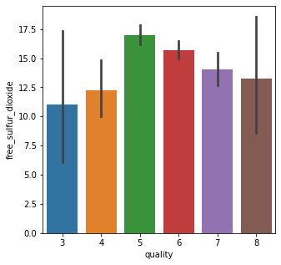
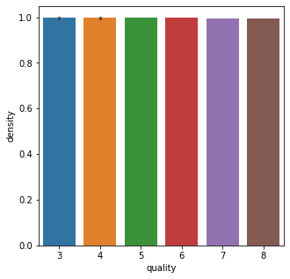
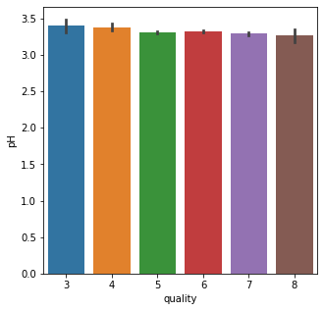

Slide 12

We can see from above graphs that there are following kind of features
Which are directly proportional to the quality of wine
Examples : Citric Acid, Sulphates, Alcohol
Which are inversely proportional to the quality of wine
Examples: Volatile Acids, Chlorides
Which shows abnormal/no effect on quality of wine
Examples: Fixed acidity, Residual Sugar, free sulphur dioxide
density, pH

Slide 13
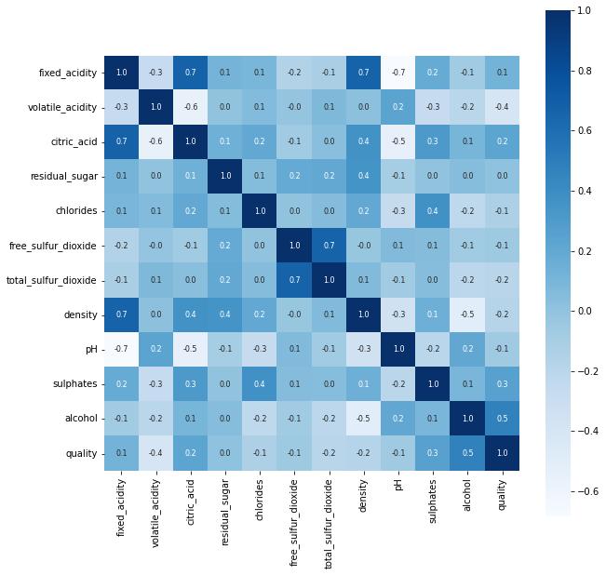
Heatmap describing relationship/correlations between different features

Slide 14
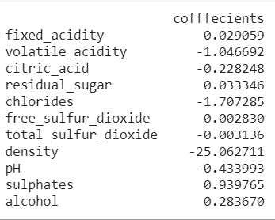
After Training With Inbuilt Linear Regression Model
Test Set Size : 20%
Train Set Accuracy : 0.599687255668491
Test Set Accuracy : 0.578125
Train Set MSE : 0.4043908611522932
Test Set MSE : 0.4705306146109029
Intercept : 29.023474276736465

Slide 15
For different train-test split ratio there was different accuracy and MSE
Test Set Size Test Set Accuracy Test Set MSE Train Set Accuracy Train Set MSE
20% 0.578 0.470 0.59 0.422
25% 0.603 0.479 0.562 0.397
30% 0.556 0.473 0.61 0.396
35% 0.585 0.425 0.593 0.413

Slide 16
After training with model built with own code
Trained model to find best set of parameter , also trained model to find best set of hyperparameters with help of validation set.
Involving stochastic gradient descent
Train Set Size : 60% Validation Set Size : 16% Test Set Size : 24%
Hyperparameters(best)
Rho : 0.8
Alpha : 0.0015
Epoch : 60
Parameters(best)
5.694970 0.427857 0.209277 -0.144415 0.259708 -0.249731 0.057129 -0.637970 0.235786 -0.124166 -0.037495 0.410185
Train Set Accuracy : 41.42
Validation Set Accuracy : 41.40
Test Set Accuracy : 49.73
Train Set MSE : 0.308
Validation Set MSE : 0.326
Test Ser MSE : 0.332

Slide 17
With other values of rho, alpha, epoch
Rho | Alpha | Epoch | Train Accuracy | Validation Accuracy | Test Accuracy | Train MSE | Validation MSE | Test MSE
0.5 | 0.0005 | 55 | 39.62 | 36.71 | 42.70 | 0.3226 | 0.3339 | 0.3502
0.9 | 0.0001 | 30 | 36.70 | 41.79 | 30.20 | 0.3679 | 0.3699 | 0.4151
0.6 | 0.001 | 50 | 36.92 | 36.71 | 42.70 | 0.3170 | 0.3307 | 0.3435
0.7 | 0.001 | 40 | 39.62 | 38.54 | 42.70 | 0.3167 | 0.3301 | 0.3431

Slide 18
Involving batch gradient descent
Train Set Size : 60% Validation Set Size : 16% Test Set Size : 24%
Hyperparameters(best)
Rho : 0.9
Alpha : 0.03
Epoch : 130
Parameters(best)
5.353384 0.028302 0.299278 -0.031828 -0.174341 -0.288673 0.433343 0.844178 -0.003897 -0.060152 0.240555 0.250939
Train Set Accuracy : 34.410
Validation Set Accuracy : 43.359
Test Set Accuracy : 35.416
Train Set MSE : 0.357
Validation Set MSE : 0.326
Test Ser MSE : 0.357

Slide 19
With other values of rho, alpha, epoch
Rho | Alpha | Epoch | Train Accuracy | Validation Accuracy | Test Accuracy | Train MSE | Validation MSE | Test MSE
0.8 | 0.015 | 160 | 43.691 | 41.796 | 40.364 | 0.449 | 0.426 | 0.468
0.5 | 0.005 | 155 | 0.834 | 0.390 | 0.260 | 3.456 | 3.464 | 3.589
0.6 | 0.02 | 150 | 35.662 | 38.671 | 30.989 | 0.389 | 0.359 | 0.397
0.7 | 0.01 | 140 | 3.128 | 3.156 | 3.645 | 1.187 | 1.179 | 1.254

Slide 20
OBSERVATIONS :
It was observed that when the alpha, rho value was high and max iterations was less the performance wasn’t optimal due to lack of proper training.
And when alpha, rho values was too less and max iterations was too much, still results weren’t optimal due to overfitting.
Hence these values shouldn’t be extreme low or high, for better performance.
After parameter and hyperparameter tuning, they might give better performance with training and validation set and may not give satisfactory results with test set. So training the model multiple times and taking appropriate parameters and hyperparameters is recommended.
Accuracy obtained with inbuilt code was better than implemented code.
For a given set of hyperparameters stochastic and batch were performing very differently, batch GD was giving better result with higher value of alpha and epoch compared to stochastic GD.

Slide 21
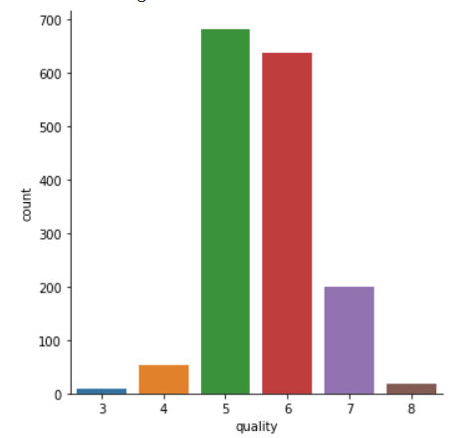
Problems with dataset
Class Imbalance :
Redundant Features :
Range of output is limited and is not much continuous : [ 3 , 4 , 5 , 6 , 7 , 8 ]

Slide 22
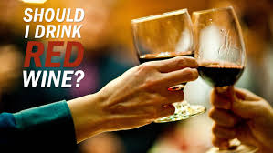
NOVELITY
Consuming wine has became a part of modern culture. In the intervening decades advancement in technology and production methods has proven advantageous for wine refineries, with explosion in the production of wine and development of various varieties of wines, they have also set forth numerous creative ways to attract consumers.
However this has become extremely problematic to an individual's personal and social life. Drink n drive, domestic violence and many more are serious effects of excessive drinking. Albeit, there are still few wines like red wine which are actually good for health and are medically proven and many a times it’s a solution from relieving stress or having a party time. One should always have control over it no matter what kind of wine they consume.
Technology should be used in a right direction towards ensuring a better quality of wine with regards to health, and government should impose strict rules over production of wine by cross checking the quality of wine.

