Slide 1
Unit 10.1

Slide 2
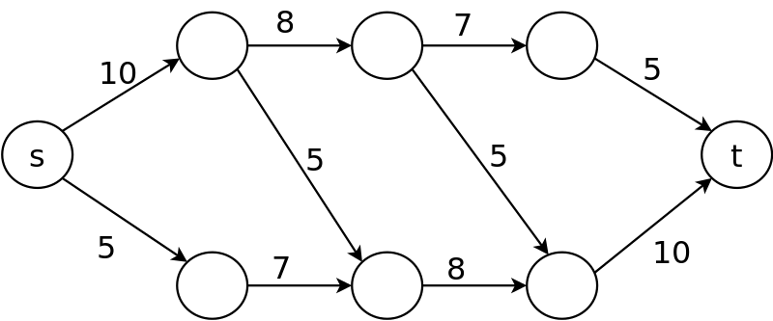
Maximum Network Flow Problem
Supply chain
Destinations
Transferring band members to concert

Slide 3
Maximum Network Flow Problem
How can we maximize the flow in a network from a source or set of sources to a destination or set of destinations?
The problem reportedly rose to prominence in relation to the rail networks of the Soviet Union, during the 1950's. The US wanted to know how quickly the Soviet Union could get supplies through its rail network to its satellite states in Eastern Europe.
In addition, the US wanted to know which rails it could destroy most easily to cut off the satellite states from the rest of the Soviet Union.
It turned out that these two problems were closely related, and that solving the max flow problem also solves the min cut problem of figuring out the cheapest way to cut off the Soviet Union from its satellites.
The first efficient algorithm for finding the maximum flow was conceived by two Computer Scientists, named Ford and Fulkerson.
Source: lbackstrom, The Importance of Algorithms, at www.topcoder.com

Slide 4
Network Flow
The network flow problem is as follows:
Given a connected directed graph G
with non-negative integer weights, where each edge weight is the capacity of that edge),
2 different vertices, s and t, called the source and the sink,
such that the source only has out-edges and the sink only has in-edges,
Find the maximum amount of some commodity that can flow through the network from source to sink.

Slide 5
What is the best we can do?
A
B
C
D
E
F
What if the graph were so big we couldn’t “see” what to do?

Slide 6


What is the best we can do?
A
B
C
D
E
F
What if the graph were so big we couldn’t “see” what to do?

Slide 7



What is the best we can do?
A
B
C
D
E
F
What if the graph were so big we couldn’t “see” what to do?

Slide 8
The Conservation Rule: In order for the assignment of flows to be valid, we must have the sum of flow coming into a vertex equal to the flow coming out of a vertex, for each vertex in the graph except the source and the sink. The Capacity Rule: Also, each flow must be less than or equal to the capacity of the edge. The flow of the network is defined as the flow from the source, or into the sink.

Slide 9
What about this one? If we take the highlighted path, what amount can be pushed?
Residual - key to simplifying
12
v₁
v₃
3
16
20
v₁
v₃
20
7
s
10
7
t
s
7
9
10
0
t
13
14
13
v₂
v₄
v₂
v₄
5
14
5
What algorithm could be used to find a path?
Difference between original and residual is amount sent on link.
Adjacency matrix is nice for residual graph as easy to add/update arcs.

Slide 10
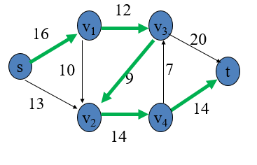

Need to update graph.
3
3
7
v₁
v₃
20
7
v₁
v₃
20
s
10
7
t
s
10
7
t
0
0
13
5
8
0
v₂
v₄
v₂
v₄
5
0
Update residual
Augmenting path –a path from the source to the sink where every
edge has a non-zero residual capacity.

Slide 11

Need to update graph.
3
0
7
v₁
v₃
20
4
v₁
v₃
17
s
10
7
t
s
10
7
t
0
0
8
0
8
0
v₂
v₄
v₂
v₄
0
0
Can we do any better? Did we make any mistakes?
Observation: can go backwards on edge with forward flow!

Slide 12
12
v₁
v₃
v₁
0
v₃
16
20
4
17
s
10
7
t
s
10
7
t
9
0
13
14
8
0
v₂
v₄
v₂
0
v₄
14
Residual Graph - forward
12
12
v₁
0
v₃
3
4
17
9
s
10
7
t
0
8
0
5
v₂
v₄
0
14
14
Residual Graph – forward and backwards

Slide 13


12
v₁
v₃
v₁
0
v₃
16
20
4
17
s
10
7
t
s
10
7
t
9
0
13
14
8
0
v₂
v₄
v₂
0
v₄
14
Residual Graph - forward
12
12
0(12)
v₁
0
v₃
3
v₁
v₃
4(12)
9(11)
4
17
9
s
10
7
t
s
10(0)
7(0)
t
0
8(1)
8
0
0(13)
0(14)
5
v₂
v₄
v₂
v₄
0
14
0(14)
14
Residual Graph – forward and backwards

Slide 14



12
v₁
v₃
v₁
0
v₃
16
20
4
17
s
10
7
t
s
10
7
t
9
0
13
14
8
0
v₂
v₄
v₂
0
v₄
14
Residual Graph - forward
12
12
0(12)
v₁
0
v₃
3
v₁
v₃
4(12)
9(11)
4
17
9
s
10
7
t
s
10(0)
7(0)
t
0
8(1)
8
0
0(13)
0(14)
5
v₂
v₄
v₂
v₄
0
14
0(14)
14
Residual Graph – forward and backwards

Slide 15
12
v₁
v₃
v₁
0
v₃
16
20
3
8
s
10
7
t
s
9
7
t
9
9
13
14
0
0
v₂
v₄
v₂
0
v₄
14
Residual Graph - forward

Slide 16
Can go backwards on an edge with forward flow. Recorded in the residual graph.
This allows you to “undo” a bad decision without starting over and with guaranteed progress. Awesome idea!
Ford-Fulkerson Algorithm
The following is simple idea of Ford-Fulkerson algorithm:
Start with initial flow as 0.
While there is a augmenting path from source to sink. Add this path-flow to flow.
Return flow.

Slide 17
Clearly, this would be a terrible way to design a plumbing system.
The “flow” is just a descriptive word
What is it used for?
Great thing about graphs is that we may find a solution to our problem in dissimilar problem statements.

Slide 18
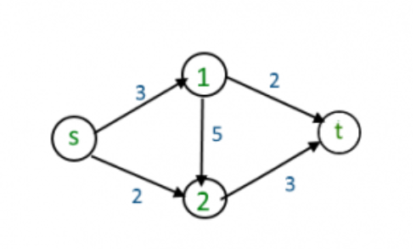
At seats
So that we all get the same steps, find paths with most flow first. List each path and the flow. Update Residual Graph.
 | s | 1 | 2 | t
s |  | 3 | 2
1 |  |  | 5 | 2
2 |  |  |  | 3
t

Slide 19
Unit 10.2a
Applications of max flow.

Slide 20
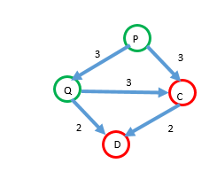
How can this be represented as a maximum flow problem?
There are some factories that produce goods and some villages where the goods have to be delivered. They are connected by a network of roads with each road having a capacity c for maximum goods that can flow through it.
The problem is to find if there is a way of transferring the goods that satisfies the demand. In the example below, factories P and Q can each produce 3 cases. Village D wants 4 cases. Village C wants 2 cases.
The road capacities don’t consider production ability of plants or needs of cities.
Produce 3
Produce 3
Produce 3
Wants 2
Wants 4

Slide 21
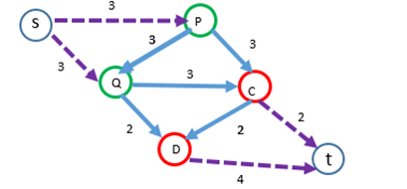
Production
Blue lines mean: can be transported
Lines from source: these can produce
Consumption
Lines to sink: these can consume items

Slide 22

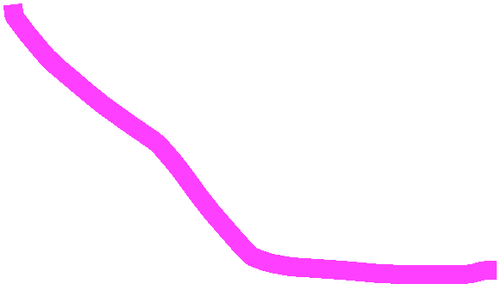



Production
Blue lines mean: can be transported
Lines from source: these can produce
Consumption
Lines to sink: these can consume items

Slide 23







Production
Blue lines mean: can be transported
Lines from source: these can produce
Consumption
Lines to sink: these can consume items

Slide 24
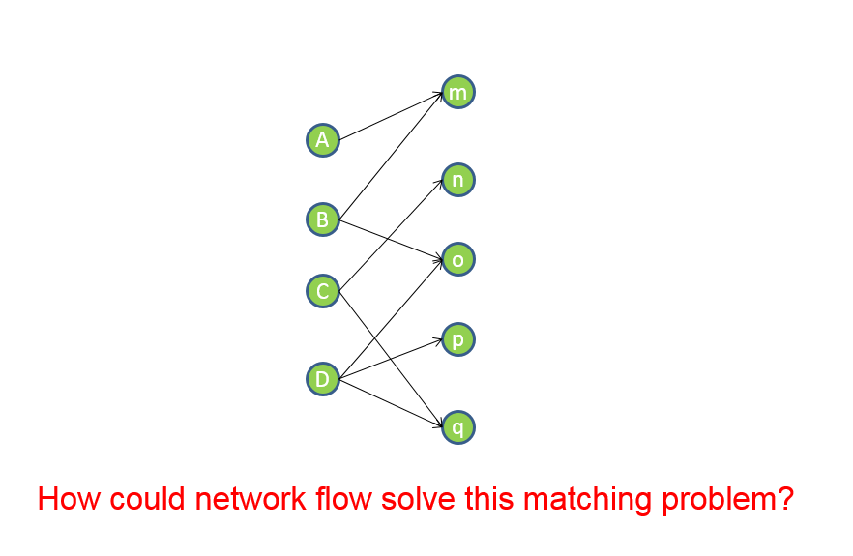
The goal of matching is to maximize the number of acceptable pairs.
Dorm Rooms
Students
Bipartite Graph
(consisting of two sets, edges go between nodes in different sets)
What if each dorm room could hold 2 people?

Slide 25
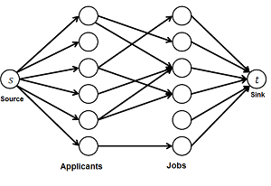

Slide 26
1
2
3
4
5
6
A
B
C
D
E
F
From this flow, what matches do we have?
What augmenting paths are available?

Slide 27
The max-flow min-cut theorem is a network flow theorem. This theorem states that the maximum flow through any network from a given source to a given sink is exactly the sum of the edge weights that, if removed, would totally disconnect the source from the sink.
Important for cutting off supplies in warfare.

Slide 28
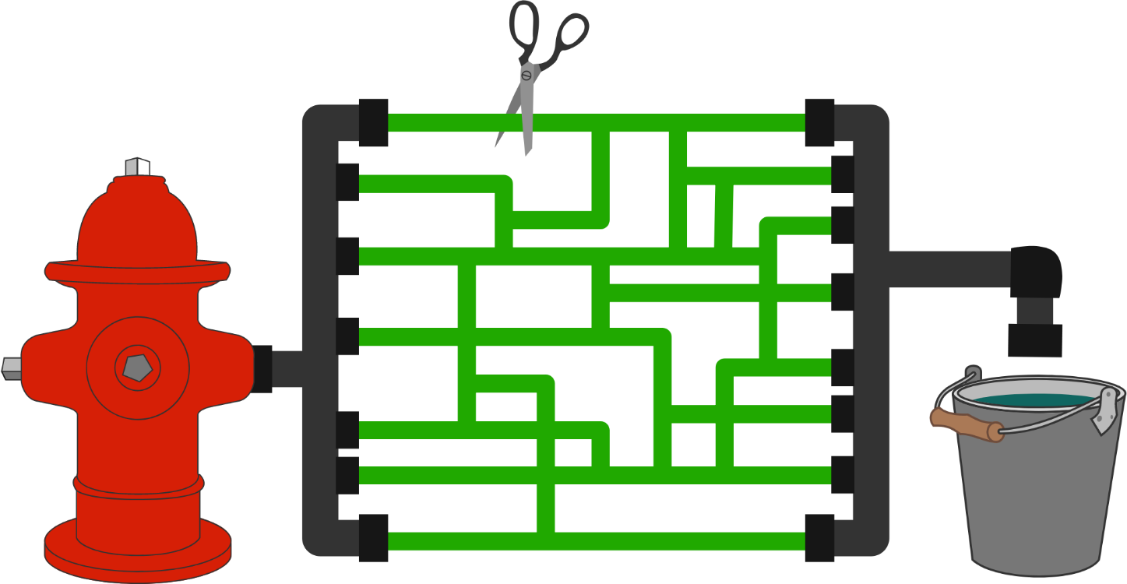
What is the fewest number of green tubes (or least weight) that need to be cut so that no water will be able to flow from the hydrant to the bucket?
Notes:
Again, somewhere along the path each stream of water takes, there will be at least one such tube-segment, otherwise, the system isn't really being used at full capacity.

Slide 29
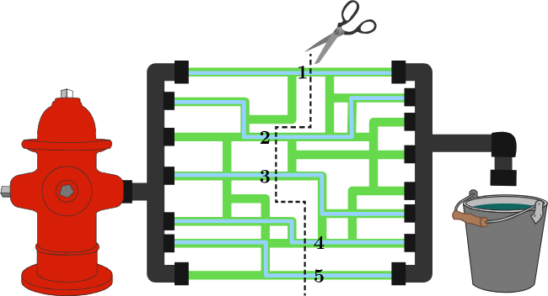

Slide 30
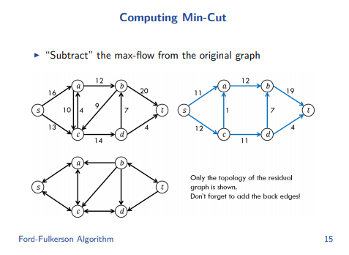
Current flow

Slide 31
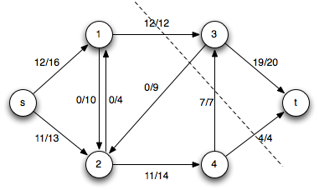








1) Run the maximum flow algorithm and consider the final residual graph.
2) Find the set of vertices that are reachable from the source in the residual graph. Call those vertices R.
3) All edges from a node in R (in the original graph) to a node NOT in R are minimum cut edges.
Print all such edges
t

Slide 32
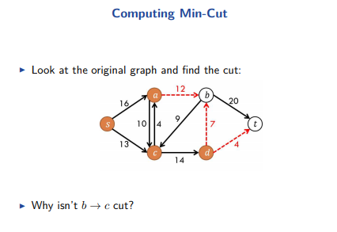
It is going the wrong direction

Slide 33
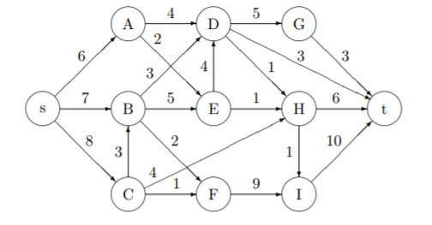
At seats find max flow and min cut. *

Slide 34


At seats find max flow and min cut.

Slide 35



At seats find max flow and min cut.

Slide 36


At seats find max flow and min cut.

Slide 37

At seats find max flow and min cut.
The paths cut must be ones that are completely full.

Slide 38







At seats find max flow and min cut.
The paths cut must be ones that are completely full.

Slide 39
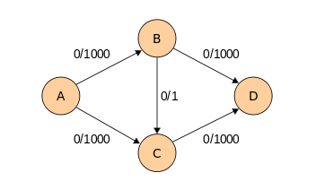
How can we avoid bad choices?

Slide 40
Edmonds-Karp Algorithm
This algorithm is a variation on the Ford-Fulkerson method which is intended to increase the speed.
The idea is to try to choose good augmenting paths.
Augmenting path with the minimal number of edges.
Augmenting path with the maximal flow

Slide 41

//ONLY finds the path (not the amount of flow)
private boolean hasAugmentingPath(FlowNetwork G, int s, int t) {
Queue<Integer> queue = new Queue<Integer>(); // breadth-first search Why?
queue.enqueue(s); // queue of all nodes to consider flow from
clearVisited();
visited[s] = true;
while (!queue.isEmpty() && !visited[t]) { //Why?
int v = queue.dequeue();
foreach succ (w) of v{ How find successor?
What goes here?
}
}
return false
}
Notes:
https://algs4.cs.princeton.edu/64maxflow/FordFulkerson.java.html

Slide 42
//ONLY finds the path (not the amount of flow)
private boolean hasAugmentingPath(FlowNetwork G, int s, int t) {
Queue<Integer> queue = new Queue<Integer>(); // breadth-first search Why?
queue.enqueue(s); // queue of all nodes to consider flow from
clearVisited();
visited[s] = true;
while (!queue.isEmpty() && !visited[t]) { //Why?
int v = queue.dequeue();
for(int w=0; w<SIZE;w++)
//– capture forward or backward capacity
if (residual[v][w]> 0 && !visited[w]) {
// Why check if already visited?
pred[w] = v; // Remembers Path
visited[w] = true;
queue.enqueue(w);
if(w==t) return true;
}
}
}
return false
}
Notes:
https://algs4.cs.princeton.edu/64maxflow/FordFulkerson.java.html

Slide 43









Why didn’t we find s-a-b-c-d-b-t?
Predecessors
 | s | a | b | c | d | t
s |  | 16 |  | 13
a |  |  | 12 | 10
b |  |  |  | 9 |  | 20
c |  | 4 |  |  | 14
d |  |  | 7 |  |  | 4
t
Residual Graph

Slide 44





 | s | a | b | c | d | t
s |  | 16 |  | 13
a |  |  | 12 | 10
b |  |  |  | 9 |  | 20
c |  | 4 |  |  | 14
d |  |  | 7 |  |  | 4
t

Slide 45






 | s | a | b | c | d | t
s |  | 16 |  | 13
a |  |  | 12 | 10
b |  |  |  | 9 |  | 20
c |  | 4 |  |  | 14
d |  |  | 7 |  |  | 4
t
Are there more? s-c-d-b-t

Slide 46
//Finds how much flow is on a path
public FordFulkerson(FlowNetwork G, int s, int t) {
totalFlow= 0;
while (hasAugmentingPath(G, s, t)) {
// compute bottleneck capacity starting at terminal node
double availFlow = Double.POSITIVE_INFINITY;
for (int v = t; v != s; v=prev){
prev = pred[v];
availFlow = Math.min(availFlow, residual[prev][v])
}
// augment flow edges from residual[prev][v]
for (int v = t; v != s; v=prev){
prev = pred[v];
update residual by availFlow on forward AND backward edges.
}
totalFlow += availFlow;
}
}

Slide 47
Ford-Fulkerson Algorithm - Runtime
While there exists an augmenting path
Add the appropriate flow to that augmenting path
We can check the existence of an augmenting path by doing a graph traversal on the network (with all full capacity edges removed.)
This graph, a subgraph with all edges of full capacity removed is called a residual graph.
It is difficult to analyze the true running time of this algorithm because it is unclear exactly how many augmenting paths can be found in an arbitrary flow network.
In the worst case, each augmenting path adds 1 to the flow of a network, and each search for an augmenting path takes O(E) time, where E is the number of edges in the graph.
Thus, at worst-case, the algorithm takes O(|f|E) time, where |f| is the maximal flow of the network.

Slide 48
Graph 10.2 b

Slide 49



Min Cost Max Flow (cost per unit is in red)
:4
:3
1
2
3
:2
:3
0
:3
:4
7
7:1
:4
:2
:1
:4
4
5
6
bellmanFord found flow 7: 0 1 4 5 6 7

Slide 50
We modify the network as follows: for each edge residual(i,j) consider the reverse edge residual(j,i). The cost Cost(j,i) = -Cost(i,j). This indicates that going backwards along an edge removes the cost incurred by going forward.
The costs never need to change, but the capacity does.
Consider putting flow f along the path i->j. residual[i,j] -=flow but residual[j,i]+=flow.
Now we can talk about the algorithms to compute the minimum-cost flow. At each iteration of the algorithm we find the cheapest path in the residual graph from source to sink.. If there doesn’t exist a path anymore, then the algorithm terminates. If a path was found, we increase the flow along it as much as possible (i.e. we find the minimal residual capacity of the path, and increase the flow by it, and reduce the back edges by the same amount). We repeat until there is no more flow possible.

Slide 51




Let’s try the algorithm on this graph
:4
:3
1
2
3
:2
:3
0
:3
:4
7
7:1
:4
:2
:1
:4
4
5
6
bellmanFord found flow 7: 0 1 4 5 6 7 ($10)
Why use BellmanFord to find the cheapest (shortest) path?

Slide 52
Let’s try the algorithm on this graph
:4
:3
1
2
3
:2
:3
0
:3
:4
7
7:1
:1
:2
:1
:4
4
5
6
0 1 4 5 6 7
0 1 5 6 7
0 4 5 6 7
0 1 2 6 7
0 1 5 6 2 3 7
10
11
11
12
13

Slide 53
Let’s try the algorithm on this graph
:4
:3
1
2
3
7/
:2
:3
0
:3
:4
7
7/
7:1
:4
7/
:2
7/
:1
7/
:4
4
5
6
bellmanFord found flow 7: 0 1 4 5 6 7 Cost per unit flow is 10. Cost is additive. You will push ALL the flow you can on the cheapest path.
The green is the flow pushed. I am not showing the residual, but that is stored.

Slide 54

Let’s try the algorithm on this graph
:4
:3
1
2
3
7/
:2
:3
0
:3
:4
7
7/
7:1
:4
7/
:2
7/
:1
7/
:4
4
5
6
bellmanFord found flow 1: 0 1 5 6 7 Cost per unit flow is 11. Goal is cheapest path – not most flow.

Slide 55
Let’s try the algorithm on this graph
:4
:3
1
2
3
8/
:2
:3
0
1/
:3
:4
7
7/
7:1
:4
8/
:2
7/
:1
8/
:4
4
5
6
bellmanFord found flow 1: 0 1 5 6 7 Cost per unit flow is 11

Slide 56

Let’s try the algorithm on this graph
:4
:3
1
2
3
8/
:2
:3
0
1/
:3
:4
7
7/
7:1
:4
8/
:2
7/
:1
8/
:4
4
5
6
bellmanFord found flow 2: 0 1 2 6 7 Cost per unit flow is 12

Slide 57
Let’s try the algorithm on this graph
2/
:4
:3
1
2
3
10/
:2
:3
0
1/
:3
2/
:4
7
7/
7:1
:4
10/
:2
7/
:1
8/
:4
4
5
6
bellmanFord found flow 2: 0 1 2 6 7 Cost per unit flow is 12

Slide 58

Let’s try the algorithm on this graph
2/
:4
:3
1
2
3
10/
:2
:3
0
1/
:3
2/
:4
7
7/
7:1
:4
10/
:2
7/
:1
8/
:4
4
5
6
bellmanFord found flow 5: 0 4 1 2 3 7 Cost per unit flow is 13
Notice how backward edge subtracts the cost.

Slide 59
Let’s try the algorithm on this graph
7/
:4
5/
:3
1
2
3
10/
:2
5/
:3
0
1/
:3
2/
:4
7
2/
7:1
5/
:4
10/
:2
7/
:1
8/
:4
4
5
6
bellmanFord found flow 5: 0 4 1 2 3 7 Cost per unit flow is 13
No more flow can be found.
Total cost is 170

Slide 60


Min Cost Max Flow Try at seats (cost per unit is in red)
:1
:3
1
2
3
:2
:3
0
:3
:0
7
7:1
:4
:2
:1
:4
4
5
6

Slide 61
Min Cost Max Flow Try at seats (cost per unit is in red)
:1
:3
1
2
3
:2
:3
0
:3
:0
7
7:1
:4
:2
:1
:4
4
5
6

Slide 62
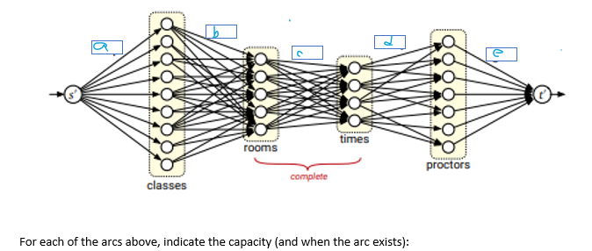
At Seats
We want to solve the tuple selection problem. For final exams, we need to schedule classes, in rooms, at times, with proctors.
A room must be big enough to hold the class. No room can be scheduled for two classes at the same time.
A proctor available can oversee at most one exam at any time, and only during times that they are available. A proctor can proctor at most 5 exams.
Notes:
A=1 (so each class will be assigned to only one room/time/proctor
B=1 (so only one room will be assigned per class)
C=1 (so each room/time pair is unique)
D=1 (so a proctor isn’t double booked)
E=5 (to control the total number of times the proctor is working)

Slide 63
Unit 10.3
Motivating example: You need to connect all homes to the power plant. Your goal is to minimize construction costs.

Slide 64
Minimum Spanning Tree
2
F
3
10
C
A
7
3
8
4
4
18
B
D
9
10
H
2
25
3
G
E
7
A Minimum Spanning Tree (MST) is a subgraph of an undirected graph such that the subgraph spans (includes) all nodes, is connected, is acyclic, and has minimum total edge weight

Slide 65







Different from a shortest path algorithm
2
F
3
1
C
A
1
1
B
D
H
1
1
1
1
G
E
1
The shortest distance from F To C is 3, but we don’t use that link in the minimal spanning tree.

Slide 66
Prim’s Algorithm
Very similar to Dijkstra’s Algorithm except that distance records only edge weights, not path lengths
It constructs a tree. I remember “prim” as in “trimming a tree”.

Slide 67

Walk-Through – start at node D (say)
2
Initialize array
F
3
10
C
A
7
3
8
4
4
18
B
D
9
10
H
2
25
3
G
E
7

Slide 68

2
F
3
C
3
DC 3
DE 25
DF 18
DG 2
10
18
A
7
3
8
4
4
B
18
D
9
10
H
2
25
3
G
E
7
25
2
Create a priority queue of all the edges to nodes you can now reach.
Mark node with the length of the best arc to it.

Slide 69
Select the smallest arc, and add what you can get to from there
We could store the minimum distance at the node, in case we tried to get there again
2
18
F
3
C
3
10
A
7
3
8
4
4
B
18
DC 3
DE 25
DF 18
DG 2
GE 7
GH 3
D
9
10
H
3
2
25
3
G
E
2
7
7
Edges are red when selected. Nodes are colored red when they have been reached.

Slide 70
2
F
3
DC 3
DE 25
DF 18
GE 7
GH 3
CB 4
CF 3
C
10
A
7
3
8
4
4
B
18
D
9
10
H
2
25
3
G
E
7

Slide 71
2
F
3
DE 25
DF 18
GE 7
GH 3
CB 4
CF 3
FB 7 (no need as B can be connected with 4)
FA 10
FE 2
C
10
A
10
7
3
8
4
4
B
18
4
D
9
10
H
2
25
3
3
G
E
2
7

Slide 72
2
3
DE 25
DF 18
GE 7
GH 3
CB 4
FA 10
FE 2
Nothing to add. Adjacent nodes are either red or have a better connect time already.
F
C
10
A
7
3
8
4
4
B
18
D
9
10
H
2
25
3
G
E
7

Slide 73
2
DE 25
DF 18
GE 7
GH 3
CB 4
FA 10
HA 4
F
3
C
10
A
7
3
8
4
4
B
18
D
9
10
H
2
25
3
G
E
7

Slide 74
2
DE 25
DF 18
GE 7
CB 4
FA 10
HA 4
AB (no need as I know a better distance to B is on the queue already. Each node stores the best link cost that connects it.)
F
3
C
10
A
7
3
8
4
4
B
18
D
9
10
H
2
25
3
G
E
7

Slide 75
2
DE 25
DF 18
GE 7
CB 4
FA 10
F
3
C
10
A
7
3
8
4
4
B
18
D
9
10
H
2
25
3
G
E
7

Slide 76
2
F
3
C
A
3
4
4
B
D
H
2
3
G
E

Slide 77
Algorithm Characteristics
Works with undirected graphs
Works with weighted and unweighted graphs but are more interesting when edges are weighted
greedy algorithm that produces optimal solutions
Tree is growing. I remember Prim’s algorithm is with a tree because you “trim” a tree.

Slide 78
Kruskal’s Algorithm
Has no concept of “in the tree” and “not in the tree”. Tree sprouts up in various places and is joined.
Two steps:
Sort edges by increasing edge weight
Select the first |V| – 1 edges that do not connect things that are already connected.

Slide 79
Walk-Through
Consider an undirected, weighted graph
F
3
C
1
A
4
3
8
4
5
B
6
D
4
4
H
2
1
3
G
E
3

Slide 80
Sort the edges by increasing edge weight
edge | d_{v}
(A,F) | 1
(D,E) | 1
(D,G) | 2
(E,G) | 3
(C,D) | 3
(G,H) | 3
(C,F) | 3
(B,C) | 4
F
3
C
1
A
4
3
8
4
5
B
6
D
4
4
H
2
1
3
(B,E) | 4
(B,F) | 4
(B,H) | 4
(A,H) | 5
(D,F) | 6
(A,B) | 8
G
E
3

Slide 81
Select first |V|–1 edges which are not already connected by selected edges.
edge | d_{v}
(A,F) | 1 | √
(D,E) | 1 | √
(D,G) | 2
(E,G) | 3
(C,D) | 3
(G,H) | 3
(C,F) | 3
(B,C) | 4
F
3
C
C
1
A
4
3
8
4
5
B
6
B
D
H
4
4
H
2
1
3
G
edge | d_{v}
(B,E) | 4
(B,F) | 4
(B,H) | 4
(A,H) | 5
(D,F) | 6
(A,B) | 8
G
E
3

Slide 82
Select first |V|–1 edges which are not already connected by selected edges.
F
3
C
edge | d_{v}
(A,F) | 1 | √
(D,E) | 1 | √
(D,G) | 2 | √
(E,G) | 3
(C,D) | 3
(G,H) | 3
(C,F) | 3
(B,C) | 4
edge | d_{v}
(B,E) | 4
(B,F) | 4
(B,H) | 4
(A,H) | 5
(D,F) | 6
(A,B) | 8
1
A
4
3
8
4
5
B
6
D
4
4
H
2
1
3
G
E
3

Slide 83
Select first |V|–1 edges which are not already connected by selected edges
F
3
C
edge | d_{v}
(A,F) | 1 | √
(D,E) | 1 | √
(D,G) | 2 | √
(E,G) | 3 | χ
(C,D) | 3
(G,H) | 3
(C,F) | 3
(B,C) | 4
edge | d_{v}
(B,E) | 4
(B,F) | 4
(B,H) | 4
(A,H) | 5
(D,F) | 6
(A,B) | 8
1
A
4
3
8
4
5
B
6
D
4
4
H
2
1
3
G
E
3

Slide 84
Select first |V|–1 edges which are not already connected by selected edges
F
3
1
C
edge | d_{v}
(A,F) | 1 | √
(D,E) | 1 | √
(D,G) | 2 | √
(E,G) | 3 | χ
(C,D) | 3 | √
(G,H) | 3
(C,F) | 3
(B,C) | 4
edge | d_{v}
(B,E) | 4
(B,F) | 4
(B,H) | 4
(A,H) | 5
(D,F) | 6
(A,B) | 8
A
4
3
8
4
5
B
6
4
D
H
4
2
1
3
G
E
3

Slide 85
Select first |V|–1 edges which are not already connected by selected edges
F
3
C
edge | d_{v}
(A,F) | 1 | √
(D,E) | 1 | √
(D,G) | 2 | √
(E,G) | 3 | χ
(C,D) | 3 | √
(G,H) | 3 | √
(C,F) | 3
(B,C) | 4
edge | d_{v}
(B,E) | 4
(B,F) | 4
(B,H) | 4
(A,H) | 5
(D,F) | 6
(A,B) | 8
1
A
4
3
8
4
5
B
6
D
4
4
H
2
1
3
G
E
3

Slide 86
Select first |V|–1 edges which are not already connected by selected edges
F
3
C
edge | d_{v}
(A,F) | 1 | √
(D,E) | 1 | √
(D,G) | 2 | √
(E,G) | 3 | χ
(C,D) | 3 | √
(G,H) | 3 | √
(C,F) | 3 | √
(B,C) | 4
edge | d_{v}
(B,E) | 4
(B,F) | 4
(B,H) | 4
(A,H) | 5
(D,F) | 6
(A,B) | 8
1
A
4
3
8
4
5
B
6
D
4
4
H
2
1
3
G
E
3

Slide 87
Select first |V|–1 edges which are not already connected by selected edges
F
3
C
edge | d_{v}
(A,F) | 1 | √
(D,E) | 1 | √
(D,G) | 2 | √
(E,G) | 3 | χ
(C,D) | 3 | √
(G,H) | 3 | √
(C,F) | 3 | √
(B,C) | 4 | √
edge | d_{v}
(B,E) | 4
(B,F) | 4
(B,H) | 4
(A,H) | 5
(D,F) | 6
(A,B) | 8
1
A
4
3
8
4
5
B
6
D
4
4
H
2
1
3
G
E
3

Slide 88
Select first |V|–1 edges which are not already connected by selected edges
F
3
1
C
A
3
4
B
D
H
2
1
3
Done
Total Cost = Σ d_{v} = 17
This is a different graph than our previous example
G
E

Slide 89
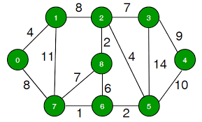
At seats. Try minimal spanning tree with both algorithms

Slide 90
Unit 10.4

Slide 91
Paths in a graph
Examples of practical problems:
A housing development lawn inspector is interested in walking as little as possible. The ideal situation would be a circuit that covers every street with no repeats. What route should he take?
A snow plow needs to find a route to plow all the streets.
You want to visit several friends on your road trip and need to plan your route.
An Euler path is a path that uses every edge in a graph with no repeats. Being a path, it does not have to return to the starting vertex. A circuit does have to return to the same starting vertex.
Is there a Eulerian path or circuit for each graph below?

Slide 92
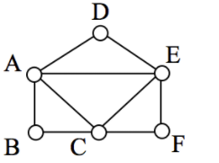
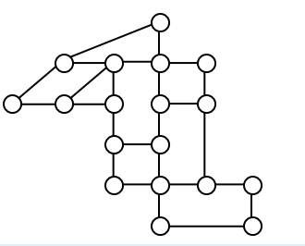
Eulerian paths or circuits?

Slide 93
Euler Paths and Circuits
The Seven bridges of Königsberg. Can you take a walk and visit all bridges exactly once? You don’t have to end up where you began?
Map physical situation into a graph. Euler 1735. Beginning of graph theory.
Draw the corresponding graph in which nodes represent land areas and arcs represent bridges connecting the land areas..
C
D
A
B

Slide 94
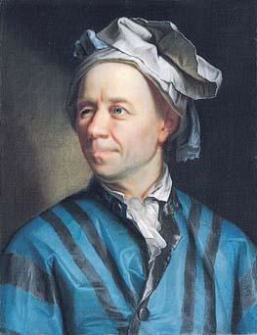
Euler Paths and Circuits
The Seven bridges of Königsberg. Can you take a walk and visit all bridges exactly once? You don’t have to end up where you began.
Map physical situation into a graph. Swiss Leonhard Euler 1735 (contemporary of Ben Franklin). Beginning of graph theory.
Interesting presentation on Euler https://www.youtube.com/watch?v=h-DV26x6n_Q
C
c
D
A
a
d
B
b

Slide 95
Euler Paths and Circuits
An Euler path is a path using every edge of the graph G exactly once.
An Euler circuit is an Euler path that returns to its start.
C
Does this graph have an Euler circuit?
A
D
No.
B

Slide 96
Necessary and Sufficient Conditions
How about multigraphs (permitted to have multiple edges between same end nodes)?
A connected multigraph has a Euler circuit iff each of its vertices has an even degree.
A connected multigraph has a Euler path but not an Euler circuit iff it has exactly two vertices of odd degree.

Slide 97
Example
Which of the following graphs has an Euler circuit?
a
b
a
b
a
b
e
e
d
c
d
c
c
d
e

Slide 98
Example
Which of the following graphs has an Euler circuit?
a
b
a
b
a
b
e
e
d
c
d
c
c
d
e
yes no no
(a, e, c, d, e, b, a)

Slide 99
Example
Which of the following graphs has an Euler path?
a
b
a
b
a
b
e
e
d
c
d
c
c
d
e
yes no yes
(a, e, c, d, e, b, a ) (a, c, d, e, b, d, a, b)

Slide 100
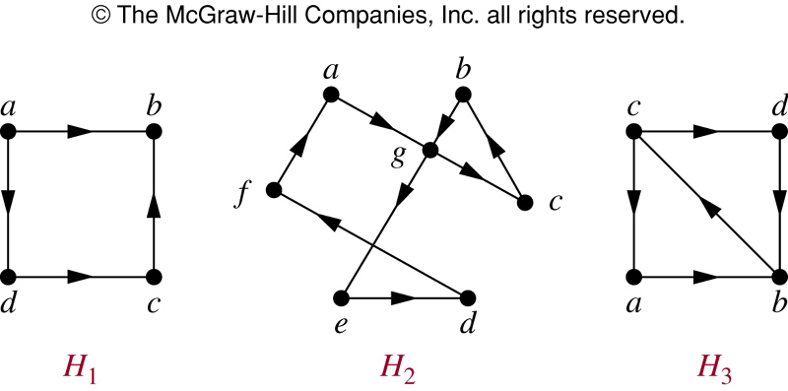
Euler Path in Directed Graphs

Slide 101
Euler Path in Directed Graphs
NO (a, g, c, b, g, e, d, f, a) (c, a, b, c, d, b)

Slide 102
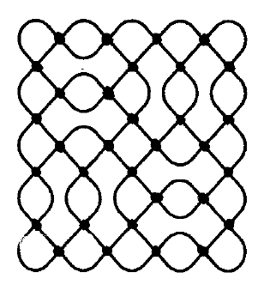
Real Life Applications of Eulerian Circuits/Tours
Snow removal, inspecting railroad tracks, Postal Route, collecting garbage, checking parking meters
May need to “Eulerize” – add arcs to make Eulerian
DNA sequencing and fragment assembly
Designs - Kolam

Slide 103
Hamilton Paths and Circuits
A Hamilton path in a graph G is a path which visits every vertex in G exactly once.
A Hamilton circuit is a Hamilton path that returns to its start.

Slide 104
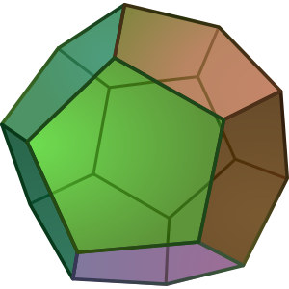
Dodecahedron is composed of twelve regular pentagons. Can you find a path which visits all vertices? Can you draw it as a graph?

Slide 105
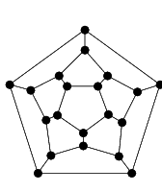
Hamilton Circuits
Dodecahedron puzzle equivalent graph
Is there a circuit in this graph that passes through each vertex exactly once?

Slide 106
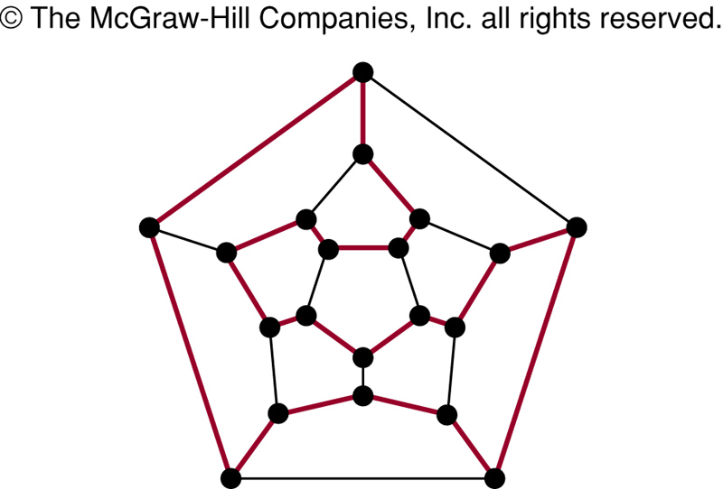
Hamilton Circuits
Yes; this is a circuit that passes through each vertex exactly once.

Slide 107
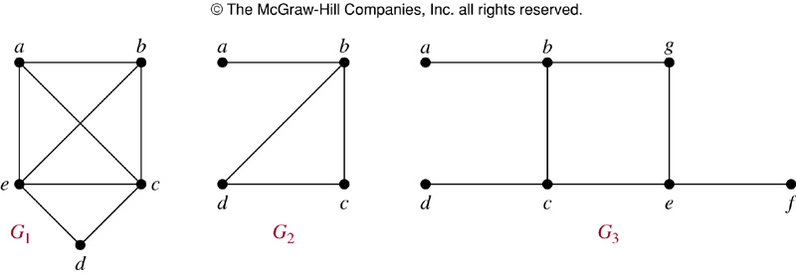
Finding Hamilton Circuits
Which of these three figures has a Hamilton circuit? Or, if no Hamilton circuit, a Hamilton path?

Slide 108
Finding Hamilton Circuits
G₁ has a Hamilton circuit: a, b, c, d, e, a
G₂ does not have a Hamilton circuit, but does have a Hamilton path: a, b, c, d
G₃ has neither.

Slide 109
Finding Hamilton Circuits
Unlike the Euler circuit problem, finding Hamilton circuits is hard.
There is no simple set of necessary and sufficient conditions, and no simple algorithm.

Slide 110
Real Life applications?
Anything where you have to visit all locations:
Pizza delivery
Mail delivery
Garbage pickup
Bus service/limousine service
Reading gas meters
Traveling Salesperson Problem – finding a Hamilton circuit in a complete graph such that the total weight of its edges is minimal

Slide 111
Summary
Euler – Edges – Easy - Even
Hamiltonian - Hard
Property | Euler | Hamilton
Repeated visits to a given node allowed? | Yes | No
Repeated traversals of a given edge allowed? | No | No
Omitted nodes allowed? | Yes (if no edges to it) | No
Omitted edges allowed? | No | Yes

Slide 112
Algorithm for finding an Eulerian Tour
Mark cycles:
Start at any node that has edges that are not labeled (the edge is not part of a cycle yet). Randomly start following unlabeled edges (edges not part of a cycle). Mark each edge you use as being in the same cycle (say, cycle i). Eventually, you will return to the node you started with. If all edges have been visited, you are very lucky (and are done).
Otherwise, repeat step 1, this time finding a new cycle. Keep repeating, until every edge belongs to a cycle.
Joining Cycles
Start traversing the cycles and joining them. As you use an edge, mark it as used (in the final tour). Keep a stack of cycles you are following. (This can be as simple as an array in which you keep track of the last subscript of the array.) The top of the stack of cycles always indicates which edges you are trying to follow. Beginning with a node in cycle x (put x on the cycle stack), keep following (and printing) edges of cycle x, until you encounter a node with edges of a different cycle (which is not on your stack of cycles).
When you encounter a new cycle, put the new cycle name on your stack and start following (and printing) the edges of the new cycle.
Any time you encounter a new cycle, you start following it. But if you encounter edges of an “old cycle”, you do not follow it until you complete the current cycle. Then you pop the current cycle off the stack, and start following edges of the top cycle of the stack.
Eventually you will return to the cycle you began with.

Slide 113
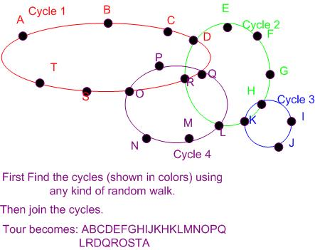

Slide 114
Unit 10.5

Slide 115
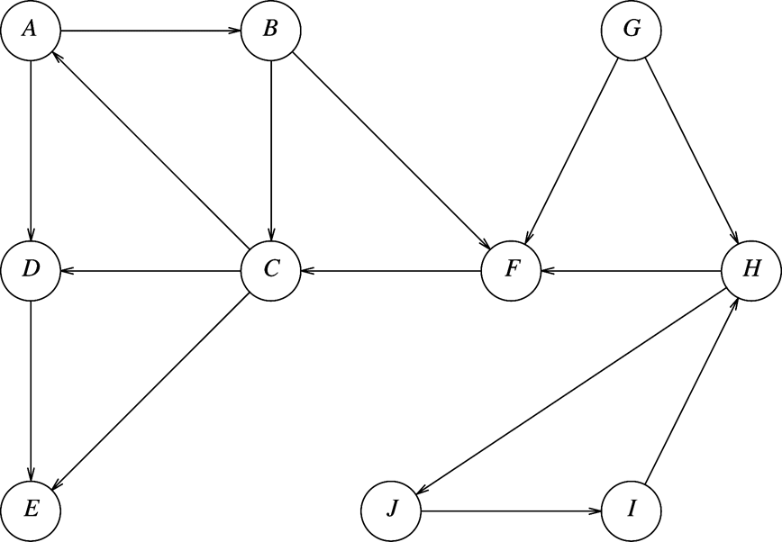
Edge types – help us think about graph
If we do a depth first search on a directed graph, we may get a forest rather than just a tree.
We get forward (to a descendant (but not a child)), back (to an ancestor), and cross edges (to unrelated node). For the graph which follows show the different types of edges. Start at A

Slide 116
Edge types
If we do a depth first traversal on a directed graph, we may get a forest rather than just a tree.
We get forward (to a descendant (but not a child)), back (to an ancestor), and cross edges (to unrelated node). For the graph which follows show the different types of edges. Start at A, then G

Slide 117

Edge types
Edge types depend on type of graph and type of traversal.
Depends on where you start.
If we do a depth first search on a directed graph, we may get a forest rather than just a tree. The edges we selected are termed tree edges
We get forward (to descendant), back (to an ancestor), and cross edges (to unrelated node). Suppose we start at B, Then H then G. If we start at different places, we get different trees, but the edge types are still useful.

Slide 118
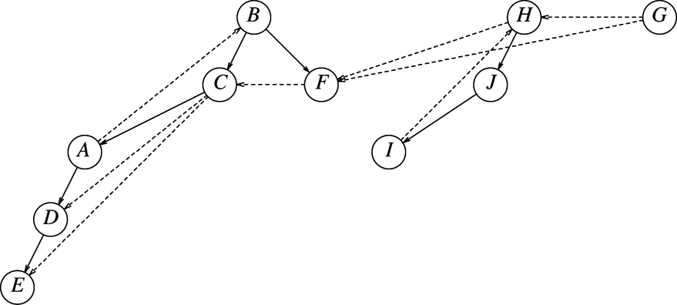






“Shaking down the tree”
.
These labels can be helpful in other algorithms as they give structure to the graph.

Slide 119
Unit 10.6

Slide 120
Finding Strongly Connected Components
First do a depth-first search, numbering nodes in postorder. When tracing on paper, I find it easiest to highlight the edges so I can keep the traversal straight. We may have to restart several times. In this case, we start at A, then C (picking a new starting place by alphabetical ordering, just to be consistent). We mark them as visited when we first enter dfsPost, but we number after visiting all children.
// Visits all nodes in depth first order, but number AFTER visiting kids
dfsPost (node)
{ node.visited = true;
for each successor of node
if successor is unvisited
dfsPost(successor)
node.number = dfs++; // dfs is a class variable
}

Slide 121
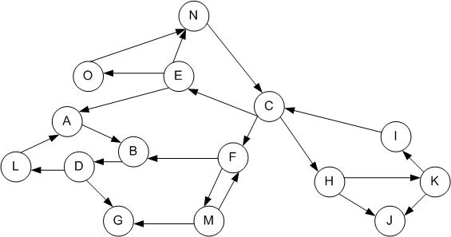
Start at A

Slide 122
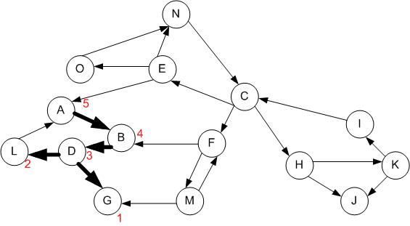
Next start at C - considering unvisited nodes in alphabetical order for those obsessive compulsive types (you know who you are)

Slide 123
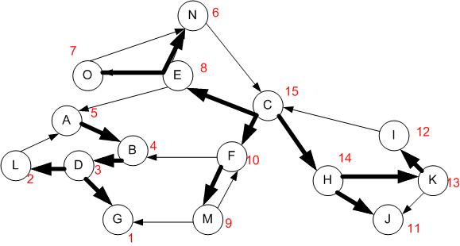
Depth first postorder numbering

Slide 124
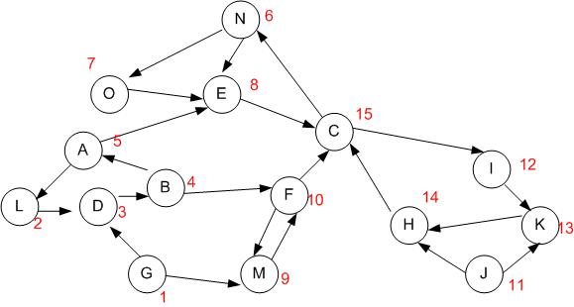
Reverse all edges. Clear visited flags. Do a depth first search marking nodes as visited. Always starting a tree at the highest numbered (unvisited)node.

Slide 125
Reverse all edges. Clear visited flags. Do a depth first search marking nodes as visited. Always starting a tree at the highest numbered node which hasn’t been visited.

Slide 126
Each tree of the forest of this second depth first search is a strongly connected component.
Start at C:15 {ECNOIKH}
Continue at J:11 {J}
Continue at F:10 {FM}
Continue at A:5 {ALDB}
Continue at G:1 {G}

Slide 127
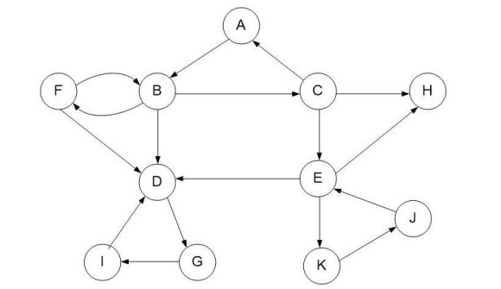
For this graph, perform post ordering numbering, starting at node A.

Slide 128
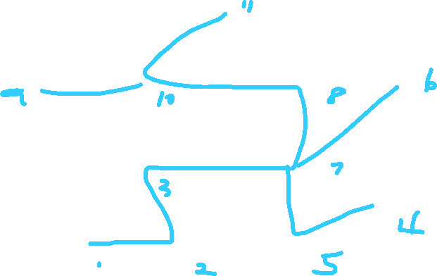
For this graph, perform post ordering numbering, starting at node A.

Slide 129
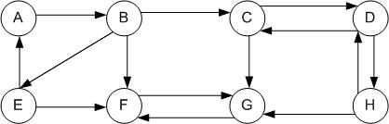
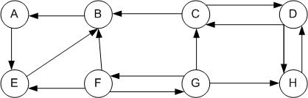
From the handout Find SCC

Slide 130
From the handout Find SCC

Slide 131
Unit 10.7

Slide 132
Biconnected
An undirected graph is biconnected if there are no vertices whose removal disconnects the rest of the graph.
This is important for computer networks (being able to route messages to all machines) and traffic routes (able to get everywhere if a road is closed).
An articulation point is a node whose removal DOES disconnect the graph.
These nodes are critical in many operations.
Identifying back edges helps us in finding biconnected components.

Slide 133
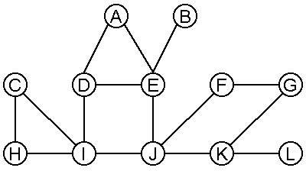

Slide 134
Algorithm
We can find articulation points as follows:
Do a depth first traversal, numbering the nodes as they are visited in preorder. Call the numbers Num(v). If a node has already been visited, we consider the edge to it as a back edge. The undirected edges become directed by the order they are visited.
The root is an articulation point if it has two children. Its removal would create two subtrees.
For each node compute the lowest vertex that can be reached by zero or more tree edges followed by possibly one back edge.

Slide 135
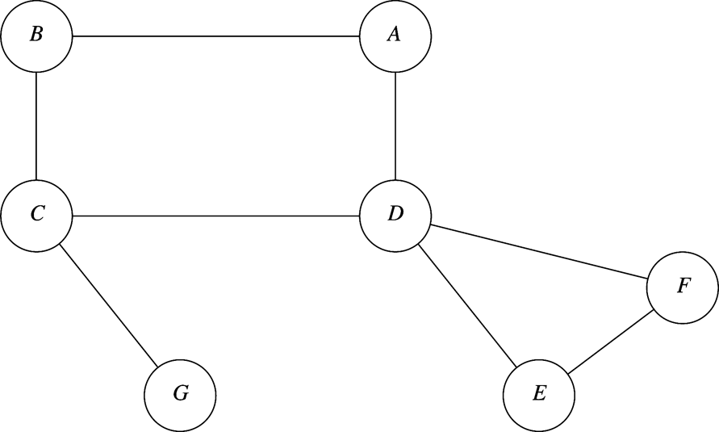
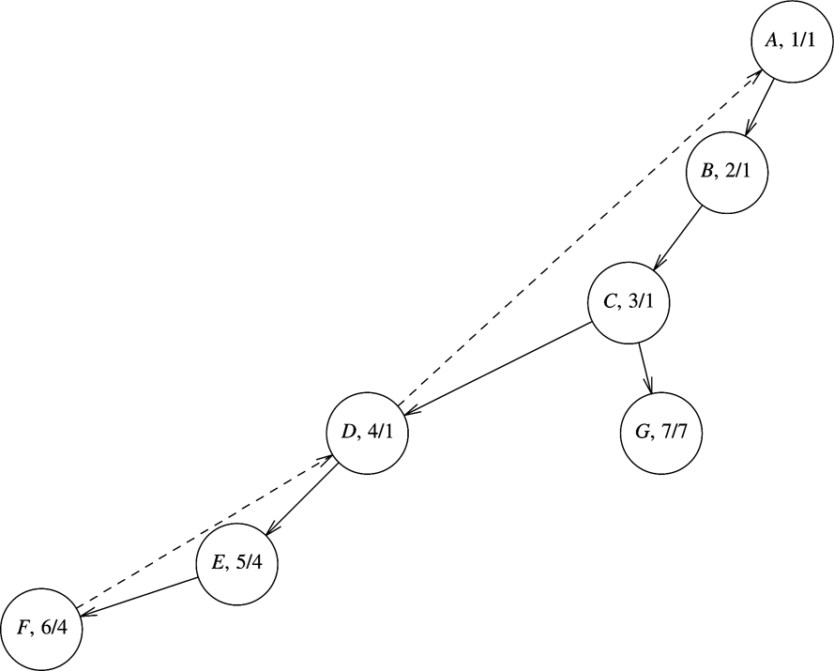
Graph on left shows num/low (starting with A)
D is an articulation point as the child of D, E, has a low of 4 (which is equal to D’s num)

Slide 136
Algorithm
tonnieford@gmail.com
We can find articulation points as follows:
Do a depth first search, numbering the nodes as they are visited in preorder. Call the numbers Num(v). If a node has already been visited, we consider the edge to it as a back edge. The undirected edges become directed by the order they are visited.
The root is an articulation point if it has two children. Otherwise, its removal would create two subtrees.
For each node compute the lowest vertex that can be reached by zero or more tree edges followed by possibly one back edge.
Low(v) is the minimum of
Num(v) [taking no edges]
The lowest Num(w) among all back edges (v,w) [no tree edges]
The lowest Low(w) among all tree edges (v,w) [some tree edges and a back edge]
To compute Low, we need a postorder traversal.
Given Low, we find articulation points as:
The root is an articulation point if it has more than one child
Any other vertex V is an articulation point if and only if v has some child,c, in the tree such that Low(c) ≥ Num(v)
In the Figure, notice C is an articulation point as C has a child G and Low(G) ≥ Num(C).
D is an articulation point as Low(E) ≥ Num(D).

Slide 137
Find Articulation for undirected graph
void Graph::findArt(Vertex v)
{ v.visited = true;
v.low = v.num = counter++;
for each vertex w adjacent to v
{ if (w.visited)
{ if (v.parent != w) v.low = min(v.low, w.num);
}
else
{ w.parent =v;
v.kidCt++;
if(v==root && v.kidCt >1) v.isArticulation = true;
findArt(w);
if (w.low >=v.num)
v.isArticulation = true;
v.low = min(v.low, w.low);
}
}
}

Slide 138
Using the algorithm, find the articulation points of the following graph.
1
2
11
3
9
12
6
8
13
7
10
4
5

Slide 139
Here are the tree edges.
1
2
11
3
9
12
6
8
13
7
10
4
5

Slide 140
I’ve changed the nodes to be the dfs number
1
2
10
3
11
12
7
8
13
6
9
4
5

Slide 141

I’ve changed the nodes to be the dfs number and added low
1
1
2
1
10
1
3
1
11
10
12
10
7
8
1
3
13
13
6
9
9
3
4
3
5
3

Slide 142




Which nodes are articulation points?
1
1
2
1
10
1
3
1
11
10
12
10
7
8
1
3
13
13
6
9
9
3
4
3
5
3

Slide 143
From your handout

Slide 144
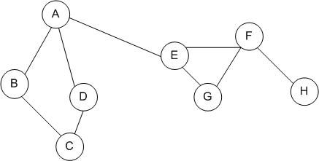
From your handout

Slide 145









From your handout

Slide 146
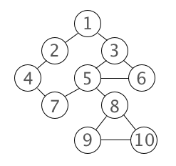
From the handout on articulation

Slide 147













From the handout on articulation

Slide 148
Consider the two algorithms: SCC and articulation points Explain why they work.

Slide 149
Unit 10.8

Slide 150
Hard versus Easy problems
Informally:
Easy is polynomial in the problem size.
Hard is exponential in the problem size.

Slide 151
NP-Complete Problems
Can’t find an efficient algorithm (polynomial)
The complexity suggests the problem is intractable – exponential
Def: intractable: unmanageable, uncontrollable, out of hand, impossible to cope with.
They are all reducible to each other (“I’m just as hard as that one!”)
If we find a reasonable algorithm (or prove intractability) for one, then we can do it for all of them!

Slide 152
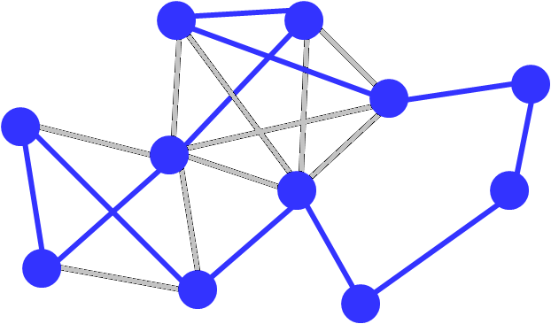
Traveling Salesperson Given a list of cities and the distances between each pair of cities, what is the shortest possible route that visits each city (exactly once?) and returns to the origin city? Is this hard? How could it be solved?
Does this look like a correct solution?

Slide 153
Find largest complete subgraph. Clique. Used in molecular biology to find common structures.

Slide 154
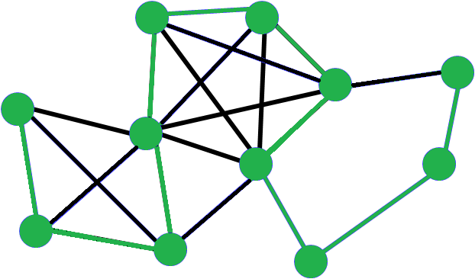
Hamiltonian Path

Slide 155
Map Coloring coloring the vertices of a graph (in the minimum number of colors) such that no two adjacent vertices are of the same color

Slide 156
Can you form this as a graph coloring problem?
We need to find a time for various clubs to meet such that individuals who are in multiple clubs can attend all meetings. We would like to use the minimal number of meeting times possible.
What are the nodes? Edges? Colors?
Notes:
Nodes are clubs. Colors are times. Arcs are “shares common members”.

Slide 157
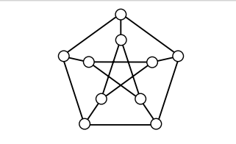
Can this graph be colored in 3 colors?

Slide 158
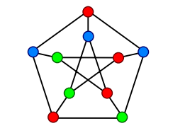

Slide 159
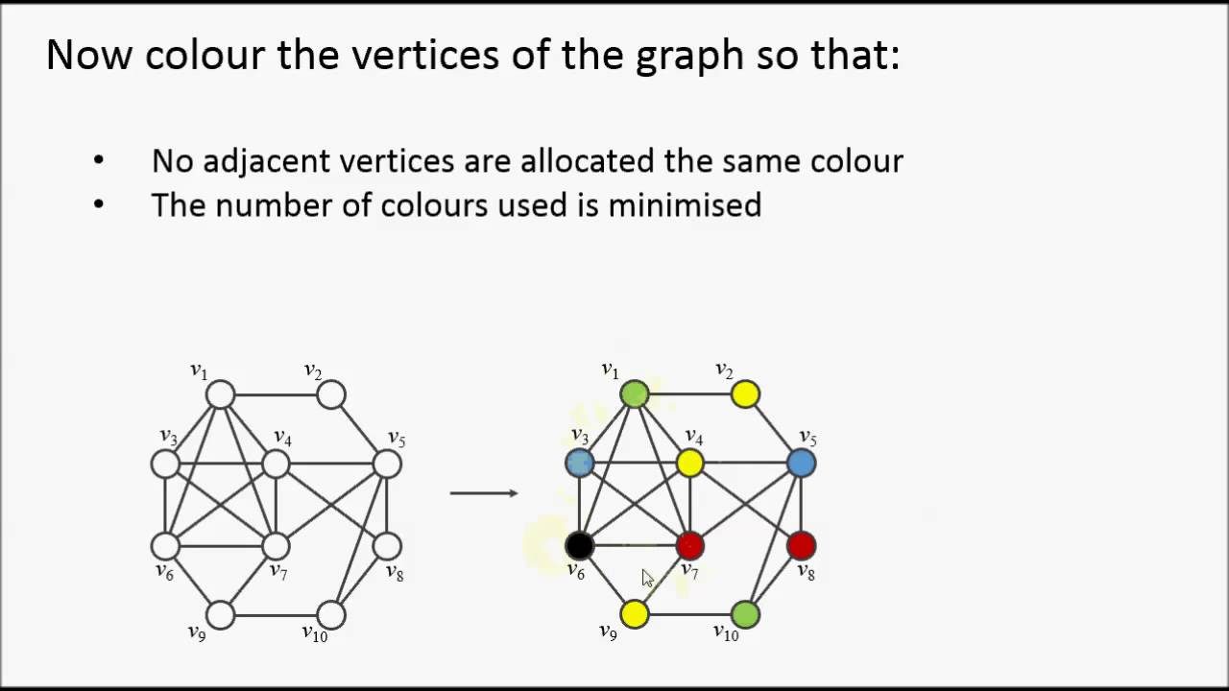
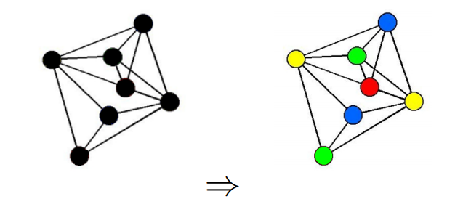
From your handout: How many colors are needed?

Slide 161
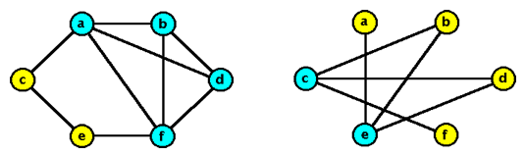
Vertex Cover (VC)
Given a graph and an integer k, is there a collection of k vertices such that each edge is connected to one of the vertices in the collection?
This could be used to decide where to place security cameras to see all hallways.
There are many other uses.

Slide 162
Can you form this as a vertex cover problem?
Text summarization is the process of reducing the content of document with a automated system that retains most important points of the original document.
We see the problem of summarization as a problem of selecting important sentences from a set of sentences.
Notes:
We consider each sentence of the article as a vertex of the graph. Thus vertex labels are the sentence numbers from the article. For our experiments, we have collected around 1,000 research article from different archive that have explicit. Edges are semantic connection.

Slide 163
Pair Programming Problem
With N students and K projects, where N is even, can we:
Assign pairs of students to each project
Every student works on every project (over time)
No student has the same partner more than once
How can this be phrased as a graph problem?
Try a graph coloring problem. Be creative about what the nodes are.
Consider a node as a pair of students.
Notes:
Can be done with graph coloring. Nodes are pairs of students. Arcs are “Contain a common member”. Colors are the projects.

Slide 164
Pair Programming Problem
With N students and K projects, where N is even, can we decide who are the partners for each project: Can be done with graph coloring. Nodes are pairs of students. Arcs are “Contain a common member”. Colors are the projects
ab
ac
ad
bd
bc
cd
Notes:
Can be done with graph coloring. Nodes are pairs of students. Arcs are “Contain a common member”. Colors are the projects.

Slide 165






Pair Programming Problem
With N students and K projects, where N is even, can we: Can be done with graph coloring. Nodes are pairs of students. Arcs are “Contain a common member”. Colors are the projects
ab
ac
ad
bd
bc
cd
Notes:
Can be done with graph coloring. Nodes are pairs of students. Arcs are “Contain a common member”. Colors are the projects. If we have N students, there are N(N-1)/2 nodes and a possibility of N-1 groups. If you want fewer projects, don’t assign all the colors to a project.

Slide 166
NP and P
What is NP?
NP is the set of all decision problems (question with yes-or-no answer) for which the 'yes'-answers can be verified in polynomial time (O(n^k) where n is the problem size, and k is a constant). Polynomial time is sometimes used as the definition of fast or quickly.
What is P?
P is the set of all decision problems which can be solved in polynomial time. Since it can solve in polynomial time, it can also be verified in polynomial time. Therefore P is a subset of NP.

Slide 167
NP-Complete
What is NP-Complete?
A problem x that is in NP is also in NP-Complete if and only if every other problem in NP can be quickly (ie. in polynomial time) transformed into x. In other words:
x is in NP, and
Every problem in NP is reducible to x
So what makes NP-Complete so interesting is that if any one of the NP-Complete problems was to be solved quickly then all NP problems can be solved quickly

Slide 168
Oracles
If we could make the ‘right decision’ at all decision points, then we can determine whether a solution is possible very quickly!
If the found solution is valid, then True
If the found solution is invalid, then False
If we could find the certificates quickly, NP-complete problems would become tractable – O(N)
This (magic) process that can always make the right guess is called an Oracle.

Slide 169
Determinism vs. Nondeterminism
Nondeterministic algorithms produce an answer by a series of “correct guesses”
Deterministic algorithms (like those that a computer executes) make decisions based on information.

