Slide 1

PATTERN SEARCH ON A 3x3 GRID USING QUANTUM GROVER ALGORITHM
Computer Engineering Project work of Quantum Computing and Quantum Internet
Team members: Klaudio Çaça Lorenzo Vanni

Slide 2
PATTERN SEARCH: CLASSICAL VS QUANTUM
Problem description: Finding specific patterns within a 3x3 grid of binary pixels. Each pixel can be "on" (1) or "off" (0), creating a total search space of 2^9 = 512 possible images.
Tools: This project compares three different computing realms:
Classical: A Python script to establish the baseline.
Qiskit (Python): To simulate the quantum algorithm, with bit flip and depolarizing noise and test it on real IBM hardware (FakeKolkata).
QuantumSavory (Julia): To analyze the time evolution of the system and its resilience to continuous noise (depolarization).
Oracle calls
Performance metrics:
Succes Rate and Resiliency

Slide 3
The Oracle and the 4 Target Patterns
Oracle Definition: A black-box function f(x) that evaluates an image and returns 1 if it meets a hidden rule ("Good"), or 0 if it doesn't ("Bad").
VERTICAL SQUARE DIAGONAL FULL
[[
[[
[[
[[

Slide 4
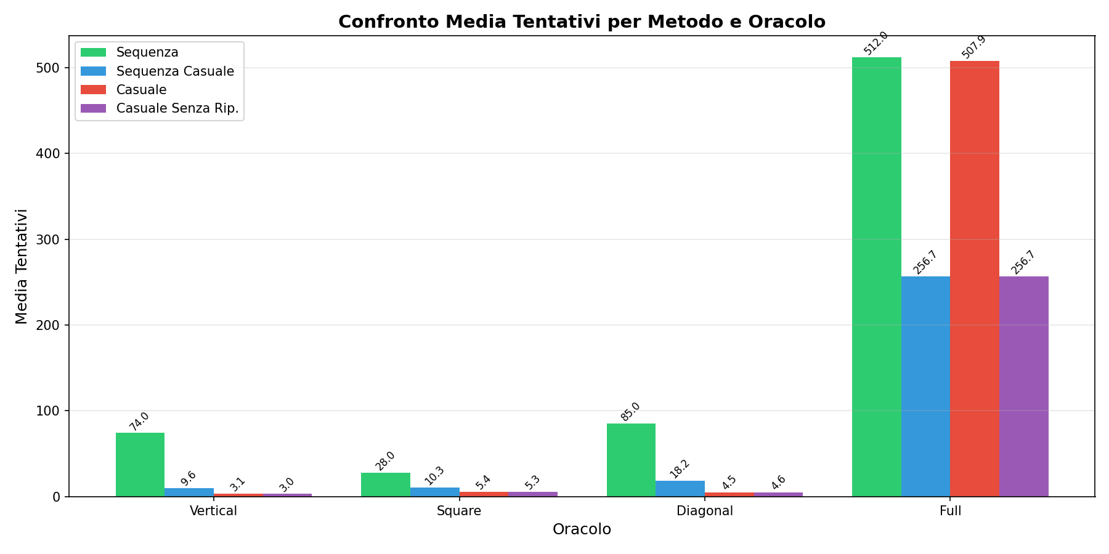
Classical Performance
Vertical: 169 / 512 solutions
Square: 95 / 512 solutions
Diagonal: 112 / 512 solutions
Full: 1 / 512 solution
4 classical algorithm:
Sequence starting from 0
Sequence starting from casual index
Full random (with repetition)
Random without repetition

Slide 5
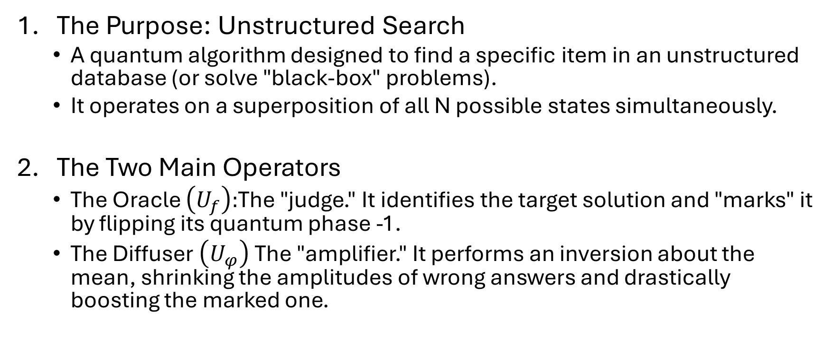
INTRODUCTION TO QUANTUM GROVER
The Purpose: Unstructured Search
A quantum algorithm designed to find a specific item in an unstructured database (or solve "black-box" problems).
It operates on a superposition of all N possible states simultaneously.
The Two Main Operators
The Oracle $\left(U_{f}\right):$The "judge." It identifies the target solution and "marks" it by flipping its quantum phase -1.
The Diffuser $\left(U_{φ}\right)$The "amplifier." It performs an inversion about the mean, shrinking the amplitudes of wrong answers and drastically boosting the marked one.

Slide 6
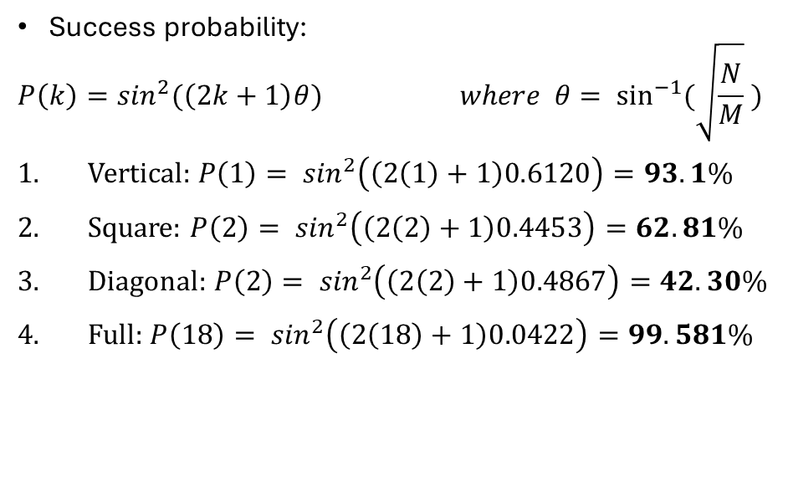
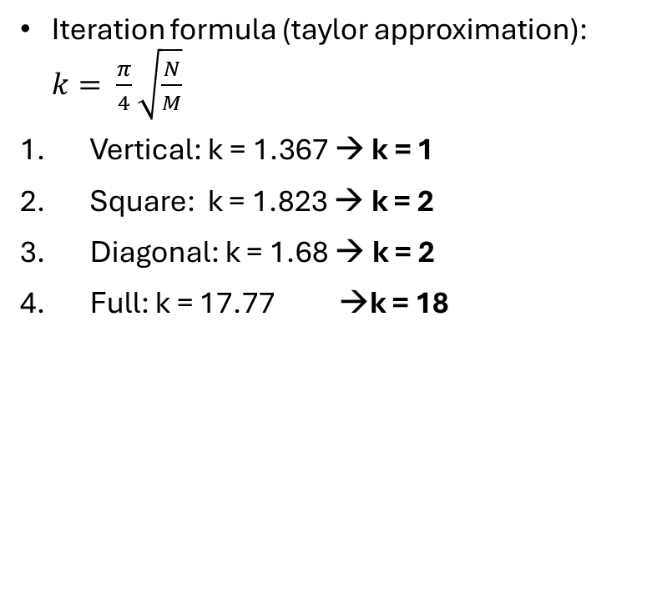
GROVER ITERATION (Taylor approximation)
Iteration formula (taylor approximation): $k= \frac{π}{4}\sqrt{\frac{N}{M}}$
Vertical: k = 1.367 → k = 1
Square: k = 1.823 → k = 2
Diagonal: k = 1.68 → k = 2
Full: k = 17.77 →k = 18
Success probability:
$$P\left(k\right)=\sin^{2}{(\left(2k+1\right)θ)} where θ= \sin^{−1}{(\sqrt{\frac{N}{M}} )}$$
Vertical: $P\left(1\right)= \sin^{2}\left(\left(2\left(1\right)+1\right)0.6120\right)=93.1\%$
Square: $P\left(2\right)= \sin^{2}\left(\left(2\left(2\right)+1\right)0.4453\right)=62.81\%$
Diagonal: $P\left(2\right)= \sin^{2}\left(\left(2\left(2\right)+1\right)0.4867\right)=42.30\%$
Full: $P\left(18\right)= \sin^{2}\left(\left(2\left(18\right)+1\right)0.0422\right)=99.581\%$

Slide 7
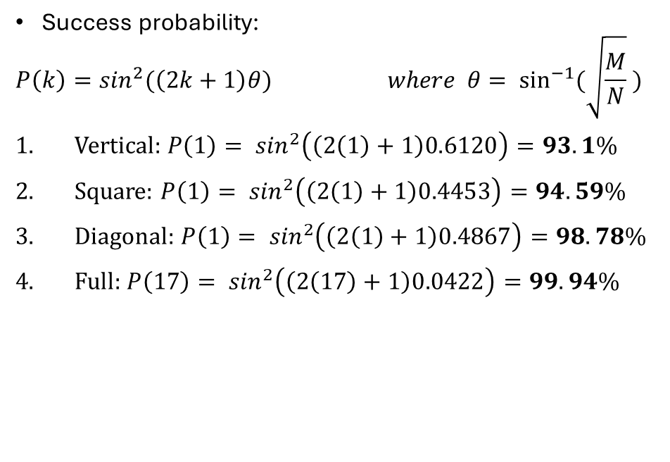
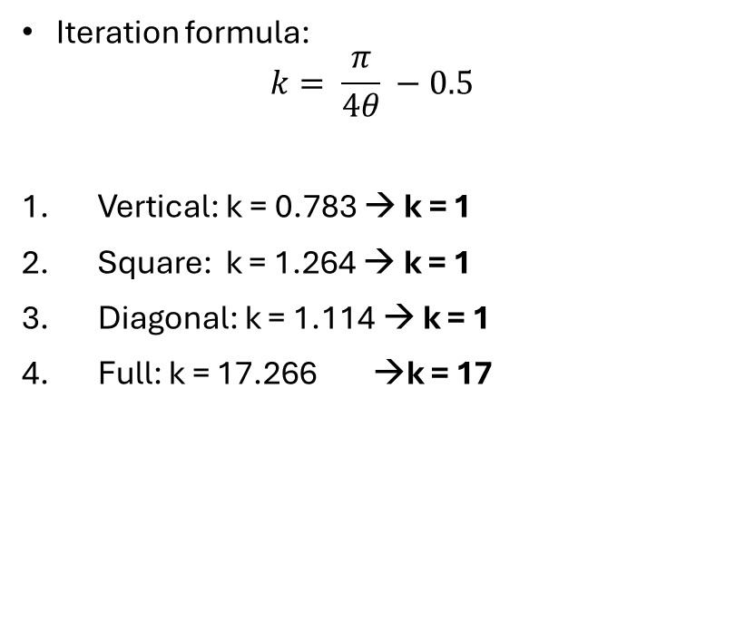
GROVER ITERATION (Geometric Interpretation)
Iteration formula:
$$k= \frac{π}{4θ} −0.5$$
Vertical: k = 0.783 → k = 1
Square: k = 1.264 → k = 1
Diagonal: k = 1.114 → k = 1
Full: k = 17.266 →k = 17
Success probability:
$$P\left(k\right)=\sin^{2}{(\left(2k+1\right)θ)} where θ= \sin^{−1}{(\sqrt{\frac{M}{N}} )}$$
Vertical: $P\left(1\right)= \sin^{2}\left(\left(2\left(1\right)+1\right)0.6120\right)=93.1\%$
Square: $P\left(1\right)= \sin^{2}\left(\left(2\left(1\right)+1\right)0.4453\right)=94.59\%$
Diagonal: $P\left(1\right)= \sin^{2}\left(\left(2\left(1\right)+1\right)0.4867\right)=98.78\%$
Full: $P\left(17\right)= \sin^{2}\left(\left(2\left(17\right)+1\right)0.0422\right)=99.94\%$

Slide 8
CLASSICAL VS GROVER
ORACLE | SOLUTIONS | CLASSICAL CALLS | PROB. | GROVER (APPROX) | PROB. | GROVER (EXACT) | PROB.
VERTICAL | 169 | 3.0 | 33.0% | 1 | 93.1% | 1 | 93.1%
SQUARE | 95 | 5.4 | 18.6% | 2 | 62.81% | 1 | 94.59%
DIAGONAL | 112 | 4.5 | 21.9% | 2 | 42.30% | 1 | 98.78%
FULL | 1 | 512 | 0.2% | 18 | 99.58% | 17 | 99.94%

Slide 9
ORACLE DESIGN: THE PRINCIPLE OF INCLUSION-EXCLUSION
The Phase Cancellation Problem
To correctly mark states and prevent phase cancellation when multiple valid patterns overlap in the same grid, We applied the Principle of Inclusion-Exclusion
Mathematical Model (Vertical Oracle Case)
We define the 3 vertical columns as sets of target pixels:
A = {0, 3, 6}
B = {1, 4, 7}
C = {2, 5, 8}

Slide 10
ORACLE DESIGN: THE PRINCIPLE OF INCLUSION-EXCLUSION
The "Naive OR" Approach: we want to find images with at least one vertical line (Column A, B, or C).
A classical mindset applies three independent MCX gates in sequence (one for each column) to act as an OR operator.
The Phase Cancellation Disaster
Gate A detects Column A → Phase is multiplied by -1
Gate B detects Column B → Phase is multiplied by -1
Gate C is OFF in this image → Phase is multiplied by +1
Total Phase Shift: (-1) x (-1) x (+1) = +1.
The valid solution loses its negative marker. Due to destructive interference, Grover's diffusion operator will completely ignore this correct state!

Slide 11
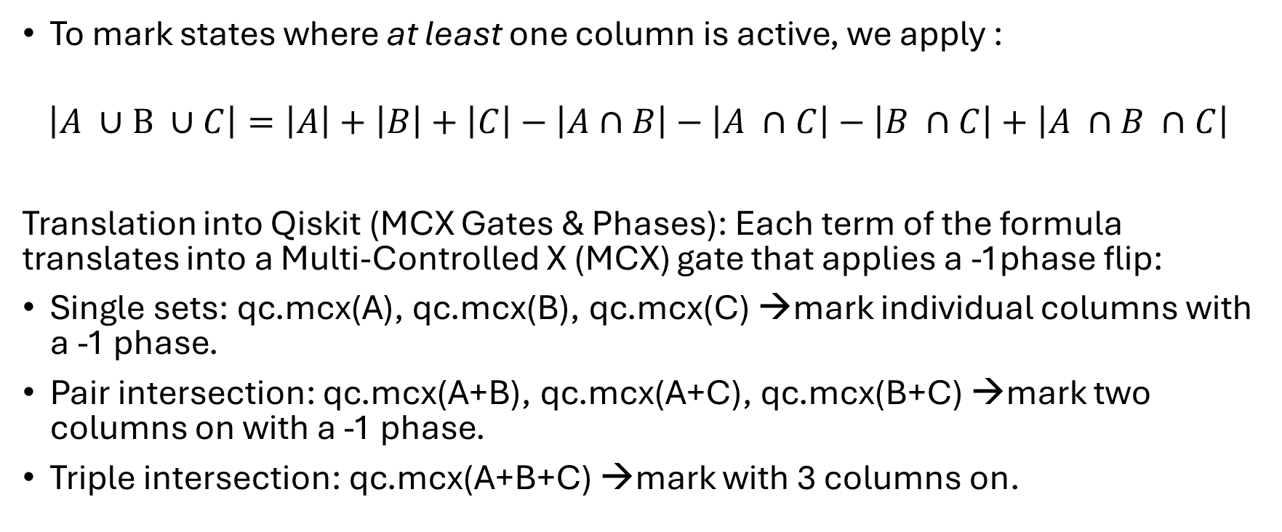
ORACLE DESIGN: THE PRINCIPLE OF INCLUSION-EXCLUSION
To mark states where at least one column is active, we apply :
$$\left|A ∪B ∪C\right|=\left|A\right|+\left|B\right|+\left|C\right|−\left|A∩B\right|−\left|A ∩C\right|−\left|B ∩C\right|+\left|A ∩B ∩C\right|$$
Translation into Qiskit (MCX Gates & Phases): Each term of the formula translates into a Multi-Controlled X (MCX) gate that applies a -1phase flip:
Single sets: qc.mcx(A), qc.mcx(B), qc.mcx(C) →mark individual columns with a -1 phase.
Pair intersection: qc.mcx(A+B), qc.mcx(A+C), qc.mcx(B+C) →mark two columns on with a -1 phase.
Triple intersection: qc.mcx(A+B+C) →mark with 3 columns on.

Slide 12
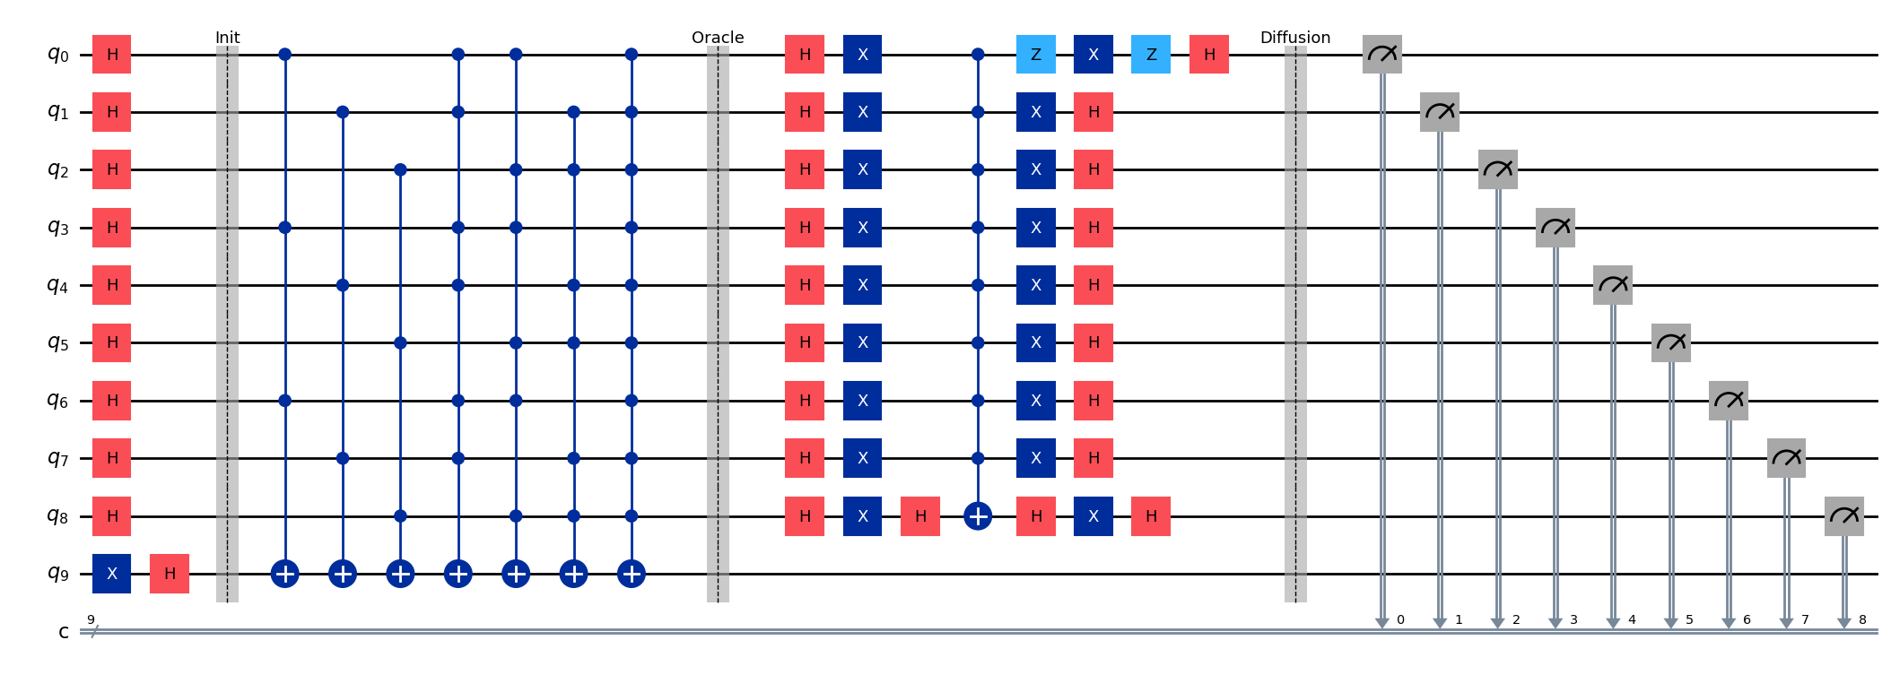
QISKIT VERTICAL CIRCUIT

Slide 13
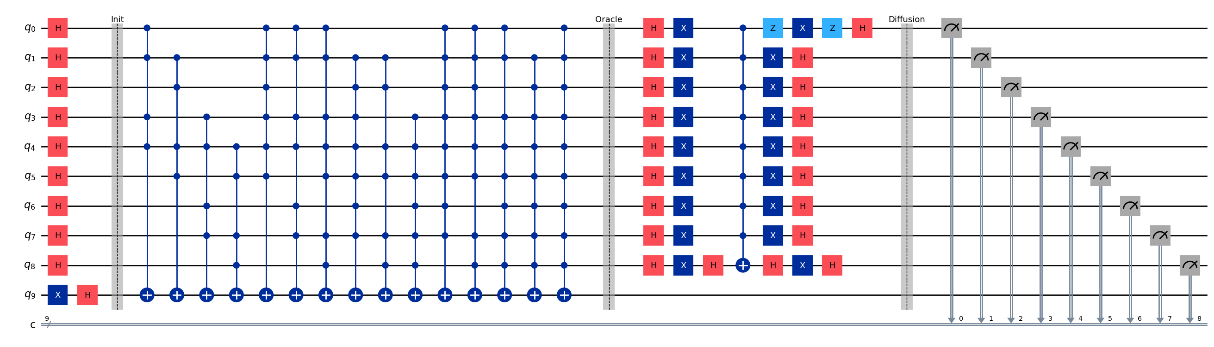
QISKIT SQUARE CIRCUIT

Slide 14
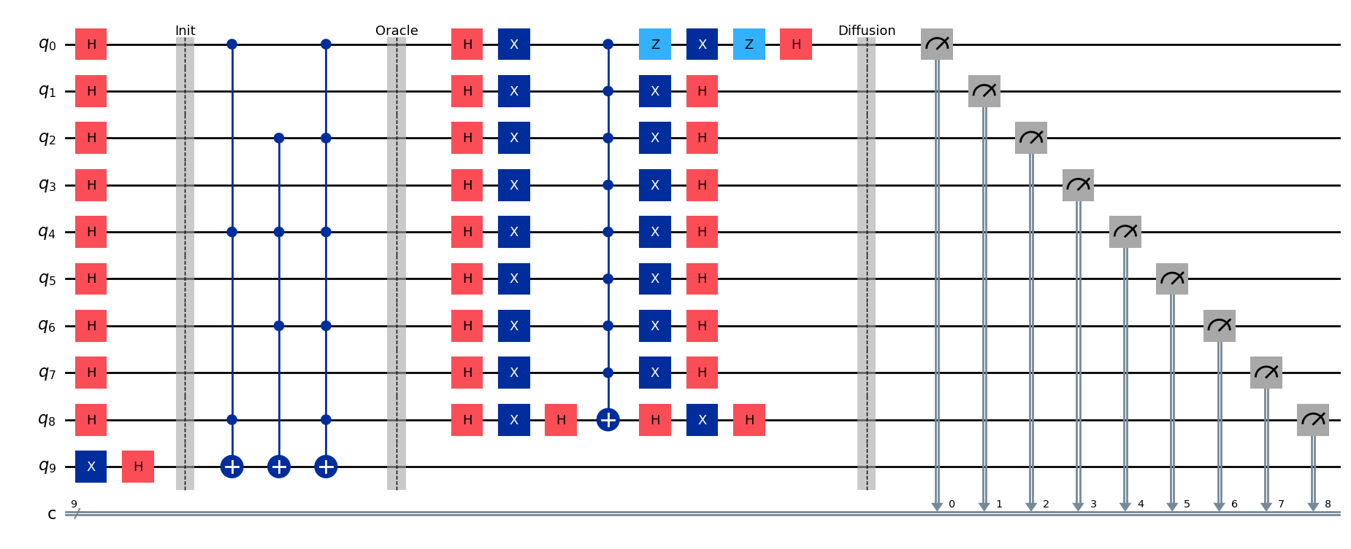
QISKIT DIAGONAL CIRCUIT

Slide 15
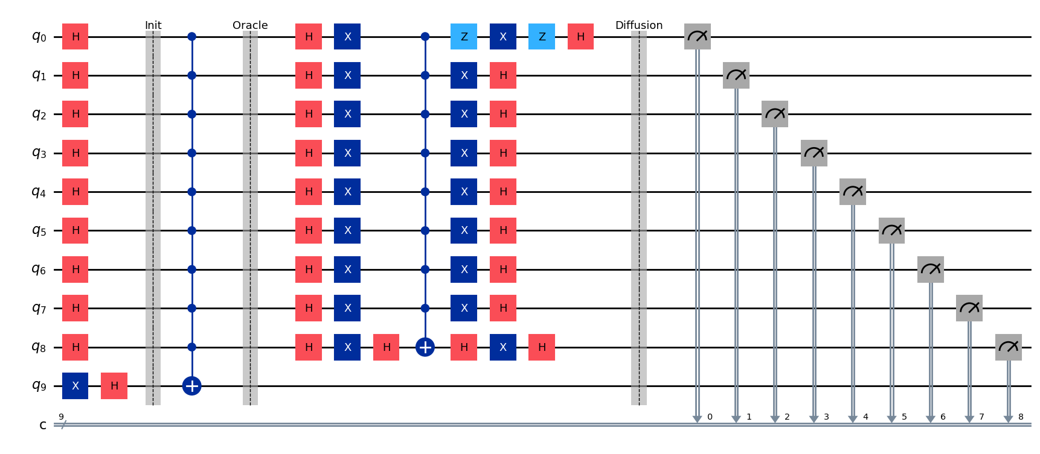
QISKIT FULL CIRCUIT

Slide 16
QISKIT NOISLESS SIMULATION
ORACLE | SOLUTIONS | CLASSIC PROB. | THEORIC GROVER | QISKIT SIMULATION
VERTICAL | 169 | 33.0% | 93.1% | 92.76%
SQUARE | 95 | 18.6% | 94.59% | 94.44%
DIAGONAL | 112 | 21.9% | 98.78% | 98.82%
FULL | 512 | 0.2% | 99.94% | 99.95%

Slide 17
QISKIT NOISE MODELS
Bit-Flip (X error)
E(rho) = (1-p) * rho + p * X * rho * X
Error simulation which inverts state of the qubit: |0> → |1>
2. Depolarizing
E(rho) = (1-p) * rho + (p/3) * (X*rho*X + Y*rho*Y + Z*rho*Z)
Error simulation on 3 directions (X,Y,Z). More dangerous.
Probabilities error: p = 0.001, 0.005, 0.01, 0.02, 0.05

Slide 18
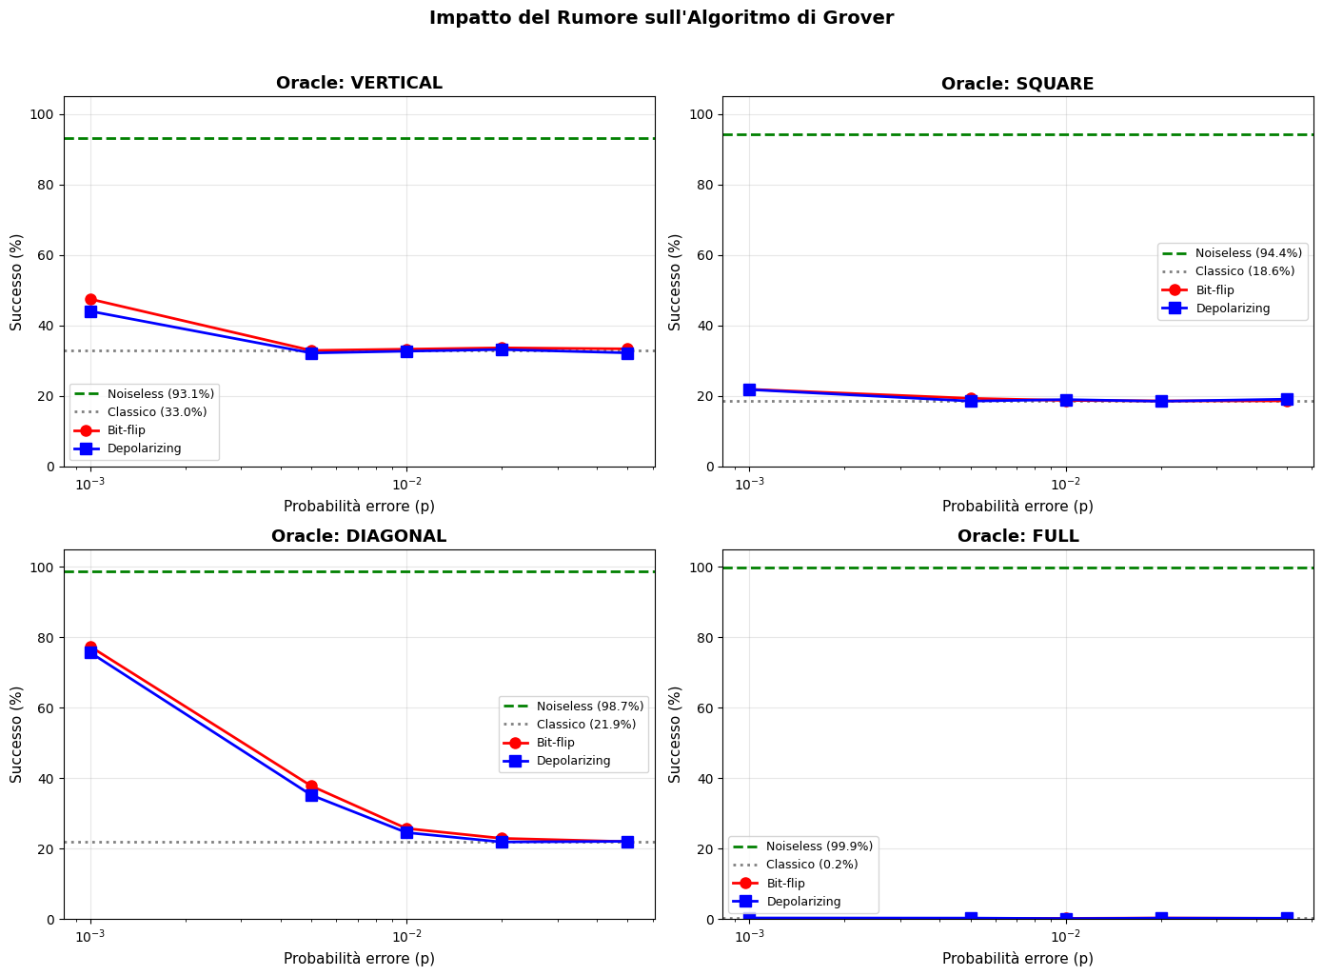
QISKIT NOISELESS VS BIT FLIP VS DEPOLARIZING

Slide 19
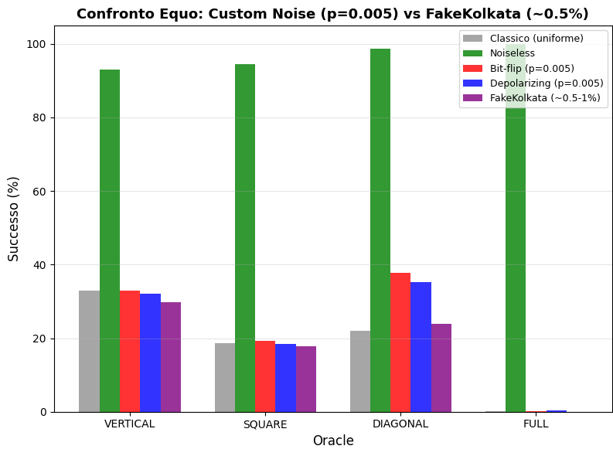
QISKIT REAL HARDWARE (FAKEKOLKATA)
Fakekolkata simulates real quantum
hardware. It simulates all error channel:
Bit-flip
Depolarizing
T1
T2
It is even worst than the classical case.

Slide 20
JULIA: QUANTUM SAVORY NOISE
Qiskit (discrete model): Simulate the circuit step by step. Noise is applied as an "error probability" associated with each logic gate (for example, a 1% error each time a CNOT gate is used).
QuantumSavory (Continuous Physical Model): Based on QuantumOpticsBase, it simulates the evolution of the quantum system in real time. Qubits decay constantly as time passes, much closer to the behavior of real quantum .
Noise Model: For this simulation, we exclusively used the continuous Depolarization model, since Bitflip is not yet supported.

Slide 21
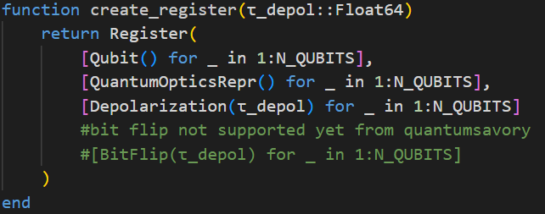
JULIA: SYSTEM CONSTRUCTION
1. Hilbert Space Setup: Definition of a 9-qubit system (without ancilla) for a 3x3 grid, which generates a 512-dimensional Hilbert space.
2. Register Creation: Each qubit is initialized using the QuantumOptics reprepresentation to handle non-Clifford operations (essential for Grover) and directly manipulate the Density Matrix.

Slide 22
JULIA: THE CORE SIMULATION LOOP
EXECUTING GROVER
The Internal Clock (t)
Unlike static circuits, the run_grover function relies on a continuous clock variable (t = 0.0) that tracks the physical time elapsed.
Every initialization and basic gate increments this clock.
During the Grover iterations, we advance the clock by the Oracle's specific "weight" (t += oracle_time).
We call uptotime!(reg[i], t). This commands QuantumSavory to apply noise until current time.

Slide 23
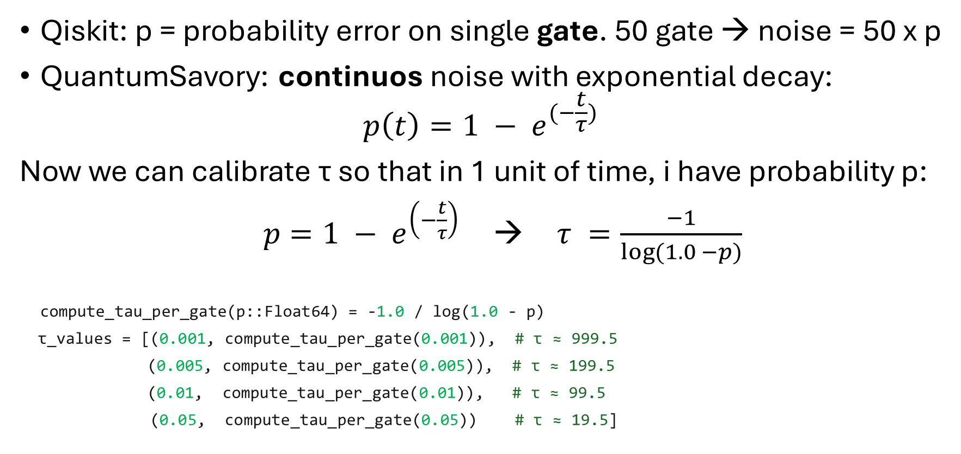
JULIA: CALIBRATING TIME FOR NOISE
Qiskit: p = probability error on single gate. 50 gate → noise = 50 x p
QuantumSavory: continuos noise with exponential decay:
$$p\left(t\right)=1 − e^{(−\frac{t}{τ})}$$
Now we can calibrate τ so that in 1 unit of time, i have probability p:
$p=1 − e^{\left(−\frac{t}{τ}\right)}$ → $τ =\frac{−1}{log⁡(1.0 −p)}$
compute_tau_per_gate(p::Float64) = -1.0 / log(1.0 - p)
τ_values = [(0.001, compute_tau_per_gate(0.001)), # τ ≈ 999.5
(0.005, compute_tau_per_gate(0.005)), # τ ≈ 199.5
(0.01, compute_tau_per_gate(0.01)), # τ ≈ 99.5
(0.05, compute_tau_per_gate(0.05)) # τ ≈ 19.5]

Slide 24
JULIA: CALIBRATING TIME FOR NOISE
In this way the Oracle cumulates error like pyhisical gates.
(t=50 → 50 gates noise)
We use the total number of gates transpiled directly from Qiskit and use those values as total time for which the noise is being applied.
const GATES_EFFECTIVE_ORACLE = Dict(
"vertical" => 3445,
"square" => 6496,
"diagonal" => 769,
"full" => 2288
)

Slide 25
JULIA: MEASURMENTS FROM DENSITY MATRIX
1. Bypassing Simulated Shots
In Qiskit, we run thousands of "shots" to approximate the probability distribution.
In this Julia implementation, we bypass statistical sampling entirely.
2. Reading the Density Matrix
Since we compute the exact physical state, we simply extract the diagonal of the final Density Matrix.
These values represent the exact analytical probabilities of all 512 states. We just sum the target states to get the true success rate.

Slide 26
COMPARISON: JULIA VS QISKIT NOISELESS
CLASSIC
QISKIT
JULIA
THEORICAL
ORACLE | SUCCESS PROB. | SUCCESS.PROB | SUCCESS PROB. | SUCCESS PROB.
VERTICAL | 33.0 % | 92.8 % | 93.1 % | 93.1 %
SQUARE | 18.6 % | 94.4 % | 94.6 % | 94.6 %
DIAGONAL | 21.9 % | 98.8 % | 98.8 % | 98.8 %
FULL | 0.2 % | 99.9 % | 99.9 % | 99.9 %

Slide 27
COMPARISON: QISKIT VS JULIA (DEPOLARIZING)
QISKIT
QUANTUMSAVORY
Error prob. | Success rate | Time | Tau | Success rate | Time
p = 0.001 | 44.0 % | 3.97 s | τ = 999.5 | 45.0 % | 3.68 s
p = 0.005 | 32.2 % | 3.396 s | τ = 199.5 | 33.2 % | 3.68 s
p = 0.01 | 32.7 % | 3.678 s | τ = 99.5 | 33.0 % | 3.68 s
p = 0.05 | 32.2 % | 3.428 s | τ = 19.5 | 33.0 % | 3.68 s
VERTICAL
QISKIT
QUANTUMSAVORY
Error prob. | Success rate | Time exec. | Tau | Success rate | Time exec.
p = 0.001 | 21.8 % | 6.512 s | τ = 999.5 | 22.5 % | 7.375 s
p = 0.005 | 18.5 % | 6.233 s | τ = 199.5 | 18.6 % | 7.375 s
p = 0.01 | 18.9 % | 5.984 s | τ = 99.5 | 18.6 % | 7.375 s
p = 0.05 | 19.0 % | 5.803 s | τ = 19.5 | 18.6 % | 7.375 s
SQUARE

Slide 28
COMPARISON: QISKIT VS JULIA (DEPOLARIZING)
QISKIT
QUANTUMSAVORY
Error prob. | Success rate | Time | Tau | Success rate | Time
p = 0.001 | 75.7 % | 0.930 s | τ = 999.5 | 72.4 % | 0.852 s
p = 0.005 | 35.2 % | 0.775 s | τ = 199.5 | 33.0 % | 0.852 s
p = 0.01 | 25.5 % | 0.766 s | τ = 99.5 | 24.2 % | 0.852 s
p = 0.05 | 21.9 % | 0.780 s | τ = 19.5 | 21.9 % | 0.852 s
DIAGONAL
QISKIT
QUANTUMSAVORY
Error prob. | Success rate | Time exec. | Tau | Success rate | Time exec.
p = 0.001 | 0.3 % | 30.196 s | τ = 999.5 | 0.2 % | 43.18 s
p = 0.005 | 0.3 % | 31.176 s | τ = 199.5 | 0.2 % | 43.18 s
p = 0.01 | 0.1 % | 30.285 s | τ = 99.5 | 0.2 % | 43.18 s
p = 0.05 | 0.2 % | 30.009 s | τ = 19.5 | 0.2 % | 43.18 s
FULL

Slide 29
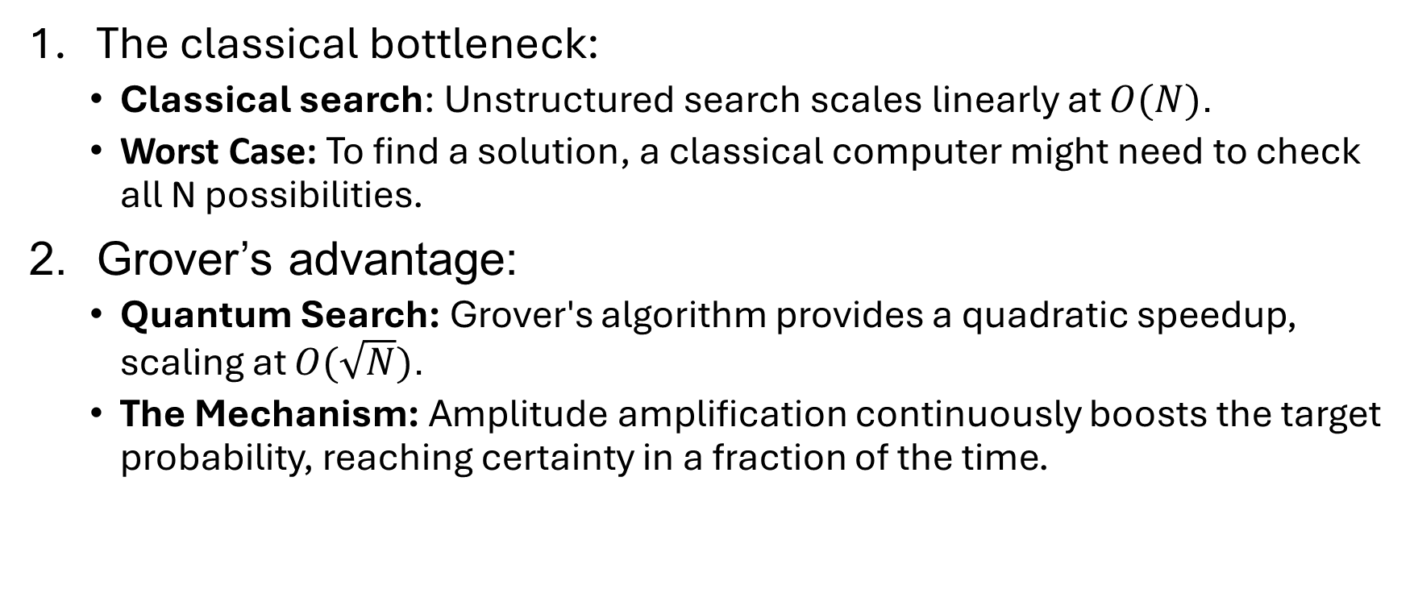
CONCLUSION: GROVER VS CLASSIC
The classical bottleneck:
Classical search: Unstructured search scales linearly at $O(N)$.
Worst Case: To find a solution, a classical computer might need to check all N possibilities.
Grover’s advantage:
Quantum Search: Grover's algorithm provides a quadratic speedup, scaling at $O(\sqrt{N})$.
The Mechanism: Amplitude amplification continuously boosts the target probability, reaching certainty in a fraction of the time.

Slide 30
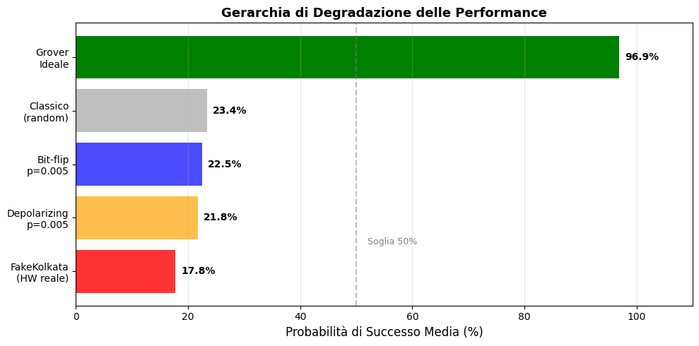
CONCLUSION: NISQ ERA
What is NISQ?
Noisy Intermediate-Scale Quantum computing.
Current quantum hardware lacks full fault-tolerance and error correction. Qubits are fragile and easily lose coherence over time.
The Depth Challenge for Grover
Grover's algorithm requires deep circuits with thousands of gates.
Why Simulations Matter
we can study the exact hardware threshold where Grover's mathematical perfection is broken by physical reality.

