Slide 1

Distributed Crazy Time
Live distributed betting system with fault tolerance
Gabriele Caioli
Klaudio Ciacia
Lorenzo Vanni

Slide 2
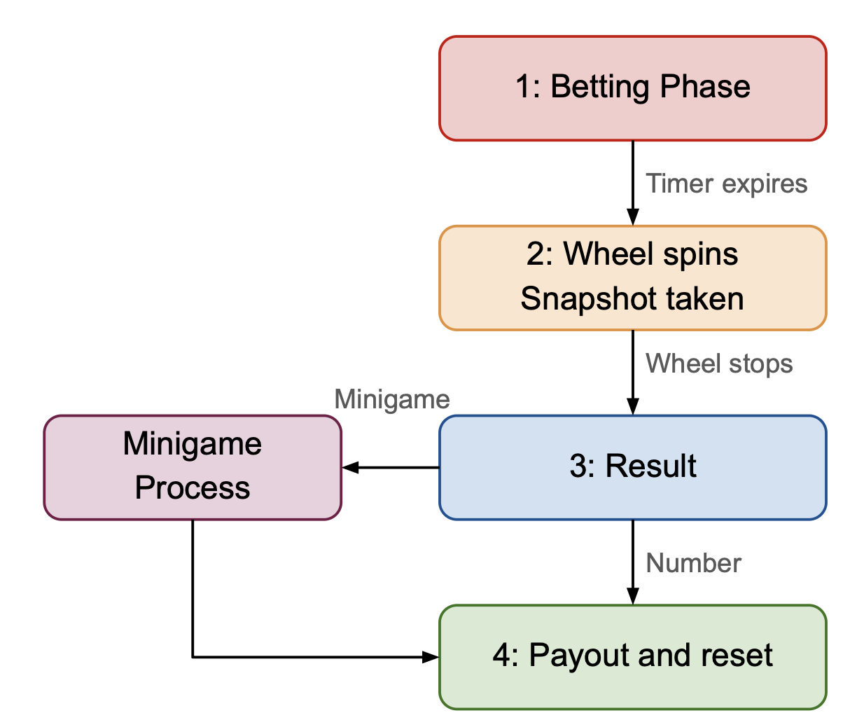
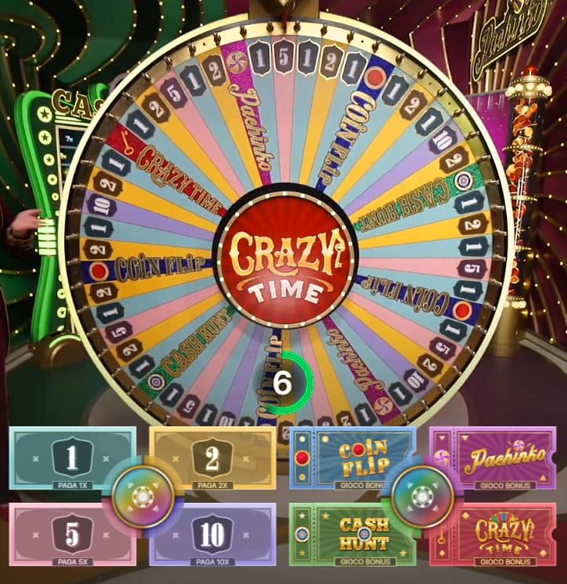
Game Loop

Slide 3
System Architecture
Browser HTML, JS, WS
Java Spring Boot H2 Database
RabbitMQ
Rest + WS
AMQP
AMQP
Erlang
Game1 (standby)
Game2 (standby)
Game3 (leader)
OTP Distribution
Mnesia (replicato)

Slide 4
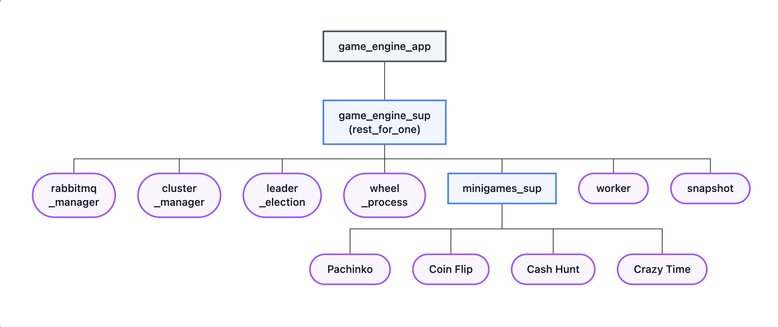
Supervision Tree

Slide 5
Cluster manager
game3 pong connected
Reads peer_nodes from config file
Monitors with net_kernel:monitor_nodes/2
At boot:
1. Pings every peer in the peer_node config
2. Starts leader_election
3. Bootstrap Mnesiadb
4. Ping every 10s for peers not yet connected
Node_up / Node_down -> leader_election
Mnesiadb exists -> join_mnesiadb()
Otherwise the lowest node will create it
net_kernel detects new node
cluster_manager receives {nodeup, game3}
Updates list connected nodes
leader_election:start_election()
Bully Algorithm game3 --> leader

Slide 6
Leader election
LEADER ELECTION: BULLY ALGORITHM

Slide 7
Workers

Slide 9
Distributed Snapshot — Chandy-Lamport Algorithm
Cut points are staggered — the marker arrives at each node at a different time.
Accepted
In-flight (ledger)
Rejected
Wheel (leader)
bet1
bet2
bet3
bet4
The marker travels the same FIFO channel as the bets, so causal order is guaranteed.
A bet forwarded before the marker is in-flight — captured if it lands before the marker returns to the leader.
A bet sent after the marker on that channel arrives too late and is rejected.
Worker 1
bet3
late
Worker 2
bet4
Snapshot collector (snapshot.erl)
Ledger = leader's accepted bets + captured in-flight bets
Persisted to Mnesia as an atomic checkpoint
Published to RabbitMQ → round_ledger

Slide 10
Chandy-Lamport Snapshot: How and Why
When Triggers at the Gong (end of betting), right after the winning segment is drawn, before the wheel animation starts.
How: 3-Phase Protocol
Reasons
1. Wheel (Leader)
Authoritative Ledger
Saves its own state, starts the collector, and sends markers to the workers on the same FIFO channels as the bets.
The definitive list of the round's bets, including those still in flight on the channels.
2. Worker
Deterministic Recovery
Each worker saves its local state, replies with the marker, and reports its portion back to the collector.
A new leader reads the checkpoint and decides whether to complete (post-gong crash) or cancel (betting-phase crash) the round.
3. Collector
Deduplication
Assembles the snapshot_record (local bets + in-flight), persists it to Mnesia (replicated), and publishes the ledger to results_queue.
The bet_id values in the checkpoint prevent bets re-delivered by the broker from being played twice.

Slide 11
What Happens When the Leader Crashes?
1. Round in progress — game3 is the LEADER
Wheel spins, bets collected, Chandy-Lamport snapshot already completed
2. CRASH — game3 dies suddenly
net_kernel detects the nodedown and notifies the cluster
3. Election — Bully Algorithm
game2 > game1 → game2 becomes LEADER (2/3 quorum verified)
4. Recovery — read from Mnesia
Unacked bets return to bets_queue and are served by the new leader
Finds the round snapshot → publishes round_cancelled or completes the round
5. Reconciliation — Java Gateway
Refunds pending bets missing from the ledger: no loss, no double payout

Slide 12
The Role of the Java Gateway
Transactional Handling
Reconciliation from the Ledger
POST /api/auth/register
POST /api/auth/login
GET /api/wallet/balance
POST /api/wallet/place-bet
From RabbitMQ → results_queue
type: "result"
PayoutListener: computes winnings, updates status (WON/LOST), credits the balance
place-bet() does:
type: "round_ledger"
LedgerListener: PENDING bets missing from the ledger → REFUNDED
1. Deducts the balance (pessimistic lock)
2. Saves the bet as PENDING
3. Sends the JSON to bets_queue
type: "round_cancelled"
LedgerListener: refunds ALL PENDING bets of the round

Slide 13
Testing
Automated verification: load handling and dealer-crash recovery
STRESS TEST
LEADER CRASH TEST
stress_test.py
crash_test.py
1. Setup
10 players each wager 10 EUR on segment 5 — the amount actually debited is recorded
50 registered players run an open-ended sequence of concurrent rounds
Each round: a random amount is wagered on a random segment, for every player, in parallel
Interactive checkpoints — the operator presses Enter when betting opens and again once the wheel stops
Per round it prints, for every player: balance before/after, payout, net result — plus the house balance
↓
moments before the gong
2. Simulated crash
pkill -9 is issued against game3 (the Leader), before the gong
↓
Bully election + Mnesia-checkpoint recovery run automatically
3. Monitoring
Player balances are sampled every 5s for one minute
↓
Java Gateway reconciles the ledger
Goal: verify correctness and responsiveness of the whole pipeline under concurrent load
4. Verification
Refunded total vs. staked total → confirms which recovery branch ran and that no money was lost
Both suites confirm zero financial loss: correct concurrency handling under load, and correct Bully election + Chandy-Lamport recovery after a dealer crash.

