Slide 1
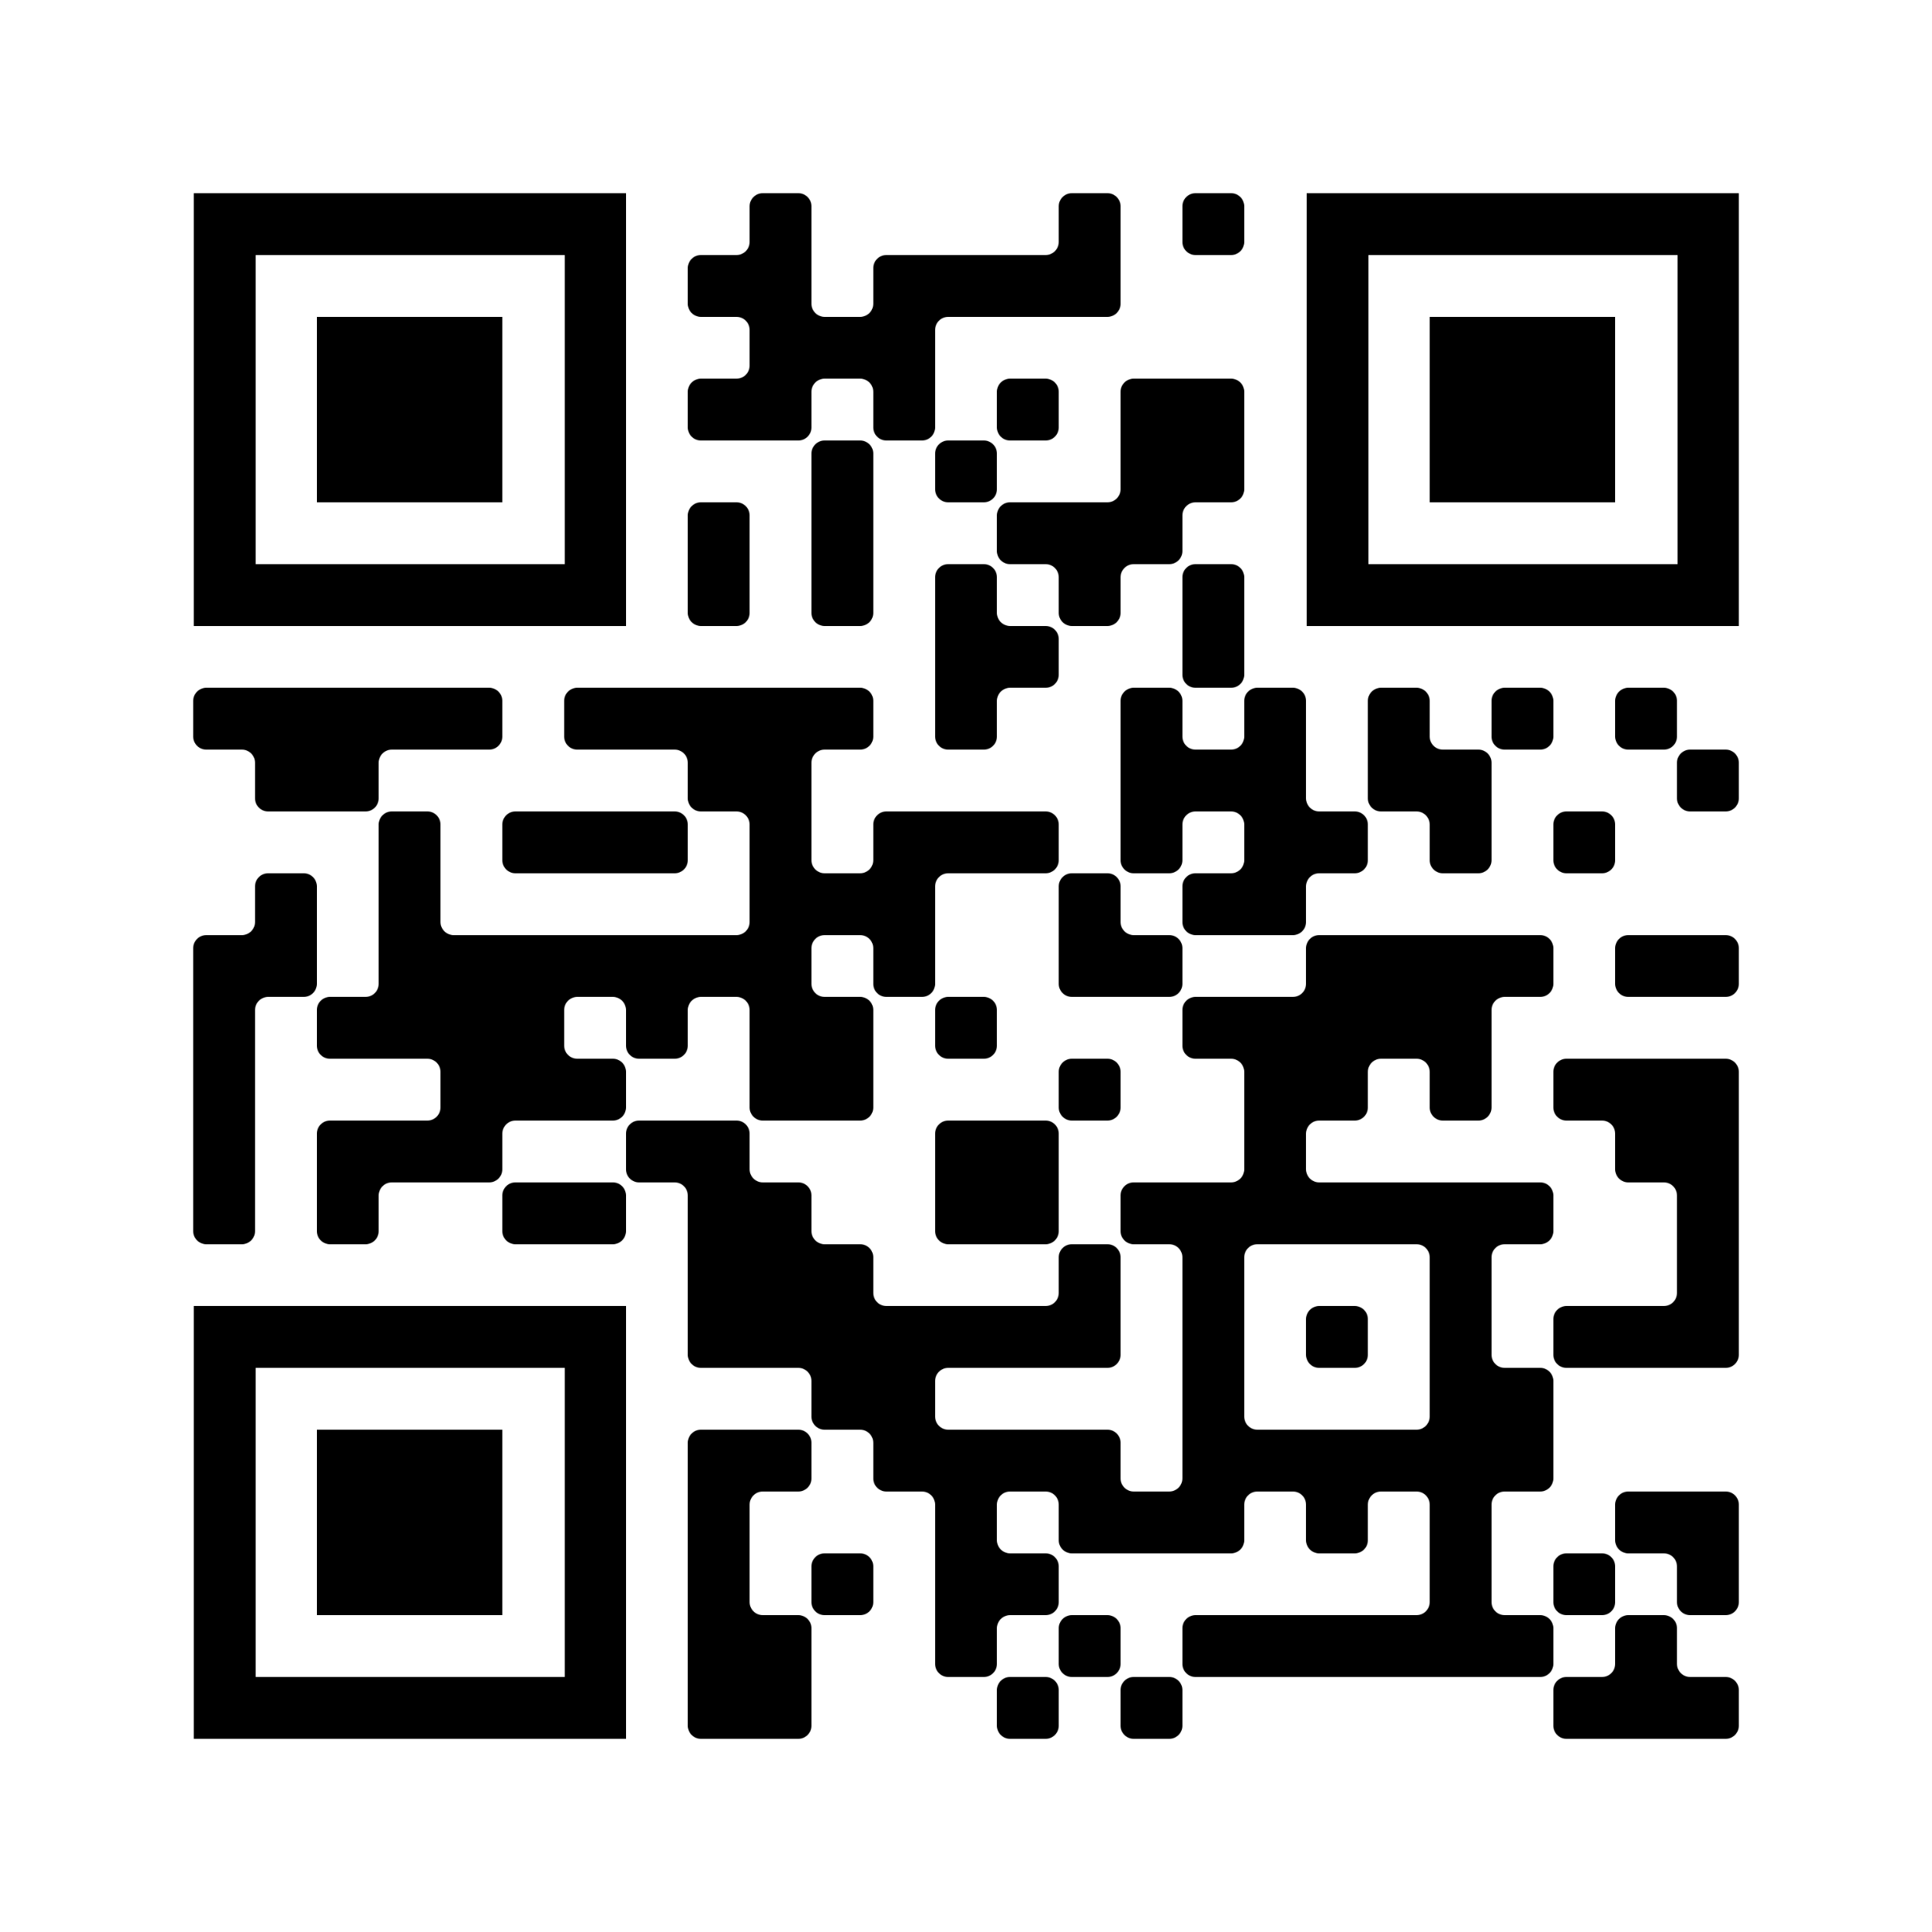
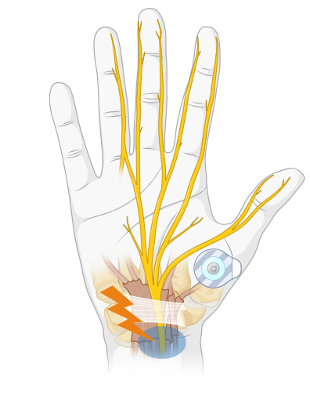
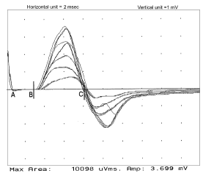
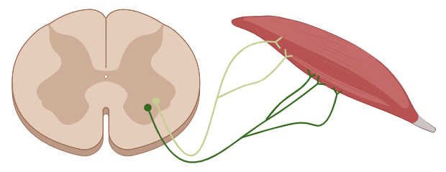
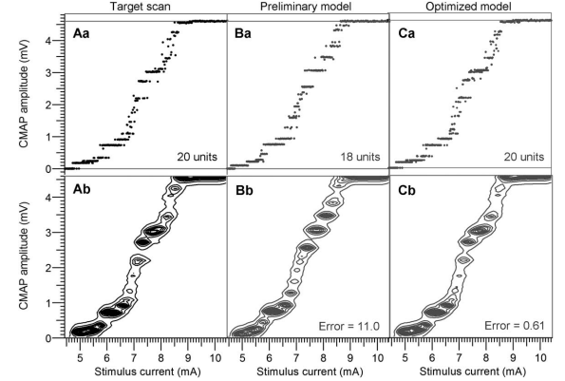
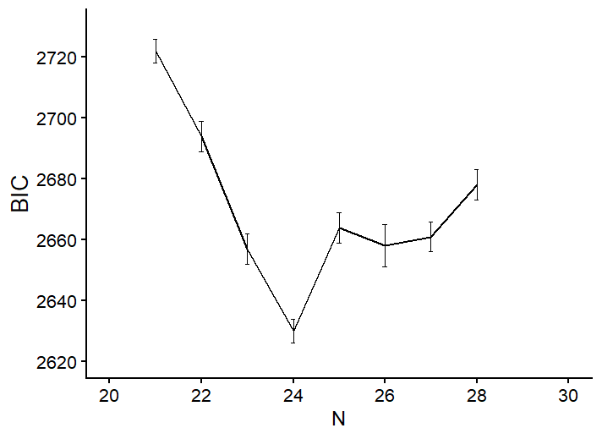
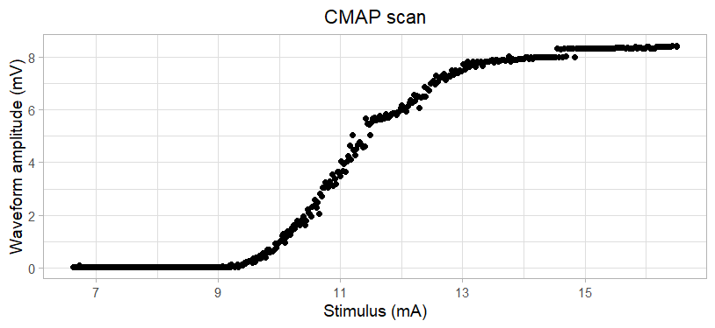
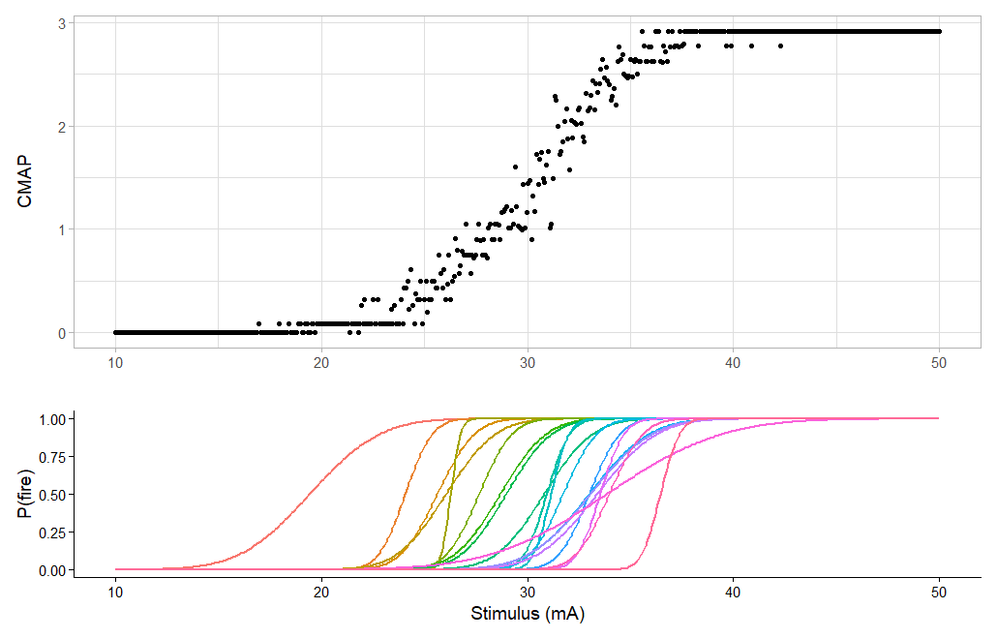
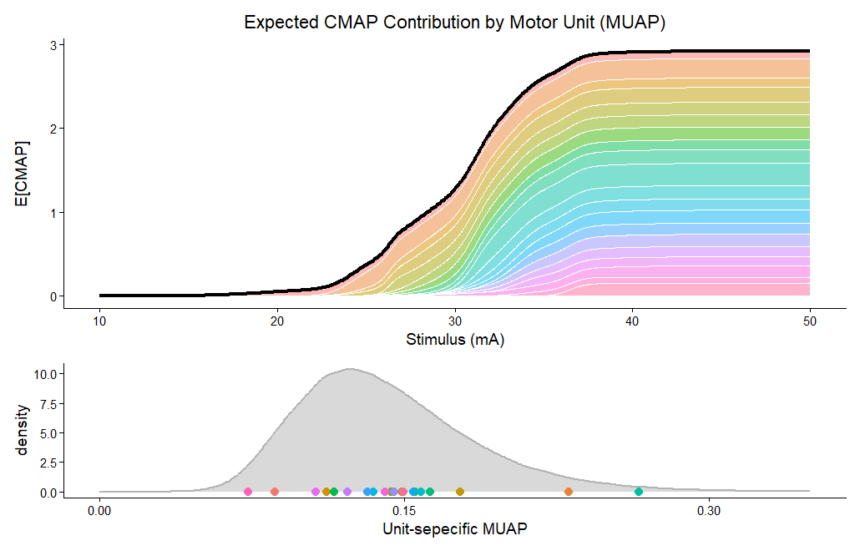





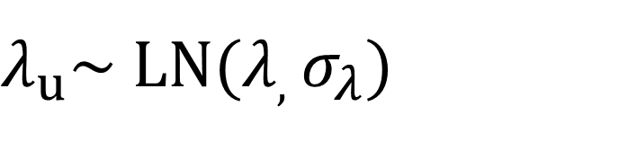
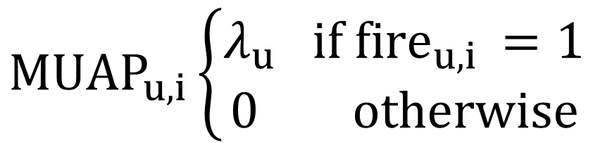
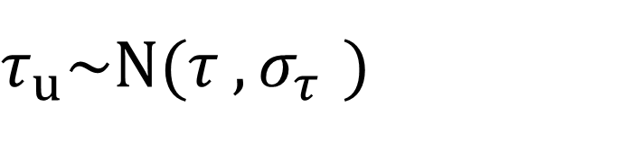
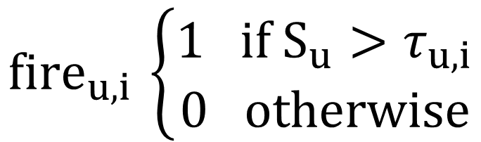
Bayesian Motor Unit Number Estimation – A
Novel Approach
Siebe Everaerts¹, Jesper Fischer Ehmsen¹, Jan Rosner^{1,2}
¹Pain & Neurorecovery group, Aarhus University, Denmark ²Hammel Neurorehabilitation Centre, University Clinic for Neurorehabilitation
Background
Previous methods
Unit 2
MScanFit
Bostock (2015)
Bayesian MUNE
Ridall et al. (2006)
Ridall et al. (2006)
smooth
Unit 1
APB
Importance
median wrist nerve
Improve the diagnostic value of MUNE (Jacobsen et al., 2018, 2024)
Model disease progression (Baumann et al., 2012)
More reliable MUNE through statistical modelling
Compare maps, refine parameters
Fit across N, compare BIC
N units?
+ Computationally efficient
+ Clinically practical
− Primarily descriptive
− Lacks probabilistic nature
+ Full probabilistic framework
+ Mechanistic
− Computationally expensive
− Limited clinical applicability
Model
Assumption 1
Assumption 2
Assumption 3
$${fire}_{u,i }\left\{\begin{aligned}1 if S_{u}>τ_{u,i} \\ 0 otherwise\end{aligned}\right.$$
$τ_{u,i}$~N($τ_{u, }σ_{u })$
$${MUAP}_{u,i}\left\{\begin{aligned}λ_{u} if {fire}_{u,i }=1 \\ 0 otherwise\end{aligned}\right.$$
$λ_{u}$~ LN($λ_{, }σ_{λ})$
$τ_{u}$~N($τ_{ },σ_{τ_{ } })$
siebe.everaerts@cfin.au.dk

Slide 2
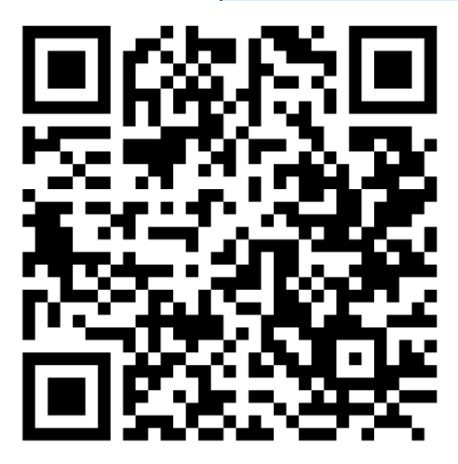
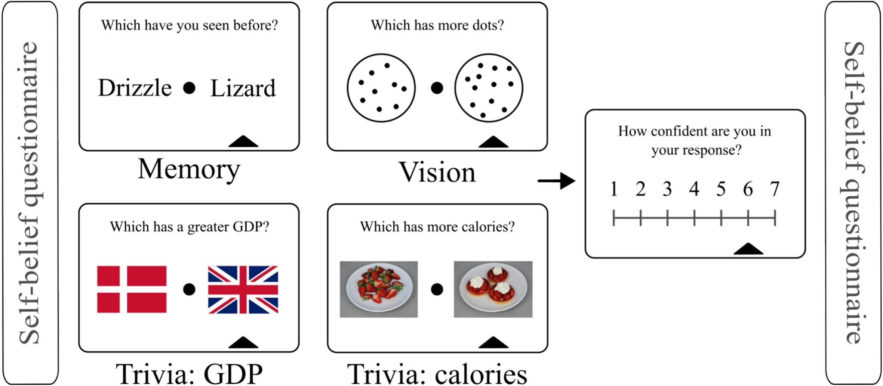
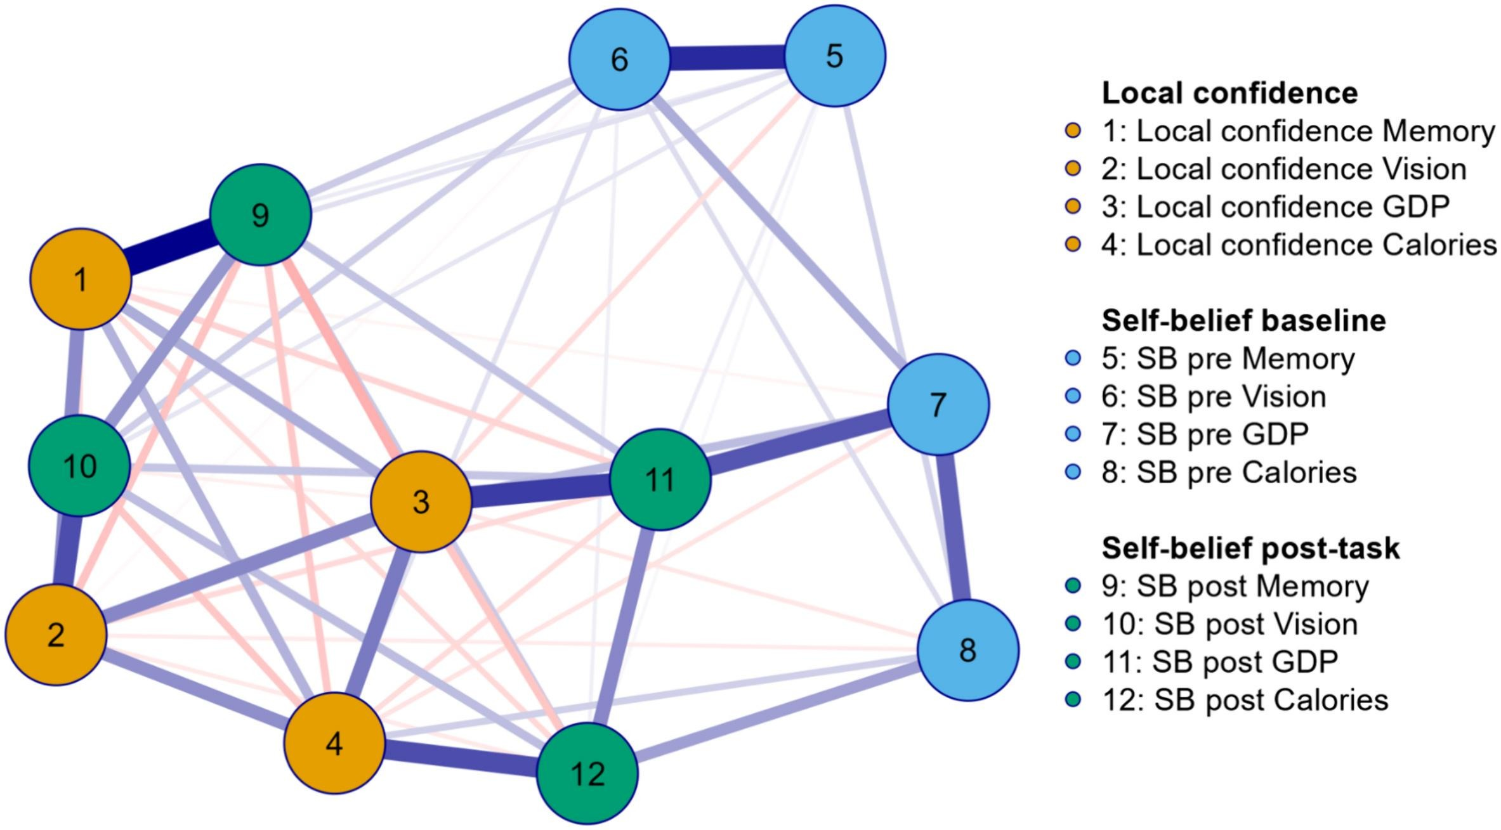
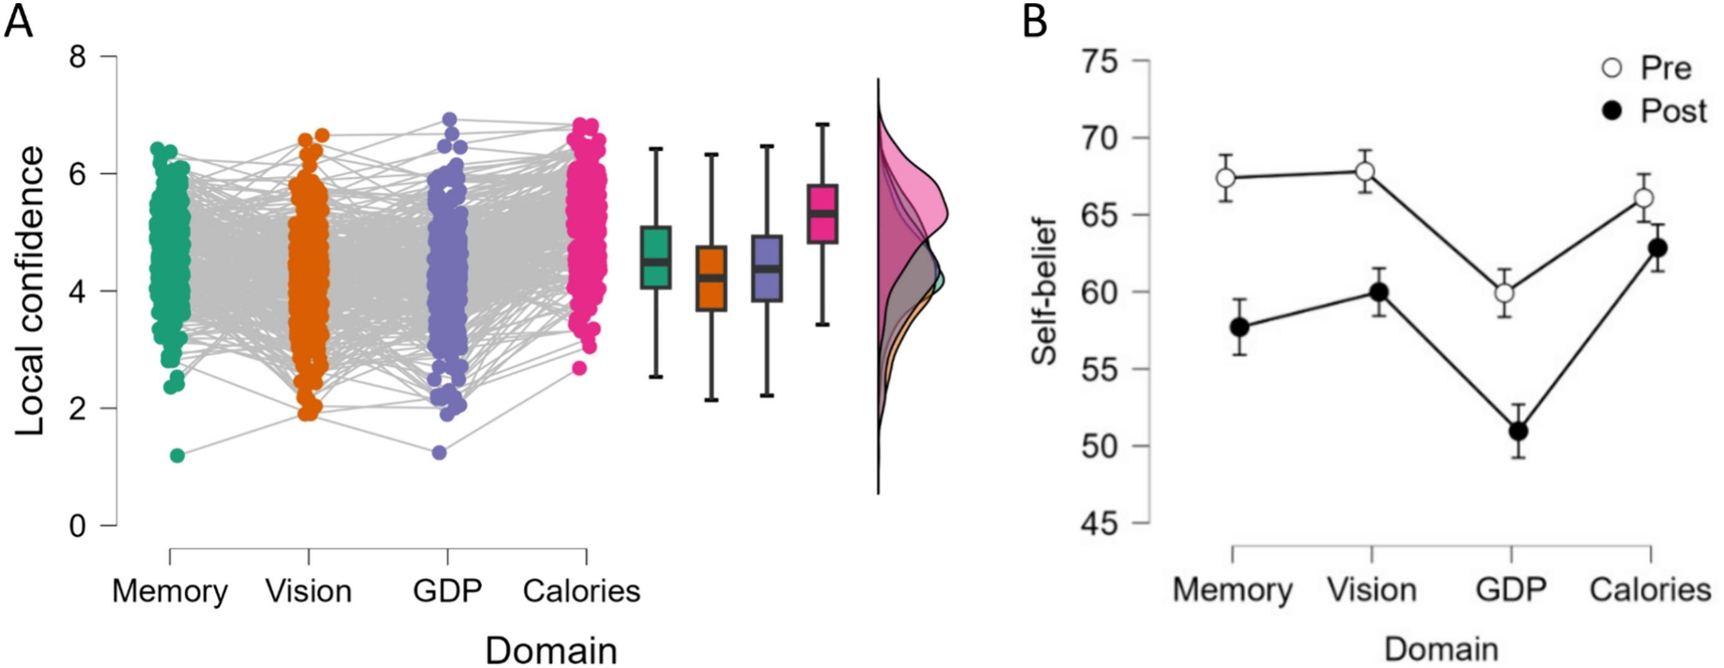
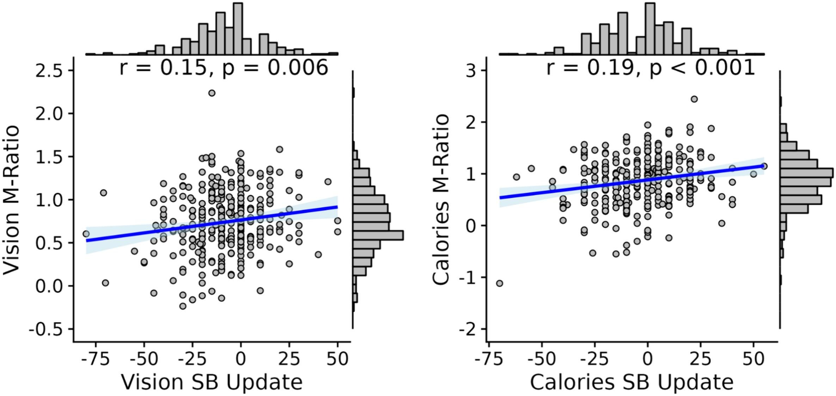





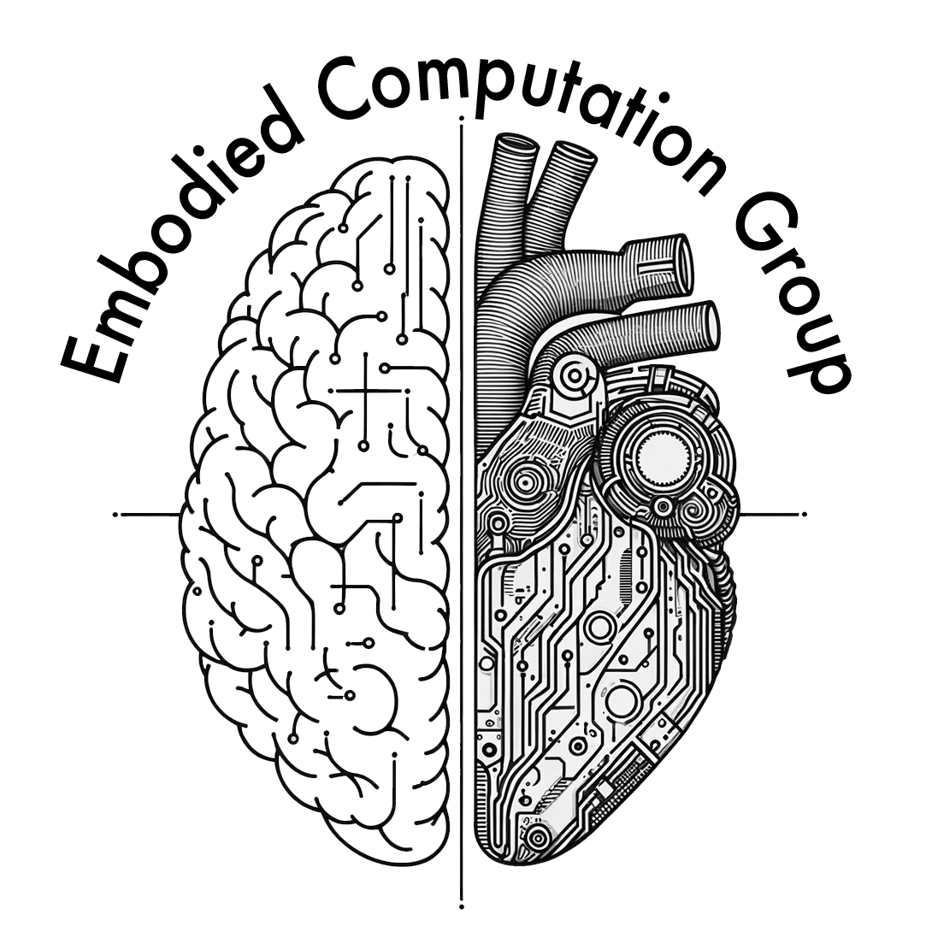
Domain-specific updating of metacognitive
self-beliefs
Kelly Hoogervorst¹, Leah Banellis, PhD¹, Ashley Tyrer, PhD¹, Micah Allen, PhD^{1,2}
¹Centre of Functionally integrative Neuroscience, Aarhus University, Denmark ²Cambridge Psychiatry, University of Cambridge, United Kingdom
HIGHLIGHTS
BACKGROUND
We tested metacognition across four different cognitive domains.
Measures included local confidence and global self-beliefs, pre- and post-task completion.
Confidence bias showed strong domain-generality.
Self-belief updating occurred in a domain-specific manner.
Preliminary findings of metacognitive efficiency correlating positively with self-belief updating.
Metacognition is the ability to monitor and evaluate our own cognitive processes.
This includes local confidence (item-specific) and global self-beliefs (ability estimates).
Hierarchical models suggest these levels are linked but how is unknown.
It is particularly unknown whether self-beliefs are updated in a domain-general or domain-specific manner.
This study aimed to understand how subjective feelings of uncertainty influence global self-beliefs across different domains.
METACOGNITIVE TESTING BATTERY
Which have you seen before?
Which has more dots?
332 healthy participants (age = 24.2, SD = 5.1)
Local confidence and global self-beliefs
recorded
Adaptive staircase procedure (71% accuracy)
Four task domains
  Recognition memory
  Visual discrimination
  Trivia task (semantic memory)
    Socioeconomics (GDP)
    Nutrition (calories)
Memory
Vision
How confident are you in your response?
Self-belief questionnaire
Which has more calories?
Self-belief questionnaire
Which has a higher GDP?
Data from Lund, et al., PsyArXiv (2023)
Trivia: GDP
Trivia: calories
RESULTS
Network analysis of the relationships between local confidences and global self-beliefs
Local confidence and global self-beliefs across domains
Local confidence
Memory
Vision
Trivia: GDP
Trivia: Calories
Self-belief baseline
Memory
Vision
Trivia: GDP
Trivia: Calories
Self-belief post-task
Memory
Vision
Trivia: GDP
Trivia: Calories
Correlations between metacognitive efficiency and self-belief updating
CONCLUSIONS
Negative self-belief updating was found across domains
Individuals with higher metacognitive efficiency showed more positive updating of self-beliefs
Confidence bias showed strong domain generality
Self-beliefs shifted to be more task-specific over time, supporting hierarchical models of metacognition
Vision self-belief update
Calories self-belief update
FUTURE WORK
Metacognition in nutritional perception
Neural mechanisms of nutritional beliefs
Pharmacological modulation of appetite
and metacognition in nutrition
Metacognitive self-beliefs are not fixed but shaped by
domain-specific feedback
kellyh@cfin.au.dk
@kellyhoogervorst

