Slide 1
Statistical MUNE methods
Notes:
HUSK AT ”AKTIVERE INDHOLD” I DIALOGBOKSEN DER KOMMER NÅR PRÆSENTATIONEN STARTER (GUL BJÆLKE)

Slide 2
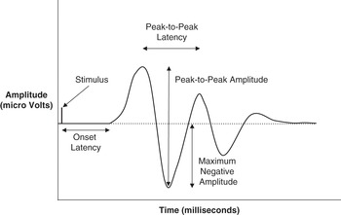

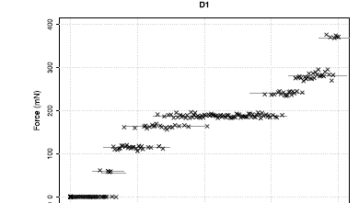
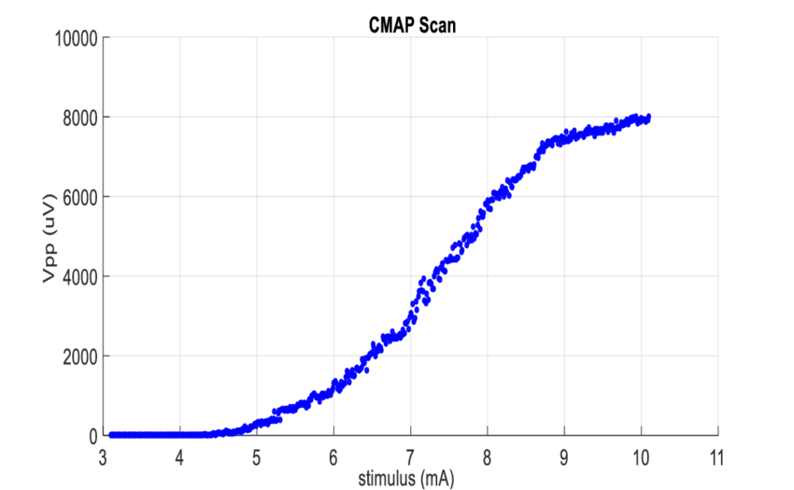
Data
Electrode (mA)

Slide 3
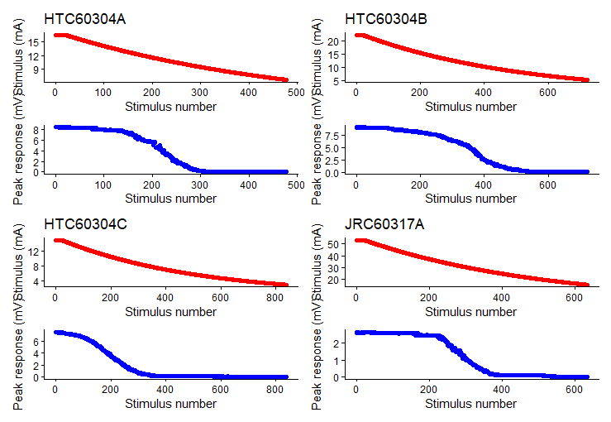

Slide 4
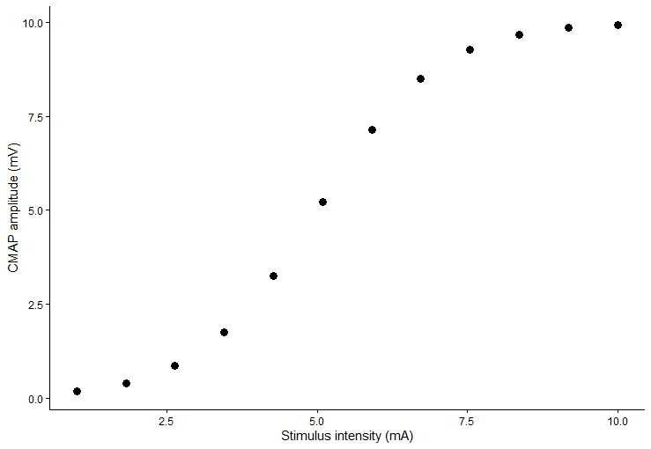
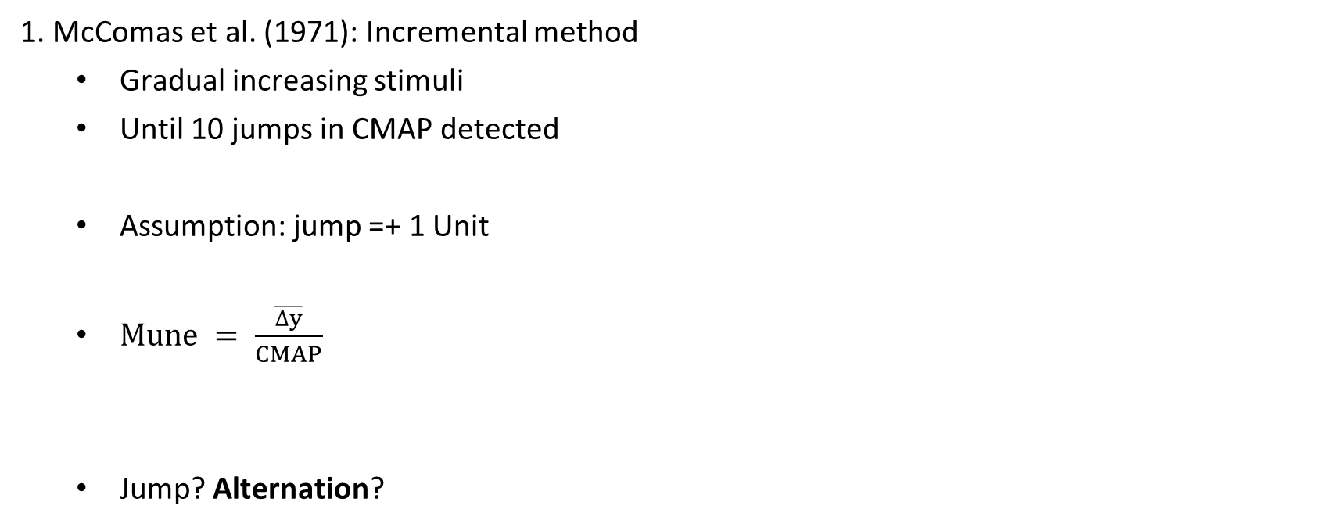
Previous MUNE methods
1. McComas et al. (1971): Incremental method
  Gradual increasing stimuli
  Until 10 jumps in CMAP detected
  Assumption: jump =+ 1 Unit
  $Mune = \frac{\overline{∆y}}{CMAP}$
  Jump? Alternation?
1 U
Notes:
Alternation = increments in CMAP is not because linear firing (S1 = 1, S2 =1+2,…)+ all units dont share the same amplitude
At S1 maybe 1 active S2 maybe 2+3, S3 maybe 1+2+4+5→ will lead to an overestimation of units
Process = not stochastic but probabilistic!!!

Slide 5
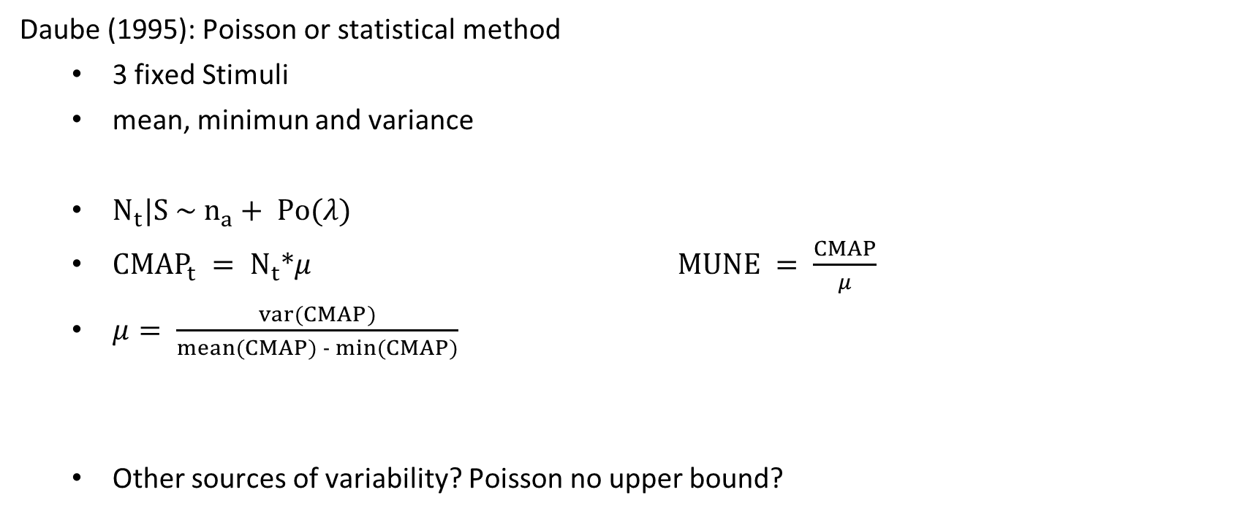
Previous MUNE methods
Daube (1995): Poisson or statistical method
  3 fixed Stimuli
  mean, minimun and variance
  $N_{t}|S \sim n_{a}+ Po(λ)$
  ${CMAP}_{t} = N_{t}*μ$ $MUNE = \frac{CMAP}{μ}$
  $μ= \frac{var(CMAP)}{mean(CMAP) - min(CMAP)}$
  Other sources of variability? Poisson no upper bound?
Notes:
To adress problem of alternation
The number of units activated at a certain point given a stimuli is assumed to be the sum of units that fire with near certainty
e.g. unit that has a mean threshold of firing at 4 and stimuli is 15
Plus those that fire probabilistic → believed to be from a poisson distribution
Mu is the shared motor unit action potential so assumption here is that all units, if they fire contribute equally to the total CMAP
We can then use the properties of Nt|S to calculate mu
Poisson no upper finite bound = problematic → theoretically N has to be constricted to the maximum number of units available

Slide 6
MUNE – A bayesian approach
Ridall et al. (2006)

Slide 7
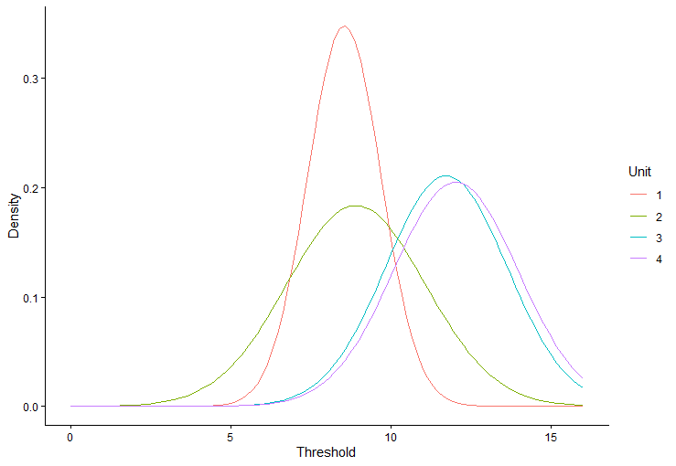
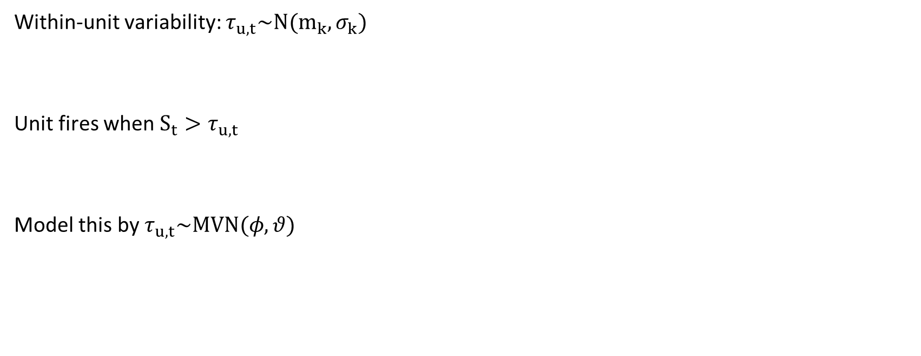
Assumption 1
Within-unit variability: $τ_{u,t}\sim N(m_{k},σ_{k})$
Unit fires when $S_{t}>τ_{u,t}$
Model this by $τ_{u,t}\sim MVN(φ,θ)$
Notes:
A unit only fires when a threshold is crossed. However due to intracellular changes in ions: voltage of a cell is not constant and neither is the excitability
The way they do that is by saying that each units threshold at a certain point comes from a unit specific Normal distr. With a unit specific mean and variance
Some units might vary more other units are generally harder to excite
Cobariance matrix

Slide 8
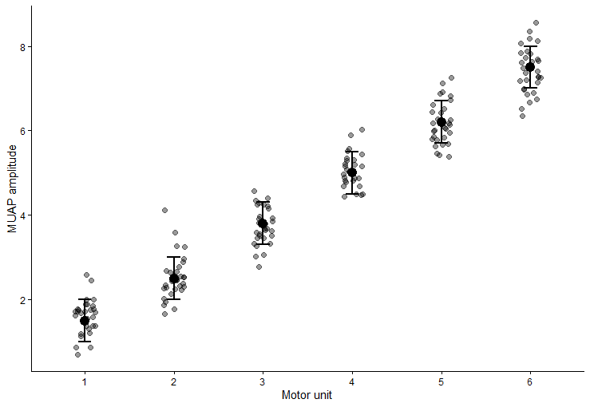
Assumption 2
Notes:
In a case for U 6 you can see that each motor unit does not share the same muap = not the same contribution there is between and withing unit variance
One problem that we will try to incorporate is that they model this as a normal dist → problem you could theoretically get muap that are negative which is not possible so not the right distribution

Slide 9

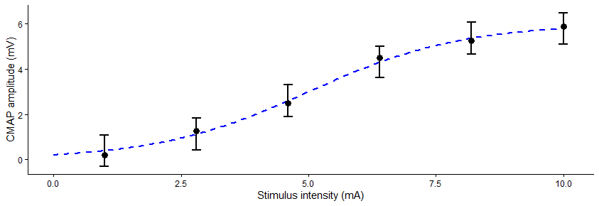
Assumption 3
There is baseline noise (recording noise)

Slide 10
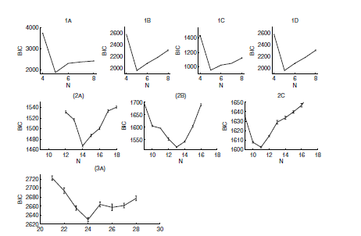
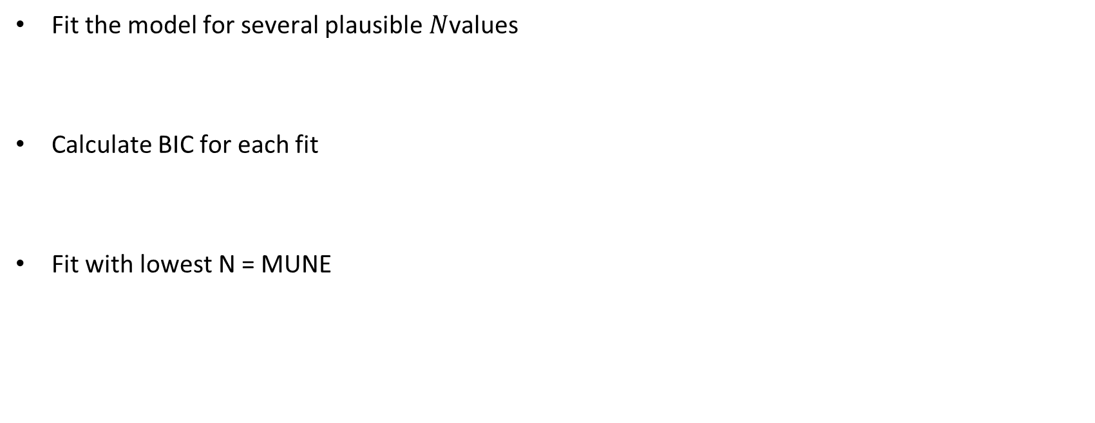
MUNE
Fit the model for several plausible $N$values
Calculate BIC for each fit
Fit with lowest N = MUNE

Slide 11
MScanfit
Bostock (2015)

Slide 12
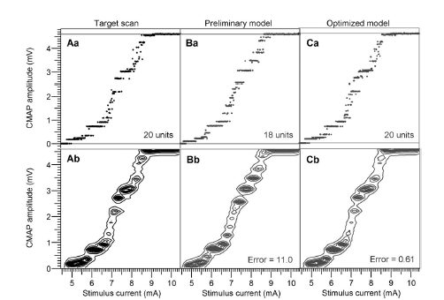
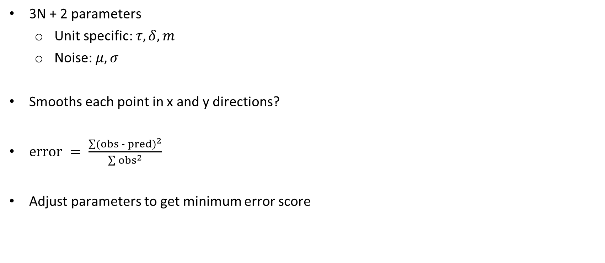
Model
3N + 2 parameters
  Unit specific: $τ,δ,m$
  Noise: $μ,σ$
Smooths each point in x and y directions?
$error = \frac{\sum{{(obs - pred)}^{2}}}{\sum{{obs}^{2}}}$
Adjust parameters to get minimum error score
Notes:
From what i understand, most used method
What this smoothing means, of what points?? Only says that it creates a prob of a stimuli evoking a response
Diff between contoured values and data → arreor score for each smoothed point?
What can we do with this, exact procedures are unknown from manuscript?

Slide 13


My approach
Bayesian model revisited
Modern tools
Optimized for clinic and scientific contribution

