Slide 1
Learning-based multi-modal indoor localization
Final Presentation
Pedro Torres Da Cunha
Master Semester Project
Supervised by
  Frederike Dümbgen
  Sepand Kashani

Slide 2
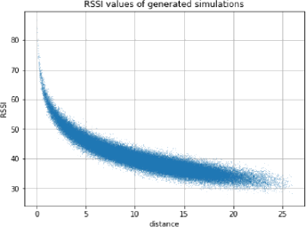
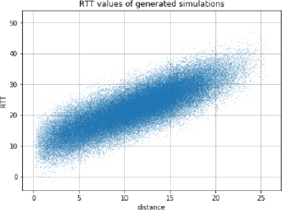
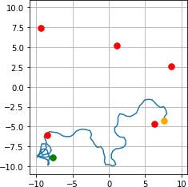
Indoor localization
Goal: predict user’s indoor position using commonly available signals : WiFi, Bluetooth
Challenges:
Handle noisy and non-linear signals
Capture complex dependencies
How: neural networks

Slide 3
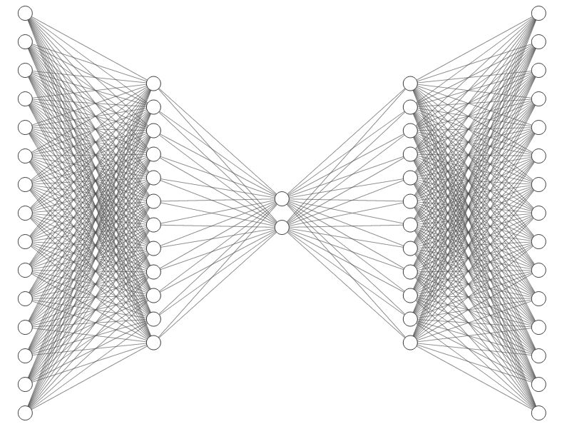



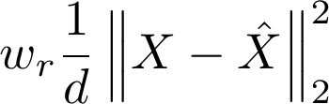
Candidate architecture : Autoencoder
d = 15
d
12
12
Recovered
anchor features
Anchor
Features
lower dimension
embedding
ReLU activations
Keep best components
Suppress noise
Unsupervised
minimize

Slide 4
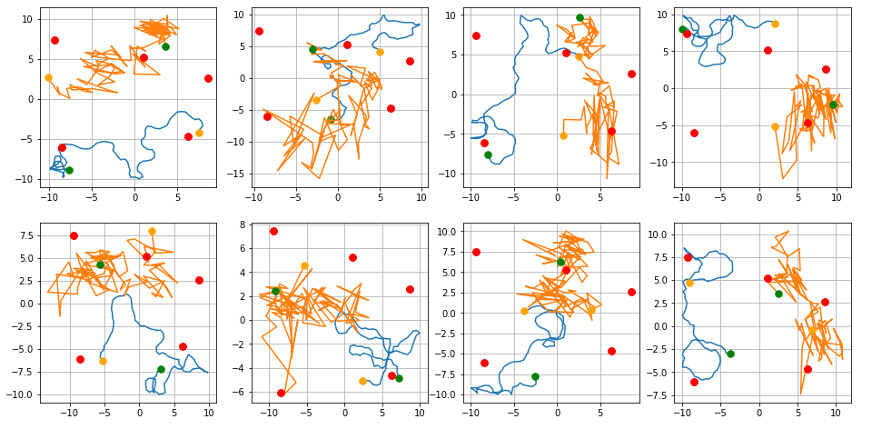
2D embeddings
Misalignment
Noisy embeddings
The Autoencoder is free to choose its 2D representation

Slide 5
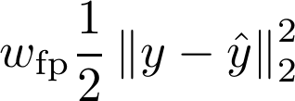
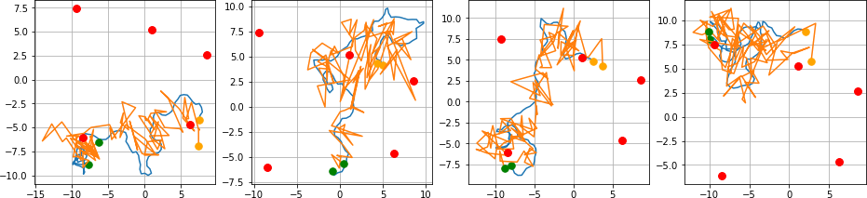
Adding constraints: Align the prediction shape
Correct the simulation shape with some known positions
minimize
The general shape matches but it is still as noisy

Slide 6
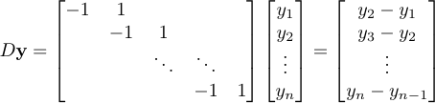

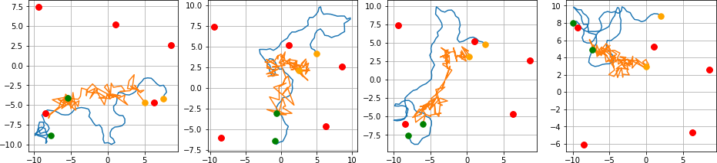
Adding constraints: Smoothing the prediction (1)
Add a smoothing regularizer : first order finite differences
minimize
Corresponds to the direction that the path following
The predictions are not smoothed. The shape is just smaller

Slide 7


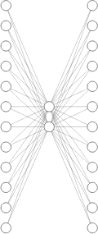
Autoencoder with convolution
d = 15
one filter
12
12
d
12
12
K = 11
Convolution with 12 filters
Transposed convolution
n = 100
2D embedding
Uses the neighbouring values to produce a new feature

Slide 8
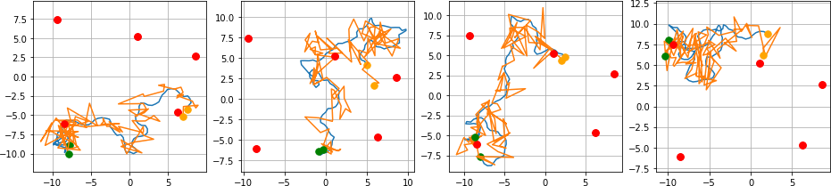
Autoencoder with convolution (results)
Convolution autoencoder with shape alignment

Slide 9
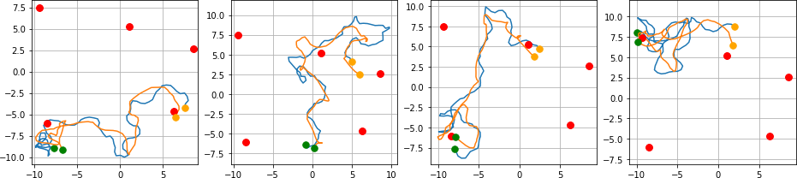
Autoencoder with convolution (results)
Convolution autoencoder with shape alignment
… and with the smoothing constraint

Slide 10
Conclusion
Indoor localization with autoencoder and constraints
Path alignment with some known points
Smooth predictions with the smoothing constraint and the convolution layer

Slide 11
Future directions
Experiment on real data
Further feature disentanglement using calibration data
Explore other neural network architectures
  Deeper architectures
  Use other neural network primitives

