Slide 1
Learning-based multi-modal indoor localization
Midterm Presentation
Pedro Torres Da Cunha
Master Semester Project
Supervised by
  Frederike Dümbgen
  Sepand Kashani

Slide 2
Outline
Indoor localization task
Data generation
Multilayer perceptron
Autoencoder
  Encoding into lower dimensions
  Guide the encoding through constraints
What’s next

Slide 3
Indoor Localization using machine learning
Goal: predict user’s indoor position using commonly available signals
Challenges:
Handle noisy and non-linear signals
Capture complex dependencies
How: neural networks

Slide 4
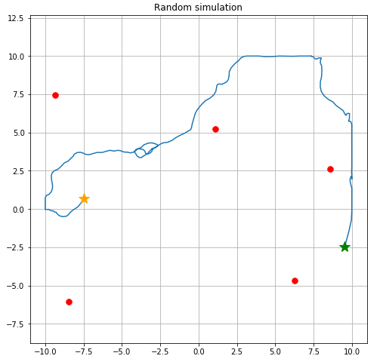
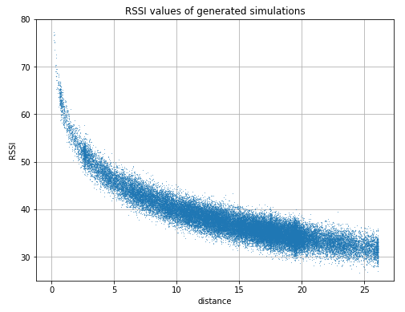
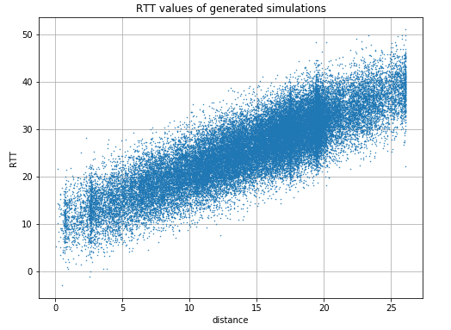
Data generation: Walk Simulation
Anchor features: RSSI, std(RSSI), RTT

Slide 5
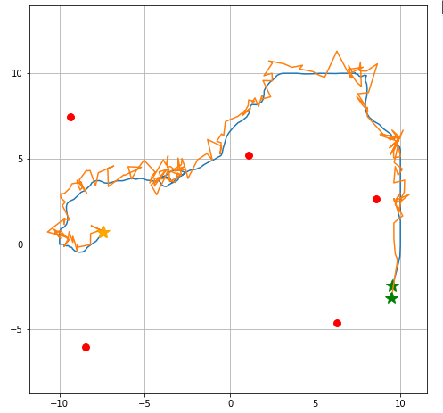
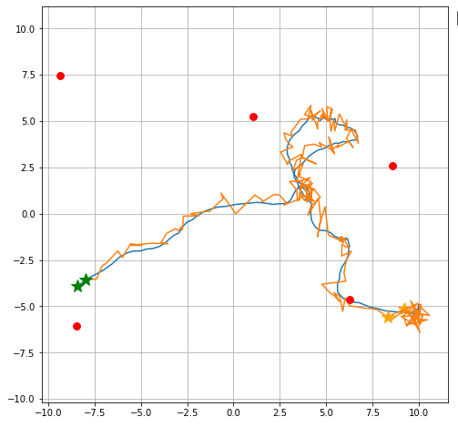
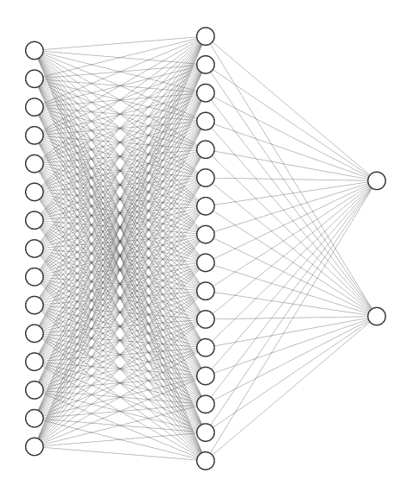
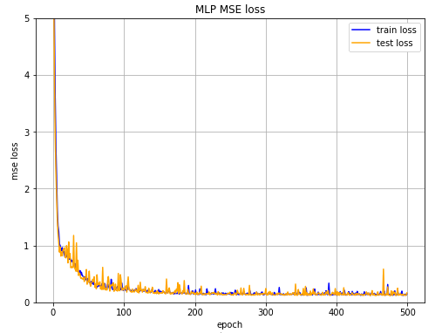
Multilayer perceptron
First approach: just feed it into a MLP
Problem: Need real positions to train
x
Anchor
features
y
ReLU activation

Slide 6
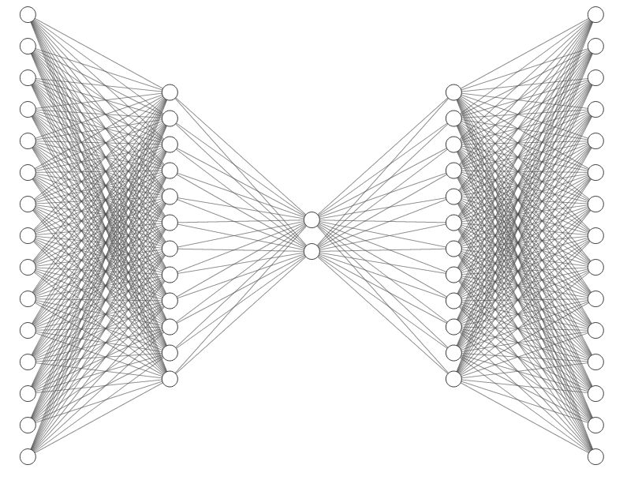
Autoencoder
Keep best components
Suppress noise
doesn’t need real positions
Anchor
features
Recovered
anchor features
lower dimension
embedding

Slide 7
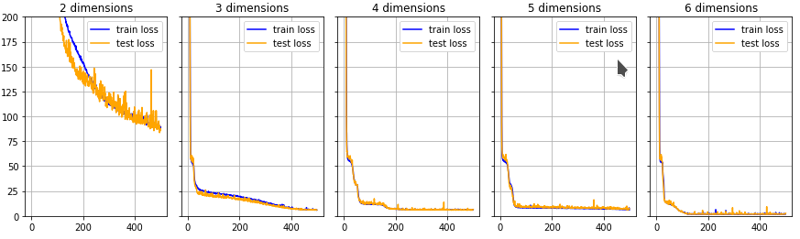
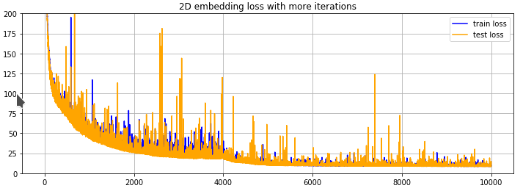
Autoencoder: Encoding into lower dimensions

Slide 8
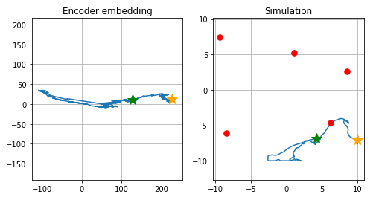
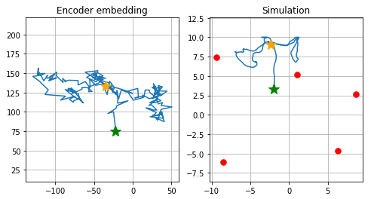
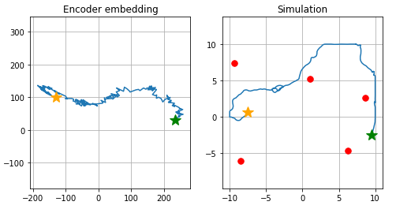
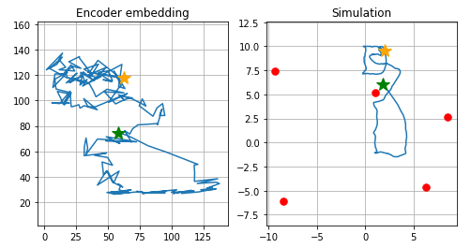
2D embedding

Slide 9
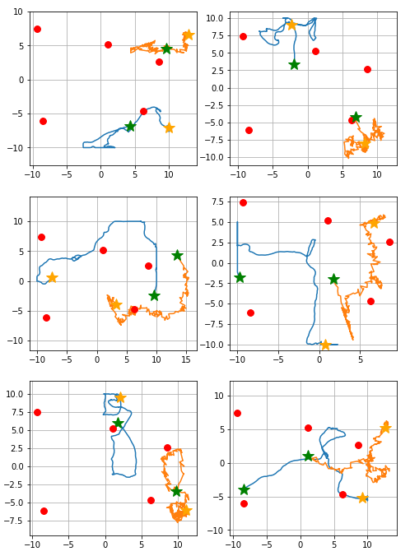
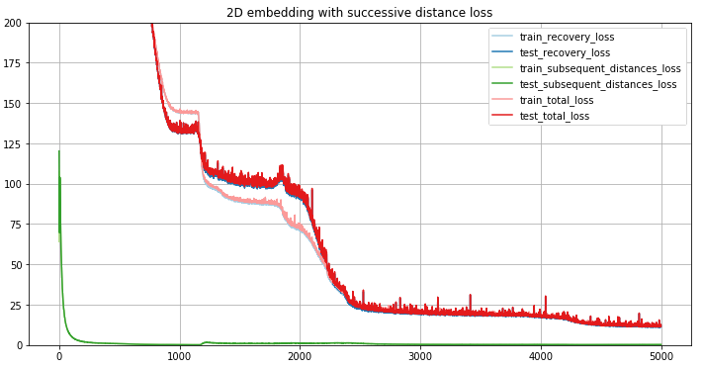
Adding constraints: Small steps
Assumption: two successive points are close together.
→ Penalize big successive distances

Slide 10
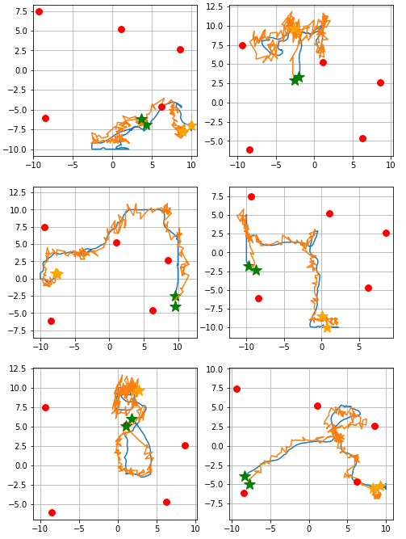
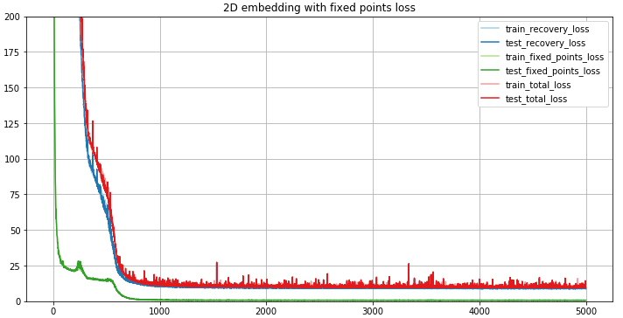
Adding constraints: Align the prediction shape
Correct the simulation shape with some known positions

Slide 11
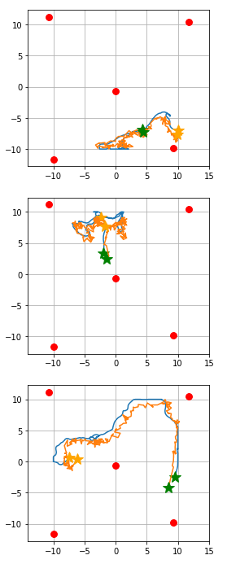
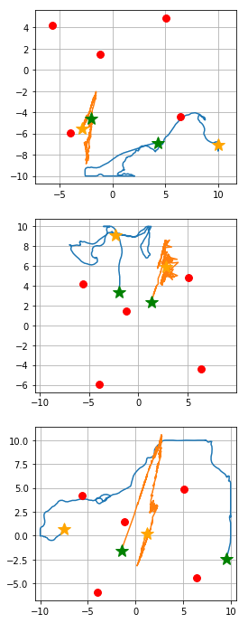
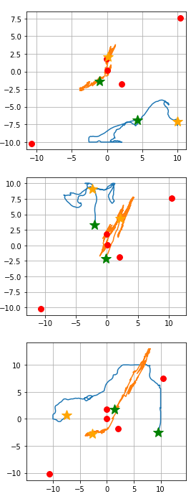
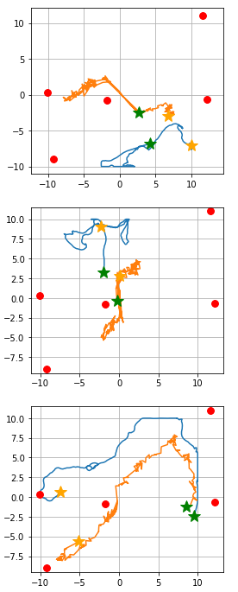
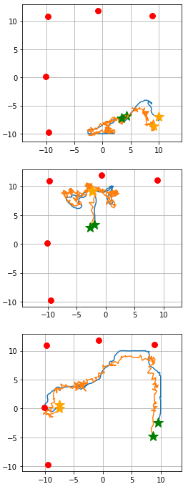
Performance in specific configurations
Experiment 1
Experiment 2
Experiment 3
Experiment 4
Experiment 5

Slide 12
What’s next
Experiment on real data
  Adapt solution to take multiple modalities
Experiment with more complex autoencoder architectures
  Might embed more information
  Add more constraints
Experiment with time-dependent architectures

