Slide 1
Numerical resolution of partial differential equations (PDE)
Sébastien Charnoz & Andrea Ciardi
University of Paris
Références :
Numerical Recipes in Fortran, Press. Et al. Cambridge University press
http://homepage.univie.ac.at/Franz.Vesely/cp0102/dx/dx.html

Slide 2



Many problems in physics are described by evolutionary equations which involve several parameters (t and x most often)
Wave equation
Diffusion equation (heat)
Shrodinger’ equation
Etc…

Slide 3
Because they involve several parameters, the differential equation involves partial derivatives w.r.t. the parameters
Wave equation
Heat equation
Shrodinger esquation
« PDE » = « Partial Differential Equation »
Means : 2, or more, parameters at the denominator of the derivative

Slide 4
Their resolution is more complex than single-parameter equations (ODE), and involve several grids because it will be necessary to discratize all parameters
For example: A 3D grid for space and a 1D grid for time
Resolution techniques change a little depending on the size of the problem
We will deal here most often with 1Dx1D systems: 1 dimension of space and 1 dimension of time.
But the methods are mostly the same in N dimensions.
Like with ODEs, we will encounter problems with: * accuracy * speed * stability
We will look for in priority :
Stability
Then : accuracy
Then : speed

Slide 5
There are two main methods of resolution
Either we work in the "physical" space (real space) and the methods will be either :
Finite difference (the basics)
Finite volumes (mass conservative method)
Finite elements (mass conservative method)
Either we work in the Fourrier space (decomposition of functions on a eigen base) and the methods will be called « spectral ». We're working on a finite base (so incomplete) solutions on which solutions will decompose. So we'll have a grid that will contain the terms of the decomposition in the eigen space.
We will study here the method of « finite differences », the most basics, but
The most widespread

Slide 6
To begin with: : The advection equation …
simple but displays a lot of important concepts
The advection equation describes how a quantity is transported in a current (e.g. a poluant in water). It is an HYPERBOLIC equation. U (x,y,z,t) - concentration of an element at the position (x,y,z) at time t
Total derivative
Pollution production at the moment t at the r position
"v scalar product with gradient of u"

Slide 7
If we only look at the case at 1D And if the water speed is constant - C Then the advection equation becomes:
Source term.
=0 if nothing is added to the system
partial derivative
w.r.t time
partial derivative w.r.t
space
We will first study some properties of this equation to be inspired on how to solve it numerically

Slide 8
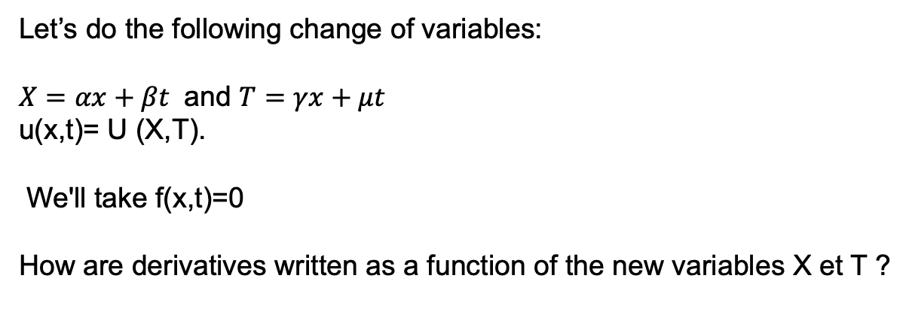
Studying the solution of advection equation
Hyperbolic equations have : Characteristic curves
A remarkable property of the advection equation (found also in the wave equations) is that the solution propagates linearly at speed C.
This is called a « characteristic curve ».
This property is going to be very useful for us.
Let’s do the following change of variables:
$X=αx+βt$ and $T=γx+μt$
u(x,t)= U (X,T).
We'll take f(x,t)=0
How are derivatives written as a function of the new variables X et T ?

Slide 9
So how does the advection equation is rewritten?

Slide 10
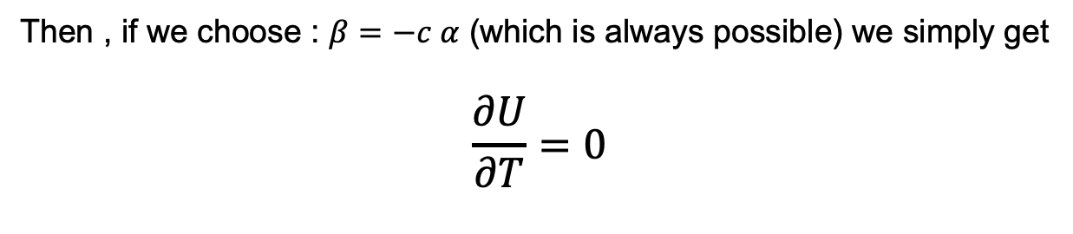
The equation is as follows :
Then , if we choose : $β=−c α$ (which is always possible) we simply get
$$\frac{∂U}{∂T}=0$$
Then U(X,T) = U(X) only
Therefore u(x,t)=U(X)=u(αx-cαt,t=0)=u(x-ct,t=0)
So u stay constant (=U(x,t=0)) along the lines with equations
x-ct=cste ⬄
t=x/c+ cste

Slide 11
t=x/c+a0
t
t=x/c+a1
t=x/c+a3
t=x/c+an
0
x
X_{min}
X_{max}
These lines (with slope 1/C) are called « characteristic curves » of the advection equation . T
the solution u (x, 0) propagates along these straight, at speed C
What is u(x,t) ? if x-ct=a then u(x,t)=u(a-ct, t=0)
If a-ct falls outside the definition domain X initial =[X_{min},X_{max}], then we need
a bounday condition ⬄ si (a-ct) ∉ =[Xmin,Xmax] alors u(x,t)=ϕ(a-ct)

Slide 12
Example: Suppose U (x.0) is like that :
So U (x.0) propagates at speed c
X
t
Caractéristic curve
X_{min}
x
X_{max}
The same behaviour is found in the sound equation Note that the initial data U (x.0) is evacuated after a time (Xmax-Xmin)/c Which is the crossing time of the resolution domai. So we need to choose boundary conditions.

Slide 13
This property of propagation of the initial state along the « characteristic curves » will impose serious constraints on numerical resolution.
It can also be used as a criterion to check the validity of the solver.
How to builf the numerical resolution
of the advection equation ?
i.e.
How to advance the solution in time, with steps dt ?

Slide 14
THE GRID
The 1D advection equation is solved on a spaceXtime grid, so each box (or ‘cell’) has dimensions : dx x dt
T
x_{j}=a+jdx et dx=(b-a)/J
t_{n}=ndt et dt=T/N
J=nb of cells in X
N= nb of cells in T
u^{n}_{j}
Let U^{n} _{j} the numerical approximation to u(x_{j}, t_{n})
The initial state of the system is U⁰_{j} for all j = u(x_{j},0)
dt
a
b
0
dx

Slide 15
Let's agree on the symbols and notation
time
n
U
j
space
n=0 : initial condition
j=0 ou J+1 : boundary condition
n goes from 0 to N
j goes from 0 to J
The evolution of the system will be done by gradually calculating values U^{n+1}_{j} for all J frome the knowledge of U^{n}_{j}

Slide 16
Resolution using finite differences
The simplest method is that of finite differences: approximation of derivatives by finite differences
The equation to be solved is
Let's apply order 1 methods :
How to compute d U^{n}_{j}/dt ⬄ d u(x_{j},t_{n})/dt ?
How to compute d U^{n}_{j}/dx ⬄ d u(x_{j},t_{n})/dx ?

Slide 17
At first order, we can just useTaylor Expansion:
Explicit forward diference :
D⁺ (f_{k})=f_{k+1}-f_{k}
Explicit backward diference :
D⁻ (f_{k})=f_{k}-f_{k-1}
If C >0, then the choice of D- (backward difference) is physically motivated by the fact that the information moves forward
from j to j+1 (in space).
In other words the « solution moves to the right »
(because C>0) so it is better to use backward difference that
Uses the left value to compute the right one

Slide 18
Here is the 1st order in space and time , explicit, integration scheme
“UPWIND SCHEME”

Slide 19
Note that at the edges of the system U^{n}_{J+1} et U^{n}₀ are given by the boundary conditions of the problem
We note:
What is the condition of validity of the scheme on σ ??
In what conditions for σ will we obtain physical solutions ?

Slide 20
We note that the system at U_{j}^{n+1} comes from the propagation of U_{p}^{n} following the characteristic curve. Note that x_{p} is between x_{j-1} and x_{j}
t_{n+1}
U_{j}^{n+1}
dx-cdt
p
t_{n}
U_{j-1}^{n}
U_{j}^{n}
cdt
t_{n-1}
Characteristic curve
x_{j-1}
X_{j+1}
We shoud have U_{j}^{n+1}= U_{p}^{n} with X_{p} between x_{j-1} et x_{j}
The integration scheme proposes : U^{n+1}_{j}=U_{j}^{n}-cdt/dx (U^{n}_{j}-U_{j-1}^{n})
We did well to take D- for the spatial derivative because the informatio, comes well from the left!!!
But what happen when the information comes from between two cells ?
x_{j}

Slide 21
Since U_{j}^{n+1}=U_{j}^{n}-cdt/dx (U_{j}^{n}-U_{j-1}^{n})=(1-σ) U_{j}^{n} +σU_{j-1}^{n}
U_{j}^{n+} is just a linear interpolation of U_{p}^{n} using U_{j}^{n} and U_{j-1}^{n}
U_{j-1}^{n}
U’_{j}^{n}
U_{j}^{n}
dx-cdt
cdt
For interpolation to be accurate x_{p} must be very close
to x_{j} or x_{j+1} . In the middle of the segment the interpolation
Is the worst. So cdt << dx => σ << 1 :
« COURANT » CONDITION ( or CFL)
(CFL : Courant-Friedrichs-Levy)

Slide 22
The CFL condition is.. very common when you integrate PDEs. It is always found in one form or another It can be understood as follows: If C is the speed of transmission of the info. If dx is the space step If dt is the time
The dt time step must be much shorter than the time to transmit the information on a length dx: dt <<dx/c ⬄ cdt/dx << 1 CONDITION CFL

Slide 23
Dr. Richard COURANT
German-American mathematician
Göttigen Univ.
NYU (New-York)
Worked with David HILBERT
Died 1972

Slide 24
Numerical implementation: Matrix writing
U^{n+1}_{0<j<J} =U^{n+1}
U^{n}_{0<j<J} =U^{n}
Vector state of the system at time T=(n+1)dt
Vector state of the system at time T=n dt
We also know that : U_{j}^{n+1}=(1-σ) U_{j}^{n} +σU_{j-1}^{n}
How to write the solver in the form U^{n+1}=AU^{n} with A a matrix ?

Slide 25
Simple matrix relationship between U^{n+1} and U^{n}
CL=“boundary condition”
A is a bi-diagonal matrix
Boundary conditions (CL)?
If the limit condition is then fixed we can imposes U^{n+1}₀=cst & U^{n+1}_{J}=cst
Important
Memory storage

Slide 26
Boundary Conditions
Boundary condition in time :
N:0 => Initial state
Boundary condition in space for j=0 (left edge) or J=J (right edge):
To be defined.
Periodic : the most simple U(j=J)=U(j=0)
Non periodic : if the domain is bounded, then many things are possible:
* Reflective : U(J=J-1, N+1)=U(J=J,N)
* Absorbing U(J)=0
etc…
For an infinite domain with “open” boundaries, interpolations are possible
for outgoing fluxes, but you have to define what happens for an ingoing flux
(for example at j=0).
Note : Since information is propagating from left to right (C>0) we may not need to impose a boundary conditions for U(j=J) because we have all information to compute U(j=J) from U(j=J-1).

Slide 27
How do we proceed step by step
Initialize U⁰, dx, dt, c
Calculate U^{n+1}=A U^{n}
CL: Put U₀^{n+1}= cste for boundary conditions
back to 2

Slide 28
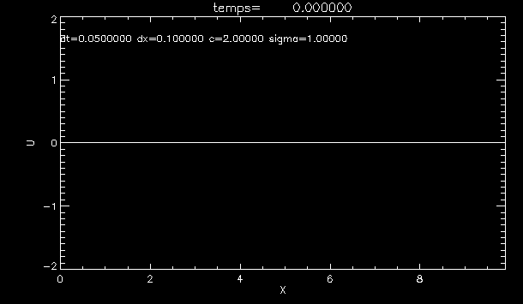
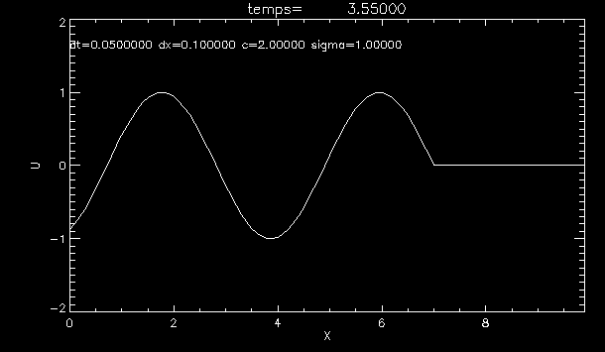
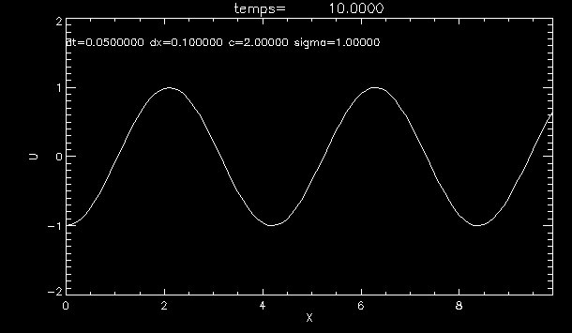
Exemple
Boundary conditons:
U(j=0, t)= sin(t)
We shoudl see a sinus wave
Propagating to the right.
Sigma=1 here
(specific case that works here)
Pathological case sigma=1, exact solution Ujn-1-Uj-1n..., specific to THE UPWIND sigma=1, in practice IMPOSSIBLE ..

Slide 29
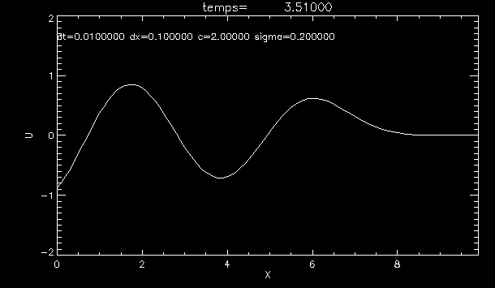
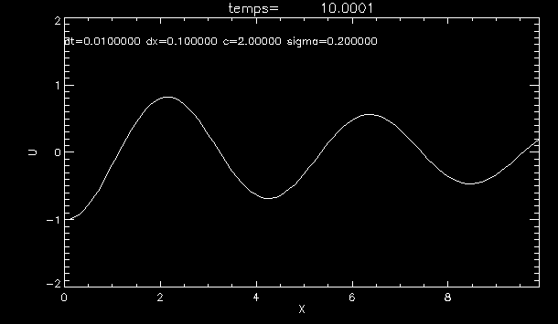
A more realistic case :
Let’s take dt=0.01
=> sigma=0.2
What happens ?

Slide 30
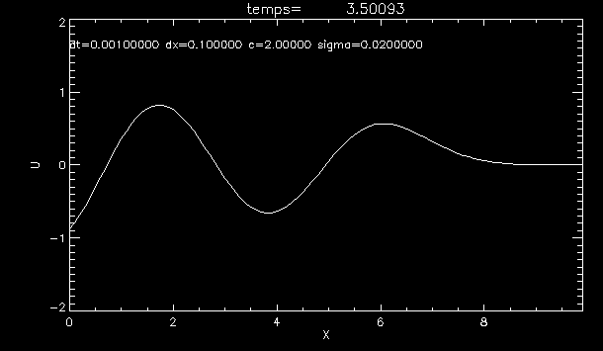
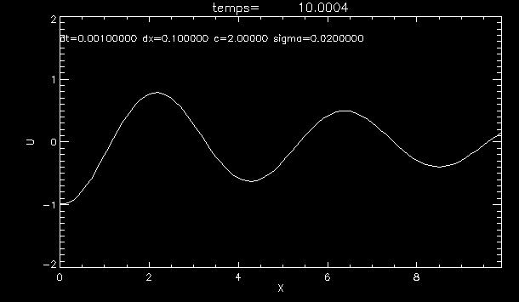
dt=0.001
sigma)=0.02
We observe « numerical dispersion»
Or « numerical damping »
=>
Artificial diffusion intrinsic to the numerical scheme

Slide 31
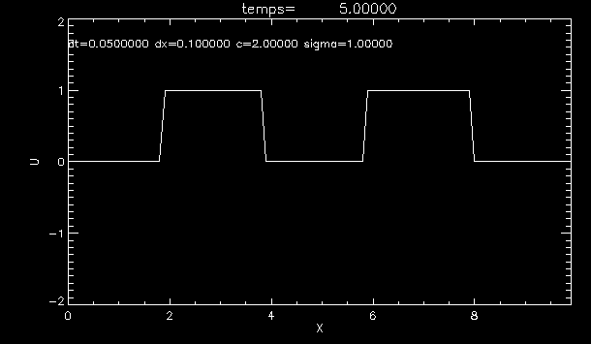
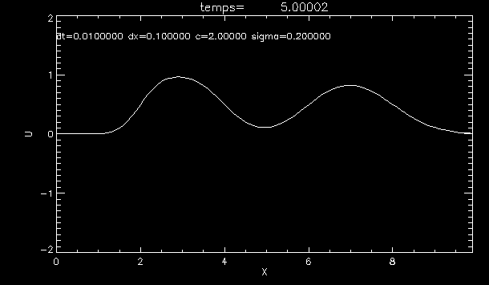
Another examples :
2 Top-hat functions as initial state
U(j=0,t)=0 at all times
Dt=0.05 sigma=1
Dt=0.01
Sigma=0.2

Slide 32
Numerical dissipation…. Where are you from ?
Our derivatives are too aproximatives....
Let’s check the 2nd order taylor development
TRUTH
UPWIND SCHEME
approximation
truth
By neglecting the 2nd order term in our approximate derivative, we introduce
Artificially a 2nd order “parasitic” term in our numerical approximation that behaves like a diffusion process (like viscosity) that “smoothes” the solution artificially.
We will do better later…

Slide 33
Stability Analysis: Von Neuman Method Let’s check upwind’s method stabitily (not easy !)
One must consider the transformation of Fourrier ' Spectral approach' Approche spectrale
We decompose U^{n}(x) on a (sinus, cosinus) base
Considering that U^{n}_{j}= U^{n}(x_{j}) avec x_{j}=j dx
The wavelength of the k mode is λ=L/k
k = number of times that the mode enters in the box of length L

Slide 34
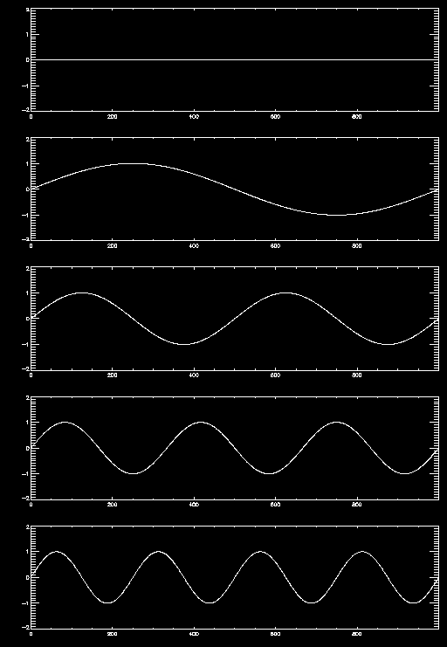
Decomposition a solution on eigen basis of modes
domain : 0 < x < 1000
K=0
K=1
K=2
K=3
K=4 etc…
spectral approach: work on f rather than on the U

Slide 35
We then consider the evolution of f^{n}_{k} which are the coefficients of each mode.
Over time: f ^{n+1}_{k}= g(k) f ^{n}_{k ,} g(k) is the amplification factor
Stability ⬄ || g(k) || < 1 for any k
We're looking at whether the modes are amplified or not

Slide 36
How does the upwind scheme translate into a fourier base?
Integration scheme
We replace U with his FT
Find the amplification factor of the k mode : u_{k} ^{n+1} = g(k) u_{k}^{n}

Slide 37
Stability: if ||g(k)|| < 1 for any k ⬄ SIGMA less than or equal to 1
We still find the CFL condition
Our pattern is stable but dispersive We also see that there is a coupling of the modes
=> origin of the dispersion

Slide 38
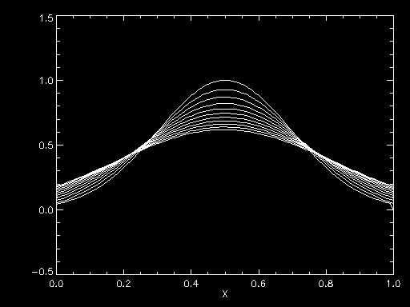
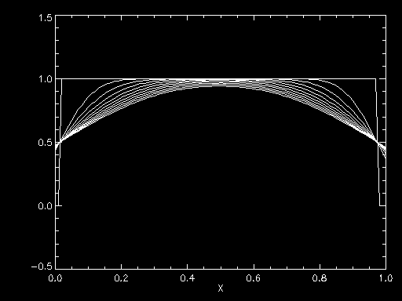
Sigma=0.2
Evolution of a Gaussian pulse
(note : the gausian is moving to
The right be here I have just
Recentered all of them for easy
Comparison)
Top hat evolution

Slide 39
Conclusion on the UPWIND scheme:
A UPWIND scheme to solve the advection eqaution is easily obtained by writing.
The scheme must respect the natural direction of transport of the information
(forward or backward difference in space)
time
If C>0
space
If C< 0
It is stable if the CFL condition is met But it is dispersive(« smoothing » of solutiions) It is mainly used to propagate functions with sharp edges (shock waves)

Slide 40
Exploring other integration schemes: 1) Higher order explicit 2) Implicit schemes

Slide 41
Using Taylor's development to design other integration schemes
J-1
j
J+1
Taylor expansion at X_{J}+dx
Taylor expansion at X_{j} - dx
2nd order method
« central difference»
2nd order accurate !
The same Reasoning on time gives :

Slide 42
NOTE :
This new expression is actually the average of Right and Left derivatives.
Indeed the centered drivative is also rewritten ;

Slide 43
We can continue the game for higher orders
3nd order accurate !
This is a 4 points forward method : the « stencil » goes from j-1 to j+2
Etc…

Slide 44
But these methods involve seeking information further "away" in time or space.
Step N-1 must be stored in memory
Let's build new diagrams for the advection equation, order 2 to time and in space
NEW INTEGRATION SCHEME?

Slide 45
Full method 2nd order space and time method :
New Integration Algorithm
Notice the simplicity.. But requires more memory
We « jump » over position j,and n
This method is called "leap-frog" or " sheep jump " in French (.... and not frog jump...)

Slide 46
Implementation of the Leap-Frog
Problème : How to Calculate the 1st time step (N=1) because we don't know The system at n=-1.
Solution: Take the first step with a UPWIND, and then continue with LEAPFROG
1st step with upwind
Initialize the systemdt,dx,U0
compute U1= A_{upwind}U0
3. compute U2=A_{leapfrog}U1+U0
U0=U1 et U1=U2
Go back to 3
Next step with leap-frog
Keep in memory U^{n-1}

Slide 47
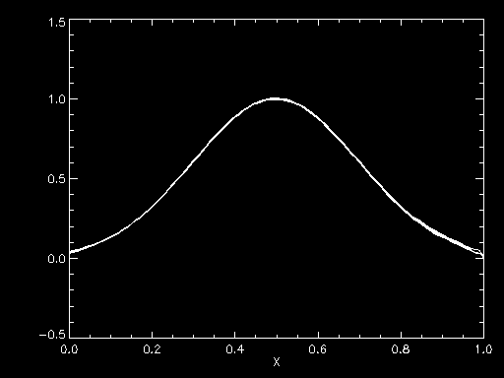
Comparison upwind Vs leap frog, sigma=0.2
Gaussian pulse
Upwind
Leap Frog
the leap-frog seembs better!!
Is it always the case?

Slide 48
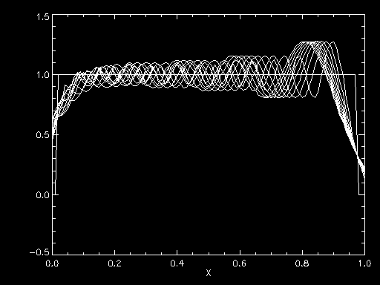
Not always... When the function is very steep and sharp the Leap-Frog can becomes somewhat unstable. So choose sigma << 1
Evolution of a top-hat impulse
upwind
Leap frog
This can be checked with Von Neuman stability analysis

Slide 49
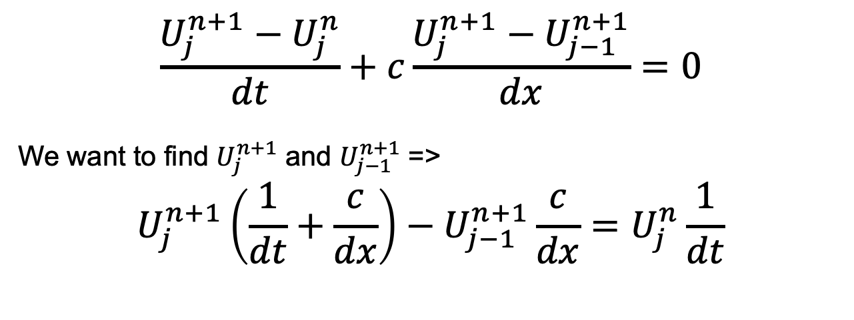
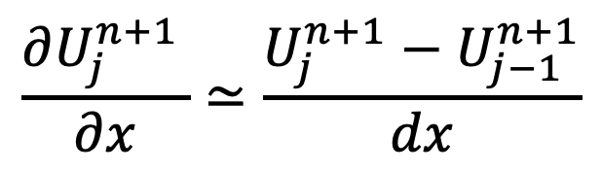
Implicit Method:
Building a simple first order implicit method
Space derivative is evaluated at time N+1
(ant not tim N)=> it is then an implicit equation!
$$\frac{∂U_{j}^{n+1 }}{∂x}≃\frac{U_{j}^{n+1}−U_{j−1}^{n+1}}{dx}$$
So the implicit equation to solve is
$$\frac{U_{j}^{n+1}−U_{j}^{n}}{dt}+c\frac{U_{j}^{n+1}−U_{j−1}^{n+1}}{dx}=0$$
We want to find $U_{j}^{n+1}$ and $U_{j−1}^{n+1}$ =>
$$U_{j}^{n+1}\left(\frac{1}{dt}+\frac{c}{dx}\right)−U_{j−1}^{n+1}\frac{c}{dx}=U_{j}^{n}\frac{1}{dt}$$

Slide 50
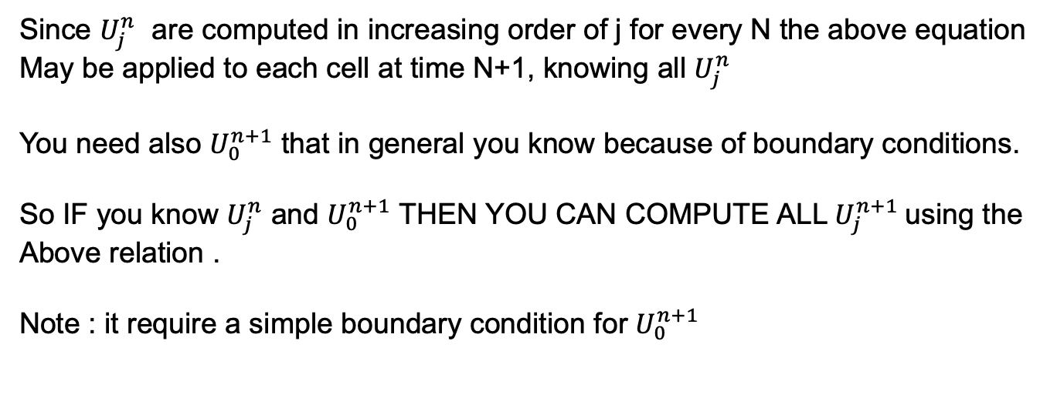

$$U_{j}^{n+1}\left(\frac{1}{dt}+\frac{c}{dx}\right)−U_{j−1}^{n+1}\frac{c}{dx}=U_{j}^{n}\frac{1}{dt}$$
First methode : Iterative (no matrix)
$$U_{j}^{n+1}\left(\frac{1}{dt}+\frac{c}{dx}\right)=U_{j}^{n}\frac{1}{dt}+U_{j−1}^{n+1}\frac{c}{dx}$$
Since $U_{j}^{n}$ are computed in increasing order of j for every N the above equation
May be applied to each cell at time N+1, knowing all $U_{j}^{n}$
You need also $U_{0}^{n+1}$ that in general you know because of boundary conditions.
So IF you know $U_{j}^{n}$ and $U_{0}^{n+1}$ THEN YOU CAN COMPUTE ALL $U_{j}^{n+1}$using the
Above relation .
Note : it require a simple boundary condition for $U_{0}^{n+1}$

Slide 51
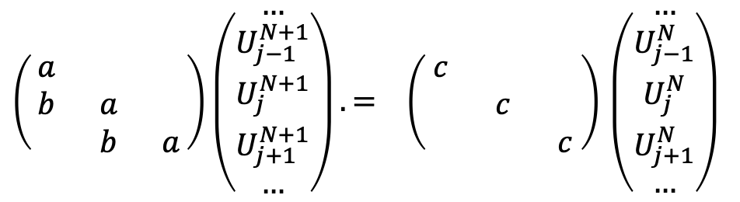
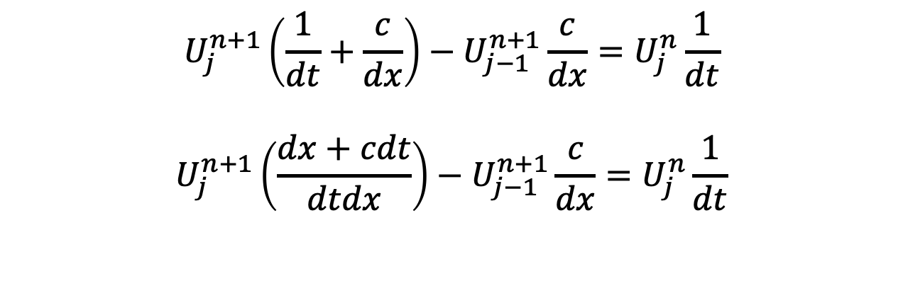



Better technics using Matrix Algebra
$$U_{j}^{n+1}\left(\frac{1}{dt}+\frac{c}{dx}\right)−U_{j−1}^{n+1}\frac{c}{dx}=U_{j}^{n}\frac{1}{dt}$$
$$U_{j}^{n+1}\left(\frac{dx+cdt}{dtdx}\right)−U_{j−1}^{n+1}\frac{c}{dx}=U_{j}^{n}\frac{1}{dt}$$
Let define : a=(dx+cdt)/dtdx , b=-c/dx , c=1/dt
We write it in matrix Form : $AU^{+1}=BU^{N}$
$$U^{N+1}$$
A
= B $U^{N}$
$\left(\begin{matrix}a & & \\ b & a & \\ & b & a\end{matrix}\right)\left(\begin{matrix}\begin{aligned}… \\ U_{j−1}^{N+1}\end{aligned} \\ U_{j}^{N+1} \\ \begin{aligned}U_{j+1}^{N+1} \\ …\end{aligned}\end{matrix}\right). = \left(\begin{matrix}c & & \\ & c & \\ & & c\end{matrix}\right)$ $\left(\begin{matrix}\begin{aligned}… \\ U_{j−1}^{N}\end{aligned} \\ U_{j}^{N} \\ \begin{aligned}U_{j+1}^{N} \\ …\end{aligned}\end{matrix}\right)$

Slide 52

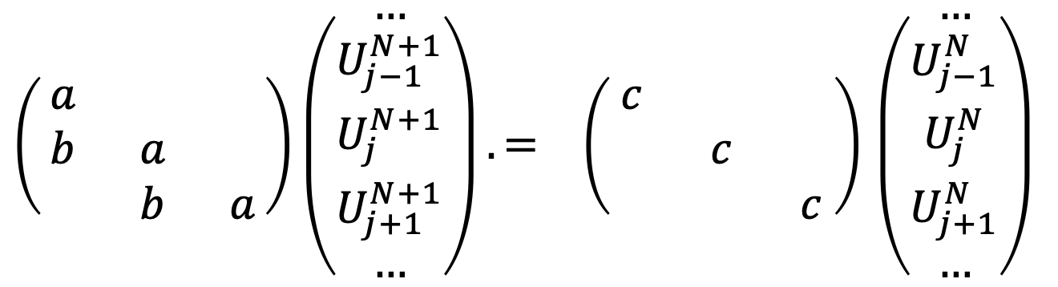
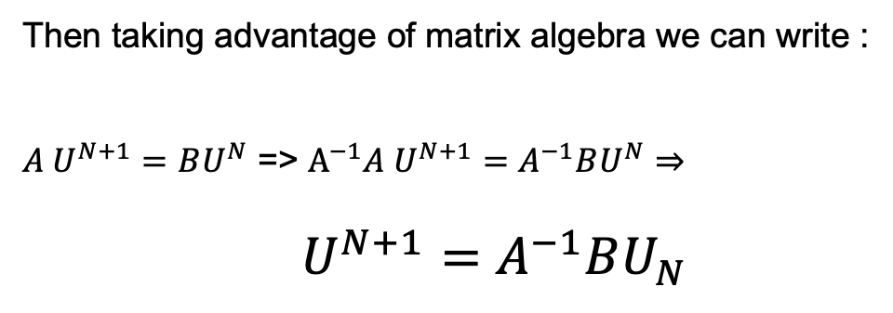

$$U^{+1}$$
A
= B $U^{N}$
$\left(\begin{matrix}a & & \\ b & a & \\ & b & a\end{matrix}\right)\left(\begin{matrix}\begin{aligned}… \\ U_{j−1}^{N+1}\end{aligned} \\ U_{j}^{N+1} \\ \begin{aligned}U_{j+1}^{N+1} \\ …\end{aligned}\end{matrix}\right).= \left(\begin{matrix}c & & \\ & c & \\ & & c\end{matrix}\right)$ $\left(\begin{matrix}\begin{aligned}… \\ U_{j−1}^{N}\end{aligned} \\ U_{j}^{N} \\ \begin{aligned}U_{j+1}^{N} \\ …\end{aligned}\end{matrix}\right)$
Then taking advantage of matrix algebra we can write :
$A U^{N+1}=BU^{N}$ => $A^{−1}A U^{N+1}=A^{−1}BU^{N}⇒$
$U^{N+1}=A^{−1}BU_{N }$
So implicit scheme requires a matrix inversion
But we now KNOW HOW to compute U^{N+1} as a function of U^{N}

Slide 53
A popular Implicit Method: Cranck-Nicholson
They are unconditionally stable.
Order 2 in space and Order 2 in time
Idea: Make time averages (rather than space average)
N+2
N+1
N
N-1
time
J-2 j-1 J J+1
space
Implicit scheme

Slide 54
By grouping the terms into U^{n+1} with U^{n}

Slide 55
So implicit scheme requires a matrix inversion:
On prendra comme condition limite : U(j=0)=0, et U(j=J_{max})=0

Slide 56
Cranck Nicholson Stability:
So the g(k) norm is 1 for any k, so it's a method unconditionally Convergent.
It is suitable for very smooth problems, but produces spurious oscillations where there are discontinuities.

Slide 57
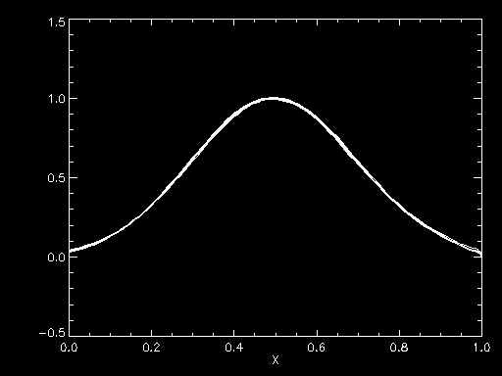
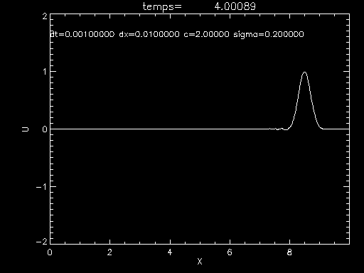
Evolution of the solution The solution is stable Here we have 1000 cells in x Notice the small oscillations at the base of the peak

Slide 58

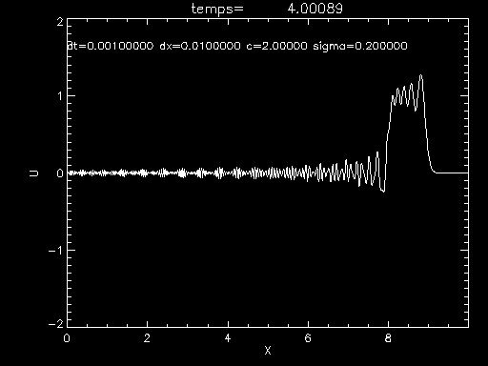
But for a function discontinuous, we get Oscillations (here a top-hat function) .............

Slide 59
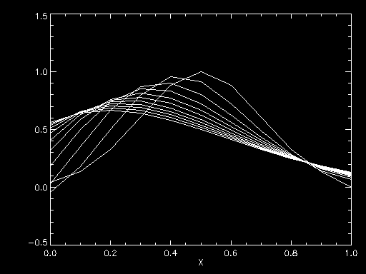
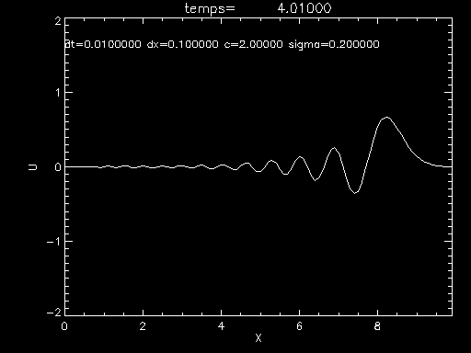
Let's take over the Gaussian function, but let's reduce the number of cells in X
Evolution of function global view
We see that when we decrease the nb of boxes in X, the function becomes more discontinuous and spurious oscillationsappear

Slide 60
Cranck Nicholson est souvent une bonne méthode
Mais plutôt pour des fonctions douces
Pour une fonction très discontinue, on utilisera plutôt la méthode upwind

Slide 61
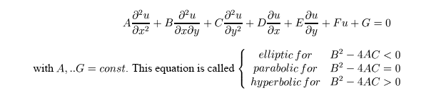
The classification of partial derivatives equations of order 2:
General form of a second-order equa.diff: u is a vector: (x1, x2, ...,xn)
If G=0 , the equation is called "homogeneous."
We're calculating The "Discriminant": The sign of Δ gives us the type of equation

Slide 62
if Δ> 0 then the equation is Hyperbolic : (A>0, B=0, C<0 => B²-4AC>0)
Wave propagation :
Advection Equation:
if Δ = 0 the equation is called Parabolic : (A=0, B=0, C>0 => B²-4AC=0)
Heat diffusion:
Shrodinger Equation :
Si Δ<0 the equation is called Elliptical : (A>0, B=0, C>0 => B²-4AC<0)
Laplace Equation
Poisson Equation :
ρ= charge density, V: electric potential

Slide 63
Second order derivatives
Many equations in physics involve a second order derivative. It can be approximated with the same type of reasoning as for the first derivative
Once again we are inspired by the Taylor’s expansion...

Slide 64
So we find:
FORWARD difference
By shifting the position, we can find other approximations
BACKWARD diference
CENTERED difference (order 2!)
The same formulas apply for time derivatives (replace x by t) Note that the CENTERED difference is always better (order 2)

Slide 65
Cross derivatives can also be calculated in the same way: Example
FORWARD difference
BACKWARD difference
CENTERED difference
Once again the centered diferences are of order 2

Slide 66
HYPERBOLIC equations
We have already studied the advection equation
Another example: the propagation of the sound waves
These equations have all "characteristics" , they propagate an initial condition.
Order 2 methods work well for soft functions
For stiff functions one would prefer a 1"UPWIND" method
See course

Slide 67
PARABOLIC equations (or diffusion equation). Quite simple to solve in general
Example: heat equation (Fourrier)
λ=thermal diffusivity
Simplest Method: Explicit
Time: forward difference Space: centered difference
We replace and find the scheme:
Note the new expression of 𝜎 (CFL)

Slide 68
Stability? VON NEUMAN METHODE again u_{k}^{n+1} = g(k) u^{n}_{k}
By pooling term to term we find

Slide 69
A condition close to the courrant condition (CFL) is again found
In practice: this explicit method is therefore STABLE if CFL is respected, however As it is only order 1 in time it is very diffusive and not very good
What means dx²/2λ ?
λ is the coefficient of diffusion In kinetic theory, gases are shown (see the course on the ideal gases) that the time it takes to diffuse over a distance dx is: dx^2/ λ ... So it's a physical quantity. This is the new Courrant condition (CFL) for heat.
Lecture on heat diffusion : www.unice.fr/lpmc/bdd/suprex/ download/Cours-thermo-ch3.doc

Slide 70
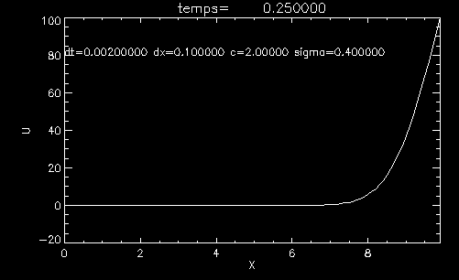
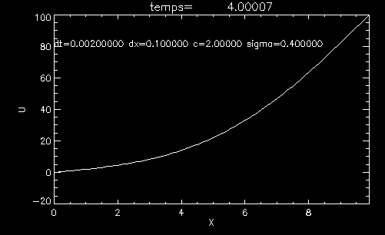
Ex: heat diffusion in a bar
here SIGMA=0.4
Not bad…
What if we increase the time step ?

Slide 71
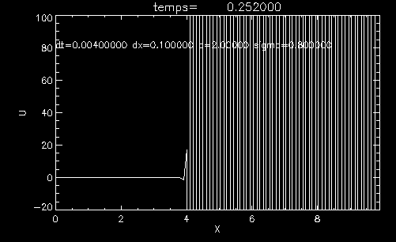
here SIGMA=0.8
…. Results is violently wrong…
Implicit methods work better

Slide 72

Implicit Method of Order 1 (in time)
Time : idem
Space : same as before, but
Taking time n+1 (implicit)
We get the following equation , that must be solved (implicit)

Slide 73
To solve, we take a matrix approach again
With A :
Matrix again tri-diagonal easily inversible
Attention will be paid to the boundary conditions when integrating

Slide 74


Stability? Von Neuman's method again
It is found that
threrefore || g(k)|| ² < 1 in all circumstances - unconditionally stable
Small time step, sigma=0.4 big time step: sigma=1.2
Here we can clearly see the superiority of the implicit method

Slide 75
Cranck Nicholson (very popular solver)
Time : as usual
Space : we average at time n-1 and n+1
In fact it's a 2-order scheme at time time n+1/2 (magic trick !!)
We get
That one writes using matrices:

Slide 76
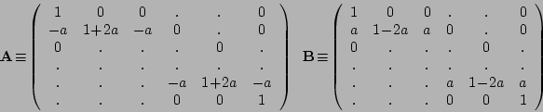

It will therefore be necessary to calculate A⁻¹. If you define C=A⁻¹B we then get The simple relationship U^{n+1}= C U^{n}
Ici σ=a
Stability : ||g(k⁾||²⁼
TESTS: it works well, it's more accurate than previous methods

Slide 77
ELLIPTICAL equations (or boundary conditions problems)
Elliptical equations do not depend on time. They only depend on boundaries. For example: Equation for Electric Potential
laplacian
U is the potential field, is the distribution of electrical charges in space
We encounter the same type of equation in fluid mechanics: For a permanent, viscous, non-turbulent flow, incompressible, we have:
Poiseuille flow

Slide 78
In any case, we can see that time does not play .
This means that one calculates A FIELD : you have to calculate the value of U for all space point.
For example the potential field, the speed field, the gravitational field etc...
This field depends solely on its boundary conditions: The distribution of loads, masses, flow at the edges of the domain etc...
These problems are called » Boundary conditions problems »
They are usually quite complex to solve. We'll fly over them quickly
There are a few matrix methods, but the best are the methods spectral, i.e. where the system is resolved in the Fourrier space and then converted in real space.

Slide 79

Example: Let's solve the field generated by a 2D electric charge
Taking the expression of the second derivative as the second derivative, the difference centered, one Leads to an equation like this
-
Y
Electric charge at the i,j knot
i
U(i,j) is U's value at the position :
X=i x dL et Y= j x dl
j
X

Slide 80
-
Grid of charges
ρ_{ij}
Grid of potential U_{ij}
weights
: -4
: 1

Slide 81
Why it is not easy to solve an elliptical equation
Simply by using matrixes like for Heat or transport equations ?
-
How to write the solved in matric form ? Is it possible ??
L x U = C
 |  |  | 2
 | 1 |  |  | 1
LAPLACIAN
U
Charge distribution

Slide 82
Let’s have a look at the equation more closely
-
Shifting a line Down
Shifting a line Up
Shifting a column on the right
Shifting a Column on the left
To shift the lines we can multiply by:
1
 | 1
 |  | 1
 | 1
 |  | 1
 |  |  | 1
or
S⁻¹
S⁺¹

Slide 83
But to shift the columns?
The only way is to use the transposed matrix
Shifting a a column: shift the lines of the transposed and take the transposed result (S-1 A^{T})^{T}
Let's think about it....
Problem !!!! =>
Matrix transposition is NOT a linear operation
it is not possible to compute a« column shift » by a simple matrix multiplication...!!!!

Slide 84
An equation of the type : A X + B X^{T} = C is not a linear operation ….
So we can NOT simply write this problem in the form of a Simple multiplication of matrixes... You can get away with it by writing a system of N² équations with N² Unknown (so a matrix containing N4 terms)... which is long and VERY ineffective...
This would require to consider a matrix with size N²xN²=N⁴ elements !
So we see that elliptical equations are very expensive in memory and computation
Example: all problems with N body where the gravity field equation is very computationally intensive

Slide 85
Solving the Poisson equation
Slow relaxation method : the Gauss Seidel method, and Jacobi Method
-
The Gauss-Siedel method is an iterative procedure that converges progressively
To the solution by successive steps of approximation.
Let’s call U^{n} the system at step n, so that U^{n+1} = f(U^{n}). With f an non-linear
(and maybe complex transformation)
We try to find a a way that when n goes to infinity U^{n} becomes solution of the above
Equation (the poisson equation)

Slide 86
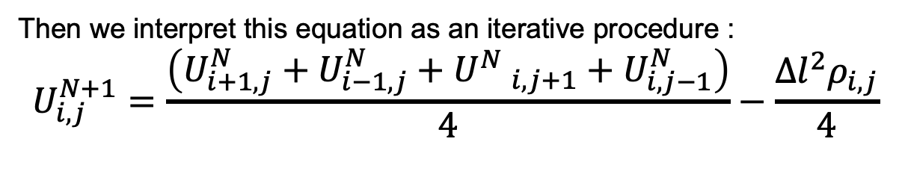
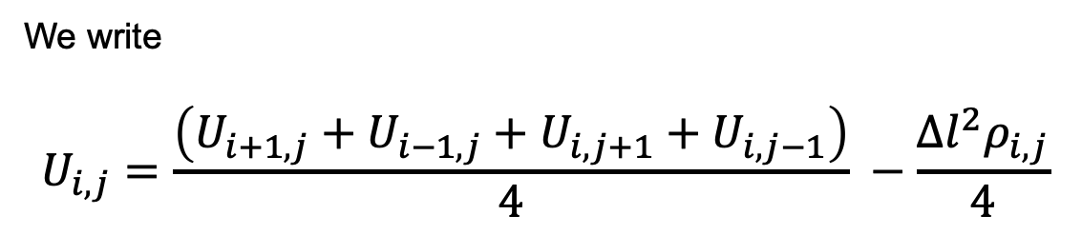
Starting from the above equation :
-
We write
$$U_{i,j}=\frac{\left(U_{i+1,j}+U_{i−1,j}+U_{i,j+1}+U_{i,j−1}\right)}{4} −\frac{Δl^{2}ρ_{i,j}}{4}$$
Then we interpret this equation as an iterative procedure :
$$U_{i,j}^{N+1}=\frac{\left(U_{i+1,j}^{N}+U_{i−1,j}^{N}+{U^{N} }_{i,j+1}+U_{i,j−1}^{N}\right)}{4}−\frac{Δl^{2}ρ_{i,j}}{4}$$
Step N+1
Step N
If U converges to the solution of the poisson equation, then the solution is the
Convergence point of the iterative procedure

Slide 87
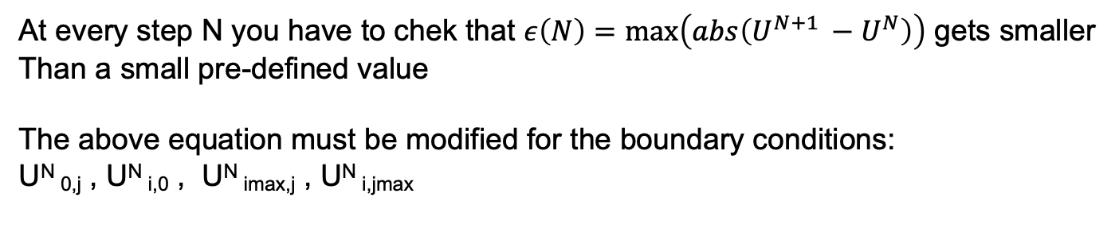
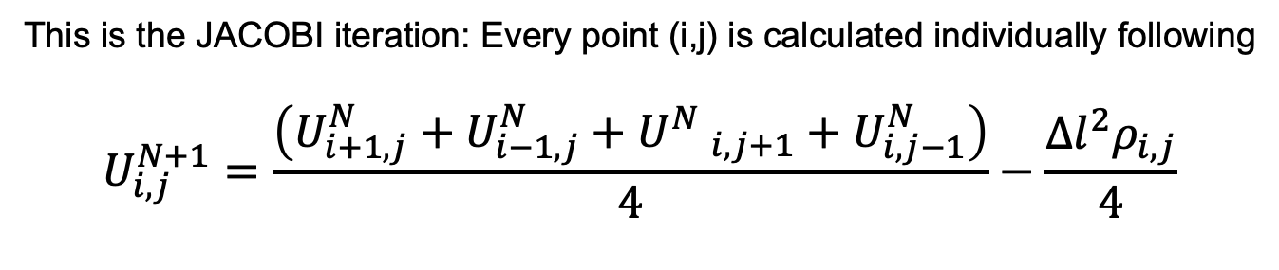
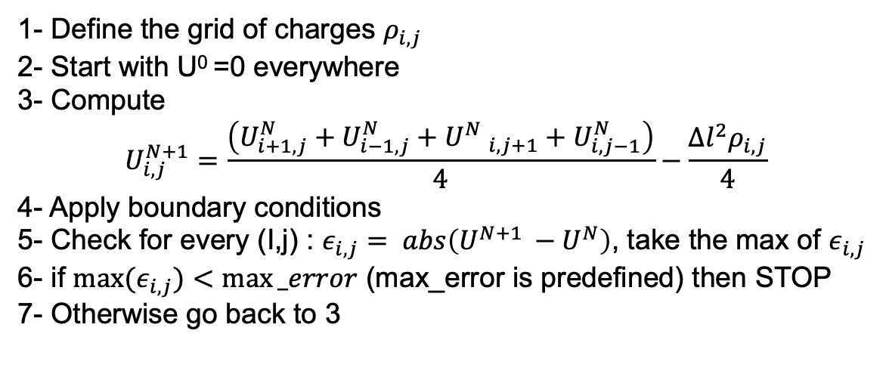
This is the JACOBI iteration: Every point (i,j) is calculated individually following
$$U_{i,j}^{N+1}=\frac{\left(U_{i+1,j}^{N}+U_{i−1,j}^{N}+{U^{N} }_{i,j+1}+U_{i,j−1}^{N}\right)}{4}−\frac{Δl^{2}ρ_{i,j}}{4}$$
At every step N you have to chek that $ε\left(N\right)=\max\left(abs\left(U^{N+1 }−U^{N}\right)\right)$ gets smaller
Than a small pre-defined value
The above equation must be modified for the boundary conditions:
U^{N} _{0,j} , U^{N} _{i,0} , U^{N} _{imax,j} , U^{N} _{i,jmax}
So the Jacobi method for solving the Poisson Equation goes as follows :
1- Define the grid of charges $ρ_{i,j}$
2- Start with U⁰ =0 everywhere
3- Compute
$$U_{i,j}^{N+1}=\frac{\left(U_{i+1,j}^{N}+U_{i−1,j}^{N}+{U^{N} }_{i,j+1}+U_{i,j−1}^{N}\right)}{4}−\frac{Δl^{2}ρ_{i,j}}{4}$$
4- Apply boundary conditions
5- Check for every (I,j) : $ε_{i,j}= abs\left(U^{N+1 }−U^{N}\right)$, take the max of $ε_{i,j}$
6- if ${max⁡(ε}_{i,j})<max⁡_error$ (max_error is predefined) then STOP
7- Otherwise go back to 3

Slide 88
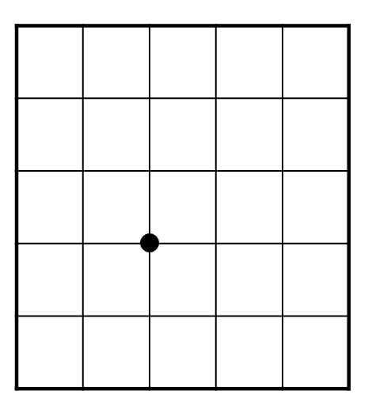
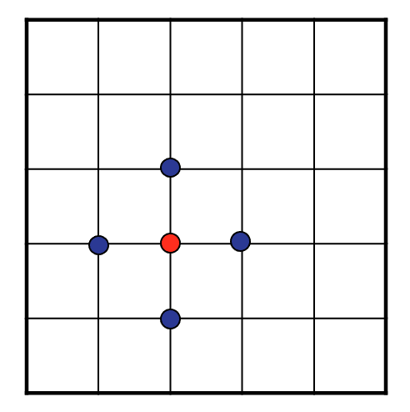
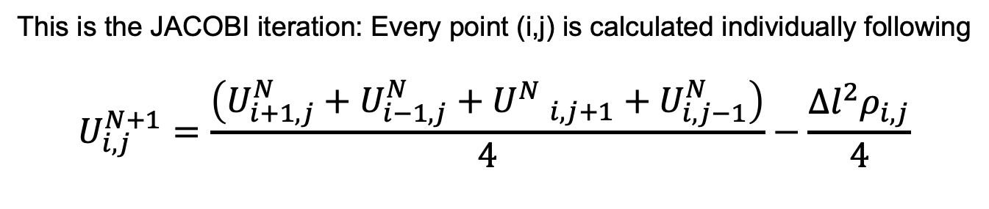
This is the JACOBI iteration: Every point (i,j) is calculated individually following
$$U_{i,j}^{N+1}=\frac{\left(U_{i+1,j}^{N}+U_{i−1,j}^{N}+{U^{N} }_{i,j+1}+U_{i,j−1}^{N}\right)}{4}−\frac{Δl^{2}ρ_{i,j}}{4}$$
U^{N}
U^{N+1}
The 4 neighbors are
Used to compute U^{N+1} for each
(I,j)
This operation is also called a
“convolution”
weights
: -4
: 1

Slide 89
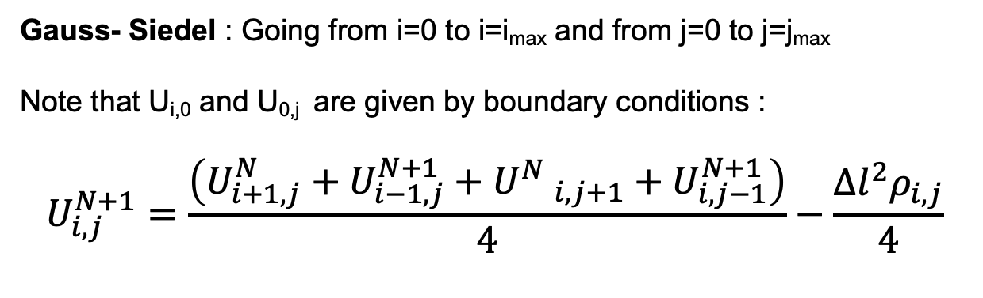
Variants : The Gauss-Seidel and and SOR method to accelerate
convergence
Gauss- Siedel : Going from i=0 to i=i_{max} and from j=0 to j=j_{max}
Note that U_{i,0} and U_{0,j} are given by boundary conditions :
$$U_{i,j}^{N+1}=\frac{\left(U_{i+1,j}^{N}+U_{i−1,j}^{N+1}+{U^{N} }_{i,j+1}+U_{i,j−1}^{N+1}\right)}{4}−\frac{Δl^{2}ρ_{i,j}}{4}$$
These 2 terms has been computed PREVIOUSLY
When computing U^{N+1}_{i,j}
So this is an implicit method

Slide 90
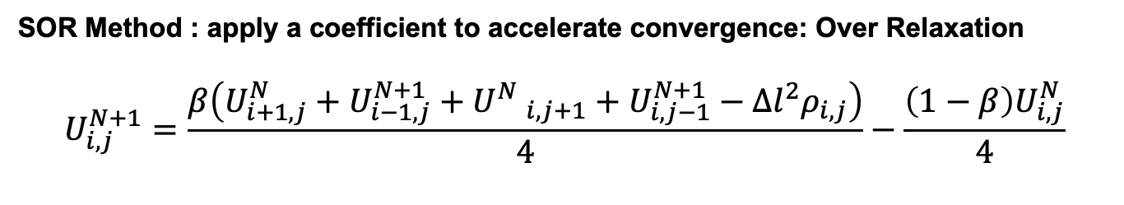
SOR Method : apply a coefficient to accelerate convergence: Over Relaxation
$$U_{i,j}^{N+1}=\frac{β\left(U_{i+1,j}^{N}+U_{i−1,j}^{N+1}+{U^{N} }_{i,j+1}+U_{i,j−1}^{N+1}−Δl^{2}ρ_{i,j}\right)}{4}−\frac{\left(1−β\right)U_{i,j}^{N}}{4}$$
With 1<𝛽<2. 𝛽 =1.5 is often a good choice.
This technics is called “Over relaxation”.

Slide 91
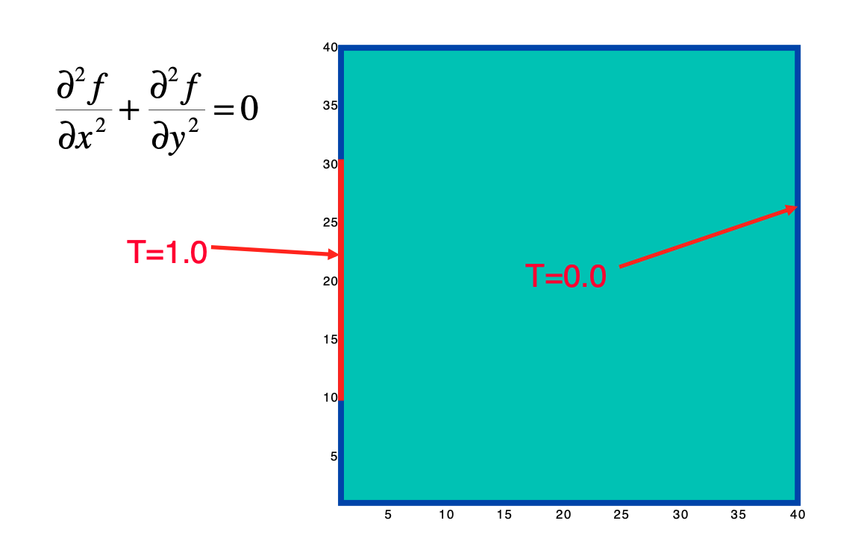
Example: solving the steady state temperature distribution in a square
Grid with boundary conditions.
The equation is Laplacian(T)=0 + Boundary conditions on the edges
Of the domain
Boundary condition
Boundary condition
The equation to solve written in finite difference is ( U=temperature at i,j):
$U_{i,j}=\frac{\left(U_{i+1,j}+U_{i−1,j}+U_{i,j+1}+U_{i,j−1}\right)}{4}$ , but on edges U_{i,j} =0 or 1

Slide 92
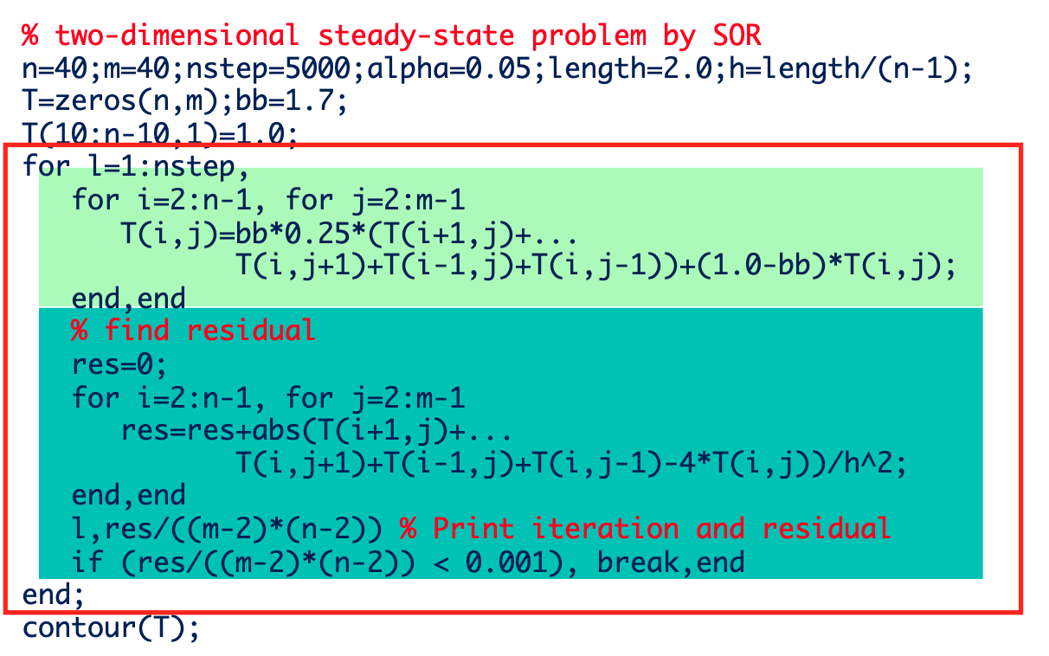
Python implementation

Slide 93
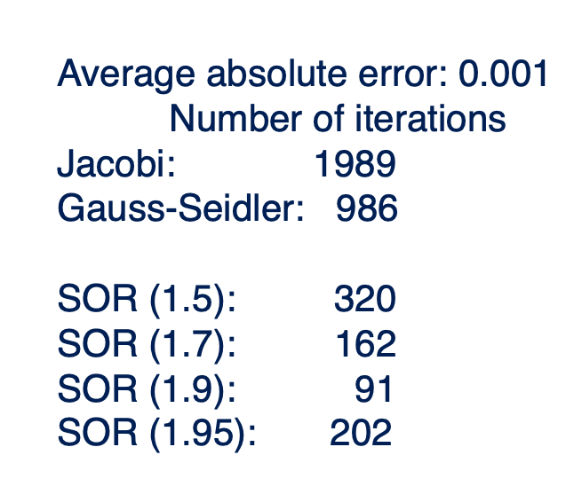

Slide 94
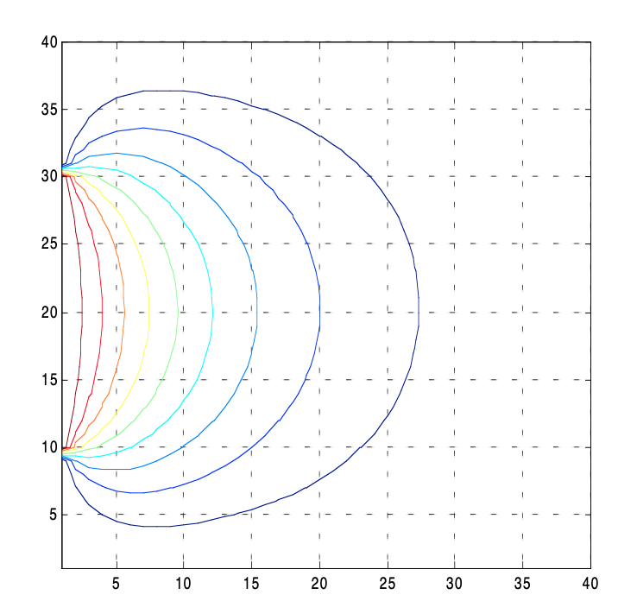
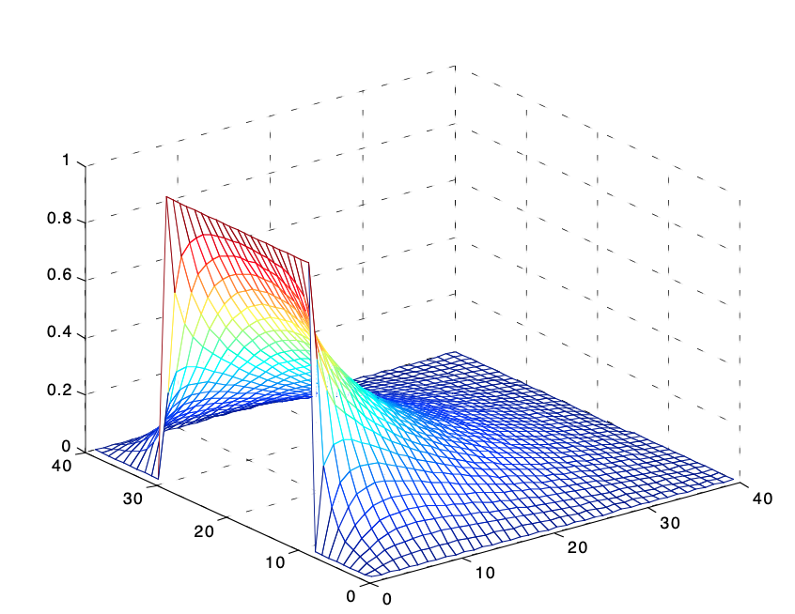
Solution after convergence
Note : you have to keep in mind that we have computed here the “steady-state” , there is NO time evolution here. The iteration (N-> N+1) “mimics” a time evolution but it is not physical.

Slide 95


Other method: Introduction to spectral methods
-
Principle: Note that this mathematical operation is actually a CONVOLUTION:
Recall on 1D convolution:
Discreet convolution : « value of f * g at point m »

Slide 96
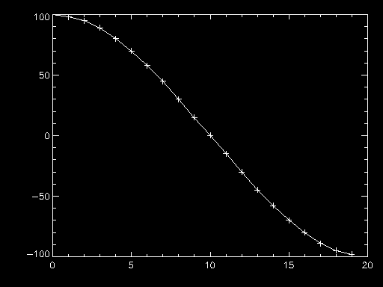
Example: Either f a series of values (one vector), here 20 values
F(m)=[100, 98,95,89,80,70, 58,45,30,15, 0, -15, -30,-45,-58 ,-70,-80,-89,-95,-98]
Convolutions This function With the function "hat"
F(x)=1/2 si -1<x<1
F(x)=0 otherwise
=> 3 points smoothing
f
m

Slide 97
Let’s do convolution with kernel G=[1,1,1] /3
since
Let C=f*g , then each point of C is replaced by the average of the 3 neighboring points of f
F(m)=[100, 98,95,89,80,70, 58,45,30,15, 0, -15, -30,-45,-58 ,-70,-80,-89,-95,-98
[1/3,1/3,1/3]
[0.,97.6,94.0,88.0, 79.6, 69.3, 57.6, 44.3, 30.0,15.0, 0.0, 15.0, -30.0, -44.3, -57.6, -69.3, -79.6,…]
Convolution can be seen as a kind of »moving" window acting on the function itself. G is called the "convolution kernel"

Slide 98
2D convolution:
We shift the « window » with the convolution kernel :
-
Laplacian
0 | 1 | 0
1 | -4 | 1
0 | 1 | 0
i
*
=
G*U
j
g
U
Laplacian of U

Slide 99

Ex :
U(i,j)= 1/i+1/j
Laplacian of U after applying convolution to every point

Slide 100
So the problem can be rewritten
Laplacian
Why does it help us???
Well thanks to this famous theorem linking Fourrier Transform and convolution :
« The Fourrier tranform of a convolution product is equal to prodcut Fourrier series » (to a multiplicative constant...)

Slide 101
So our problem is rewritten:
let U*= TF(U), Lap*=TF(lap) , ρ*=TF (ρ) where TF means « fourrier transform » «
U*xLap*=ρ* =>
U*= ρ*/Lap* =>
U= TF⁻¹(ρ*/Lap*)
☺
Advantage : FFT is super radid (Nxlog(N) )
INCONVENIENT : limited to periodic boundary conditions!!
This kind of method is the basis of so-called spectral methods...
But they are actually very sensitive to numerical noise and require to be used with care

Slide 102
Exemple : « PARTICLE MESH METHOD», inspired on previous results
The equation of the potential of electric charges:
Convolution
where ρ(r)= charge at position r
where P(r)=1/R
So we've got U*= ρ* x P* => U=TF⁻¹ (ρ* x P*)

Slide 103

EXEMPLE :
Calculate the potential field generated by 10 charges - and 10 charges - placed In a grid 200x200 (40,000 mesh points)
« White » = +1
« Black » =-1
ρ(r)

Slide 104


Convolution kernel: 1/R
P(r)
Color coded
3D display of P(x,y)

Slide 105


ρ
P
FFT
FFT
ρ*
P*

Slide 106

ρ*
P*
X
=
U*

Slide 107
U* : Fourrier transform of field U
To find U, we take the reverse FT of U, and we find ...

Slide 108


U
Potential field
Notice the periodic conditions

Slide 109


The same with 4000 charges (it's no longer)
ρ
U

Slide 110
CONCLUSION on elliptical equations Elliptical functions (which require calculating a field on a grid) require a rather complex resolution because the equation that allows calculating them is not linear and is not simply written with dies.
They are called "equations with boundary conditions"
Spectral approaches, which pass through a TF, are often the fastest
(thanks to FFT algorithme) .
Boundary conditions can sometimes be difficult to handle. Of course the FFT assumes periodic term conditions
For isolated non-periodic systems ... this still requires a little work.

