Slide 1
Pneumonia Classification
Chest X Ray

Slide 2
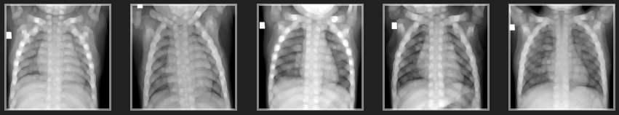
Team Details (Team #35)
Rustamov Sunatillo U1910136
Pak Anna U1910243
Sultanov Azamat U1910256

Slide 3
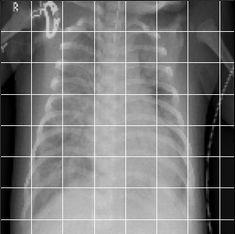
Pneumonia
Lungs Infection
Caused by viruses, bacteria, or fungi
World’s leading cause of death among children under 5 y.o.
Killed 740 180 children in 2019

Slide 4

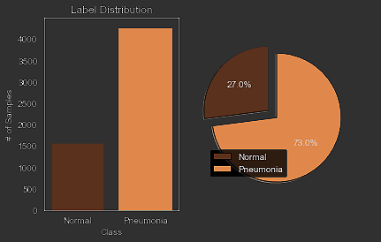
About Dataset
Patients of 1 to 5 y.o from Guangzhou Women and Children’s Medical Center
Training Set: 5216 images
Testing Set: 624 images

Slide 5
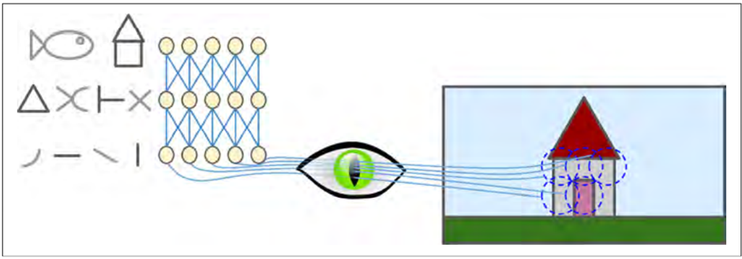
HOW VISUAL CORTEX WORKS

Slide 6
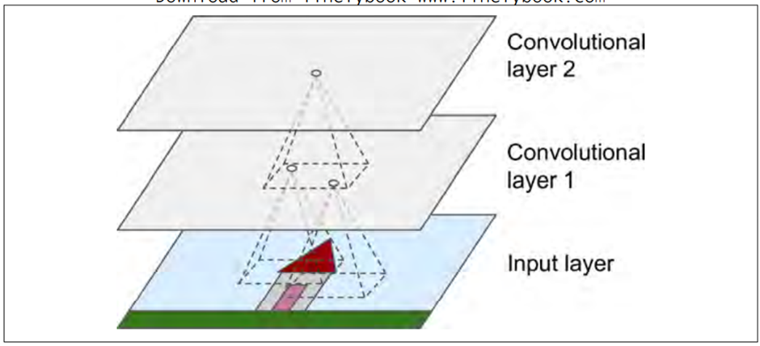
CONVOLUTIONAL NEURAL NETWORKS

Slide 7
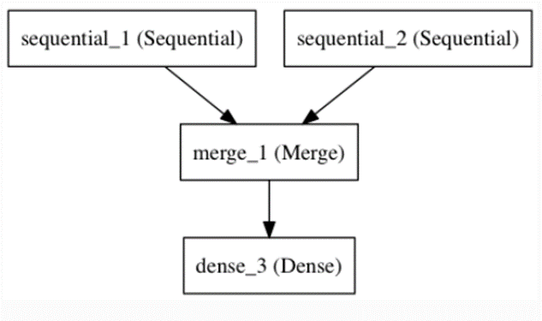
OUTPUT FROM SEQUENTIAL CAN BE USED AS INPUT TO ANOTHER SEQUENTIAL

Slide 8
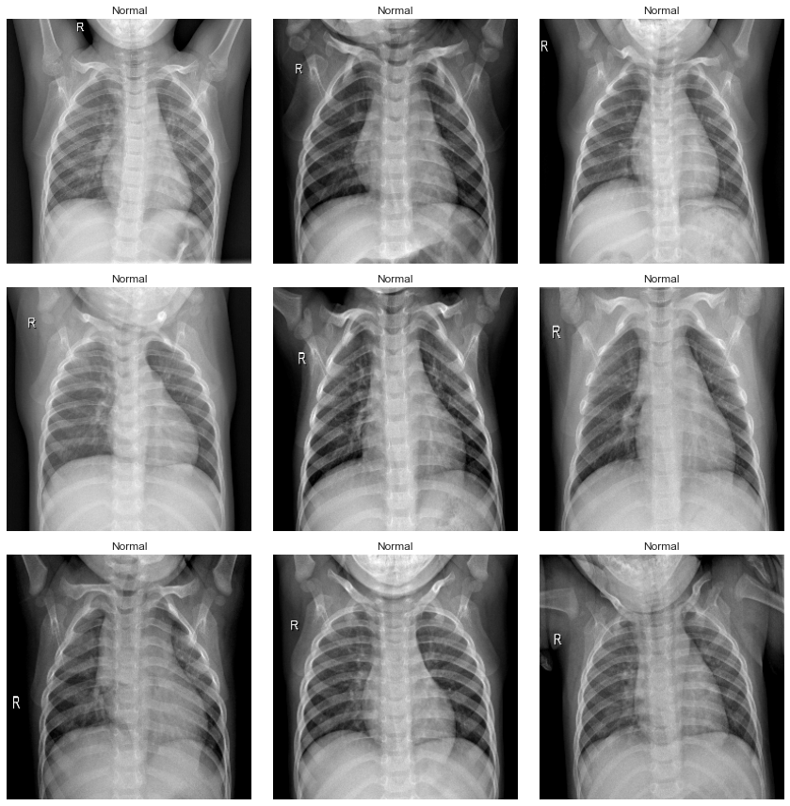
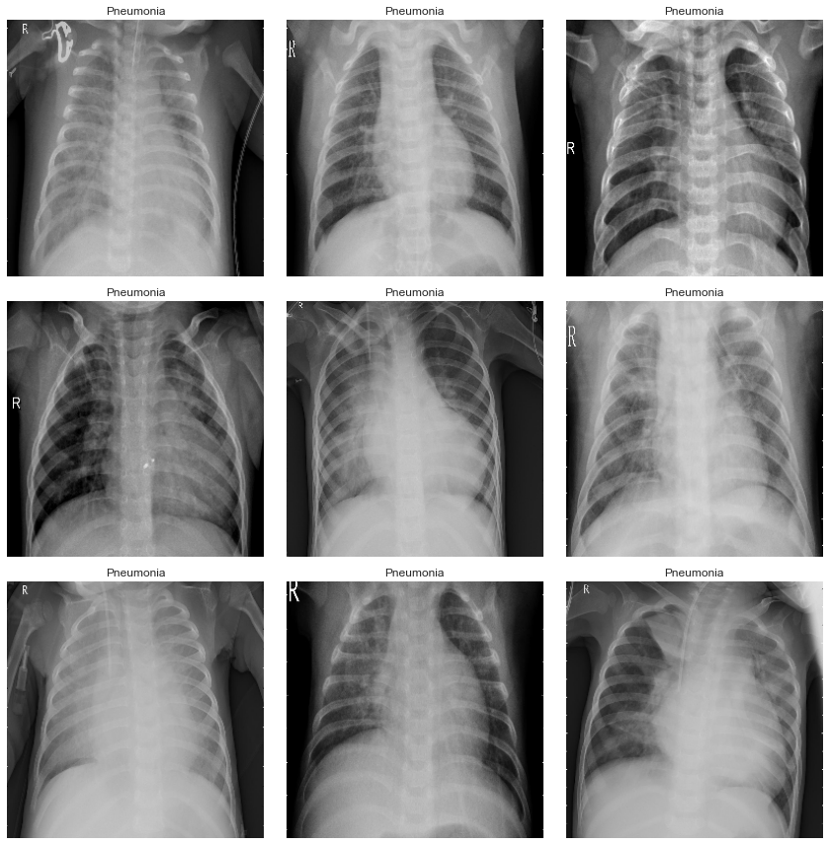
Normal
Pneumonia

Slide 9
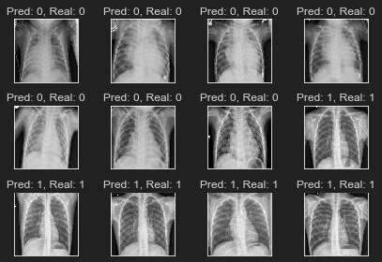
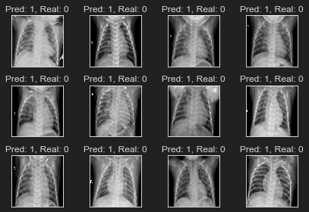
Correctly Classified
Incorrectly Classified

Slide 10
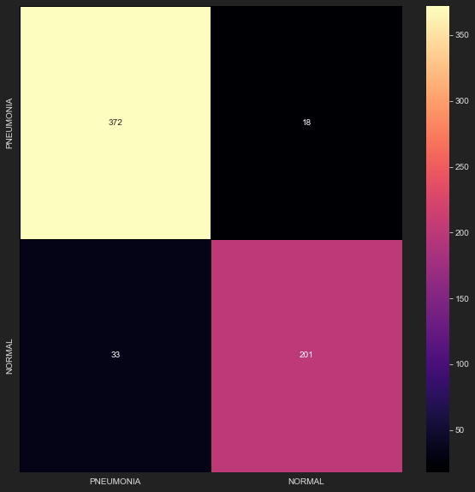
Performance Measures
On the validation (test set):
Accuracy: 91.82%
Precision: 91,85%
Recall: 95,38%
F1 Score: 93,58%

