Slide 1
EDUMATCH
Predictive Modeling and Prescriptive Analytics for Early Student Retention Intervention
An end-to-end educational performance metric with local regulatory knowledge bases using machine learning and RAG architecture.
TECH STACK: Python, Pandas, NumPy, Scikit-Learn (Random Forest, K-Means, Standard Scaler), Matplotlib, Seaborn, LLMS, Streamlit
PAUL KWAKU LARBI ANDERSON

Slide 2



Main Objective: Mitigating Early Student Attrition
The Core Problem
Higher education institutions face severe drop-out rates during the first two semesters of undergraduate study.
Systemic Challenge
Traditional intervention models react to student failures — registration anomalies or failing grades — rather than acting preemptively.
Action Pathway
This project constructs an end-to-end predictive pipeline to identify ‘at-risk’ students from baseline demographics, socioeconomic stressors, and initial academic trajectory.
Final Project | Paul Kwaku Larbi Anderson | WBS
2

Slide 3



The Database: Ingestion and Exploration
Data Alignment: Portugal Dataset to German RAG Engine
Portugal Dataset
(Kaggle- CSV)
Bologna Process
German RAG Engine
(PDF to Text)
4,424-row quantitative training core tracking undergraduate journeys at the Polytechnic Institute of Portalegre.
Standardized ECTS credit accumulation, equivalent winter/summer semesters, and matching grading metrics enable domain transferability.
Prescriptive layer driven by the unstructured text rules of the University of Siegen General Examination Regulations (Prüfungsordnung).
Data Harmonization Strategy
Though trained on Portuguese behavioral features and applied to German rules, both institutions operate under the European Bologna Process. Unified ECTS benchmarks and matching semester structures allow robust domain transferability between the two academic systems.
Unified Features: ECTS credit accumulation • equivalent winter/summer semester divisions • matching baseline grading metrics
Final Project | Paul Kwaku Larbi Anderson | WBS
3

Slide 4
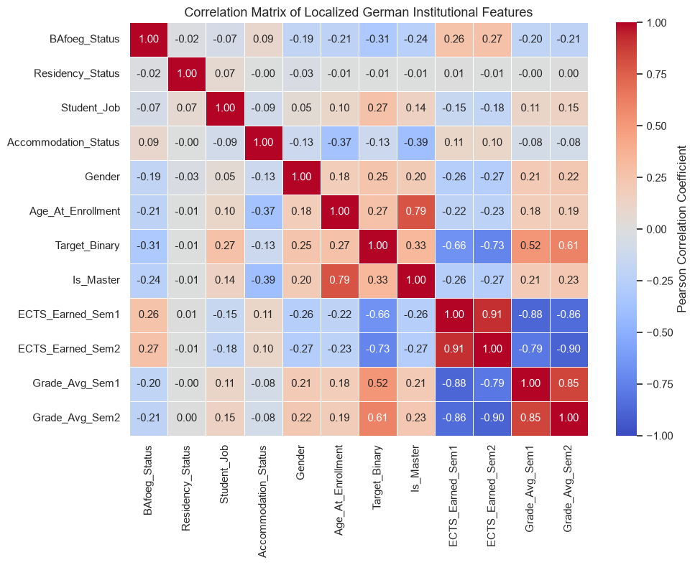
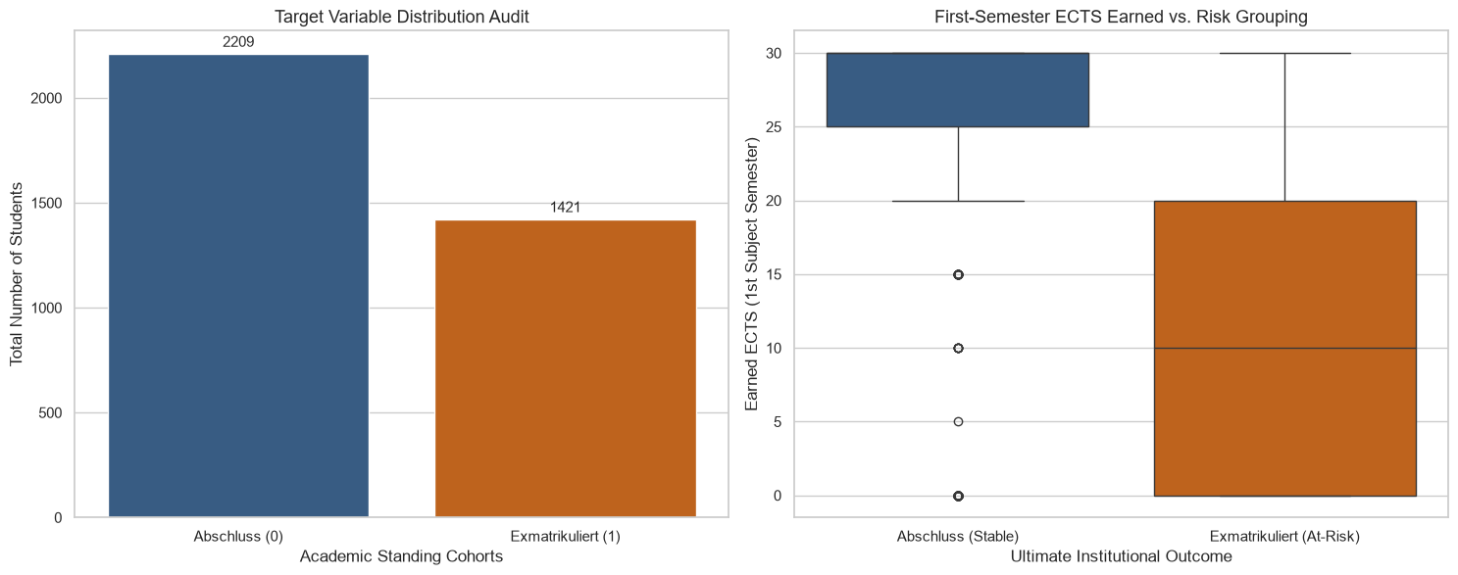
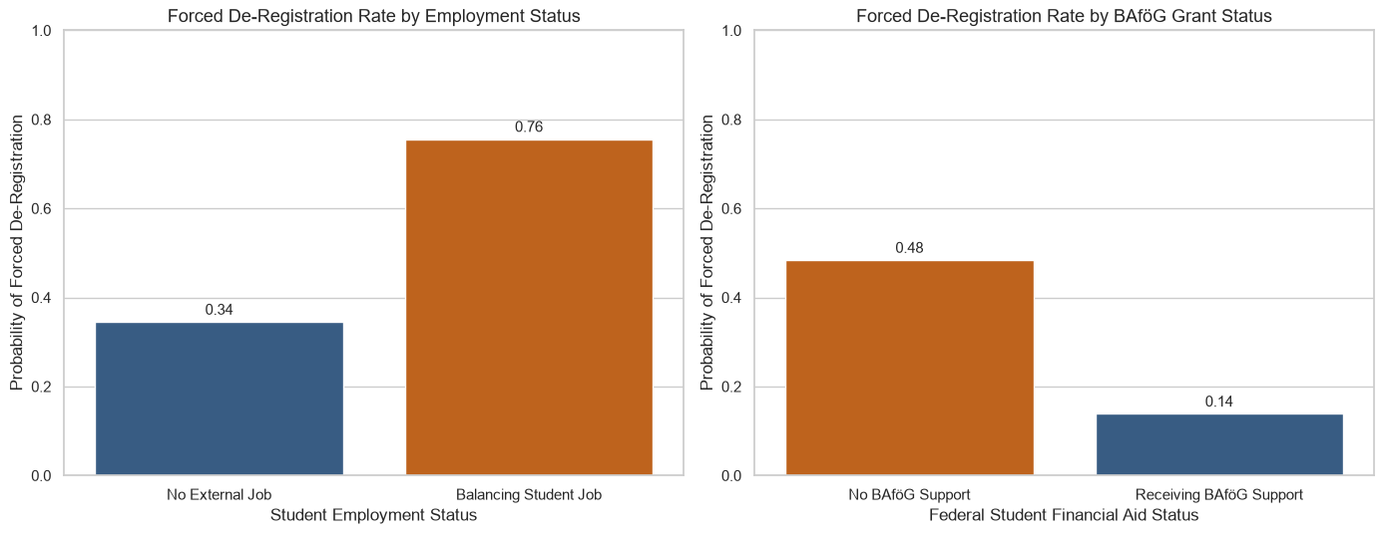
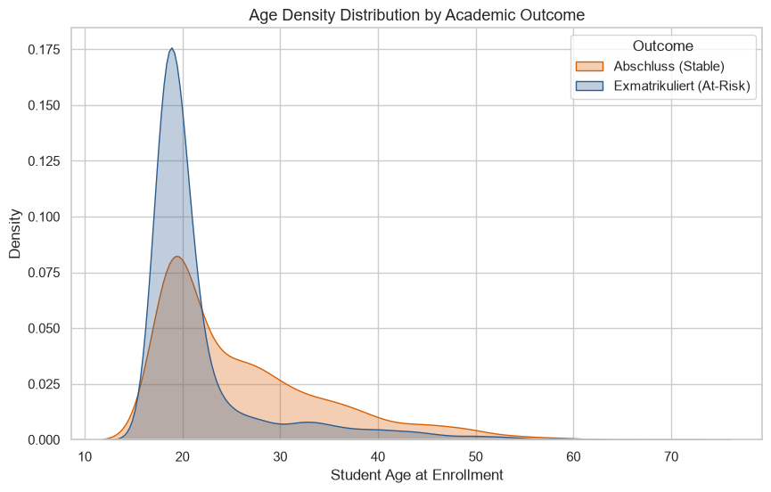
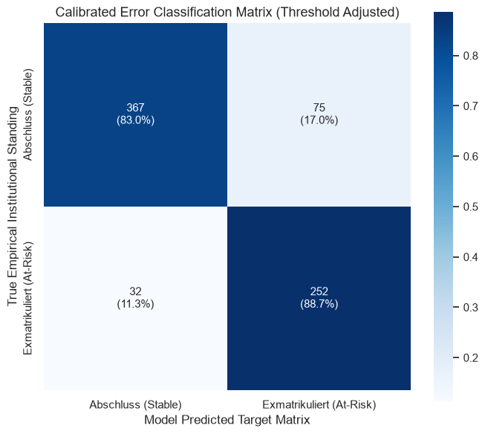
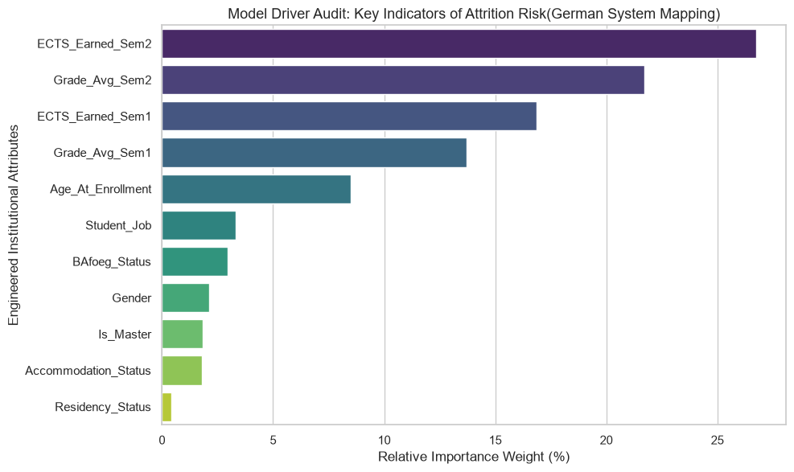
Supporting Data Visualization Images
EDA, model driver, and validation charts underpinning the EduMatch pipeline
Target Variable Audit & ECTS vs. Risk Grouping
De-Registration Rate by Employment & BAföG Status
Correlation Matrix — Institutional Features
Age Density Distribution by Academic Outcome
Calibrated Confusion Matrix (Threshold-Adjusted)
Model Driver Audit — Feature Importance
Final Project | Paul Kwaku Larbi Anderson | WBS
11

Slide 5


Decision Boundary Re-Calibration and K-Means Clustering
Strategic Threshold Tuning
Proactive 0.35
Standard 0.50
Set a manageable margin of precision to reduce the number of missed at-risk individuals for early intervention when warning indicators appear.
Unsupervised Persona Profiling — K-Means Clustering of At-Risk Students
Stabilized Academic Deficit
Latent Socioeconomic Risk
Acute Academic Collapse
Persistent but manageable underperformance –routed to targeted academic advisory.
Financial stress, residential status, and accommodation stability as socio-economic impact factors –needing proactive intervention
Severe, fast-moving academic breakdown – requiring immediate peer-mentorship intervention.
Final Project | Paul Kwaku Larbi Anderson | WBS
6

Slide 6



Knowledge Base Extraction and Chunking
Contextual Fragmentation
Raw Regulatory Text
Sliding Window Overlap
University of Siegen examination guidelines for Bachelor’s and Master’s students (English PDF) extracted via a local text reader.
Custom parsing class cuts continuous text walls into explicit character chunks, avoiding ‘lost-in-the-middle’ bias.
A character overlap window preserves continuity, so sentences and legal clauses are never split.
Local Knowledge Assembly: All outputs are consolidated into a portable local staging index (raw_extracted_po.txt), bypassing external cloud dependencies.
Final Project | Paul Kwaku Larbi Anderson | WBS
8

Slide 7
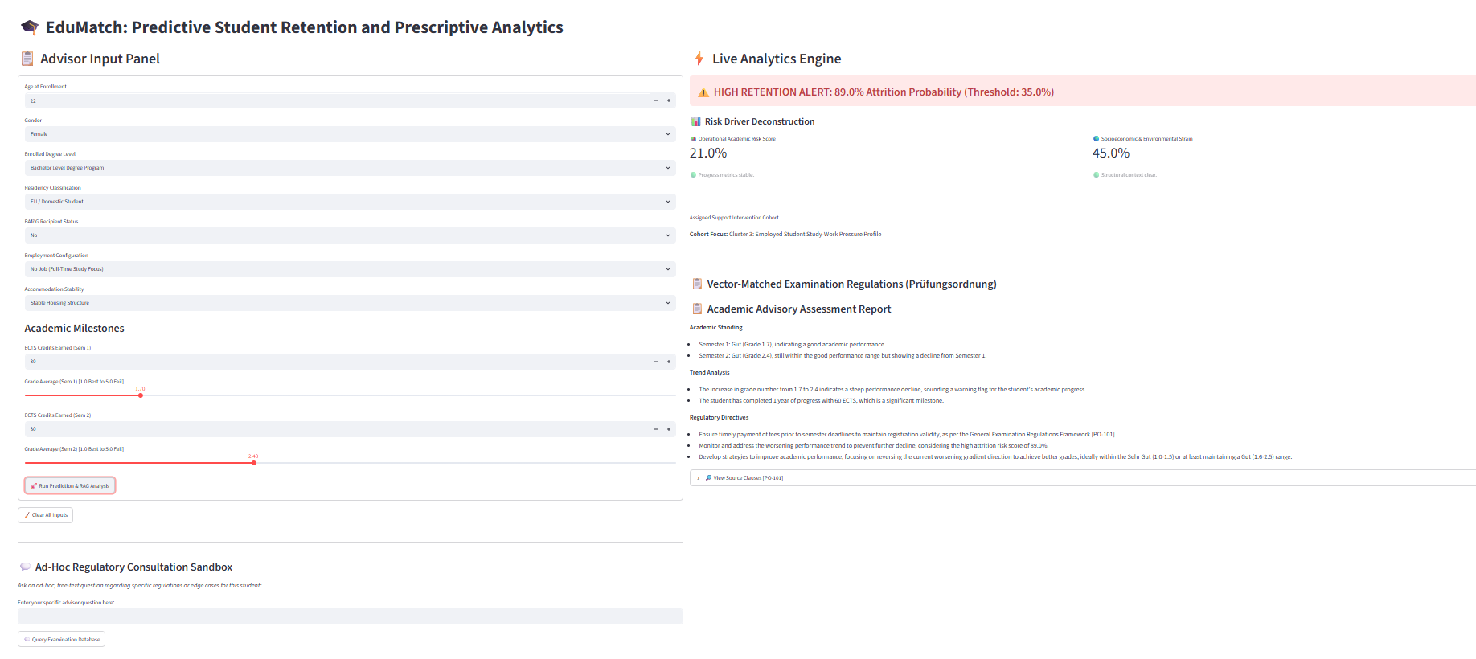
Streamlit UI Interactive Dashboard
Final Project | Paul Kwaku Larbi Anderson | WBS

Slide 8
THANK YOU FOR YOUR ATTENTION
VIELEN DANK!
ME DAASE!
I’m happy to take questions, feedback, or recommendations for my next career.
Final Project | Paul Kwaku Larbi Anderson | WBS

