Slide 1
Titanic Survival SQL Data Analysis
SQL Project Report

Slide 2
Dataset Overview
Source: Kaggle Titanic Dataset
Columns: PassengerId, Survived, Pclass, Name, Sex, Age, SibSp, Parch, Ticket, Fare, Cabin, Embarked
Objective: Perform SQL-based analysis to uncover survival trends.

Slide 3
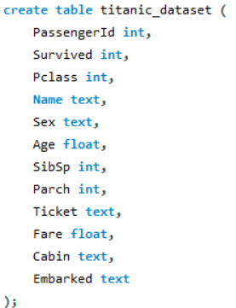
Schema and Environment Setup
Tools: MySQL Workbench
Load Data using import command.
Schema: create table titanic_dataset

Slide 4


Overall Survival Statistics
SQL Query
Output
Insights
Classifies Passengers into Survived(1) and not survived(0).

Slide 5
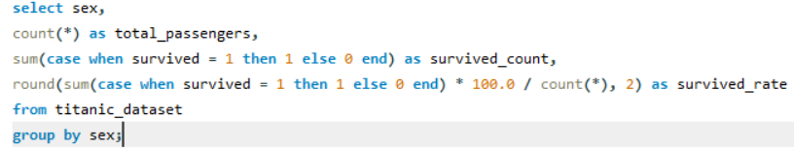

Gender-Based Survival Analysis
SQL Query
Output
Insights
Female had a higher survival rate.

Slide 6
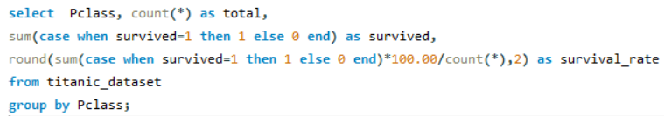

Class-wise Survival Rate
SQL Query
Output
Insights
1st class passengers survived more.

Slide 7
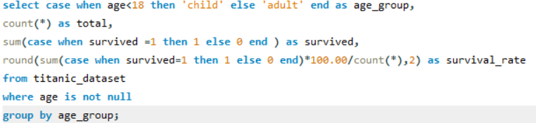

Children vs Adults Survival
SQL Query
Output
Insights
Children were prioritized over adults.

Slide 8
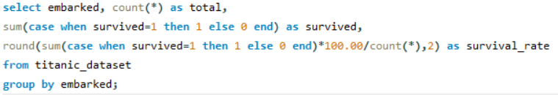
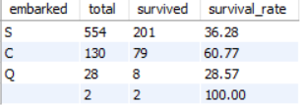
Survival by Embarkation Port
SQL Query
Output
Insights
Embarked port “C” had the highest survival rate.

Slide 9
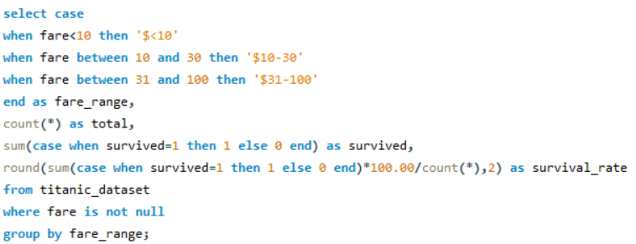
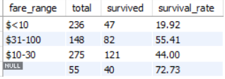
Fare Range and Survival
SQL Query
Output
Insights
Fare >$100 had higher survival.

