Slide 1
T-Test Independent and Paired Means Anova Bootstrapping

Slide 2
Recap
We revised a lot of stuff last weekend
Confidence Interval with margin of error
Hypothesis Testing with Z-distribution

Slide 3
Hypothesis Test with t-distribution
We did hypothesis testing using z-distribution before considering central limit theorem and its conditions
We use t-distribution instead of a normal when sample size is smaller than 30 and we don’t know the population standard deviation (which is usually the case)

Slide 4
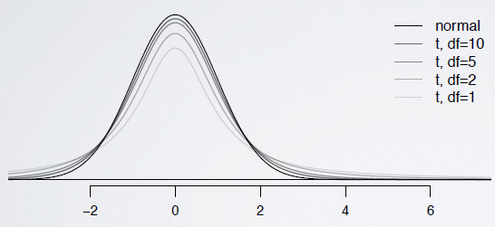
What’s a T-distribution ?
always centered at 0 (like the standard normal)
Has one parameter : Degree of freedom

Slide 5
T statistics
Same as Z- statistics
T= observed-Null/SE
P-value is still the same (Just need degrees of freedom due to t-distribution)

Slide 6
Lets practice in R!
pt (critical_point,degree_freedom)
example : pt (2.08,df=21)
qt( area,degree_freedom)
example : qt(0.975,21)
Notes:
95% confidence interval

Slide 7
Confidence interval using t
Remember,
point estimate ± margin of error
x ± t*_{df} SE_{x}
x ± t*_{df} S/sqrt(n)
x ± t*_{n-1} S/sqrt(n)

Slide 8
Hypothesis testing using t
Same procedure as before with the modification of the distribution
Let’s do some examples to get a better understanding.
Notes:
“inference for a mean”

Slide 9
Comparing independent means
Notes:
Inference for comparing two independent means

Slide 10
Comparing paired means
Notes:
Inference for comparing two paired means

Slide 11
Analysis of Variance (Anova)

