Slide 1



examples
hypothesis
testing
(for one mean)
Dr. Mine Çetinkaya-Rundel
Duke University

Slide 2
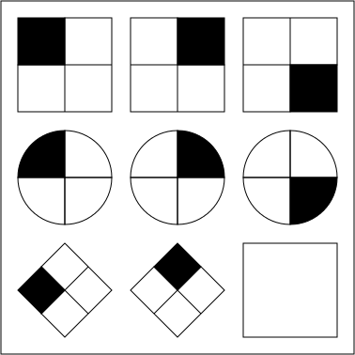
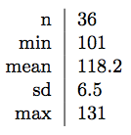
Researchers investigating characteristics of gifted children collected data from schools in a large city on a random sample of thirty-six children who were identified as gifted children soon after they reached the age of four. In this study, along with variables on the children, the researchers also collected data on their mothers’ IQ scores.The histogram shows the distribution of these data, and also provided are some sample statistics.
12
8
4
0
100 105 110 115 120 125 130 135
Mother's IQ
Raven Matrix, Life of Riley (CC-BY-SA 3.0): http://en.wikipedia.org/wiki/File:Raven_Matrix.svg

Slide 3
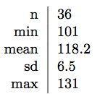
μ = average IQ score of mothers of gifted children
Perform a hypothesis test to evaluate if these data provide convincing evidence of a difference between the average IQ score of mothers of gifted children and the average IQ score for the population at large, which is 100. Use a significance level of 0.01.
1. Set the hypotheses
H₀: μ = 100 H_{A}: μ ≠ 100
2. Calculate the point estimate
12
8
4
x = 118.2
0
100 105 110 115 120 125 130 135
Mother's IQ
3. Check conditions
random & 36 < 10% of all gifted children -> independence
n > 30 & sample not skewed -> nearly normal sampling distribution

Slide 4


H₀: μ = 100
12
x = 118.2
8
H : μ ≠ 100
A
4
s n
0
100 105 110 115 120 125 130 135
Mother's IQ
X ~ N(μ = 100, SE =
= ^{6.5} ≈ 1.083)
36
4. Draw sampling distribution, shade p-value, calculate test statistic
_{Z =} 118.2 - 100 _{= 16.8}
1.083
p-value ≈ 0
81.8
18.2
100
18.2 118.2

Slide 5
5. Make a decision, and interpret it in context of the research question
p-value is very low -> strong evidence against the null
We reject the null hypothesis and conclude that the data provide convincing evidence of a difference between the average IQ score of mothers of gifted children and the average IQ score for the population at large.

Slide 6
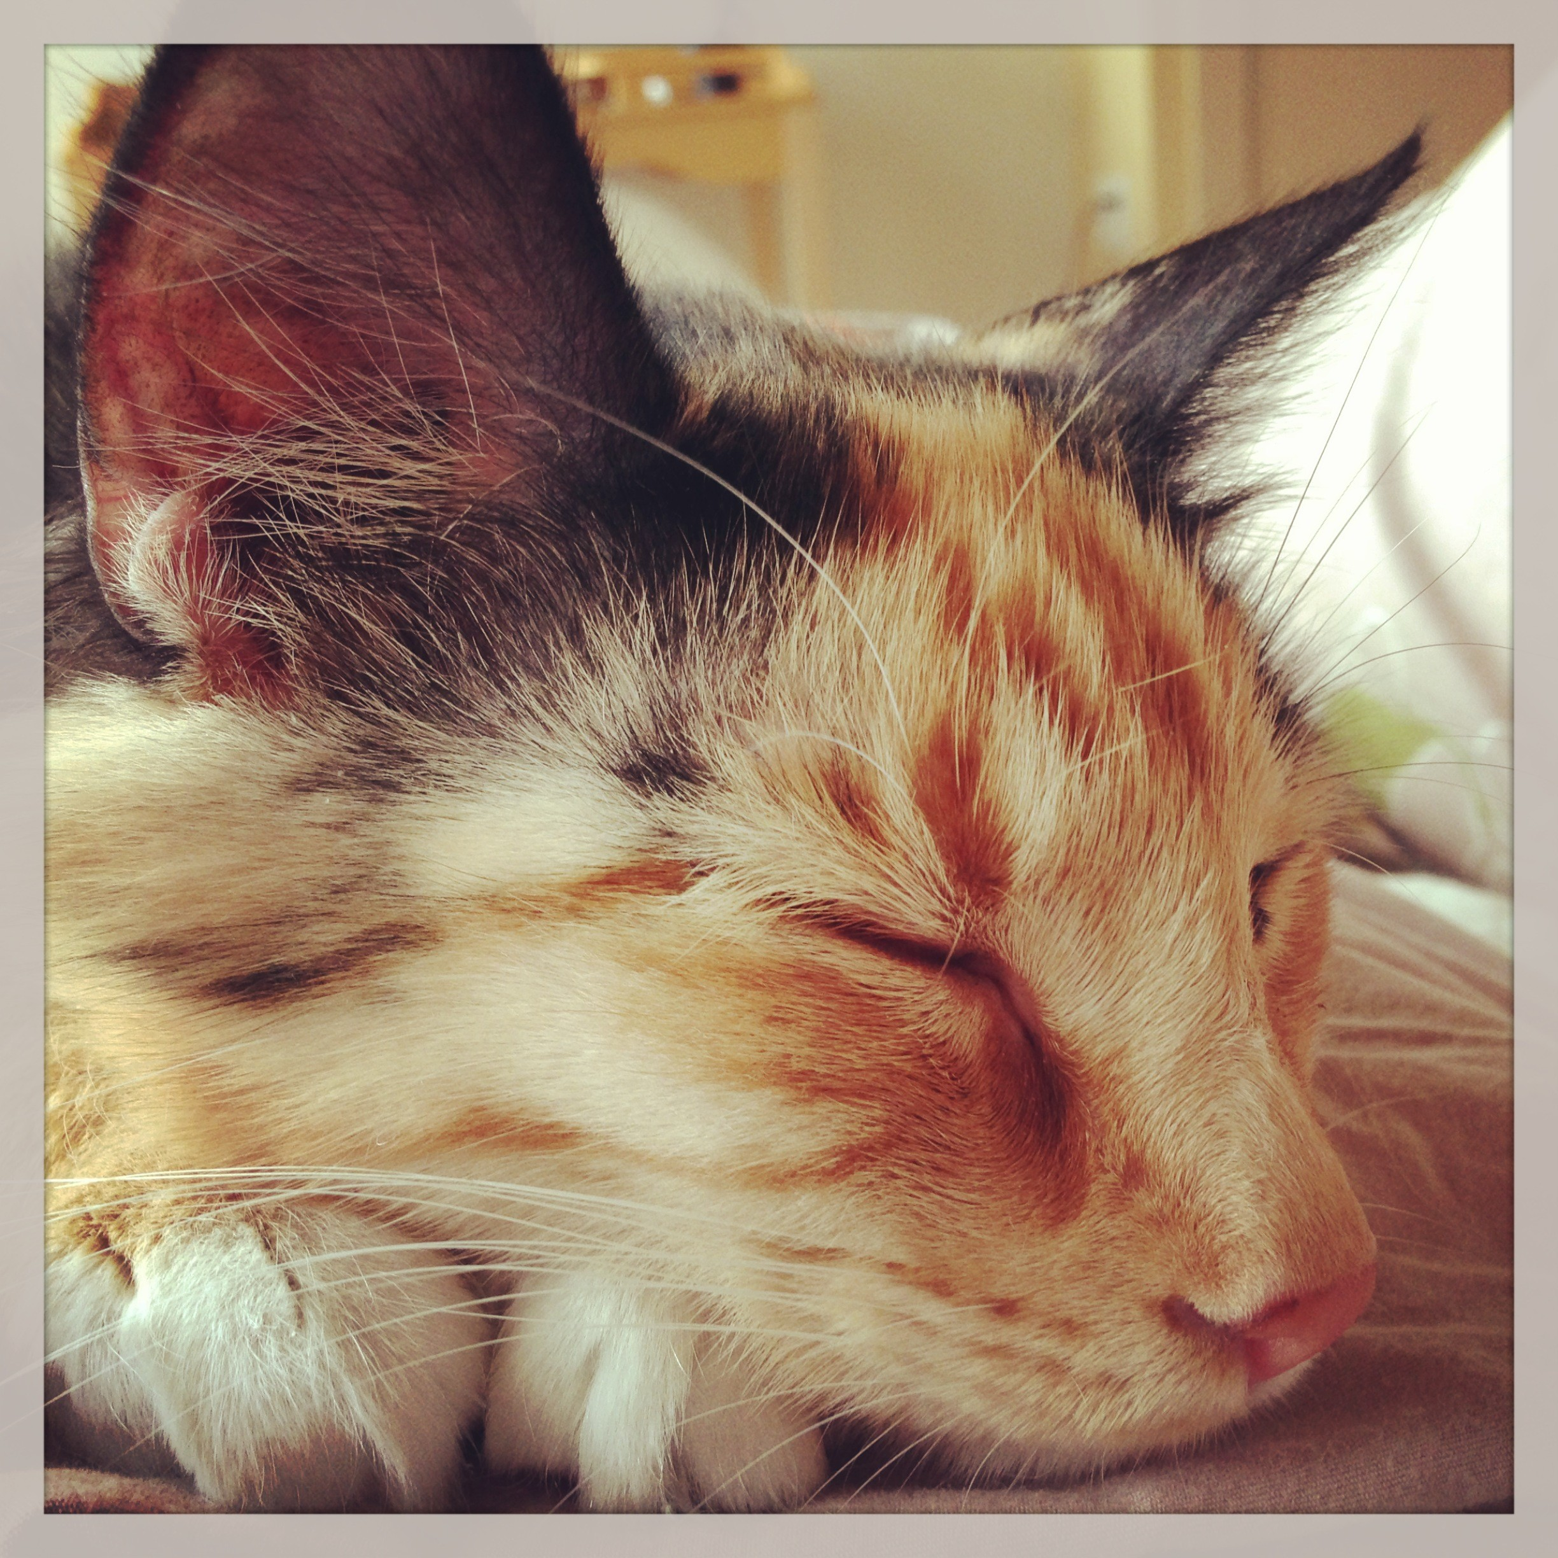
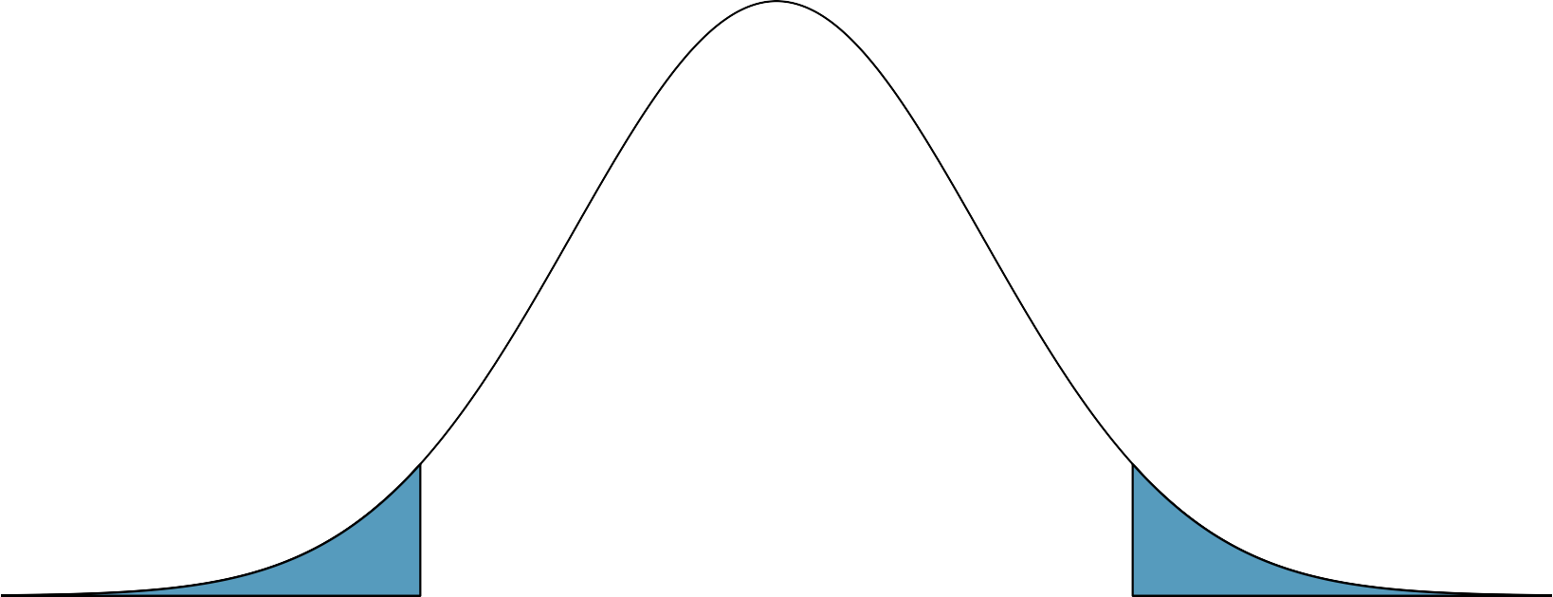
x = 16
H₀: μ = 14
A statistics student interested in sleep habits of domestic cats took a random sample of 144 cats and monitored their sleep.The cats slept an average of 16 hours / day. According to online resources domestic dogs sleep, on average, 14 hours day. We want to find out if these data provide convincing evidence of different sleeping habits for domestic cats and dogs with respect to how much they sleep.The test statistic is 1.73.
p-value = 0.0418 x 2
= 0.0836
0.0418
0.0418
H_{A}: μ ≠ 14
−1.73
0
1.73

Slide 7
What is the interpretation of this p-value in context of these data?
= P(observed or more extreme outcome | H₀ true)
=P(obtaining a random sample of 144 cats that sleep 16 hours or more or 12 hours or less, on average, if in fact cats truly slept 14 hours per day on average) = 0.0836
n = 144
x = 16 H₀: μ = 14
H_{A}: μ ≠ 14

