Slide 1
COVID-19
Jennie Cinelli, John Russell, Mohamed Ismael, Pallavi Umap

Slide 2
Motivation & Summary
As a group, we decided that we wanted to analyze data from the COVID-19 pandemic in the United States and find out which US states overall ranked best and worst by death rate and other factors.
1. What is the death rate for each state?
We can rank states by death rate.
2. What is the death rate for each state normalized by age?
We already knew that age is a defining factor in death rate, but what if we normalized it by comparing each state with the same
population parameters.
3. What is the excess death for each state in comparison to death rate?
4. What other factors affect death rate?
1. Geographic
2. Healthcare
3. Preventative Measures

Slide 3
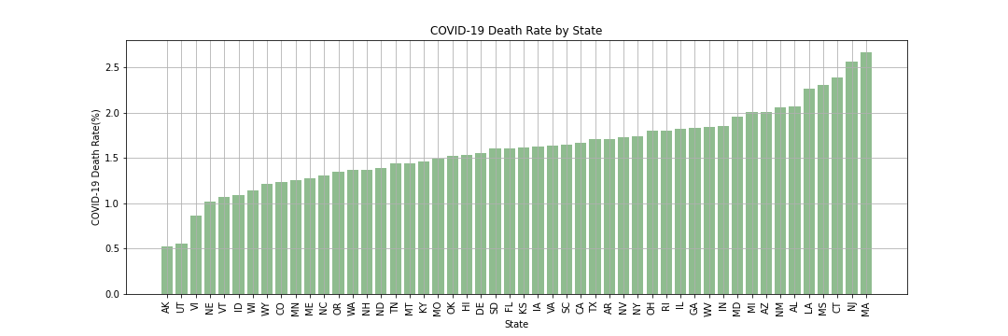
Death Rate Death rate ranked by US State
The Small Print
Definitions of any terms or metrics: March 2020 to April 2021 | Death Rate is cumulative confirmed Covid Deaths / cumulative confirmed Covid Cases
Data Sources: Center for Disease Control (CDC) website: cdc.gov

Slide 4
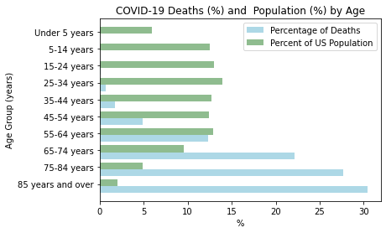
Death Rate Is age a factor in death rate?
The Small Print
Definitions of any terms or metrics: January 2020 to April 2021 | Death Rate is cumulative confirmed Covid Deaths / cumulative confirmed Covid Cases
Data Sources: Center for Disease Control (CDC) website: cdc.gov

Slide 5
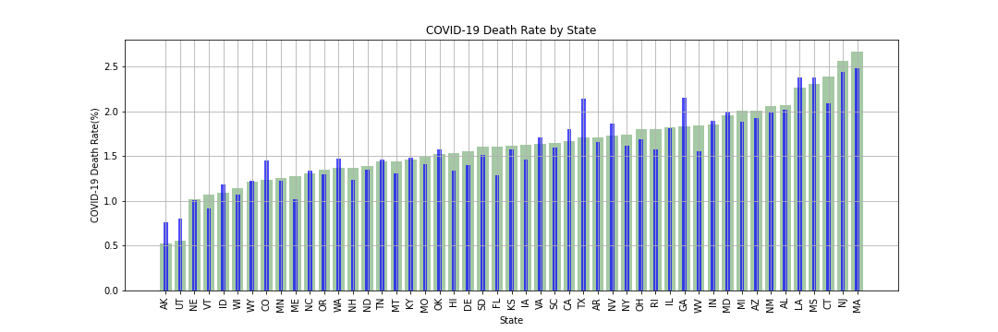
Death Rate Normalized Death Rate by Age Group
The Small Print
Definitions of any terms or metrics: January 2020 to April 2021 | Death Rate is cumulative confirmed Covid Deaths / cumulative confirmed Covid Cases
Data Sources: Center for Disease Control (CDC) website: cdc.gov

Slide 6
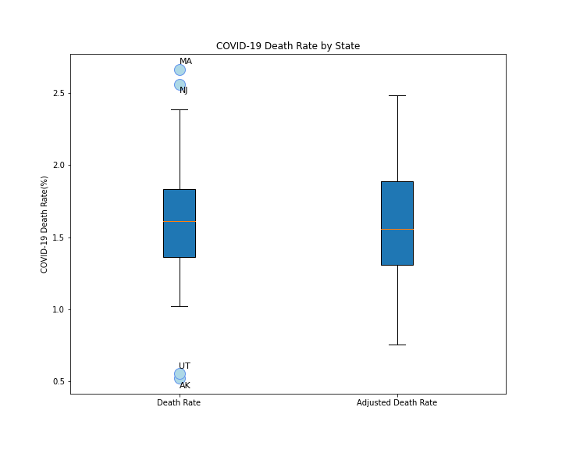
Death Rate
Death Rate:
The lower quartile of the death rate for all states is: 1.35
The upper quartile of the death rate for all states is: 1.83
The interquartile range of the death rate for all states is: 0.48
The median of the death rate for all states is: 1.61
Values below 0.64 could be outliers.
Values above 2.55 could be outliers.
Adjusted Death Rate by Age:
The lower quartile of the adjusted death rate for all states is: 1.31
The upper quartile of the adjusted death rate for all states is: 1.89
The interquartile range of the adjusted death rate for all states is: 0.58
The median of the adjusted death rate for all states is: 1.56
Values below 0.44 could be outliers.
Values above 2.75 could be outliers.
The Small Print
Definitions of any terms or metrics: March 2020 to April 2021 | Death Rate is cumulative confirmed Covid Deaths / cumulative confirmed Covid Cases
Data Sources: Center for Disease Control (CDC) website: cdc.gov

Slide 7
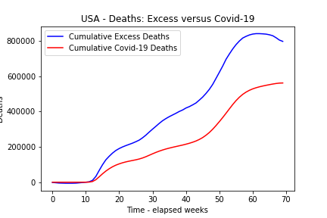
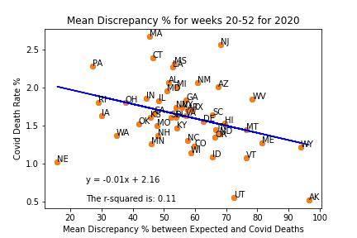
Excess Deaths Are states reporting consistently? Does it affect the death rate?
The Small Print
Definitions of any terms or metrics: Excess deaths are typically defined as the difference between the observed numbers of deaths in specific time periods and expected numbers of deaths in the same time periods.
Data Sources: Center for Disease Control (CDC) website: cdc.gov
Omissions or filtering:

Slide 8
Conclusions [All]

Slide 9
Mitigating / Explanations
Health
Quality of health care => hospital beds per capita
Scatter plot normalized death rate versus hospital beds
Regression analysis
Preventative Measures
Mask mandate data (by month)
Yes or no
2-sample t-test

Slide 10
Mitigating / Explanations
Demographics (Scatter Plot – regression)
Sex
Race
Income (if we have time)
Timing
Vaccination roll out
Geography
Urban/Metropolitan populations (if we have time)

Slide 11
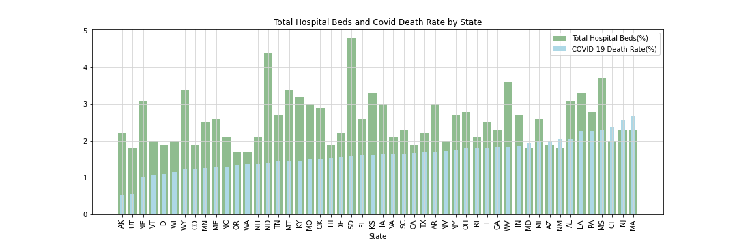
Health Care : Hospital Beds versus Death Rate Does having accessible healthcare effect death rate?
The Small Print
Data Sources: Center for Disease Control (CDC) website: cdc.gov

Slide 12
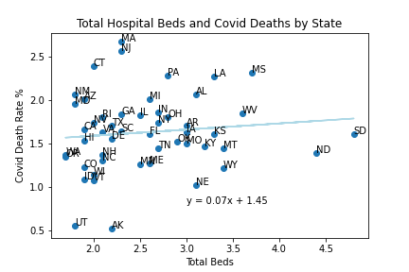
Health Care : Hospital Beds versus Death Rate Does having accessible healthcare effect death rate?
The Small Print
Data Sources: Center for Disease Control (CDC) website: cdc.gov

Slide 13
Preventative Measures [John] High-level conclusion
2 histogram on same plot – death rate with mask and without mask
2 Sample t-test – is there a difference?
The Small Print
Definitions of any terms or metrics: March 2020 to April 2021 | Death Rate is cumulative confirmed Covid Deaths / cumulative confirmed Covid Cases
Data Sources: Center for Disease Control (CDC) website: cdc.gov
Omissions or filtering: No data for AS

Slide 14
Vaccination Rollout [?] High-level conclusion
Scatter % complete versus death rate
Regression
The Small Print
Definitions of any terms or metrics: March 2020 to April 2021 | Death Rate is cumulative confirmed Covid Deaths / cumulative confirmed Covid Cases
Data Sources: Center for Disease Control (CDC) website: cdc.gov
Omissions or filtering: No data for AS

Slide 15
Demographics [?] High-level conclusion
Chart
The Small Print
Definitions of any terms or metrics: March 2020 to April 2021 | Death Rate is cumulative confirmed Covid Deaths / cumulative confirmed Covid Cases
Data Sources: Center for Disease Control (CDC) website: cdc.gov
Omissions or filtering: No data for AS

Slide 16
Overall Conclusions [All]
Summary
Lessons learned

