Slide 1
COVID-19
Jennie Cinelli, John Russell, Mohamed Ismael, Pallavi Umap

Slide 2
Which state is best / worst
Death Rate by State (bar graph – sorted top to bottom)
1. Death Rate = Covid Deaths / Covid Infections [ ~ 1%]
2. Death Rate = Covid Deaths / Total Population [ ]
Death Rate normalized by age
Deaths by age group (month) / population by age group
Excess Deaths….
% difference at end of March (weekly)
Ranks states first to last
Missing: Population by age group by state / Covid infections by state

Slide 3
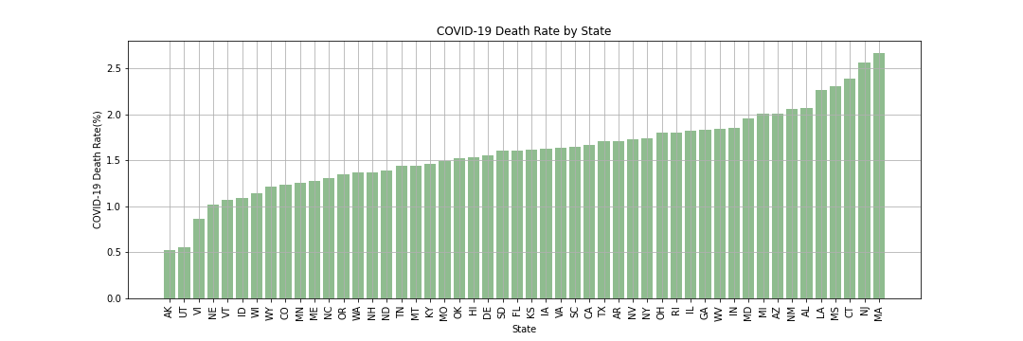
Death Rate Death rate ranked by US State
The Small Print
Definitions of any terms or metrics: March 2020 to April 2021 | Death Rate is cumulative confirmed Covid Deaths / cumulative confirmed Covid Cases
Data Sources: Center for Disease Control (CDC) website: cdc.gov

Slide 4
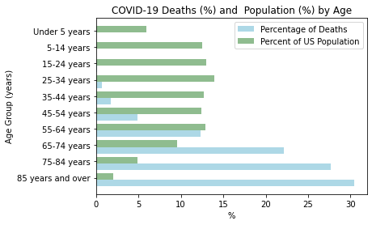
Death Rate Is age a factor in death rate?
The Small Print
Definitions of any terms or metrics: January 2020 to April 2021 | Death Rate is cumulative confirmed Covid Deaths / cumulative confirmed Covid Cases
Data Sources: Center for Disease Control (CDC) website: cdc.gov

Slide 5
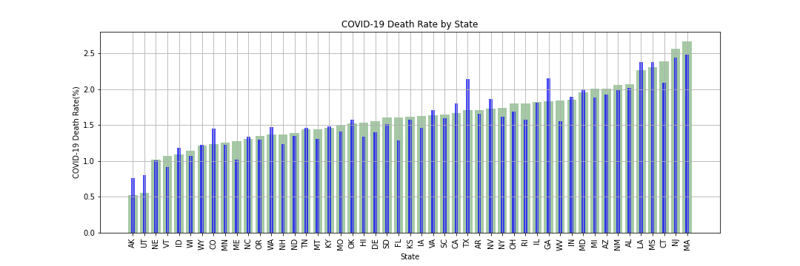
Death Rate Normalized Death Rate by Age Group
The Small Print
Definitions of any terms or metrics: January 2020 to April 2021 | Death Rate is cumulative confirmed Covid Deaths / cumulative confirmed Covid Cases
Data Sources: Center for Disease Control (CDC) website: cdc.gov

Slide 6
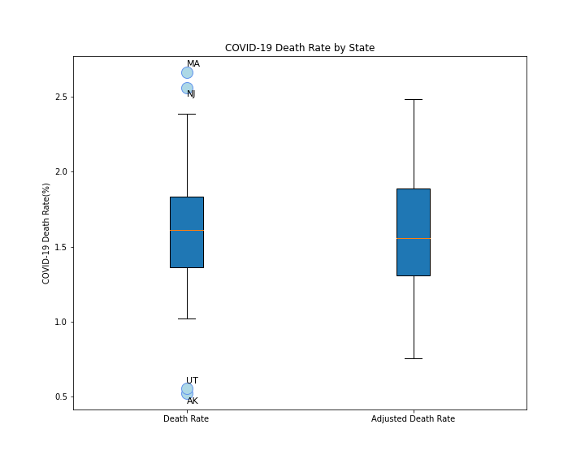
Death Rate
Death Rate:
The lower quartile of the death rate for all states is: 1.35
The upper quartile of the death rate for all states is: 1.83
The interquartile range of the death rate for all states is: 0.48
The median of the death rate for all states is: 1.61
Values below 0.64 could be outliers.
Values above 2.55 could be outliers.
Adjusted Death Rate by Age:
The lower quartile of the adjusted death rate for all states is: 1.31
The upper quartile of the adjusted death rate for all states is: 1.89
The interquartile range of the adjusted death rate for all states is: 0.58
The median of the adjusted death rate for all states is: 1.56
Values below 0.44 could be outliers.
Values above 2.75 could be outliers.
The Small Print
Definitions of any terms or metrics: March 2020 to April 2021 | Death Rate is cumulative confirmed Covid Deaths / cumulative confirmed Covid Cases
Data Sources: Center for Disease Control (CDC) website: cdc.gov

Slide 7
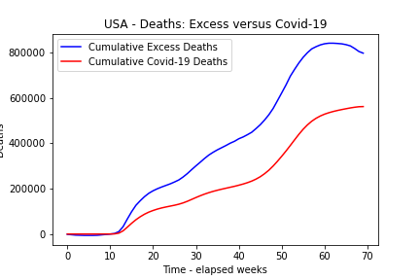
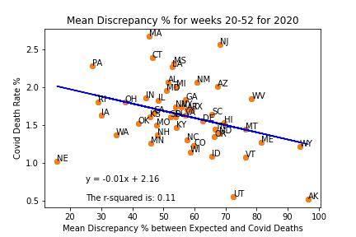
Excess Deaths Are states reporting consistently? Does it affect the death rate?
The Small Print
Definitions of any terms or metrics: Excess deaths are typically defined as the difference between the observed numbers of deaths in specific time periods and expected numbers of deaths in the same time periods.
Data Sources: Center for Disease Control (CDC) website: cdc.gov
Omissions or filtering:

Slide 8
Conclusions [All]

Slide 9
Mitigating / Explanations
Health
Quality of health care => hospital beds per capita
Scatter plot normalized death rate versus hospital beds
Regression analysis
Preventative Measures
Mask mandate data (by month)
Yes or no
2-sample t-test

Slide 10
Mitigating / Explanations
Demographics (Scatter Plot – regression)
Sex
Race
Income (if we have time)
Timing
Vaccination roll out
Geography
Urban/Metropolitan populations (if we have time)

Slide 11
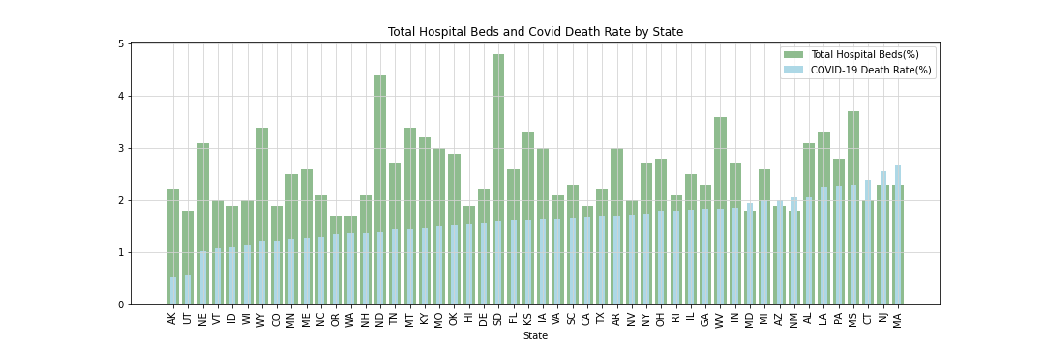
Health Care : Hospital Beds versus Death Rate Does having accessible healthcare effect death rate?
The Small Print
Data Sources: Center for Disease Control (CDC) website: cdc.gov

Slide 12
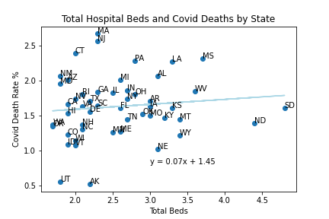
Health Care : Hospital Beds versus Death Rate Does having accessible healthcare effect death rate?
The Small Print
Data Sources: Center for Disease Control (CDC) website: cdc.gov

Slide 13
Preventative Measures [John] High-level conclusion
2 histogram on same plot – death rate with mask and without mask
2 Sample t-test – is there a difference?
The Small Print
Definitions of any terms or metrics: March 2020 to April 2021 | Death Rate is cumulative confirmed Covid Deaths / cumulative confirmed Covid Cases
Data Sources: Center for Disease Control (CDC) website: cdc.gov
Omissions or filtering: No data for AS

Slide 14
Vaccination Rollout [?] High-level conclusion
Scatter % complete versus death rate
Regression
The Small Print
Definitions of any terms or metrics: March 2020 to April 2021 | Death Rate is cumulative confirmed Covid Deaths / cumulative confirmed Covid Cases
Data Sources: Center for Disease Control (CDC) website: cdc.gov
Omissions or filtering: No data for AS

Slide 15
Demographics [?] High-level conclusion
Chart
The Small Print
Definitions of any terms or metrics: March 2020 to April 2021 | Death Rate is cumulative confirmed Covid Deaths / cumulative confirmed Covid Cases
Data Sources: Center for Disease Control (CDC) website: cdc.gov
Omissions or filtering: No data for AS

Slide 16
Overall Conclusions [All]
Summary
Lessons learned

