Slide 1
COVID-19
Jennie Cinelli, John Russell, Mohamed Ismael, Pallavi Umap

Slide 2
Motivation & Summary
As a group, we decided that we wanted to analyze data from the COVID-19 pandemic in the United States and find out which US states overall ranked best and worst by death rate and other factors.
1. What is the death rate for each state?
We can rank states by death rate.
2. What is the death rate for each state normalized by age?
We already knew that age is a defining factor in death rate, but what if we normalized it by comparing each state with the same
population parameters.
3. What is the excess death for each state in comparison to death rate?
4. What other factors affect death rate?
1. Geographic
2. Healthcare
3. Preventative Measures

Slide 3
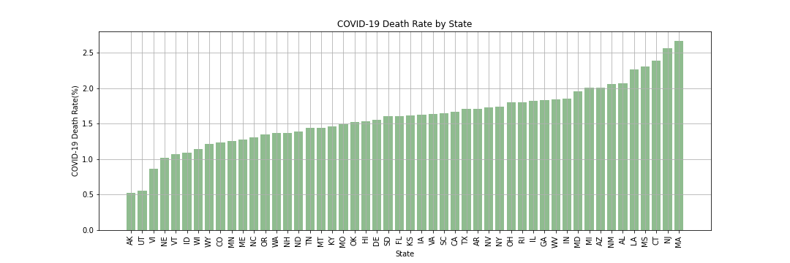
Death Rate Death rate ranked by US State
The Small Print
Definitions of any terms or metrics: March 2020 to April 2021 | Death Rate is cumulative confirmed Covid Deaths / cumulative confirmed Covid Cases
Data Sources: Center for Disease Control (CDC) website: cdc.gov

Slide 4
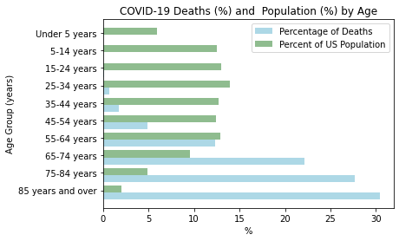
Death Rate Is age a factor in death rate?
The Small Print
Definitions of any terms or metrics: January 2020 to April 2021 | Death Rate is cumulative confirmed Covid Deaths / cumulative confirmed Covid Cases
Data Sources: Center for Disease Control (CDC) website: cdc.gov

Slide 5
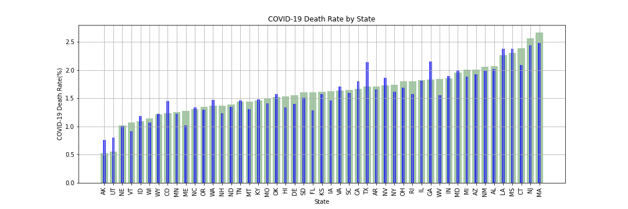
Death Rate Normalized Death Rate by Age Group
The Small Print
Definitions of any terms or metrics: January 2020 to April 2021 | Death Rate is cumulative confirmed Covid Deaths / cumulative confirmed Covid Cases
Data Sources: Center for Disease Control (CDC) website: cdc.gov

Slide 6
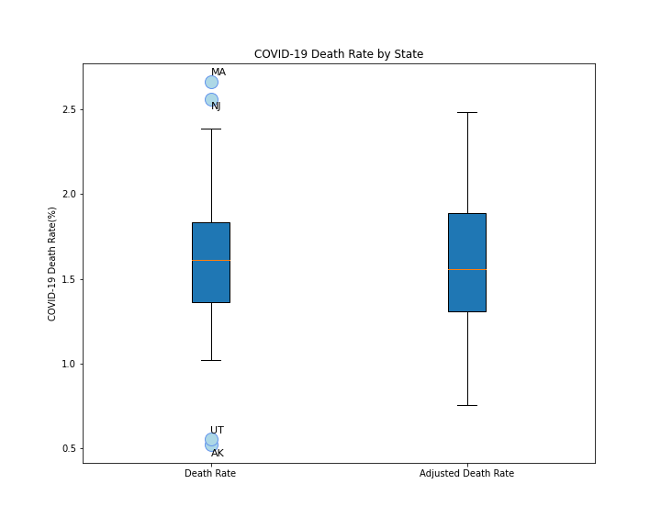
Death Rate
Death Rate:
The lower quartile of the death rate for all states is: 1.35
The upper quartile of the death rate for all states is: 1.83
The interquartile range of the death rate for all states is: 0.48
The median of the death rate for all states is: 1.61
Values below 0.64 could be outliers.
Values above 2.55 could be outliers.
Adjusted Death Rate by Age:
The lower quartile of the adjusted death rate for all states is: 1.31
The upper quartile of the adjusted death rate for all states is: 1.89
The interquartile range of the adjusted death rate for all states is: 0.58
The median of the adjusted death rate for all states is: 1.56
Values below 0.44 could be outliers.
Values above 2.75 could be outliers.
The Small Print
Definitions of any terms or metrics: March 2020 to April 2021 | Death Rate is cumulative confirmed Covid Deaths / cumulative confirmed Covid Cases
Data Sources: Center for Disease Control (CDC) website: cdc.gov

Slide 7
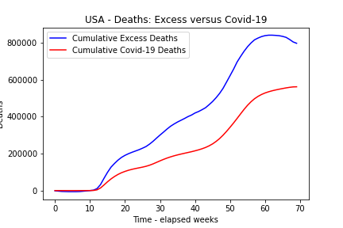
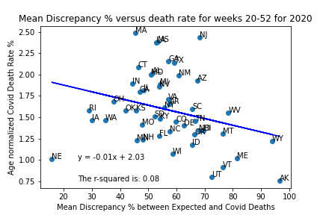
Excess Deaths Excess deaths range from ~20% (NE) to ~96% (AK) higher than Covid-19. The discrepancy provides very weak or little explanation of death rate or there are stronger confounding variables.
The Small Print
Definitions of any terms or metrics: Excess deaths are typically defined as the difference between the observed numbers of deaths in specific time periods and expected numbers of deaths in the same time periods.
Data Sources: Center for Disease Control (CDC) website: cdc.gov

Slide 8
Initial Conclusions (1st = NE, last = MA)
Best performing states:
AK, UT, NE, VT and ID
small, sparse states
some of which may have underreported (not NE)
Worst performing states:
MA, NJ, CT, MS, LA
3 North Eastern states with very high population densities
Over 65s make up 78% of all Covid Deaths
States with a “younger population”: AK, UT, CO, TX, GA – adjusted went up
States with “older populations”: ME, FL, CT, WV, HI, RI
If an adjustment was made for excess deaths this would make a large impact on death rate.

Slide 9
Mitigating / Explanations
Health
Quality of health care => hospital beds per capita
Preventative Measures
Mask mandates
Demographics
Sex, race, income
Timing
Vaccination roll out
Geography
Urban/Metropolitan populations

Slide 10
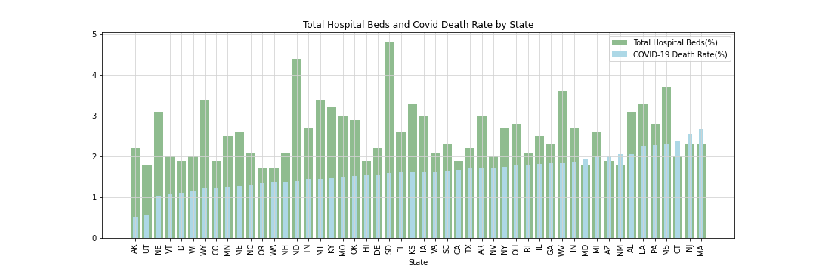
Health Care : Hospital Beds versus Death Rate Does having accessible healthcare effect death rate?
The Small Print
Data Sources: Center for Disease Control (CDC) website: cdc.gov

Slide 11
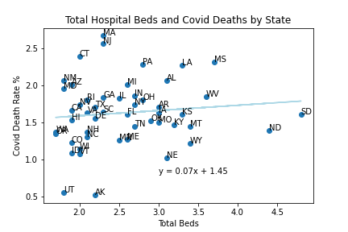
Health Care : Hospital Beds versus Death Rate Does having accessible healthcare effect death rate?
The Small Print
Data Sources: Center for Disease Control (CDC) website: cdc.gov

Slide 12
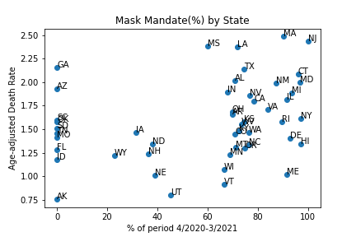
Preventative Measures States with no mask mandate have better outcomes than those with >80% mandates.
The Small Print
Definitions of any terms or metrics: March 2020 to April 2021 | Death Rate is cumulative confirmed Covid Deaths / cumulative confirmed Covid Cases
Data Sources: Center for Disease Control (CDC) website: cdc.gov
Omissions or filtering: No data for AS

Slide 13
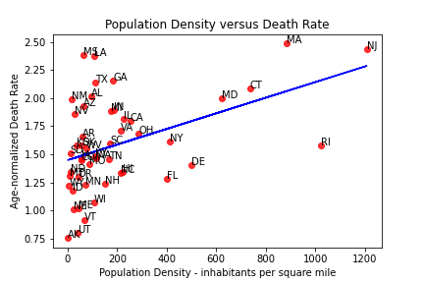
Geography “Distancing” is a factor in the spread of Covid-19. Death Rate shows a very weak correlation with population density.
The Small Print
Definitions of any terms or metrics: March 2020 to April 2021 | Death Rate is cumulative confirmed Covid Deaths / cumulative confirmed Covid Cases
Data Sources: Center for Disease Control (CDC) website: cdc.gov
Omissions or filtering: No data for AS

Slide 14
Overall Conclusions
Very difficult to make a judgement on best or worst
Surprised that data was not more conclusive
Lessons learned
Collaborating on Github
Finding the data was difficult
CDC data is amazing / CDC API
Used Census data API
A lot pandas manipulation

