Slide 1
DIABETES ONSET PREDICTION
Module 1: Understanding the dataset and EDA in Python
Cleaning strategy, missing-data diagnosis, and exploratory findings on the Pima Indians Diabetes dataset

Slide 2
AGENDA
What This Module Covers
01
Dataset Audit
Shape, structure, class balance, and data quality checks
02
The Missing-Data Problem
Handling biologically-impossible zeros as disguised missing values
03
Cleaning Strategy
Leakage-safe train/test split, imputation, and outlier treatment
04
EDA Findings
Distributions, correlations, and class-separating features
Diabetes Onset Prediction | Module 1: Data Understanding & EDA
2

Slide 3
DATASET AUDIT
A Clean, Compact, Imbalanced Clinical Dataset
768
8
0
34.9%
Patient Records
Diagnostic Features
Duplicate Rows
Diabetes Prevalence
Diabetes Onset Prediction | Module 1: Data Understanding & EDA
3

Slide 4
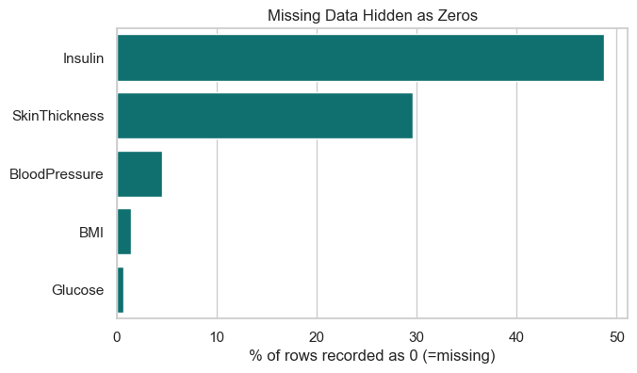
DATA QUALITY
Missing Data, Disguised as Zeros
A value of 0 for Glucose, Blood Pressure, Skin Thickness, Insulin, or BMI is not a low reading — it is not physiologically possible in a living patient. These are treated as missing, not as outliers.
Insulin
48.7% missing
Skin Thickness
29.6% missing
Blood Pressure
4.6% missing
BMI / Glucose
< 2% missing
Insulin and Skin Thickness missingness co-occur strongly (correlation 0.67) — suggesting a shared cause, such as a test not administered, rather than random nulls.
Diabetes Onset Prediction | Module 1: Data Understanding & EDA
4

Slide 5
METHODOLOGY
Cleaning Strategy
1
Split before imputing
Train/test split (80/20) happens first, so imputation statistics are learned only from training data — no leakage into the test set.
2
Median imputation
Insulin and Skin Thickness are right-skewed — the median resists distortion from extreme values that the mean would absorb.
3
No target-based imputation
Imputing by Outcome group is not valid: a real new patient has no known Outcome to condition on. That approach doesn’t generalize to deployment.
4
Missingness as a feature
Insulin_missing and SkinThickness_missing indicator flags preserve the signal in whether a value was recorded at all.
Diabetes Onset Prediction | Module 1: Data Understanding & EDA
5

Slide 6
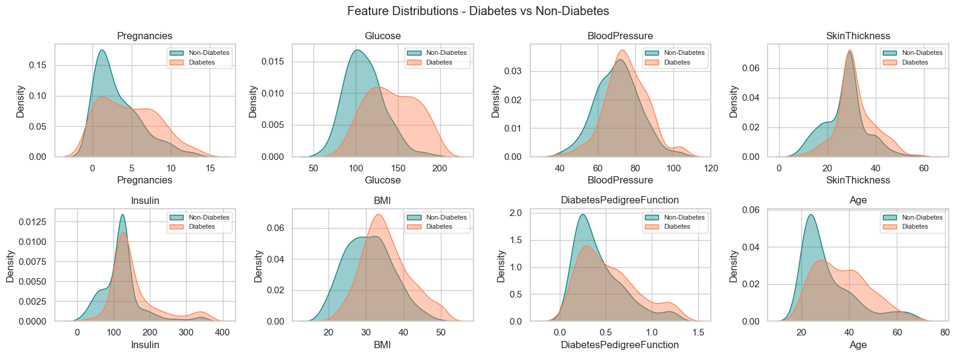
EXPLORATORY ANALYSIS
Feature Distributions by Outcome
Diabetes Onset Prediction | Module 1: Data Understanding & EDA
6

Slide 7
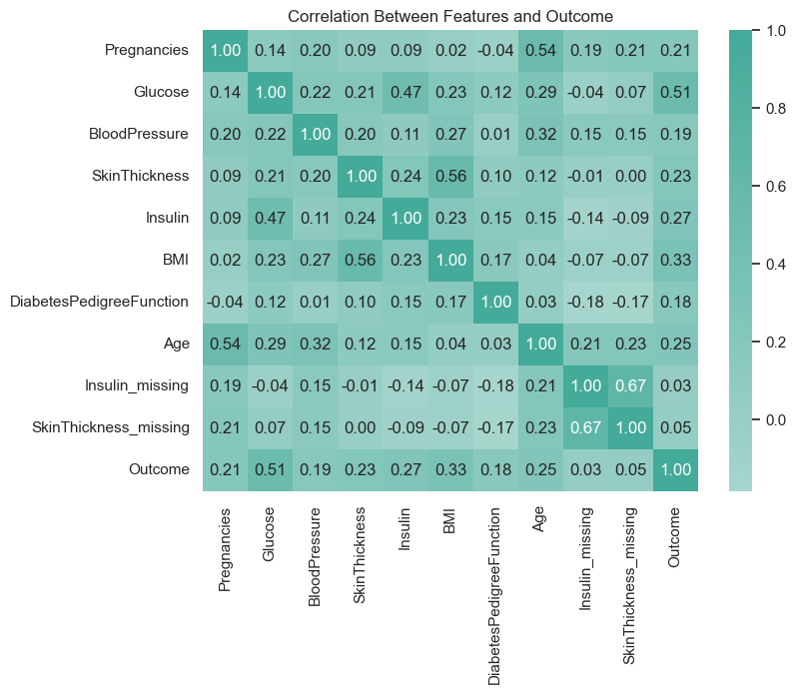
EXPLORATORY ANALYSIS
What Correlates With Diabetes Onset?
Glucose
Strongest single correlate with Outcome — consistent with clinical expectation.
BMI
Second-strongest correlate; moderate positive relationship.
Age & Pregnancies
Moderately correlated with each other, as expected physiologically — worth watching for multicollinearity in linear models.
Skin Thickness & BMI
Correlated with each other; a candidate for feature engineering or redundancy checks in Module 2.
Diabetes Onset Prediction | Module 1: Data Understanding & EDA
7

Slide 8
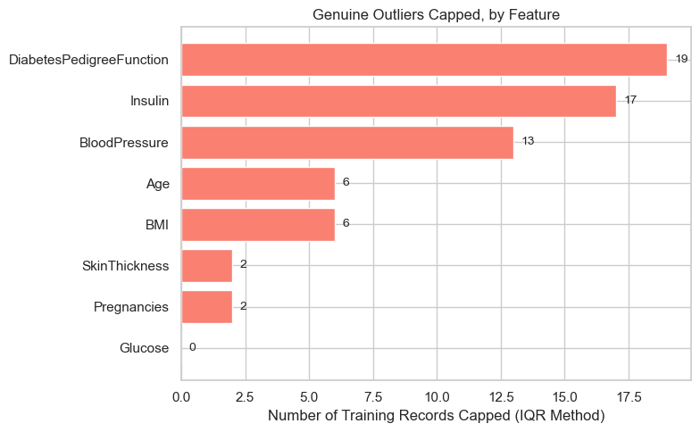
METHODOLOGY
Outlier Treatment — and a Bug We Caught
QA Finding
Computing IQR bounds after imputing Insulin flagged 41% of records as “outliers.” That's a false signal: half the column was one repeated median value, which skewed the interquartile range itself.
Fix: IQR bounds are computed only from originally observed values, then applied to the full column. Result: Insulin's flagged outliers dropped from 253 to 17 records.
Diabetes Onset Prediction | Module 1: Data Understanding & EDA
8

Slide 9
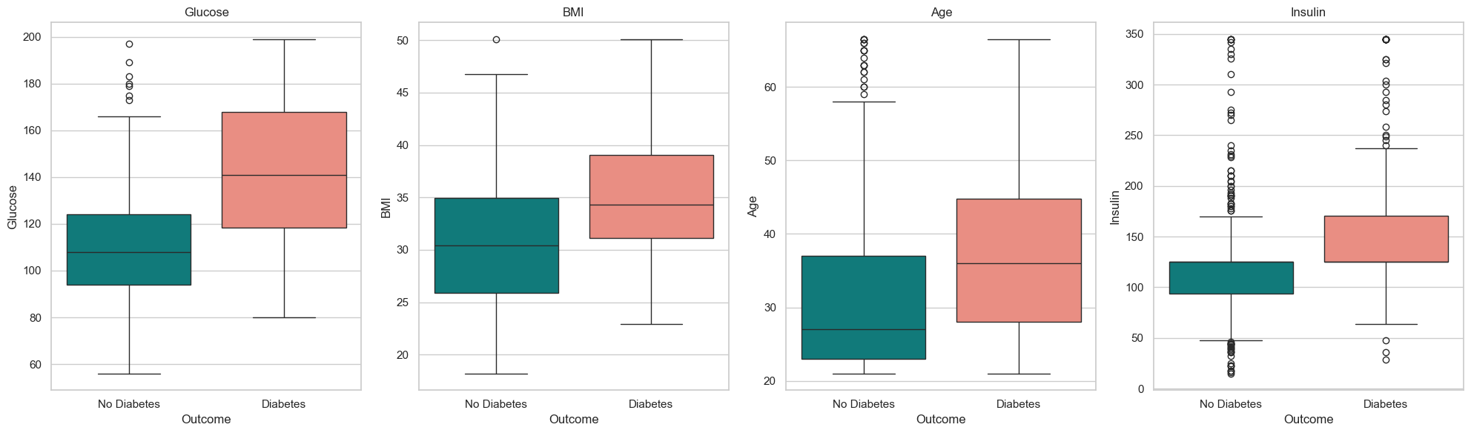
EXPLORATORY ANALYSIS
Key Features Separate the Two Classes
Glucose and BMI show the clearest median separation between classes. Age shows a modest shift; Insulin's overlap is wide, consistent with its high missingness and noisier imputed values.
Diabetes Onset Prediction | Module 1: Data Understanding & EDA
9

Slide 10
MODULE 1 — SUMMARY
Dataset Is Understood, Cleaned, and Leak-Proof
614 training / 154 test records, stratified 80/20 split
NEXT: MODULE 2
Sentinel zeros in 5 columns identified and imputed (train-fit median)
Model Building and Feature Engineering.
Insulin_missing & SkinThickness_missing indicators added
Outlier bounds corrected to use observed-only data — realistic capping
Diabetes Onset Prediction | Module 1: Data Understanding & EDA
10

