Slide 1
SWING

Slide 2
JAVA provides a rich set of libraries to create Graphical User Interface in a platform independent way. In this PPT , we'll look at SWING GUI controls.

Slide 3
SWING - Overview
Swing API is a set of extensible GUI Components to ease the developer's life to create JAVA based Front End/GUI Applications. It is build on top of AWT API and acts as a replacement of AWT API, since it has almost every control corresponding to AWT controls. Swing component follows a Model-View-Controller architecture to fulfill the following criterias.
A single API is to be sufficient to support multiple look and feel.
API is to be model driven so that the highest level API is not required to have data.
API is to use the Java Bean model so that Builder Tools and IDE can provide better services to the developers for use.

Slide 4
MVC Architecture
Swing API architecture follows loosely based MVC architecture in the following manner.
Model represents component's data.
View represents visual representation of the component's data.
Controller takes the input from the user on the view and reflects the changes in Component's data.
Swing component has Model as a seperate element, while the View and Controller part are clubbed in the User Interface elements. Because of which, Swing has a pluggable look-and-feel architecture.

Slide 5
Swing Features
Light Weight − Swing components are independent of native Operating System's API as Swing API controls are rendered mostly using pure JAVA code instead of underlying operating system calls.
Rich Controls − Swing provides a rich set of advanced controls like Tree, TabbedPane, slider, colorpicker, and table controls.
Highly Customizable − Swing controls can be customized in a very easy way as visual apperance is independent of internal representation.
Pluggable look-and-feel − SWING based GUI Application look and feel can be changed at run-time, based on available values.

Slide 6
SWING - Controls
Every user interface considers the following three main aspects −
UI Elements − These are the core visual elements the user eventually sees and interacts with. GWT provides a huge list of widely used and common elements varying from basic to complex, which we will cover in this tutorial.
Layouts − They define how UI elements should be organized on the screen and provide a final look and feel to the GUI (Graphical User Interface). This part will be covered in the Layout chapter.
Behavior − These are the events which occur when the user interacts with UI elements

Slide 7
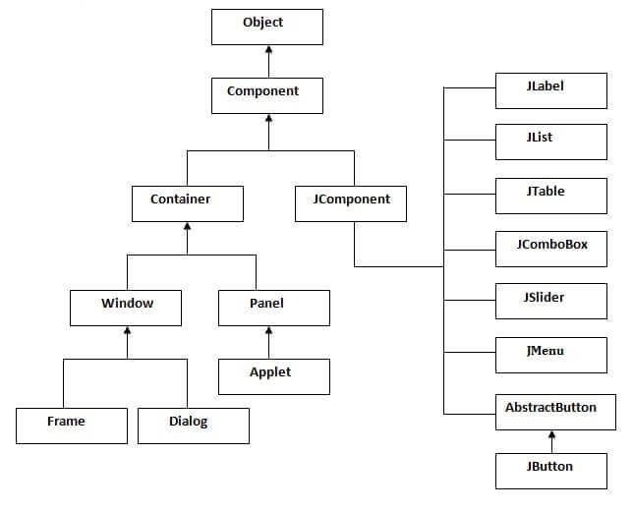
Hierarchy of Java Swing classes

Slide 8
Java JTable
The JTable class is used to display data in tabular form. It is composed of rows and columns.

Slide 9
Commonly used Constructors:
Constructor | Description
JTable() | Creates a table with empty cells.
JTable(Object[][] rows, Object[] columns) | Creates a table with the specified data.

Slide 10
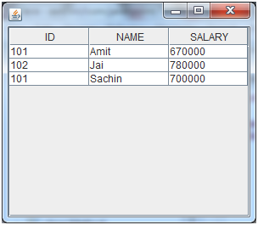
Java JTable Example
import javax.swing.*;
public class TableExample {
JFrame f;
TableExample(){
f=new JFrame();
String data[][]={ {"101","Amit","670000"},
{"102","Jai","780000"},
{"101","Sachin","700000"}};
String column[]={"ID","NAME","SALARY"};
JTable jt=new JTable(data,column);
jt.setBounds(30,40,200,300);
JScrollPane sp=new JScrollPane(jt);
f.add(sp);
f.setSize(300,400);
f.setVisible(true);
}
public static void main(String[] args) {
new TableExample();
}
}

Slide 11
Java JList
The object of JList class represents a list of text items. The list of text items can be set up so that the user can choose either one item or multiple items. It inherits JComponent class.

Slide 12
Commonly used Constructors:
Constructor | Description
JList() | Creates a JList with an empty, read-only, model.
JList(ary[] listData) | Creates a JList that displays the elements in the specified array.
JList(ListModel<ary> dataModel) | Creates a JList that displays elements from the specified, non-null, model.

Slide 13
Commonly used Methods
Methods | Description
Void addListSelectionListener(ListSelectionListener listener) | It is used to add a listener to the list, to be notified each time a change to the selection occurs.
int getSelectedIndex() | It is used to return the smallest selected cell index.
ListModel getModel() | It is used to return the data model that holds a list of items displayed by the JList component.
void setListData(Object[] listData) | It is used to create a read-only ListModel from an array of objects.

Slide 14
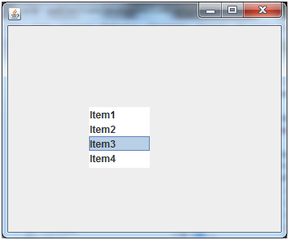
Java JList Example
public class ListExample
{
ListExample(){
JFrame f= new JFrame();
DefaultListModel<String> l1 = new DefaultListModel<>();
l1.addElement("Item1");
l1.addElement("Item2");
l1.addElement("Item3");
l1.addElement("Item4");
JList<String> list = new JList<>(l1);
list.setBounds(100,100, 75,75);
f.add(list);
f.setSize(400,400);
f.setLayout(null);
f.setVisible(true);
}
public static void main(String args[])
{
new ListExample();
}
}

Slide 15
Java JOptionPane
The JOptionPane class is used to provide standard dialog boxes such as message dialog box, confirm dialog box and input dialog box. These dialog boxes are used to display information or get input from the user. The JOptionPane class inherits JComponent class.

Slide 16
Common Constructors of JOptionPane class
Constructor | Description
JOptionPane() | It is used to create a JOptionPane with a test message.
JOptionPane(Object message) | It is used to create an instance of JOptionPane to display a message.
JOptionPane(Object message, int messageType | It is used to create an instance of JOptionPane to display a message with specified message type and default options.

Slide 17
Common Methods of JOptionPane class
Methods | Description
JDialog createDialog(String title) | It is used to create and return a new parentless JDialog with the specified title.
static void showMessageDialog(Component parentComponent, Object message) | It is used to create an information-message dialog titled "Message".
static void showMessageDialog(Component parentComponent, Object message, String title, int messageType) | It is used to create a message dialog with given title and messageType.
static int showConfirmDialog(Component parentComponent, Object message) | It is used to create a dialog with the options Yes, No and Cancel; with the title, Select an Option.
static String showInputDialog(Component parentComponent, Object message) | It is used to show a question-message dialog requesting input from the user parented to parentComponent.
void setInputValue(Object newValue) | It is used to set the input value that was selected or input by the user.

Slide 18
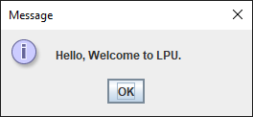
Java JOptionPane Example: showMessageDialog()
import javax.swing.*;
public class ope {
JFrame f;
ope(){
f=new JFrame();
JOptionPane.showMessageDialog(f,"Hello, Welcome to LPU.");
}
public static void main(String[] args) {
new ope();
}
}

Slide 19
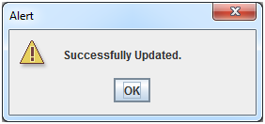
Java JOptionPane Example: showMessageDialog()
import javax.swing.*;
public class OptionPaneExample {
JFrame f;
OptionPaneExample(){
f=new JFrame();
JOptionPane.showMessageDialog(f,"Successfully Updated.","Alert",JOptionPane.WARNING_MESSAGE);
}
public static void main(String[] args) {
new OptionPaneExample();
}
}

Slide 20
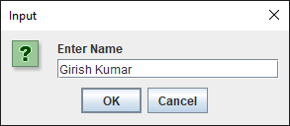
Java JOptionPane Example: showInputDialog()
import javax.swing.*;
public class OptionPaneExample {
JFrame f;
OptionPaneExample(){
f=new JFrame();
String name=JOptionPane.showInputDialog(f,"Enter Name");
}
public static void main(String[] args) {
new OptionPaneExample();
}
}

Slide 21
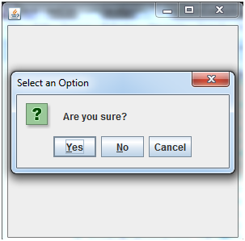
Java JOptionPane Example: showConfirmDialog()
import javax.swing.*;
import java.awt.event.*;
public class OptionPaneExample extends WindowAdapter{
JFrame f;
OptionPaneExample(){
f=new JFrame();
f.addWindowListener(this);
f.setSize(300, 300);
f.setLayout(null);
f.setDefaultCloseOperation(JFrame.DO_NOTHING_ON_CLOSE);
f.setVisible(true);
}
public void windowClosing(WindowEvent e) {
int a=JOptionPane.showConfirmDialog(f,"Are you sure?");
if(a==JOptionPane.YES_OPTION){
f.setDefaultCloseOperation(JFrame.EXIT_ON_CLOSE);
}
}
public static void main(String[] args) {
new OptionPaneExample();
}
}

Slide 22
Java JColorChooser
The JColorChooser class is used to create a color chooser dialog box so that user can select any color. It inherits JComponent class.

Slide 23
Commonly used Constructors
Constructor | Description
JColorChooser() | It is used to create a color chooser panel with white color initially.
JColorChooser(color initialcolor) | It is used to create a color chooser panel with the specified color initially.

Slide 24
Commonly used Methods
Method | Description
void addChooserPanel(AbstractColorChooserPanel panel) | It is used to add a color chooser panel to the color chooser.
static Color showDialog(Component c, String title, Color initialColor) | It is used to show the color chooser dialog box.

Slide 25
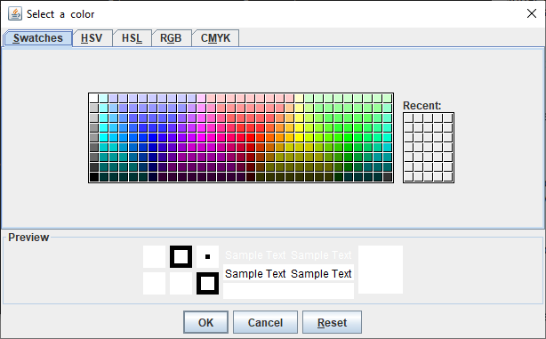
Java JColorChooser Example
import java.awt.Color;
import javax.swing.JColorChooser;
public class Main {
public static void main(String[] args) {
// Display a color chooser dialog
Color color = JColorChooser.showDialog(null, "Select a color", null);
// Check if user selected a color
if (color == null) {
System.out.println("we cancelled or closed the color chooser");
} else {
System.out.println("we selected color: " + color);
}
}
}

Slide 26
Java JProgressBar
The JProgressBar class is used to display the progress of the task. It inherits JComponent class.

Slide 27
Commonly used Constructors
Constructor | Description
JProgressBar() | It is used to create a horizontal progress bar but no string text.
JProgressBar(int min, int max) | It is used to create a horizontal progress bar with the specified minimum and maximum value.
JProgressBar(int orient) | It is used to create a progress bar with the specified orientation, it can be either Vertical or Horizontal by using SwingConstants.VERTICAL and SwingConstants.HORIZONTAL constants.
JProgressBar(int orient, int min, int max) | It is used to create a progress bar with the specified orientation, minimum and maximum value.

Slide 28
Commonly used Methods
Method | Description
void setStringPainted(boolean b) | It is used to determine whether string should be displayed.
void setString(String s) | It is used to set value to the progress string.
void setOrientation(int orientation) | It is used to set the orientation, it may be either vertical or horizontal by using SwingConstants.VERTICAL and SwingConstants.HORIZONTAL constants.
void setValue(int value) | It is used to set the current value on the progress bar.

Slide 29
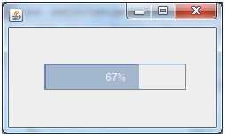
Java JProgressBar Example
import javax.swing.*;
public class ProgressBarExample extends JFrame{
JProgressBar jb;
int i=0,num=0;
ProgressBarExample(){
jb=new JProgressBar(0,2000);
jb.setBounds(40,40,160,30);
jb.setValue(0);
jb.setStringPainted(true);
add(jb);
setSize(250,150);
setLayout(null);
}
public void iterate(){
while(i<=2000){
jb.setValue(i);
i=i+20;
try{Thread.sleep(150);}catch(Exception e){}
}
}
public static void main(String[] args) {
ProgressBarExample m=new ProgressBarExample();
m.setVisible(true);
m.iterate();
}
}

Slide 30
Java JSlider
The Java JSlider class is used to create the slider. By using JSlider, a user can select a value from a specific range.

Slide 31
Commonly used Constructors of JSlider class
Constructor | Description
JSlider() | creates a slider with the initial value of 50 and range of 0 to 100.
JSlider(int orientation) | creates a slider with the specified orientation set by either JSlider.HORIZONTAL or JSlider.VERTICAL with the range 0 to 100 and initial value 50.
JSlider(int min, int max) | creates a horizontal slider using the given min and max.
JSlider(int min, int max, int value) | creates a horizontal slider using the given min, max and value.
JSlider(int orientation, int min, int max, int value) | creates a slider using the given orientation, min, max and value.

Slide 32
Commonly used Methods of JSlider class
Method | Description
public void setMinorTickSpacing(int n) | is used to set the minor tick spacing to the slider.
public void setMajorTickSpacing(int n) | is used to set the major tick spacing to the slider.
public void setPaintTicks(boolean b) | is used to determine whether tick marks are painted.
public void setPaintLabels(boolean b) | is used to determine whether labels are painted.
public void setPaintTracks(boolean b) | is used to determine whether track is painted.

Slide 33

Java JSlider Example
import javax.swing.*;
public class SliderExample1 extends JFrame{
public SliderExample1() {
JSlider slider = new JSlider(JSlider.HORIZONTAL, 0, 50, 25);
JPanel panel=new JPanel();
panel.add(slider);
add(panel);
}
public static void main(String s[]) {
SliderExample1 frame=new SliderExample1();
frame.pack();
frame.setVisible(true);
}
}

Slide 34
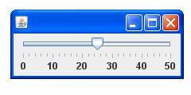
ava JSlider Example: painting ticks
import javax.swing.*;
public class SliderExample extends JFrame{
public SliderExample() {
JSlider slider = new JSlider(JSlider.HORIZONTAL, 0, 50, 25);
slider.setMinorTickSpacing(2);
slider.setMajorTickSpacing(10);
slider.setPaintTicks(true);
slider.setPaintLabels(true);
JPanel panel=new JPanel();
panel.add(slider);
add(panel);
}
public static void main(String s[]) {
SliderExample frame=new SliderExample();
frame.pack();
frame.setVisible(true);
}
}

Slide 35
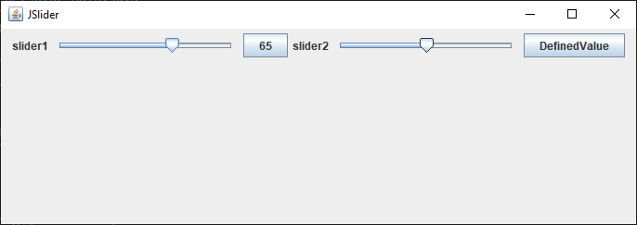
public void stateChanged(ChangeEvent ev)
{
if(ev.getSource() == slider1)
{
jb1.setText(""+slider1.getValue());
}
if(ev.getSource() == slider2)
{
jb2.setText(""+slider2.getValue());
}
}
}
public class Main {
public static void main(String[] args) {
JSliderTest js = new JSliderTest();
}
}
import javax.swing.JFrame;
import javax.swing.JSlider;
import javax.swing.JLabel;
import javax.swing.JButton;
import javax.swing.event.ChangeListener;
import javax.swing.event.ChangeEvent;
import java.awt.FlowLayout;
class JSliderTest extends JFrame implements ChangeListener{
JSlider slider1,slider2;
JButton jb1,jb2;
JSliderTest()
{
setTitle("JSlider");
setLayout(new FlowLayout());
setJSlider();
setSize(700, 250);
setVisible(true);
setDefaultCloseOperation(JFrame.EXIT_ON_CLOSE);
}
private void setJSlider()
{
slider1 = new JSlider();
slider1.addChangeListener(this);
add(new JLabel("slider1"));
add(slider1);
add(jb1 = new JButton("DefaultValue"));
slider2 = new JSlider(100,200);
slider2.addChangeListener(this);
add(new JLabel("slider2"));
add(slider2);
add(jb2 = new JButton("DefinedValue"));
}

Slide 36
Thanks

