Slide 1

Unit – 1 Introduction to Web Technology
Prof. Arjun V. Bala
 9624822202
→ arjun.bala@darshan.ac.in
Web Technology (2160708) Darshan Institute of Engineering & Technology

Slide 2
Outline
Introduction
What is WWW?
What is Internet?
HTTP
HTTP Request
HTTP Response
Web Browsers
Features of Web 2.0

Slide 3
What is WWW?
WWW stands for World Wide Web.
A technical definition of the WWW is − All the resources and users on the Internet that are using HTTP.
HTTP stands for Hypertext Transfer Protocol.
This is the protocol being used to transfer hypertext documents that makes the World Wide Web possible.

Slide 4
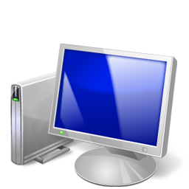
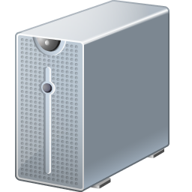

How the Web Works?
World Wide Web (WWW) use classical client / server architecture
Hyper Text Transfer Protocol is text-based request-response protocol
Server running Web Server Software (IIS, Apache, etc.)
Client running a Web Browser
HTTP
Page request
HTTP
Server response

Slide 5
What is the Internet?
The Internet is a massive network of networks, a networking infrastructure.
It connects millions of computers together globally, forming a network in which any computer can communicate with any other computer as long as they are both connected to the Internet.
Information that travels over the Internet uses many different set of rules which are known as protocols.

Slide 6
HTTP Request
Request Method
GET
POST
PUT
DELETE
Etc….
Request Header Fields
Accept-Charset, Accept-Encoding, Accept-Language, User-Agent, Host

Slide 7
HTTP Request (Example)
GET /hello.html HTTP/1.1 |  | hello.html is requested from server using GET method of HTTP version 1.1
User-Agent: Mozilla/4.0 |  | Client is using version 4 of the mozila browser
Host: www.abc.com |  | Host of the page is abc.com
Accept-Language: en-us |  | Client accepts US English Locale

Slide 8
HTTP Response
Response Header Fields
Date, Server, Last-Modified, Content-Length, Content-Type
Status Code
1** : Information
2** : Success
3** : Redirection
4** : Client Error
5** : Server Error

Slide 9
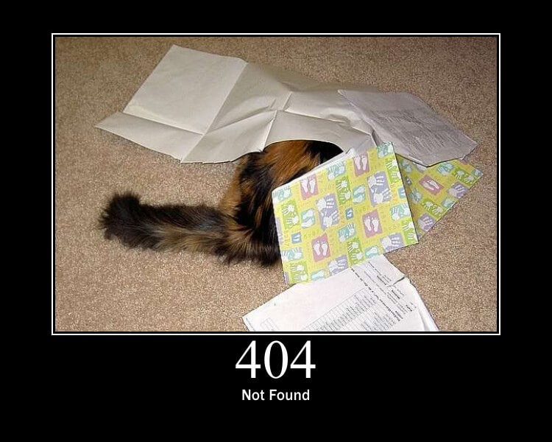
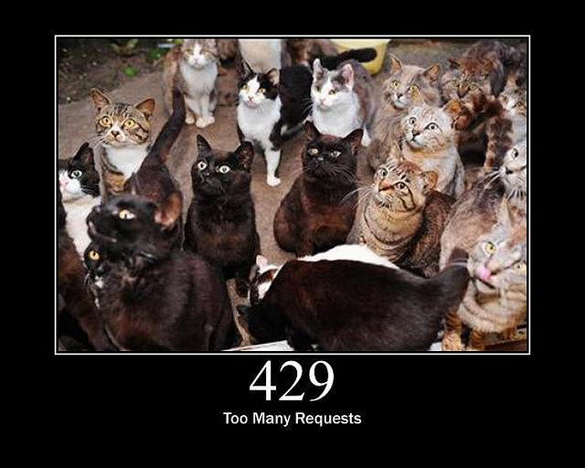
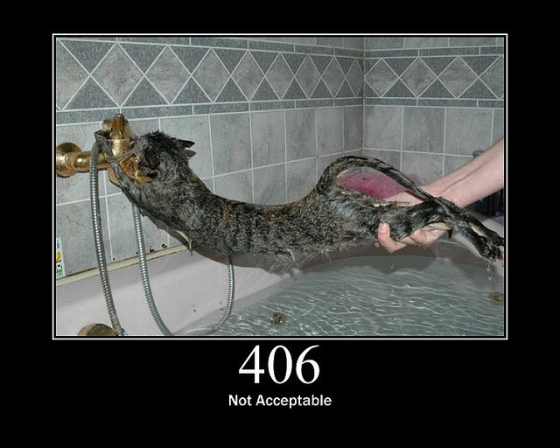
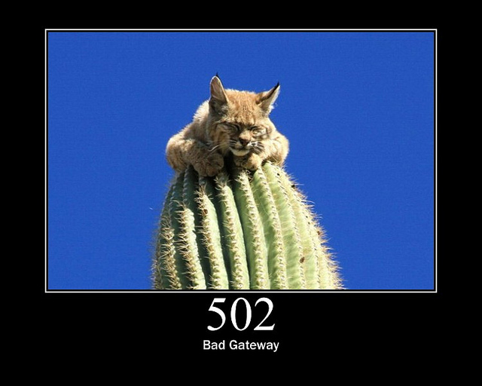
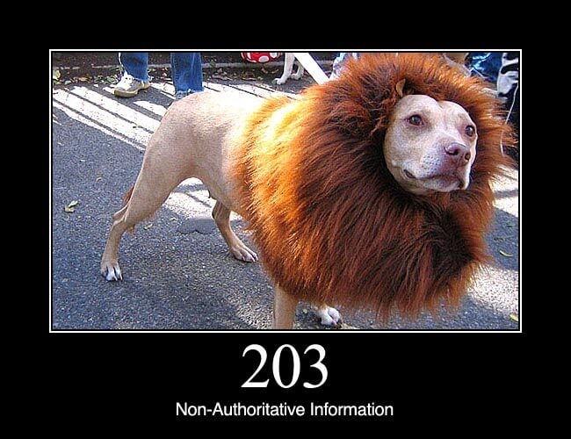
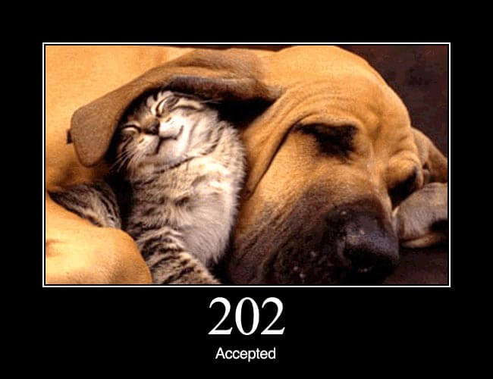
HTTP Status Codes

Slide 10
HTTP Response (Example)
HTTP/1.1 200 OK |  | Response is 200 status code with OK message using HTTP1.1
Date: Mon, 27 Jul 2009 12:28:53 GMT |  | Response Date & Time
Server: Apache/2.2.14 (Win32) |  | Webserver used by server
Last-Modified: Wed, 22 Jul 2009 19:15:56 GMT |  | Last modified at Date & Time
Content-Length: 88 |  | Content-Length in bytes
Content-Type: text/html |  | Content-Type of the response

Slide 11
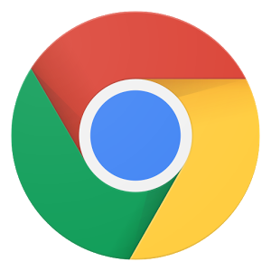



Web Browsers
A web browser or Internet browser is a software application for retrieving, presenting, and traversing information resources on the World Wide Web.
Example :
An information resource is identified by a Uniform Resource Identifier (URI) and may be a web page, image, video, or other piece of content.
Hyperlinks present in resources enable users to easily navigate their browsers to related resources
Mozila Firefox
Google Chrome
Opera
Internet Explorer

Slide 12
Features of Web 2.0
Folksonomy | Social Tagging
Traditional Web like Yahoo Directory and DMOZ uses a pre-defined classification of Information like category & sub category.
On the other hand Web 2.0 without sticking to the existing framework of classification , allows user to create free classification/ arrangement of information.
This is also known as Social tagging.
Wikis
Wikis - sites like Wikipedia and others enable users from around the world to add and update online content
Social Networking
Sites like Facebook and MySpace allow users to build and customize their own profiles and communicate with friends.

Slide 13
Features of Web 2.0 (Cont.)
User Participation
In traditional web the contents are solely provided by the website owner or company, but in web 2.0 the users participate in content sourcing. This is also known as Crowd sourcing. Examples: Wikipedia & YouTube.
Long Tail
The traditional web was like a retail business the product is sold directly to user and the revenue generated. But in web 2.0 the niche product is not sold directly but offered as a service on demand basis and income is generated as monthly fee and pay per consumption.
Rich User Experience
Traditional web are built with HTML and CSS CGI and had been offered as a static page. On the other hand Web 2.0 uses Ajax(Asynchronous JavaScript + XML) presenting dynamic, rich user experience to users.

