Slide 1

With Dylan

Slide 2
Visit go.wisc.edu/ststoday
in your web browser
Complete Step 1: Sign In
Complete Step 2: Canvas (Class Files)
“Enroll in Course” → “Go To Course” → Modules →SQL I
Click on chinook.db

Slide 3
Visit go.wisc.edu/ststoday
in your web browser
Complete Step 1: Sign In
Complete Step 2: Class Files
https://go.wisc.edu/oocu69 (blank) https://go.wisc.edu/6ar9nt (filled out)→ “Open with Google Collaboratory” → File→Save a Copy in Drive

Slide 4


https://go.wisc.edu/sts

Slide 5
Land Acknowledgment
Before we begin the workshop, we want to recognize that the UW-Madison campus occupies the homeland of the indigenous Ho-Chunk tribe, whom the US government forced to sign a series of treaties that ultimately displaced them from the area in the 1830s.
It’s important to remember that many opportunities students enjoy at UW-Madison, such as this workshop, are only available as a result of systemic and individual oppression that indigenous people of this area have faced and continue to experience today.
It is vital for the voices, messages, and stories of Indigenous people to be heard, understood, and amplified by non-Indigenous people. We can’t change the past, but we must acknowledge it and learn from it so we can address the harms that may persist from it.
By examining U.S. history and reflecting on the ways we as individuals suffer and/or benefit from its effects, we can work towards a future that chooses help over harm, prioritizes awareness over ignorance, and seeks equity over injustice.

Slide 6
If you have any questions as to why STS has chosen to implement a land acknowledgement statement into our curriculum, please contact our supervisors at sts@doit.wisc.edu

Slide 7
SQL
What We’re Covering
Basic database concepts and terminology
The relational model of databases
Basics of the SQL language
Multi-table Queries
Data Modeling with SQL

Slide 8
Databases
Organization Data is organized in a way that you can find (query) it easily and efficiently
Structure
In the relational model, data has attributes and values that give it meaning.
Interaction
A database management system (DBMS) is
the software we use to insert, delete, or otherwise
modify the items in a database or the database itself
Note: Many times people use the terms “database” and “database management system” interchangeably. It’s important in some cases to know the distinction

Slide 9
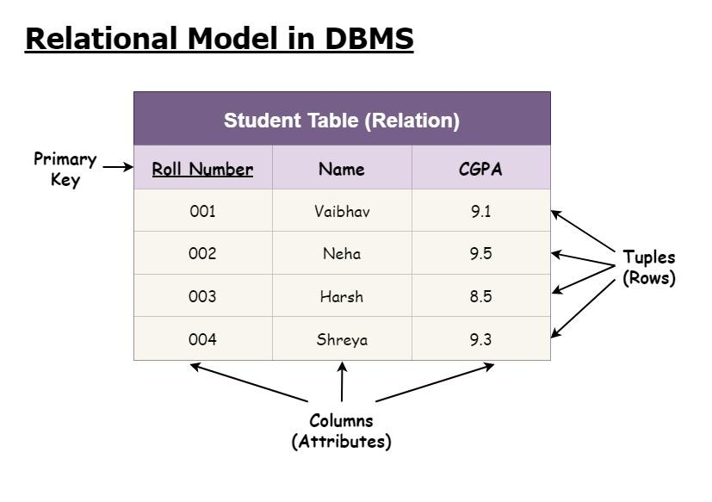
Organization: The Relational Model
Basically, tables Tables have rows (relations, tuples, entities) and
columns (attributes)
A table is a set of entities of the same class
Each row represents a specific entity
Each column represents a certain property of the
entity
Isn’t this just Excel?
No! The key behind the relational model is we can link tables together to gain more information than we would normally have with a single table

Slide 10
Structure: Attributes and Data types
Schema An outline the structure of a table. The table
name and a list of it’s attributes
Values and Data Types
The form of the values of an attribute.
E.g. string/varchar (text), integer,
float (decimal numbers), boolean (true/false)
Special value- NULL. Means nothing
Keys (A unique type of attribute)
A unique identifier for a row. Usually some kind of ID number, but can be any (set of) attribute(s) where the values are unique
What is the schema of this table?

Slide 11
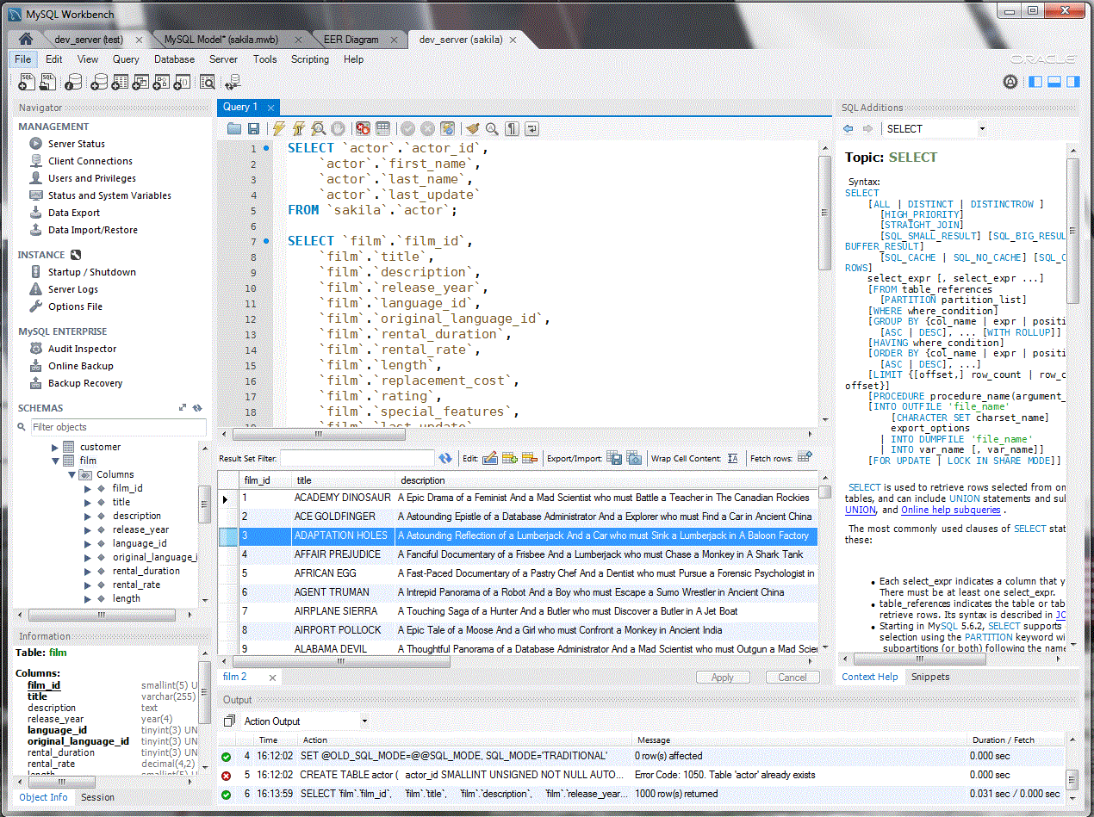
Interaction: SQL
Structured Query Language A programming language for the relational
model. It is used both to define tables and
retrieve data. In essence, we use it to create
tables from data, and create tables from
tables
Database Management System
The software where we can write SQL
queries and manage the structure of the
database

Slide 12





Common DBMS’s

Slide 13
Common DBMS’s
Notes:
Today we’re doing SQLite. Why? It’s the only one here that’s serverless (no configuration needed.) More time for analysis!
With the exception of Microsoft and Oracle, syntax is basically identical so it transfers over.

Slide 14
Go to https://sqliteonline.com/
Select File -> Open DB -> Select “Chinook.db” -> Open

Slide 15
ACTIVITY 1: Basic Queries

Slide 16
Go through basic queries section:
Select
Where
Order by
Group by / Aggregates
Addition, subtraction, multiplication, division
Then return to slides (everything after here might be SQL II material)

Slide 17
Multi-Table Queries: Why?
Example: Student Enrollment Table
We are building a database to keep track of students and the classes they are enrolled in. How might we do this?

Slide 18
Multi-Table Queries: Why?
Example: Student Enrollment Table
Idea: Create a table containing all the information:
Create Table Student (
s_id INTEGER
s_name CHAR(20),
s_email CHAR(20) UNIQUE –ensures unique values
class CHAR(20)
);
The table contains each student and the classes they are taking

Slide 19
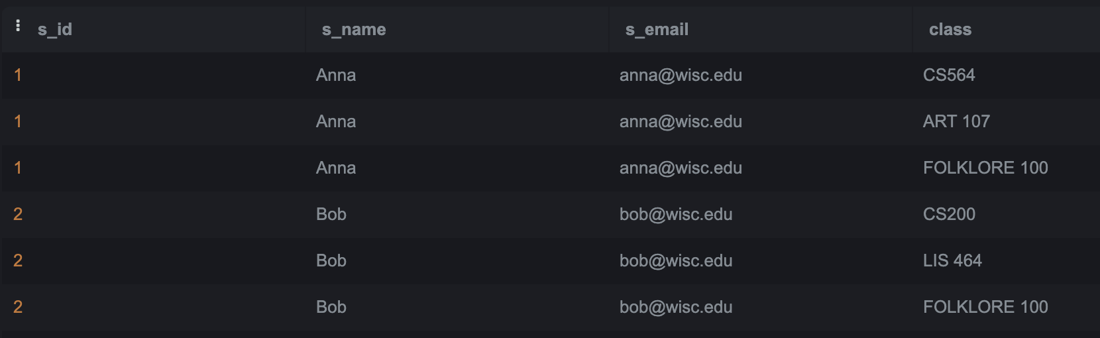
Multi-Table Queries: Why?
Example: Student Enrollment Table
What’s the problem here?
Notes:
Problems include: duplicated data, primary keys not unique

Slide 20
Multi-Table Queries: Why?
Example: Student Enrollment Table
Idea 2: Separate the information into tables for Students and Classes
Notes:
Problems include: duplicated data, primary keys not unique

Slide 21
Multi-Table Queries
Remember that key stuff from before? A unique identifier for a row.
Primary key
THE unique identifier for a row. Can think of it like a name or ID number
Foreign key
A link to another table. Allows you to match rows from one table to another table, ensuring that all the attributes in both tables match with their correct rows

Slide 22
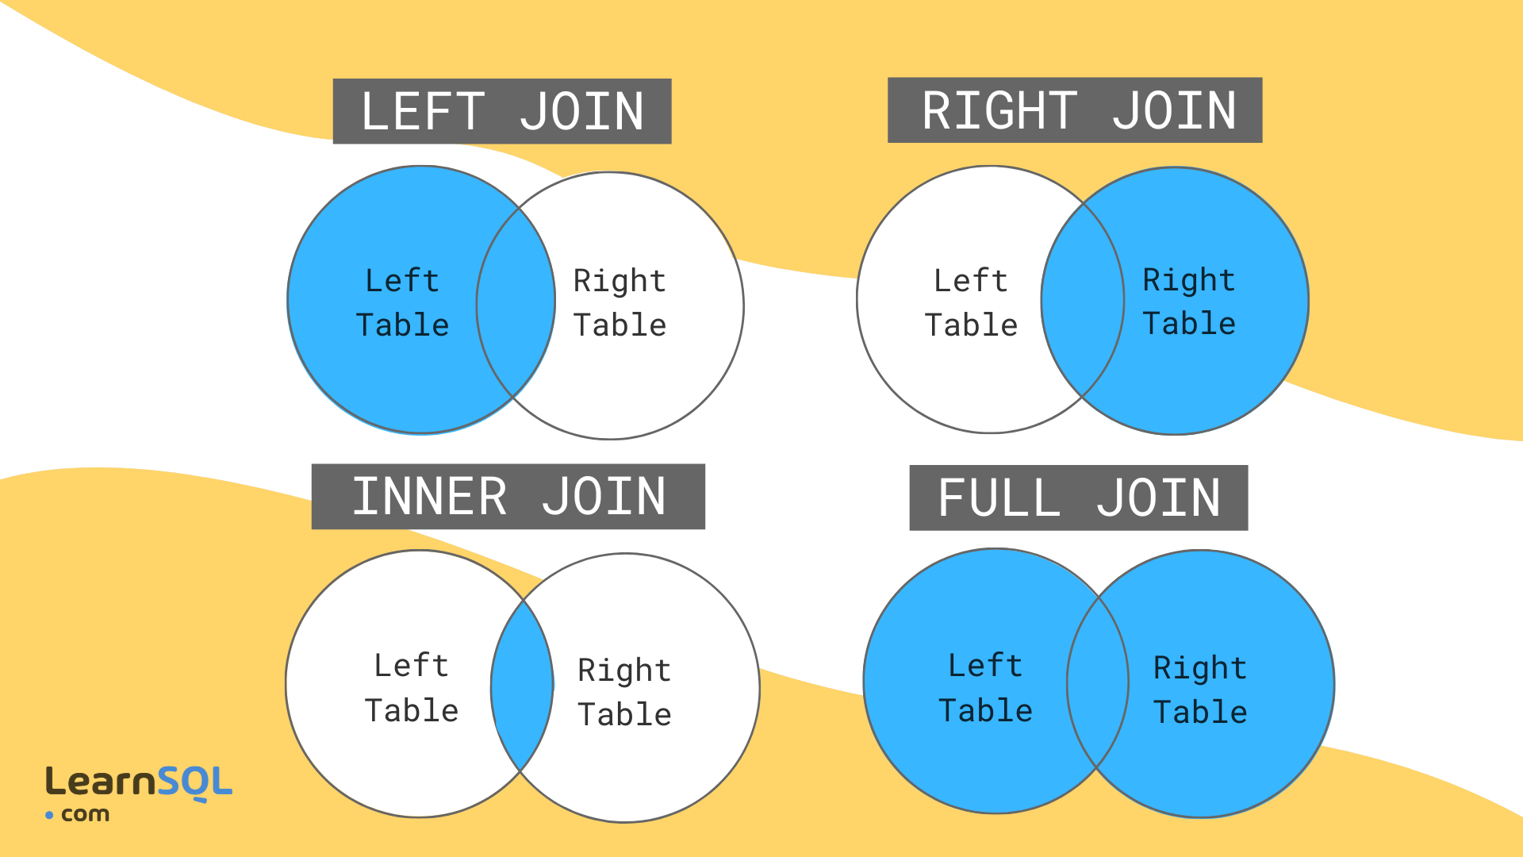
Joins
Join Merges two tables based on a
foreign key
Inner join
Everything where there’s a match
in both tables
Left outer join
Everything in the left table regardless
of whether there’s a match in the right table

Slide 23
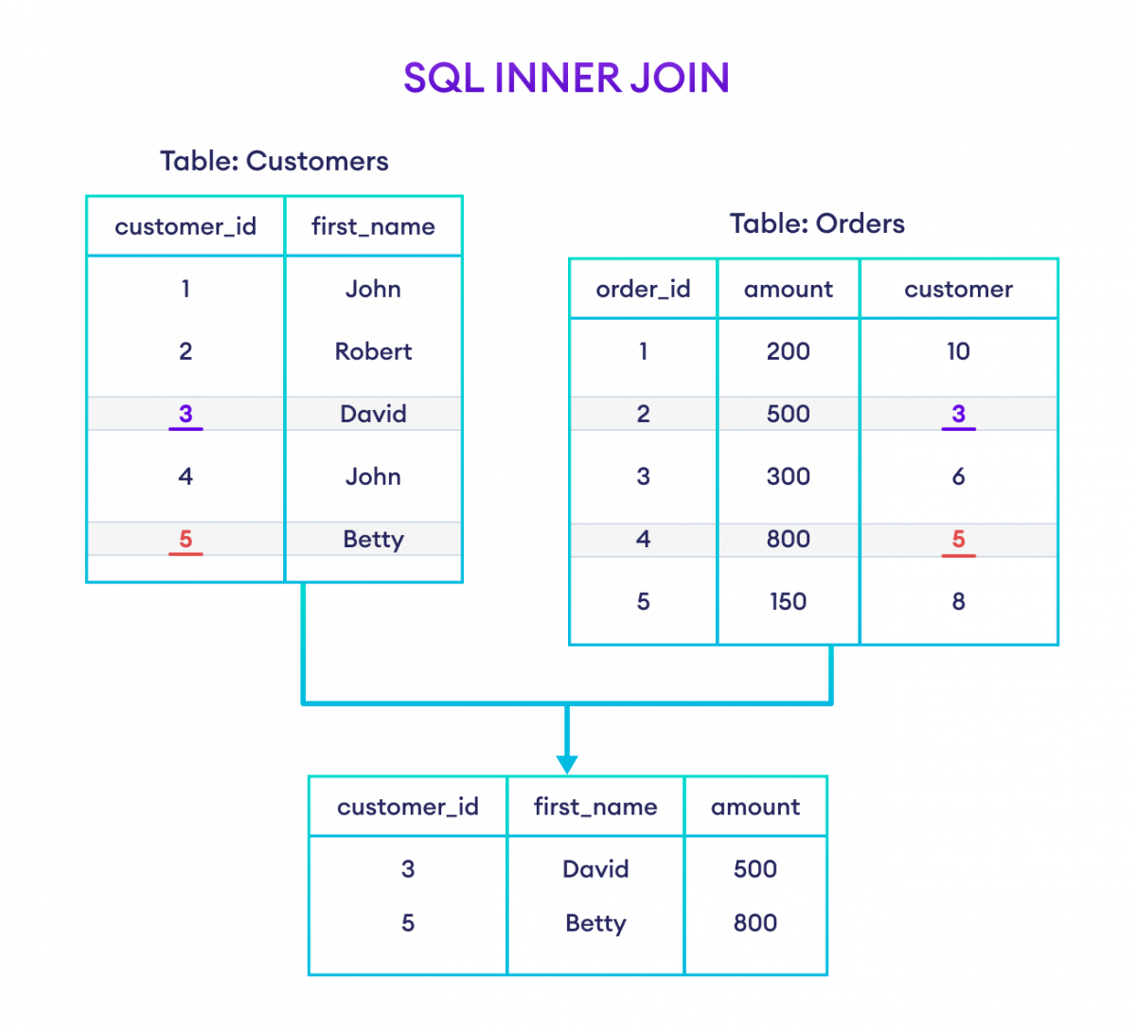
Join Examples
Inner join
Everything where there’s a match
in both tables
SELECT c.customer_id, c.first_name, o.amount
FROM Customers c
INNER JOIN Orders o ON
c.customer_id = o.customer

Slide 24
Join Examples
Inner join
Everything where there’s a match
in both tables
ALTERNATIVELY:
SELECT c.customer_id, c.first_name, o.amount
FROM Customers c, Orders o
WHERE c.customer_id = o.customer

Slide 25
SQL Join syntax
Explicit join vs implicit join
SELECT c.customer_id, c.first_name, o.amount
FROM Customers c
INNER JOIN Orders o ON
c.customer_id = o.customer
SELECT [Column1, Column2…]
FROM [Table1]
[JoinType] JOIN [Table2] ON
[Table1].[JoinColumn1] = [Table2].[JoinColumn2]
SELECT c.customer_id, c.first_name, o.amount
FROM Customers c, Orders o
WHERE c.customer_id = o.customer
SELECT [Column1, Column2…]
FROM [Table1], [Table2]
WHERE [Table1].[JoinColumn1] = [Table2].[JoinColumn2]

Slide 26
SQL Join syntax
Explicit join vs implicit join
SELECT c.customer_id, c.first_name, o.amount
FROM Customers c
INNER JOIN Orders o ON
c.customer_id = o.customer
SELECT [Column1, Column2…]
FROM [Table1]
[JoinType] JOIN [Table2] ON
[Table1].[JoinColumn1] = [Table2].[JoinColumn2]
SELECT c.customer_id, c.first_name, o.amount
FROM Customers c, Orders o
WHERE c.customer_id = o.customer
SELECT [Column1, Column2…]
FROM [Table1], [Table2]
WHERE [Table1].[JoinColumn1] = [Table2].[JoinColumn2]
Explicitly state your join type Use a WHERE clause - join is implied

Slide 27
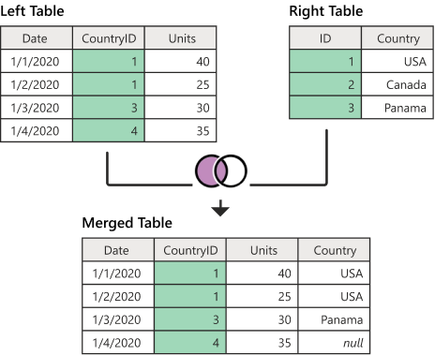
Join Examples
Left outer join
Everything in the left table regardless
of whether there’s a match in the right table
SELECT l.Date, l.CountryID, l.Units, r.Country
FROM LeftTable l
LEFT OUTER JOIN RightTable r ON
l.CountryID = r.ID

Slide 28
ACTIVITY 2: Joins and Multi-Table Queries

Slide 29
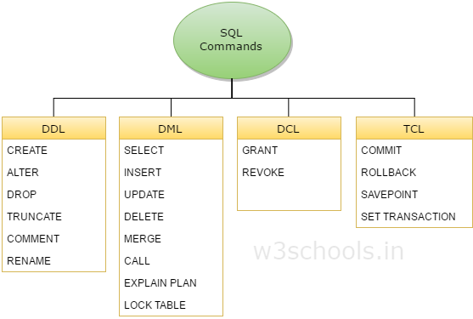
Creating Tables
Data Definition Language
A Data Definition Language (DDL). A DDL
allows us to define our schema
Data Manipulation Language
A Data Manipulation Language (DML). A DML
allows us to change our data

Slide 30
Creating Tables - Definitions
Data Manipulation Language
A Data Manipulation Language (DML). A DML
allows us to change our data
Data Definition Language
A Data Definition Language (DDL). A DDL
allows us to define our schema
SQL is BOTH a DML and DDL

Slide 31

Creating Tables - Commands
UPDATE - begin updating a table
INSERT - adds a row to a table
SET- change values in a row
DELETE - deletes a row from a table
CREATE - create a new table
DROP - permanently deletes a table (WARNING: VERY DANGEROUS - CAN’T UNDO)

Slide 32
ACTIVITY 3: Creating Tables

Slide 33
TL;DR
SELECT Column(s)
FROM Table(s)
[WHERE Condition(s)]
[GROUP BY Column(s)]
[HAVING Condition(s)]
[ORDER BY Column(s) [ASC/DESC]]
[LIMIT NumberOfRows]
Note: all the clauses MUST be in this order
[ ] denotes optional clause

Slide 34
Documentation
https://www.sqlite.org/docs.html - reference for all SQLite functionality
https://www.sqlitetutorial.net/ - comprehensive tutorial for beginners
https://www.geeksforgeeks.org/ - tutorials with examples
https://www.w3schools.com/ - interactive tutorials
https://dbeaver.io/ - free and open source database management system

Slide 35
Visit go.wisc.edu/ststoday
in your web browser
Complete Step 3: Evaluation
SQL I with Dylan

