Slide 1

Project Guide: Ms. Archana Goel Submitted by Pala Mohana Jyothi
LAPTOP SHOP MANAGEMENT SYSTEM

Slide 2
CONTENTS
Introduction
Objective
Tools or Languages Used
Employee Module
Product Module
Supplier Module
Project Screenshots
Future Scope
Conclusion

Slide 3
In Laptop Shop Management System, it stores records related to Product details such as specifications of Laptop & their stock, Seller Information like contact info & quantity of stock purchased and Employee Records are maintained and manipulated. Generally all this work is done and managed manually hence leading to the chances of human errors that may create some problems. Thus, a secured and reliable system is required to handle it. Laptop Shop Management System, as described above, can Improve the management system to be error free, secure, reliable and fast. It can assist the administrator on their other activities rather than concentrating on keeping records. This increases productivity of tasks and better utilization of resources in the organization.
INTRODUCTION

Slide 4
This Project deals with the management of the Laptop Shop Management System. Shop is a place where the work is to sale Laptops, Purchasing stock for the shop and make better preparations. The aim of this project is to automate its existing manual system by the help of computerized equipment and full-fledged computer software, full filling their requirements. The main objective behind the development of the project are as follows:
OBJECTIVE
To assist the staff in capturing the effort spent on their respective working areas.
To utilize resources of the organization are used efficiently there by increasing productivity through automation.
To keep and manipulate suppliers information.
To keep and manipulate product details
To maintain and the purchase of stock at shop.

Slide 5





TOOLS OR LANGUAGES USED
Operating System:
The proposed software is targeted to run on windows operating system.
Frontend :
HTML,
CSS,
JavaScript,
Thymeleaf,
Bootstrap.
Backend :
MySQL

Slide 6
EMPLOYEE MODULE
Employee
Id (PK)
Date of Joining
First Name
Last Name
Position
Salary
Phone number
Email

Slide 7
DATABASE STRUCTURE : EMPLOYEE MODULE
KEY (Auto Increment) | COLUMN NAME | DATA TYPE
Primary Key | id | int
 | doj | Varchar(45)
 | first_name | Varchar(45)
 | last_name | Varchar(45)
 | position | Varchar(45)
 | salary | int
 | phone_no | int
 | email | Varchar(45)

Slide 8
PRODUCT MODULE
Product
Id (PK)
Brand
Model
Category
Price
Stock

Slide 9
DATABASE STRUCTURE : PRODUCT MODULE
KEY (Auto Increment) | COLUMN NAME | DATA TYPE
Primary Key | id | int
 | brand | Varchar(45)
 | model | Varchar(45)
 | category | Varchar(45)
 | price | int

Slide 10
SUPPLIER MODULE
Supplier
Id (PK)
Seller Name
Phone Number
Model
Price
Discount
Quantity
Cost

Slide 11
DATABASE STRUCTURE : SUPPLIER MODULE
KEY (Auto Increment) | COLUMN NAME | DATA TYPE
Primary Key | id | int
 | seller | Varchar(45)
 | phone | Varchar(45)
 | model | Varchar(45)
 | price | int
 | discount | int
 | quantity | int
 | cost | int

Slide 12
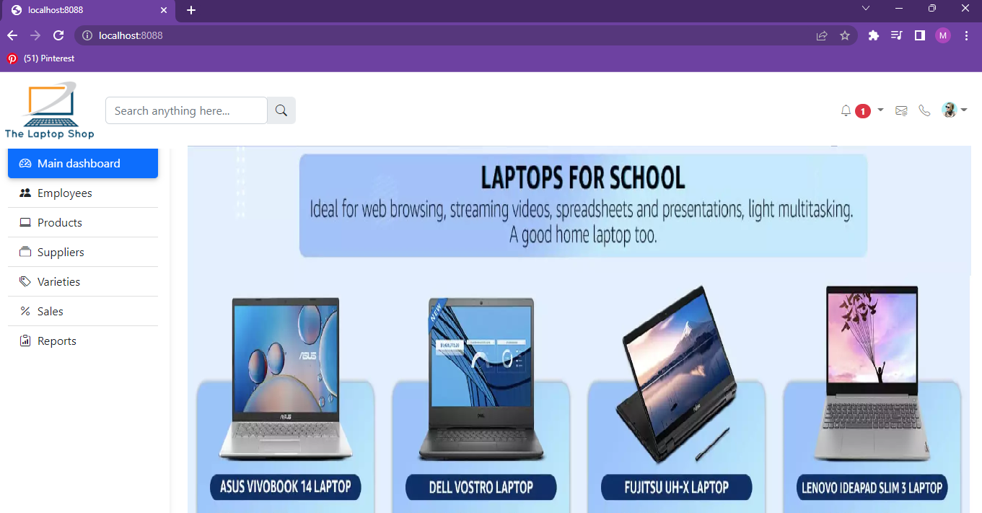
PROJECT SCREENSHOT : Home Page

Slide 13
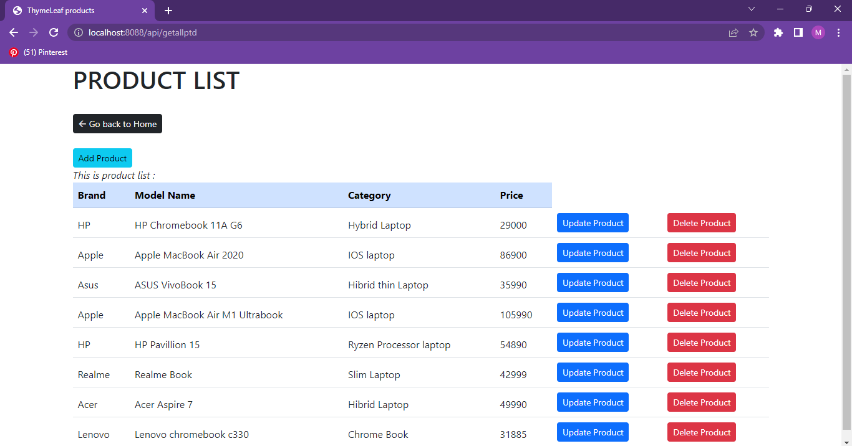
PROJECT SCREENSHOT : LIST OR TABLE

Slide 14
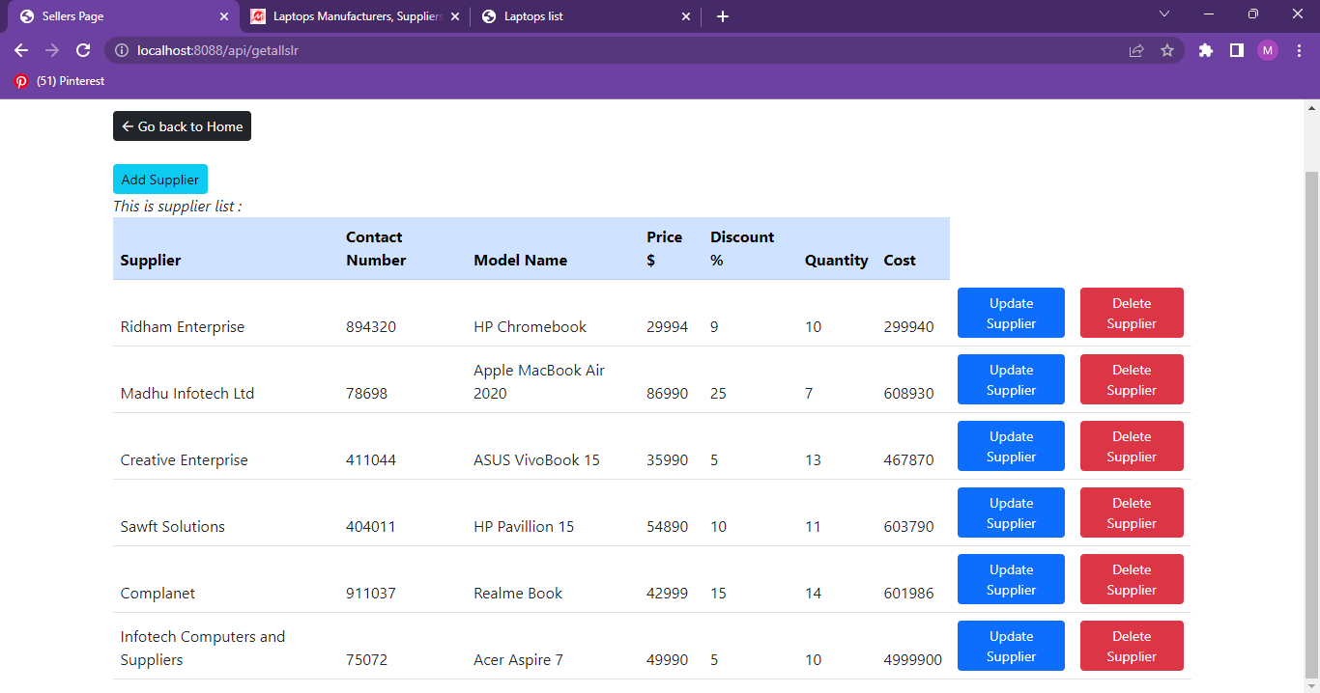
PROJECT SCREENSHOT : LIST OR TABLE

Slide 15
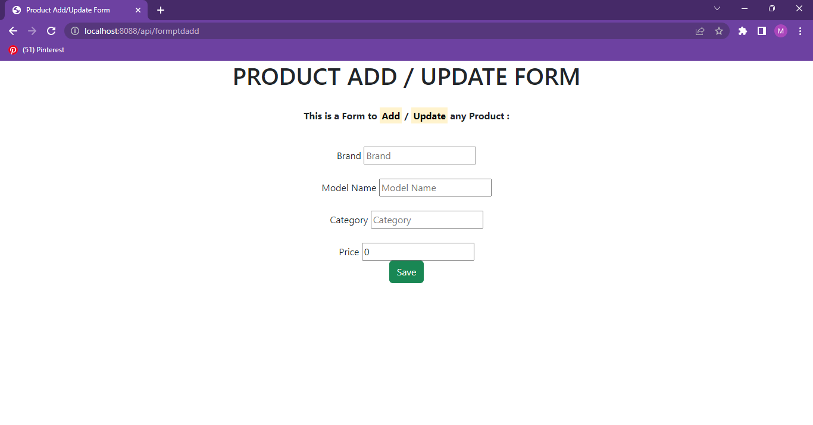
PROJECT SCREENSHOT : ADD FORM

Slide 16

PROJECT SCREENSHOT : UPDATE FORM

Slide 17
In a nutshell the future scope of the project mainly revolves around maintaining information regarding : 1. In the future the project can be extended to maintain the accounting in the shop. 2.The future version can also combine the facility to handle staff details and salary details. 3.The future version can also run on network too. The above mentioned points are the enhancements which can be done to increase the applicability and usage of this project.
FUTURE SCOPE

Slide 18
At the end it is conclude that we made effort on following points :
CONCLUSION
The Introduction of the project explains the basic description of the project.
Made Statements for the aims, objectives and purpose of the project.
The Key modules of the project are discussed.
Each module is a basic context of CRUD operations all of whose records are maintained in MySQL.
Database Structures of each module in MySQL are shown.
Browser Screenshots of the project are included in the presentation for references.
Future Scope of the project is discussed to make improvements and to enhance the project in the future.

Slide 19
THANK YOU

