Slide 1
STUDENT EXAM ELIGIBILITY
PROGRAMMING FOR PROBLEM SOLVING
MINI PROJECT

Slide 2
WHAT IS THIS PROJECT ABOUT?
In today’s modernizing world where everybody wants to save time, this project will help you to determine which student is eligible for the university exam by asking the attendance of the student and if they have paid the tuition fees and cleared their all dues or not.

Slide 3
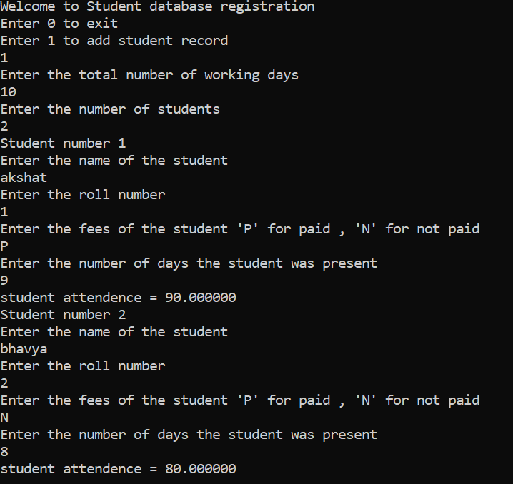
output

Slide 4
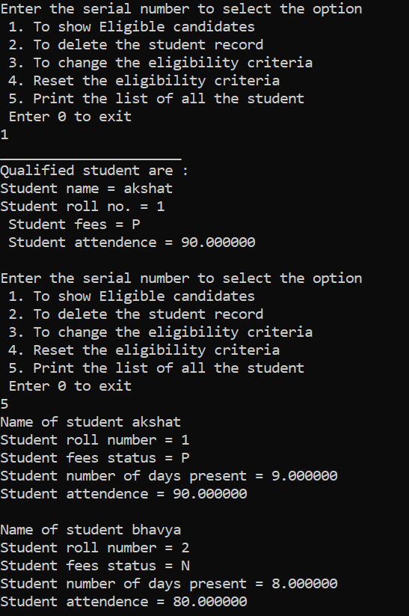

Slide 5
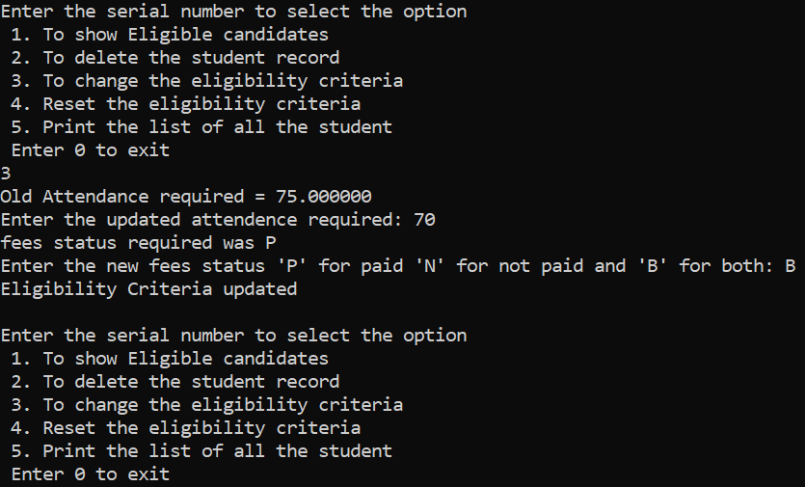

Slide 6
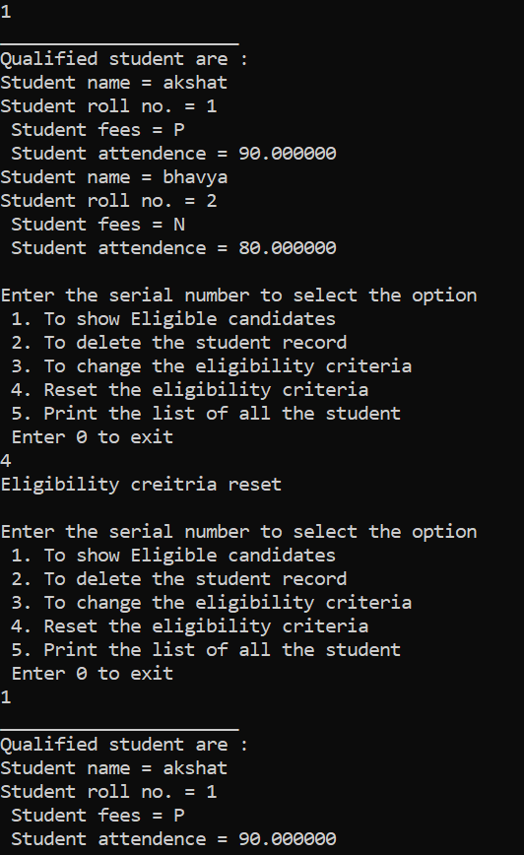

Slide 7
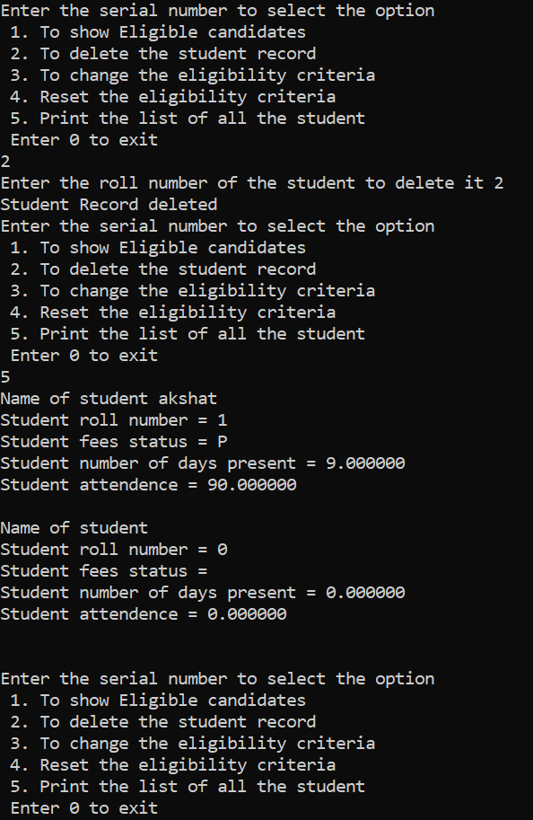

Slide 8

THANK YOU
BY: PALAASH SURANA-RA2111003010319
KSHITIJ RAJ-RA2111003010316

