Slide 1
Hospital Management System
Yoan Palacios G & Aayush Koirala

Slide 2
SYSTEM DESCRIPTION
Our project is a simple web app hospital management system.
Super Admin can:
Update the data of the following:
a. Nurse
b. Doctor
c. Hospital
d. Rooms
e. Workers (maintenance workers)
f. Patients
g. Medication
View reports on the following:
a. Number of patients per Hospital
b. Avg stay in Hospital
c. Number of Nurses per Hospital
d. Number of Doctors per Hospital
e. Most used medication per Hospital

Slide 3
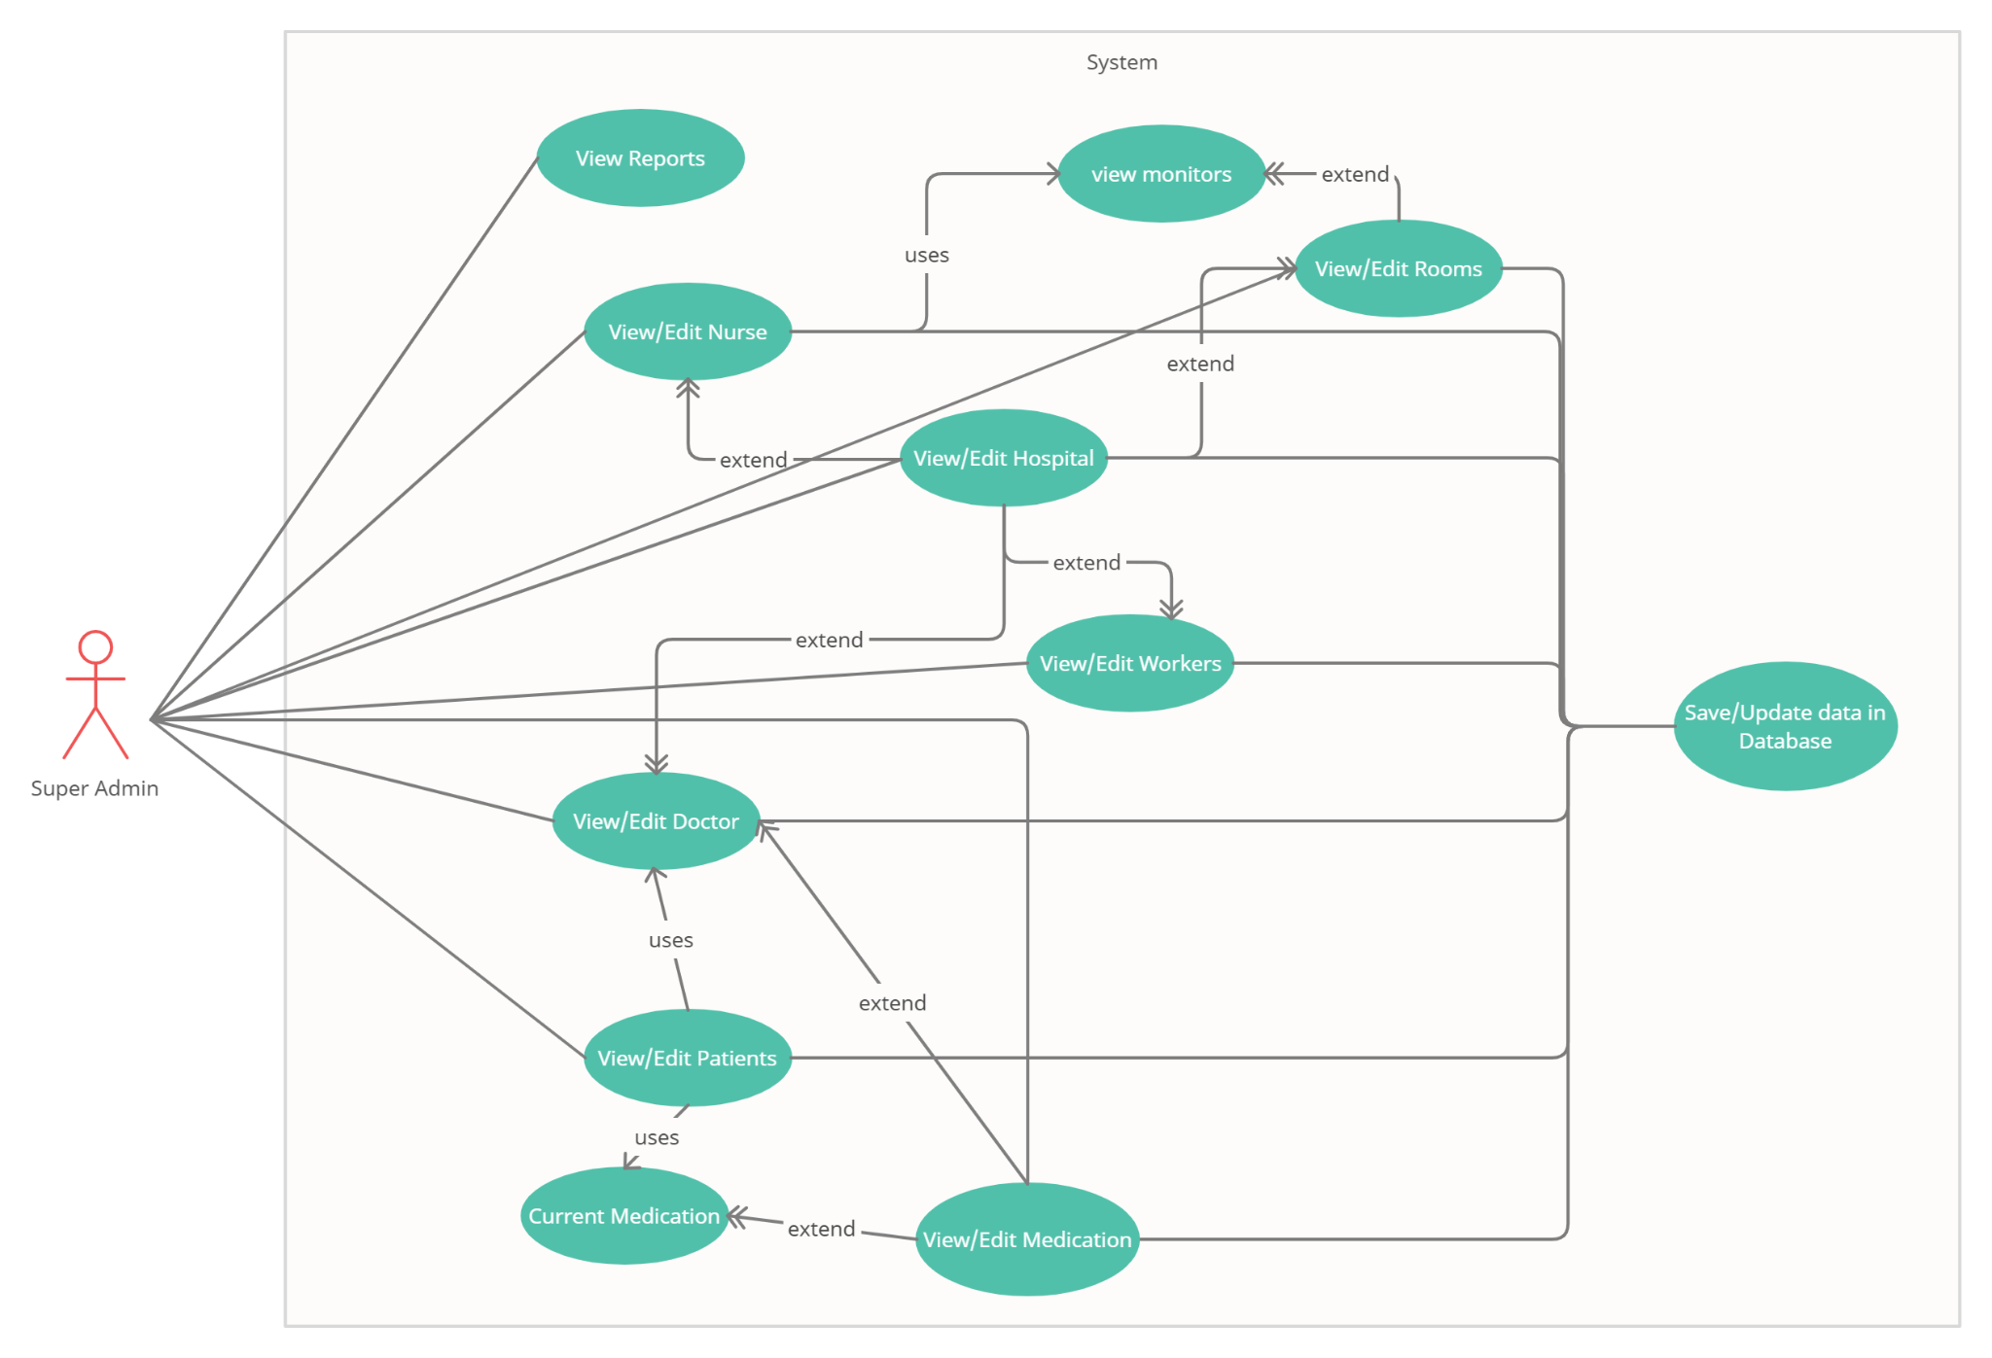
USE-CASE DIAGRAM

Slide 4
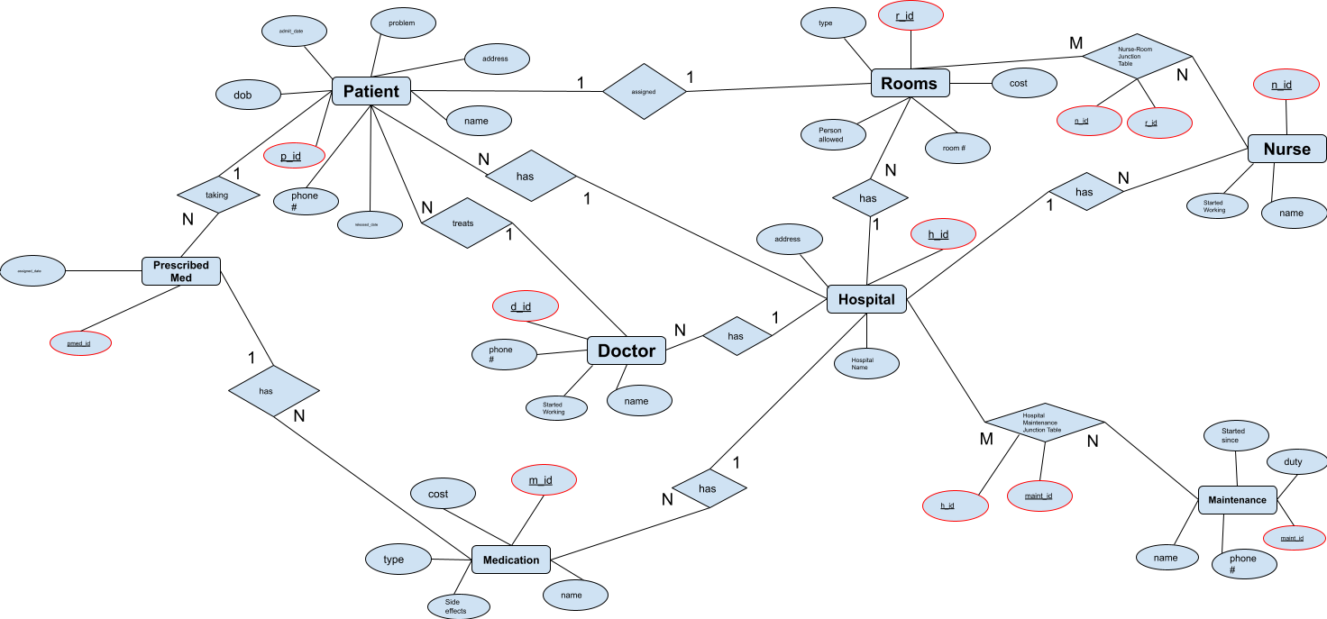
E/R DIAGRAM

Slide 5
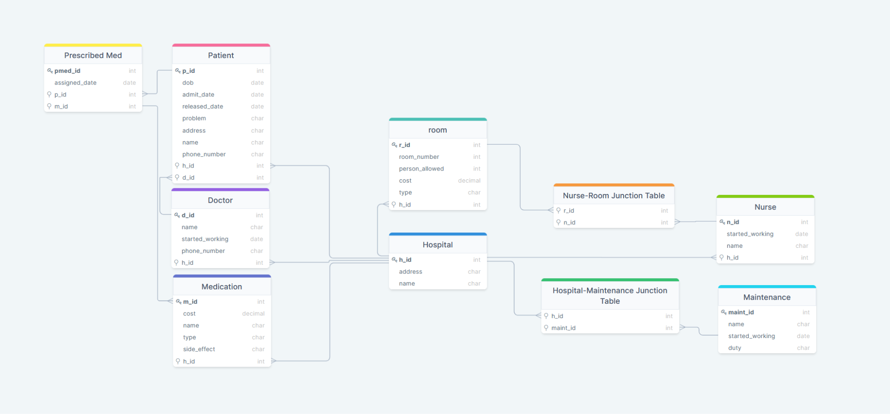
Relationship SCHEMA

Slide 6



TOOLS
We plan on using the following:
Backend:
Python: Pandas, Numpy, Flask, flask_resful
MySQL
Frontend:
React (HTML/CSS)

Slide 7
THANK YOU
ANY QUESTIONS?

