Slide 1
Hospital Management System
Yoan Palacios G & Aayush Koirala

Slide 2
SYSTEM DESCRIPTION
Our project is a simple web app hospital management system.
Super Admin can:
View, Update and Add the data of the following:
a. Nurse
b. Doctor
c. Hospital
d. Rooms
e. Workers (maintenance workers)
f. Patients
g. Medication
h. Prescibed medicaition
In addition to View and Update:
a. Patients taking certain medication
Maintenance maintaining hospitals
Nurse monitoring rooms
Room nurses are monitoring
Patient in each room
Doctor’s patients

Slide 3
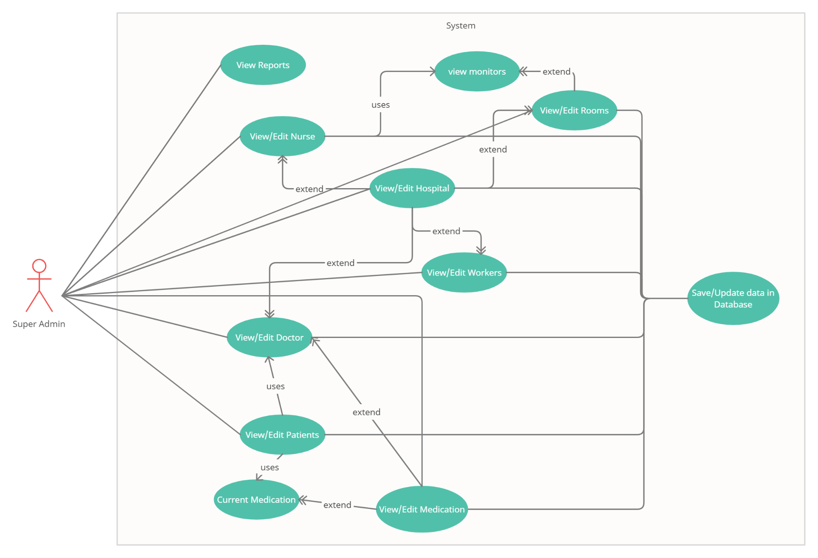
USE-CASE DIAGRAM

Slide 4
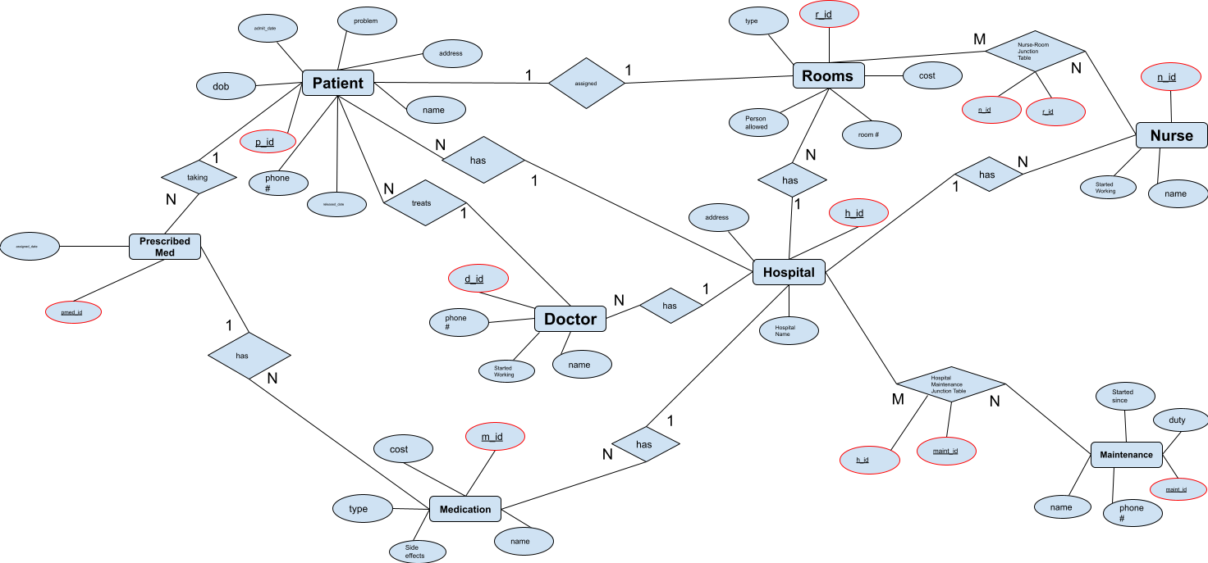
E/R DIAGRAM

Slide 5
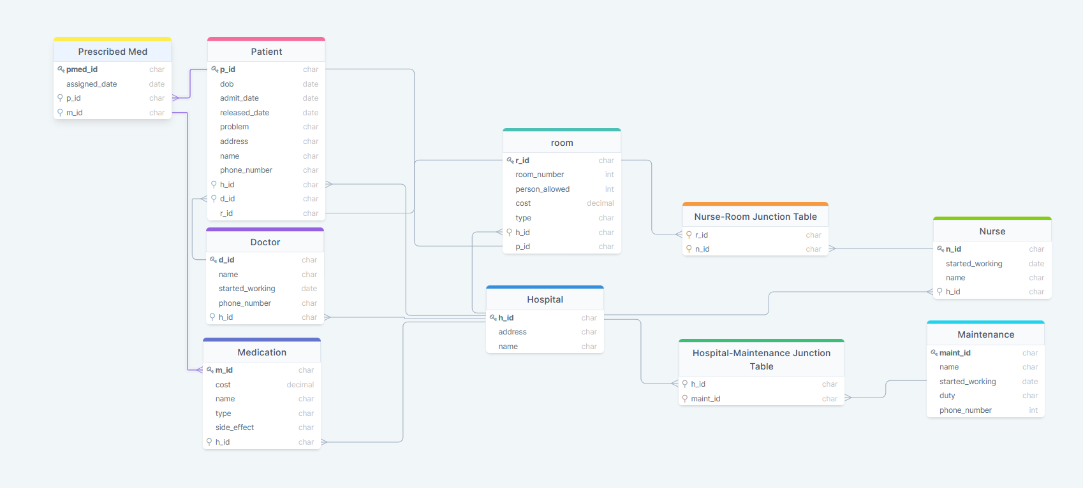
Relationship SCHEMA

Slide 6




TOOLS
Github: https://github.com/PalaciosYoan/Hospital_Management_System
To build our system, we used the following:
Backend:
Python: Pandas, Numpy, Flask, flask_resful
SQLite
Frontend:
JS Library React (with HTML/CSS)

