Slide 1
Hospital Management System
Yoan Palacios G & Aayush Koirala

Slide 2
SYSTEM DESCRIPTION
Our project is a simple web app hospital management system.
Super Admin can:
Update the data of the following:
a. Nurse
b. Doctor
c. Hospital
d. Rooms
e. Workers (maintenance workers)
f. Patients
g. Medication
View reports on the following:
a. Number of patients per Hospital
b. Avg stay in Hospital
c. Can view per Hospital
d. Number of Nurses per Hospital
e. Number of Doctors per Hospital
f. Most used medication per Hospital

Slide 3
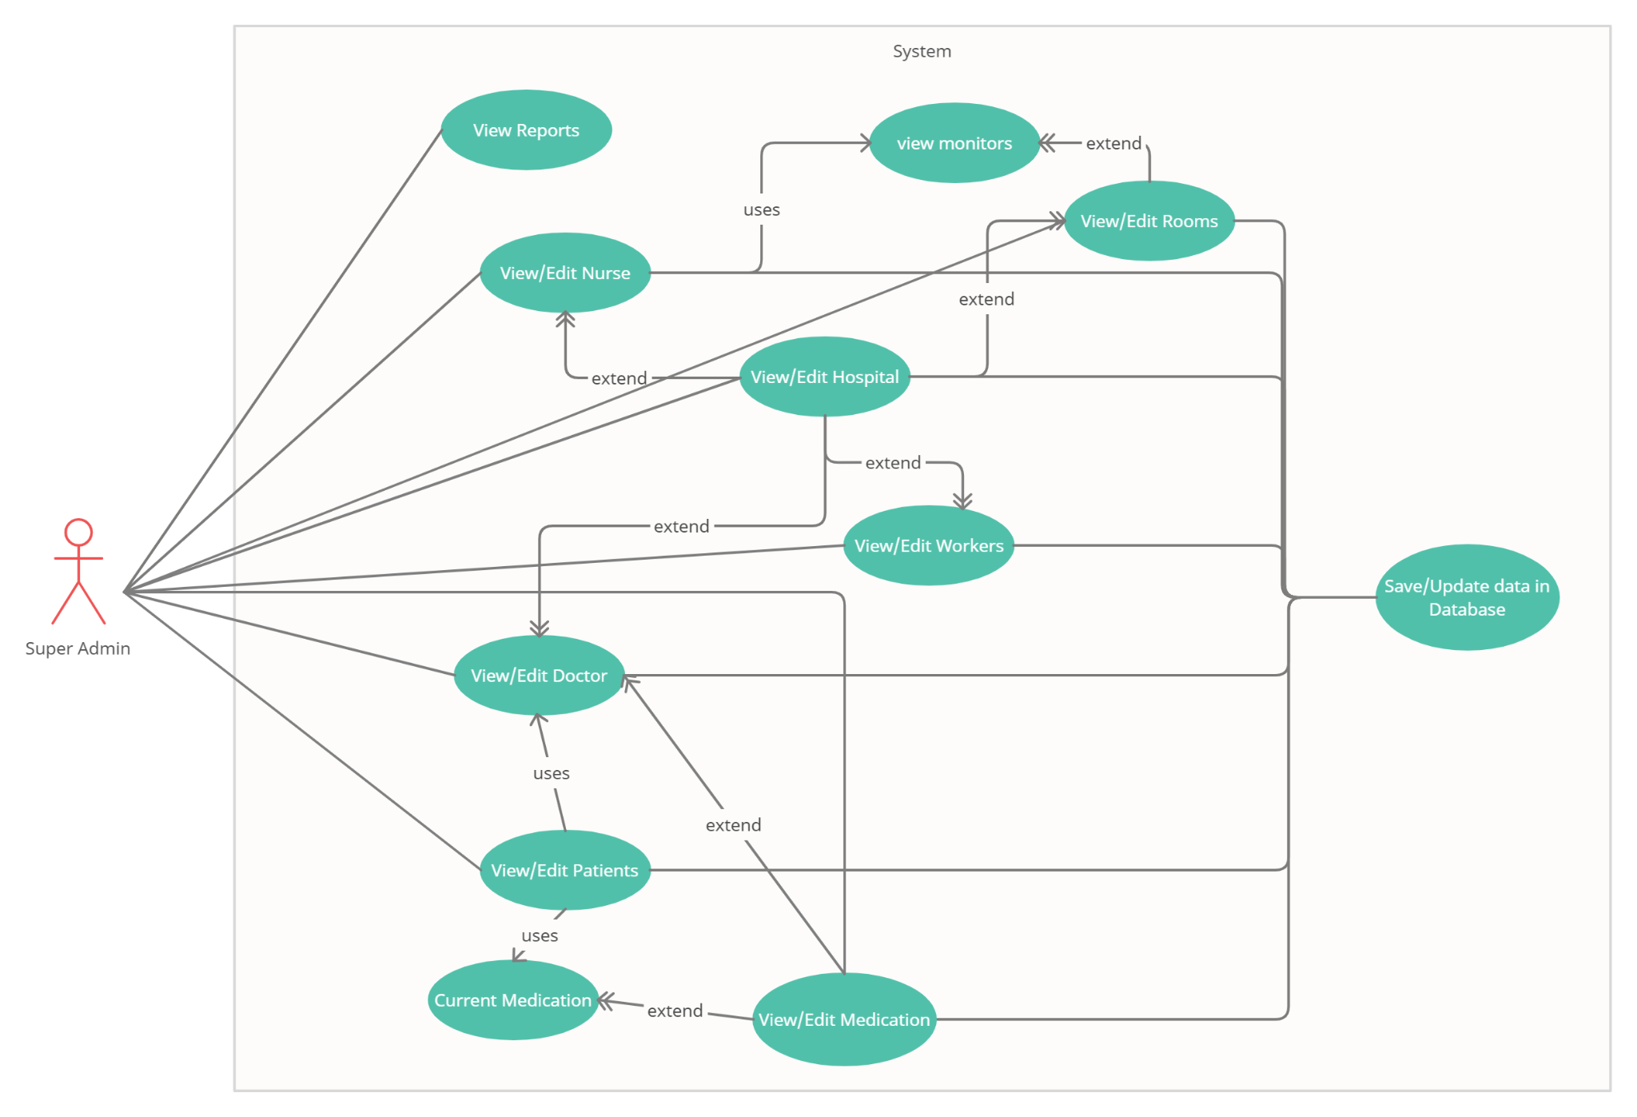
USE-CASE DIAGRAM

Slide 4
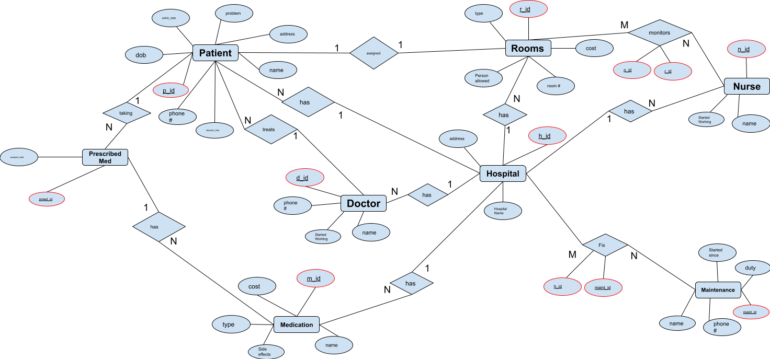
E/R DIAGRAM

Slide 5
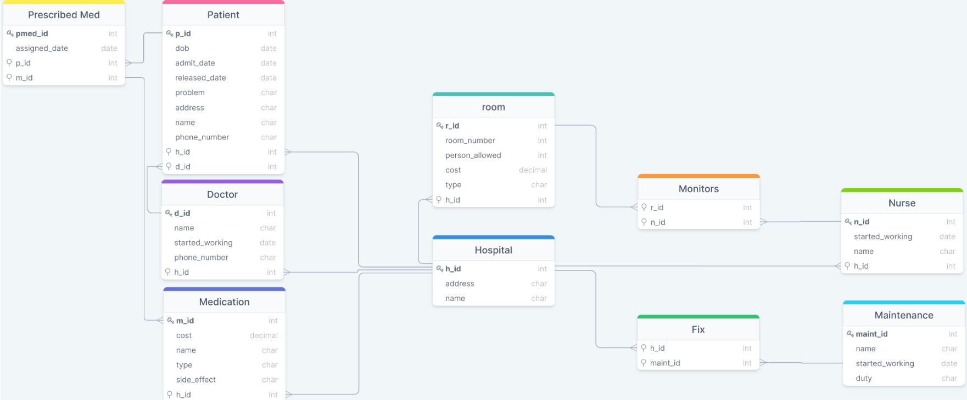
Relationship SCHEMA

Slide 6



TOOLS
We plan on using the following:
Backend:
Python: Pandas, Numpy, Flask
MySQL
Frontend:
HTML/CSS, JS
Bootstrap a design template

Slide 7
THANK YOU
ANY QUESTIONS?

