Slide 1
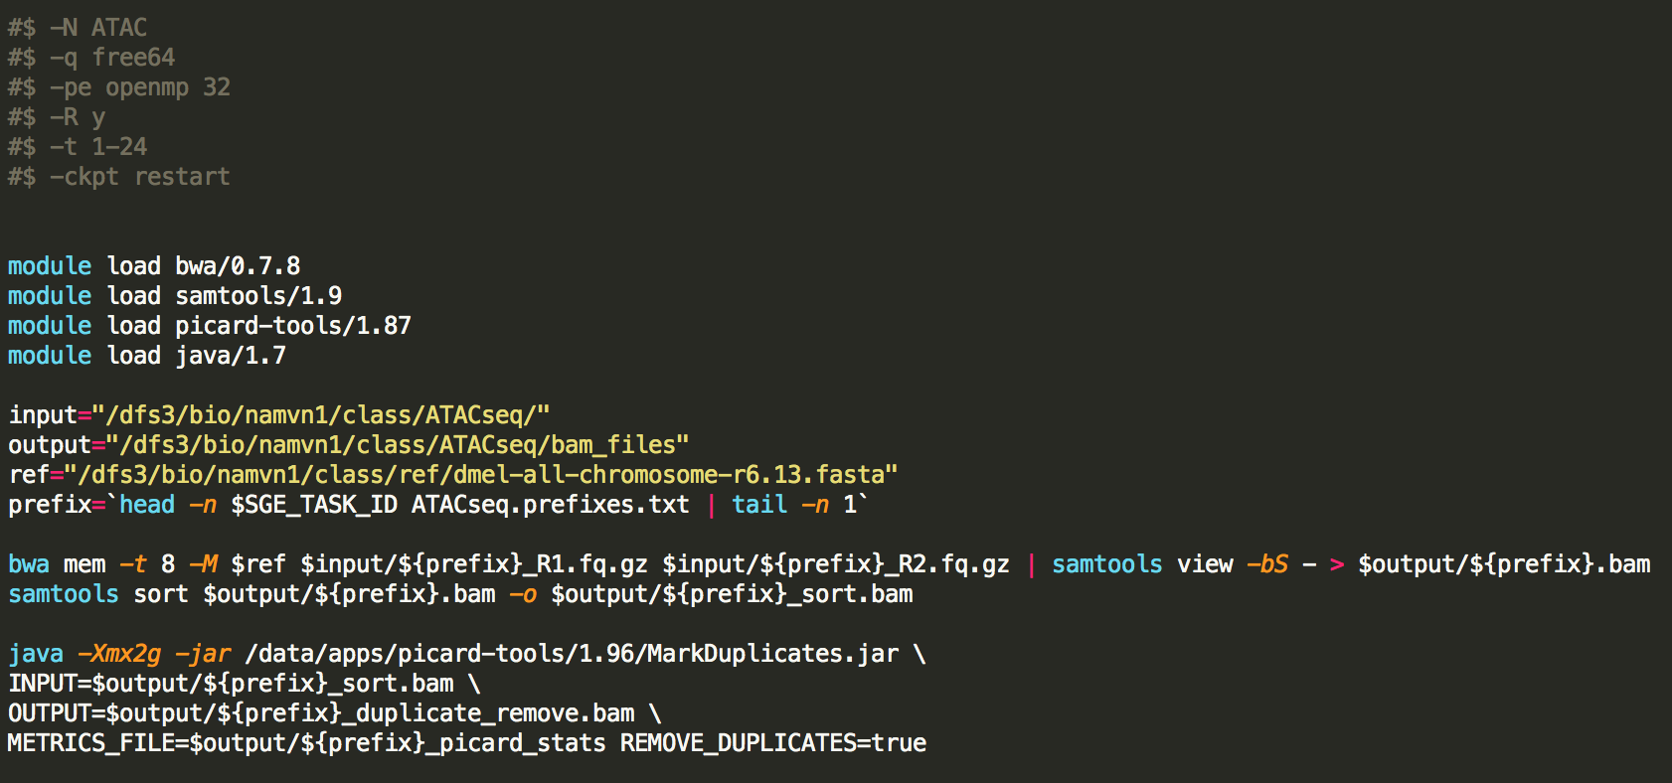
Running alignment with bwa and remove duplicate

Slide 2
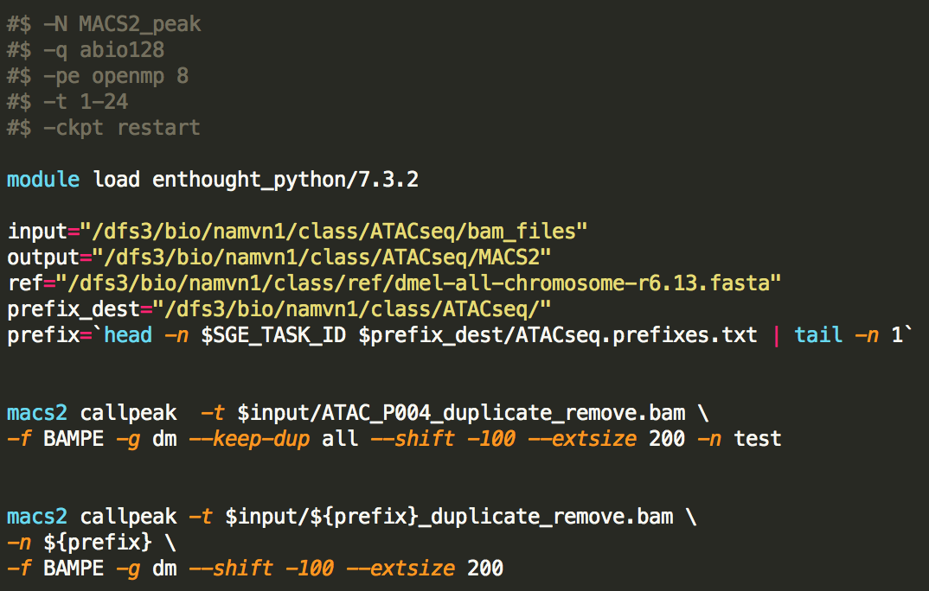
Calling ATAC peaks with MACS2

Slide 3
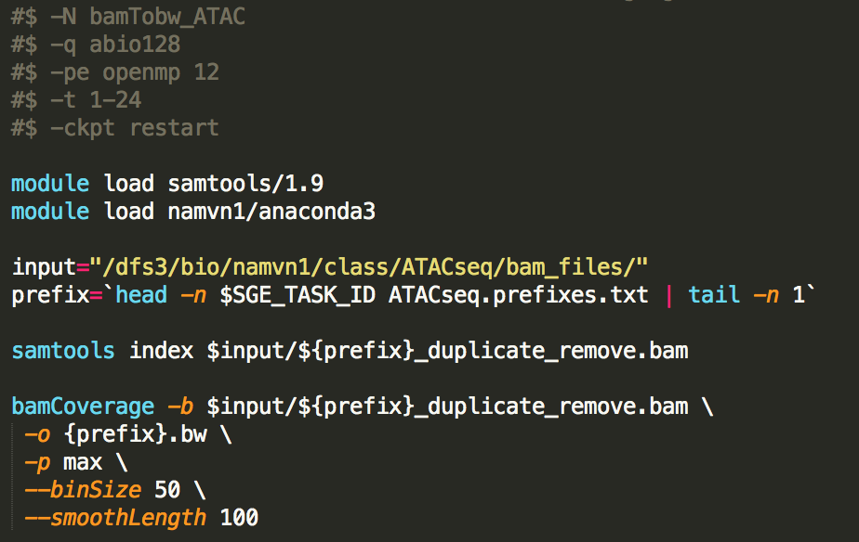
Convert bam files to bigwig files with deeptools

Slide 4
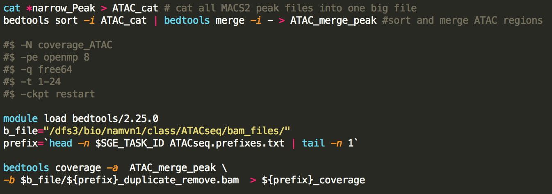
Merge all ATAC peaks and call into reads into the peak regions from each bam file

Slide 5
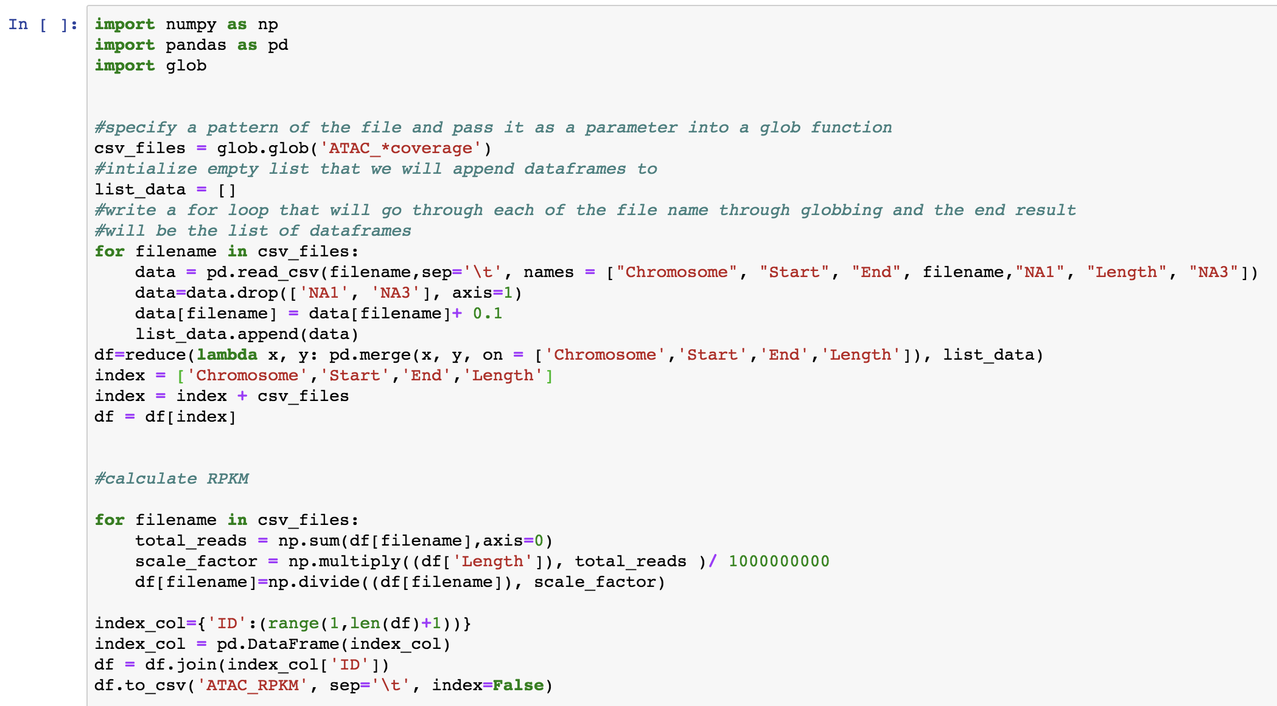
Merge all coverage files into a matrix and perform normalization with RPKM

Slide 6
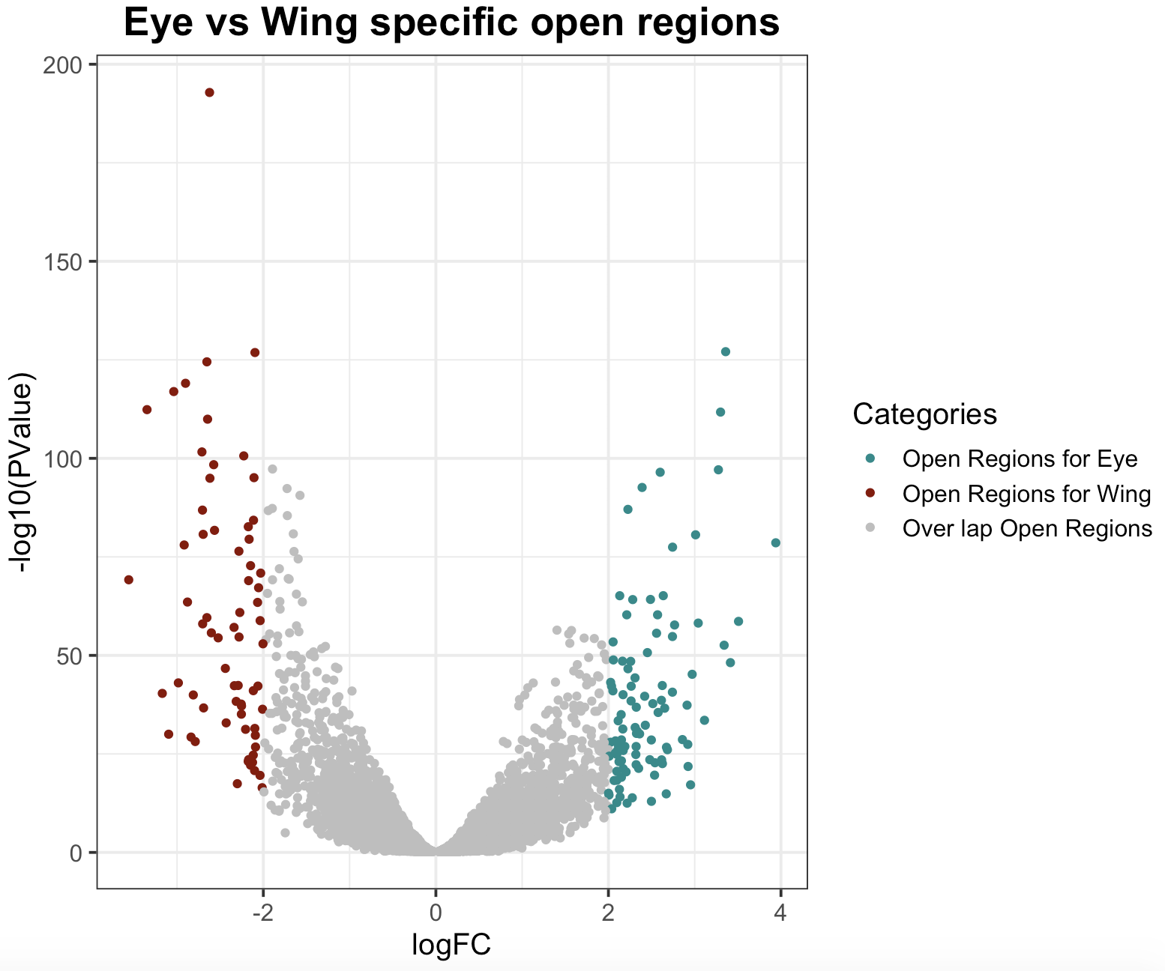
Perform EdgeR analysis and volcano plot the results of differential peaks of Eye vs Wing

Slide 7
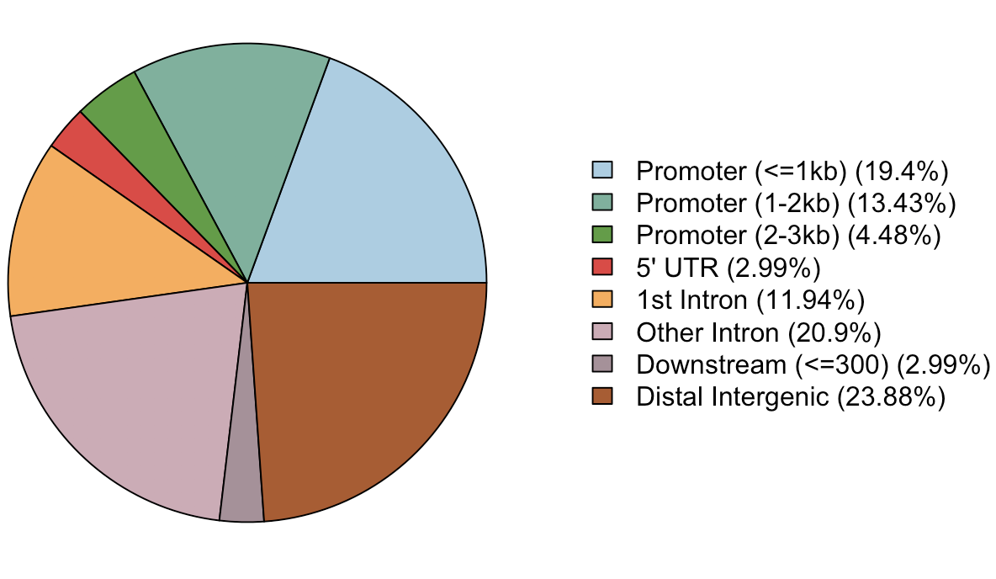
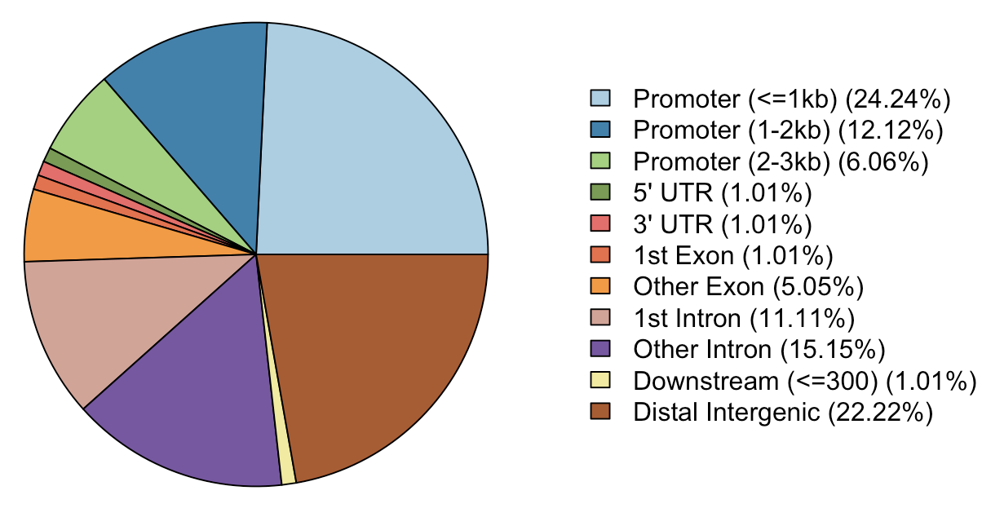
Annotation of Peaks that are specific to either Wing or Eye
Wing specific peaks
Eye specific peaks

Slide 8
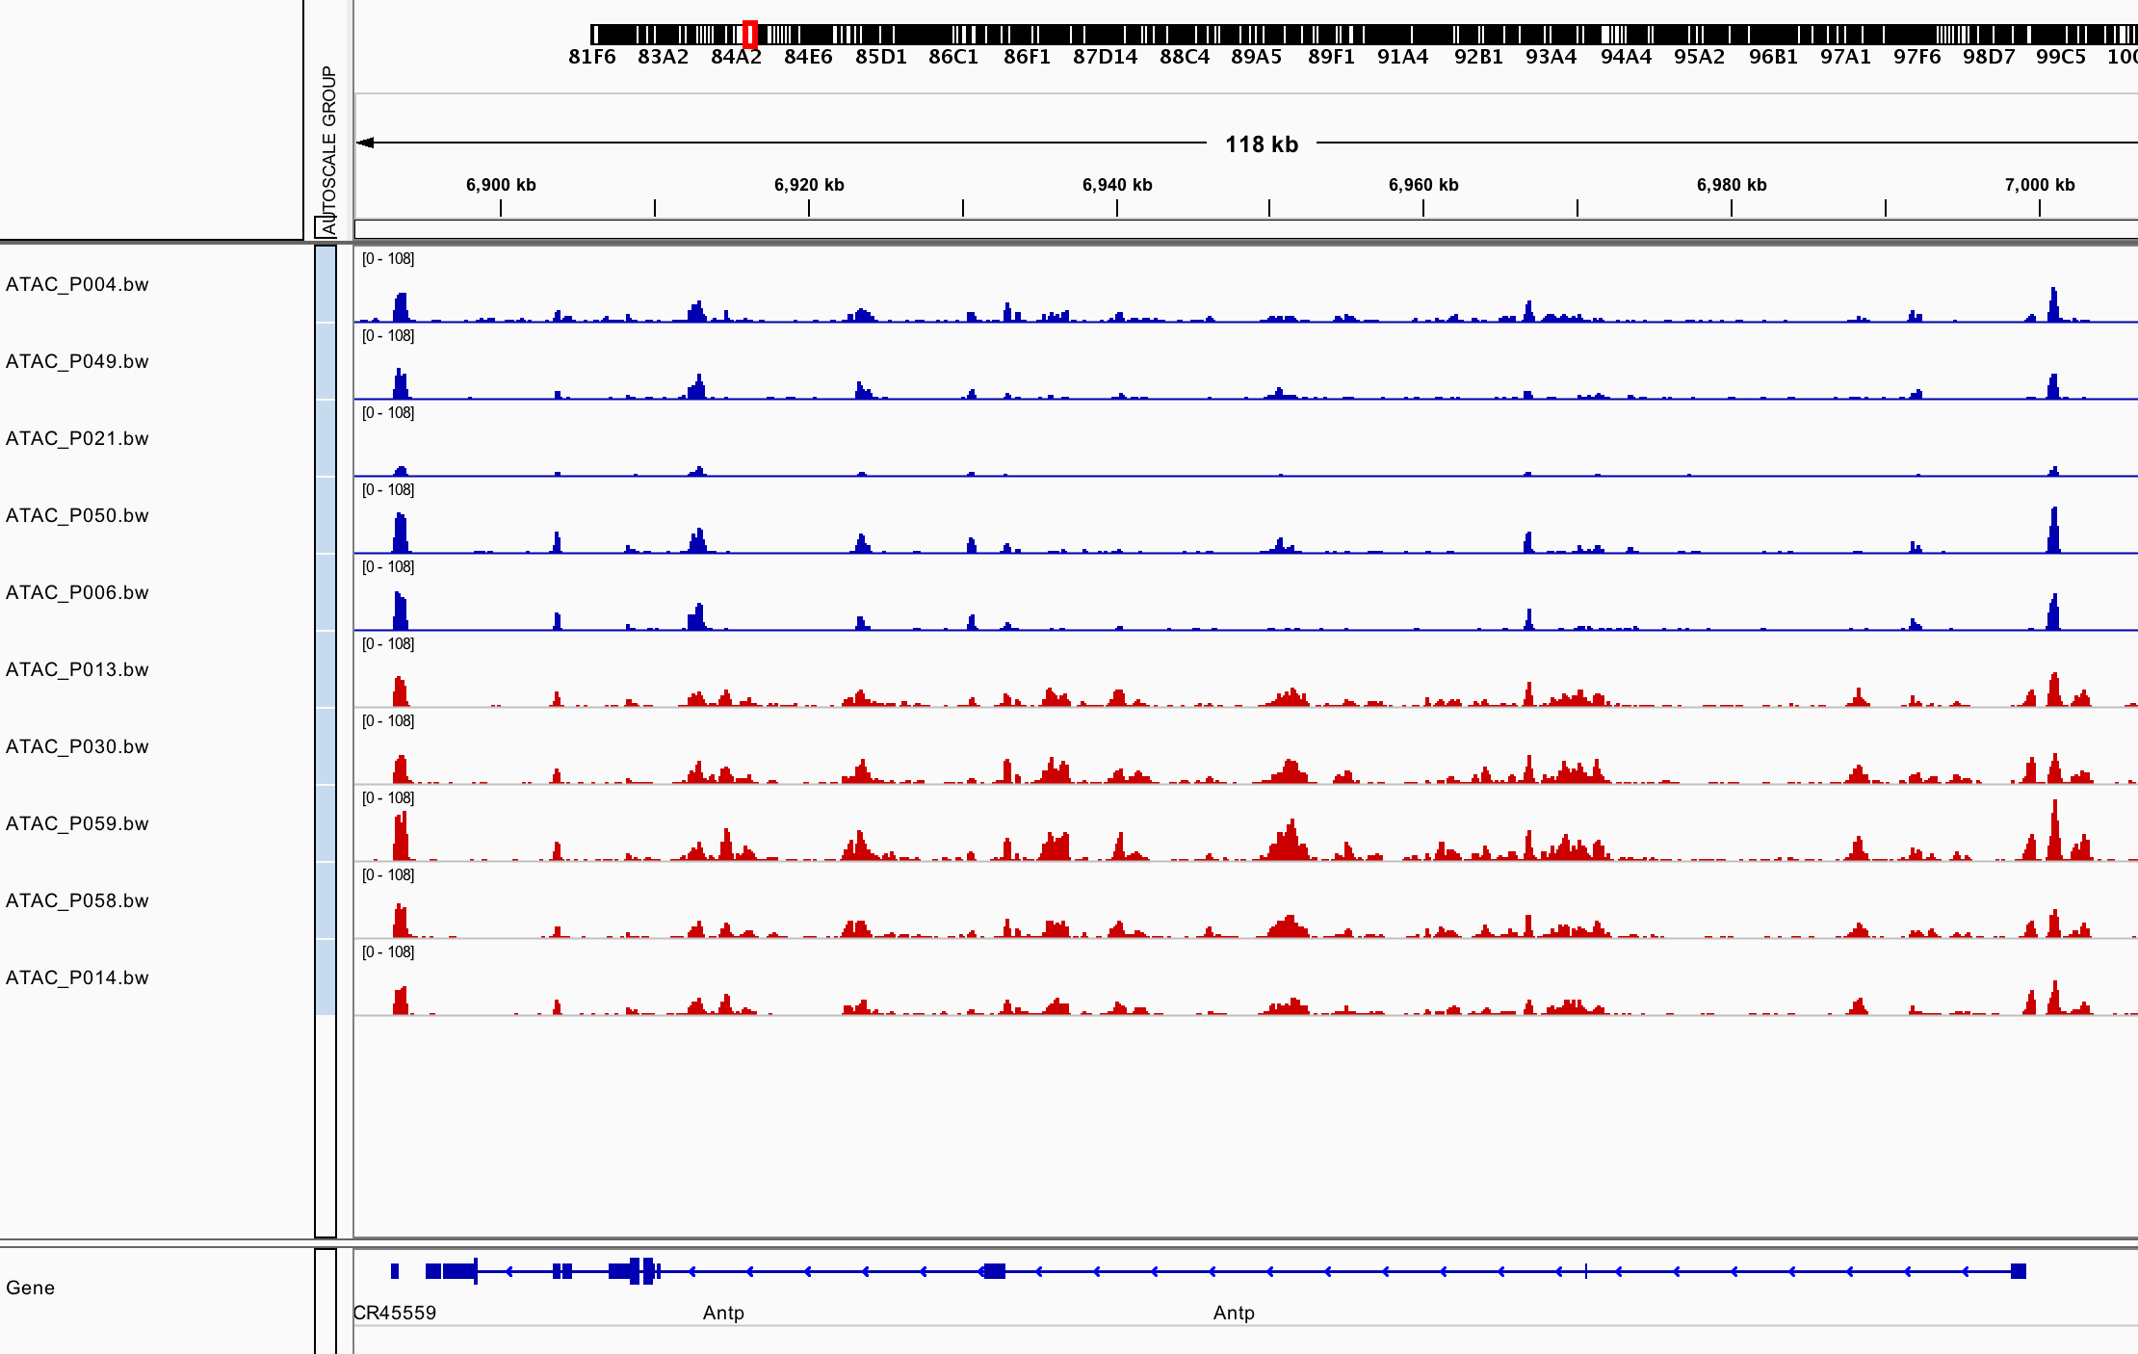
Antp gene is specific to Wing

Slide 9
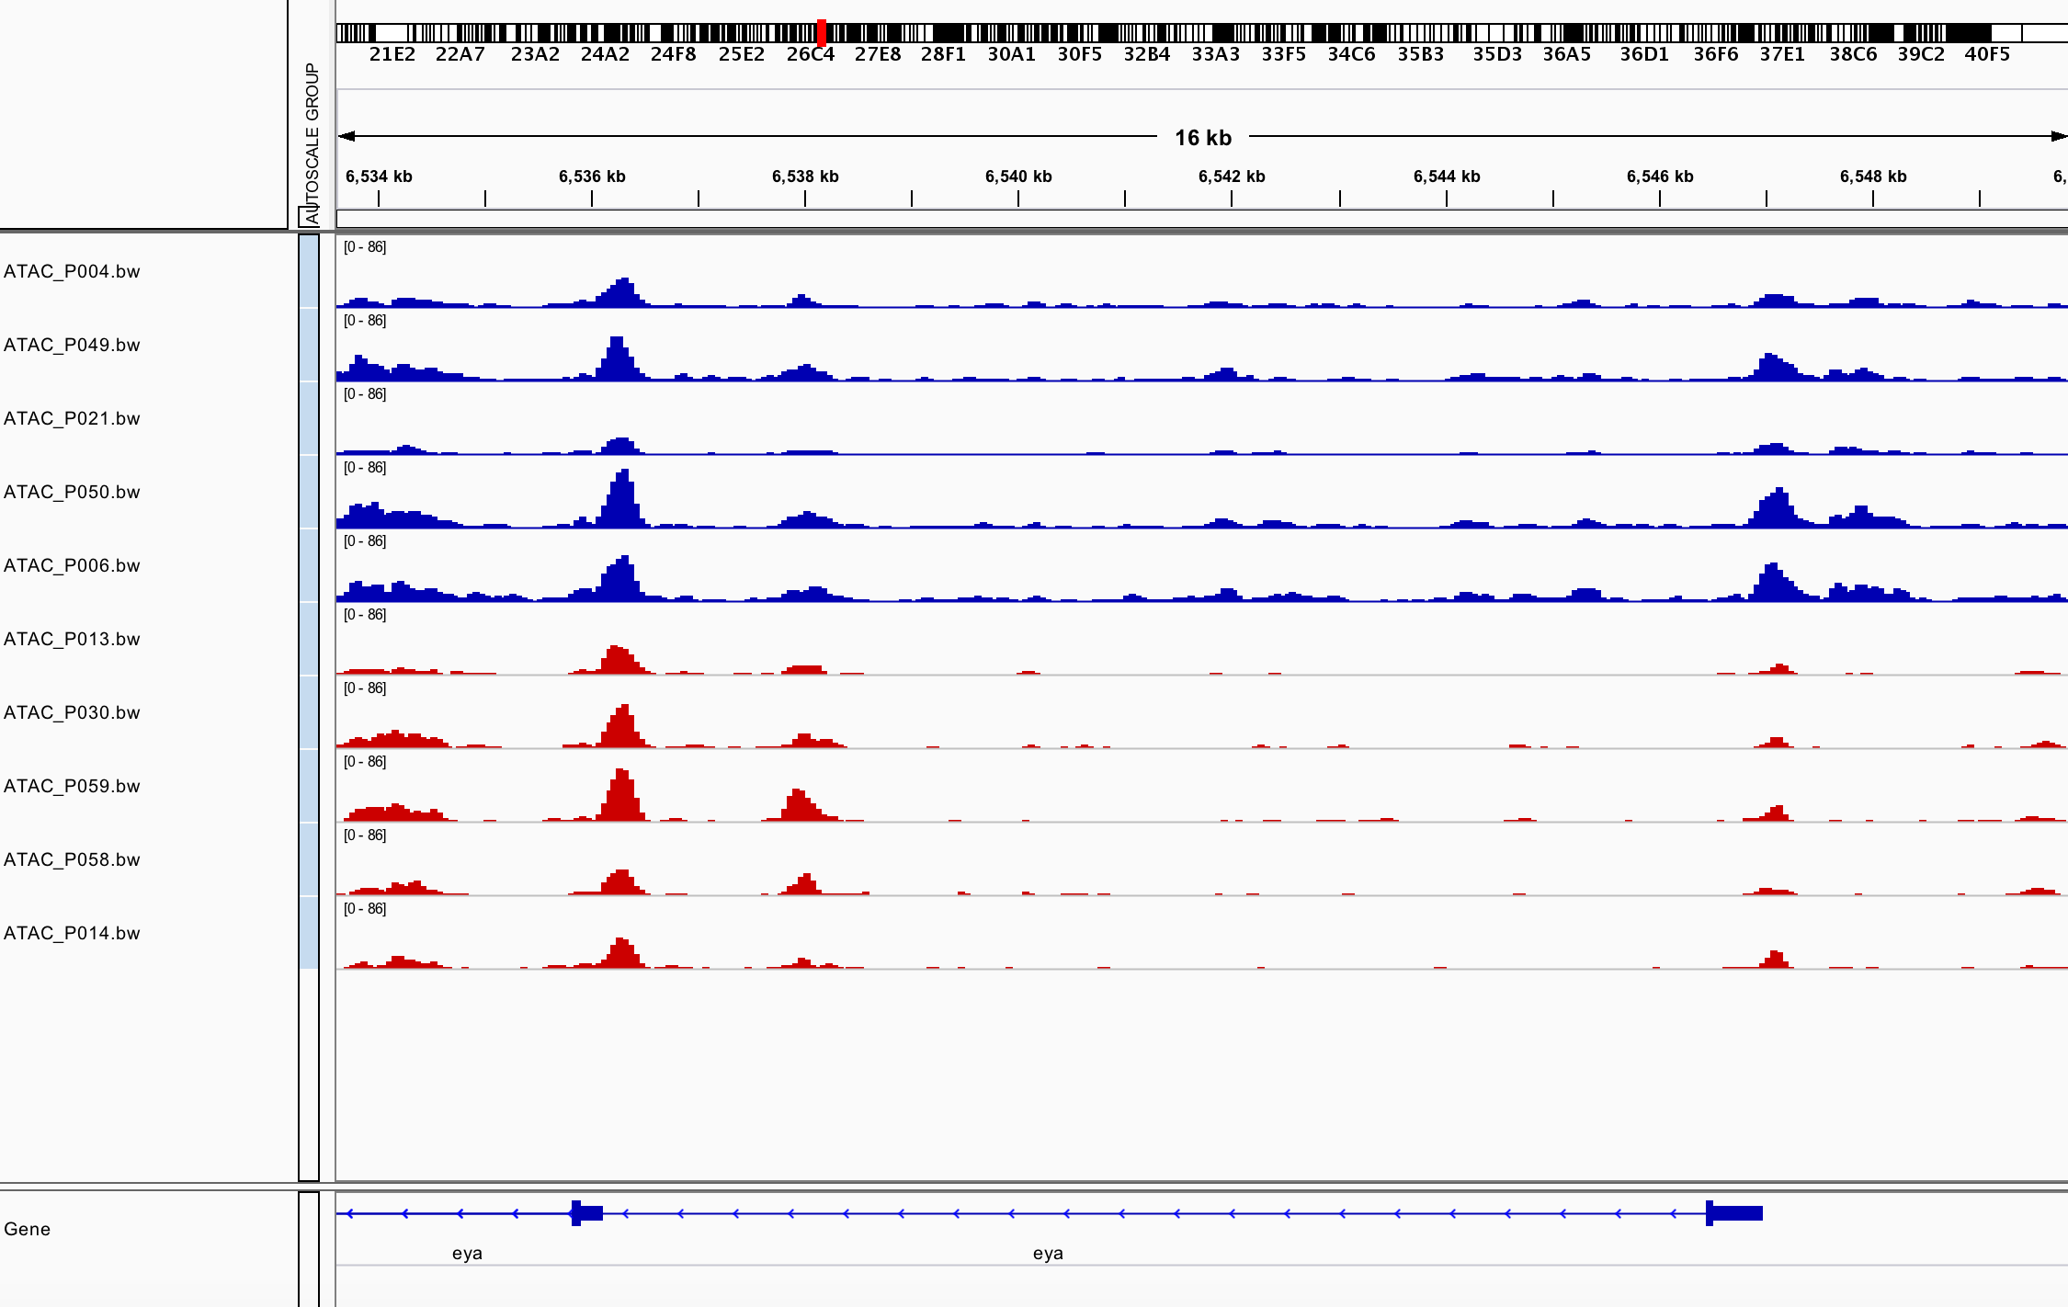
eya gene is specific to Eye

Slide 10
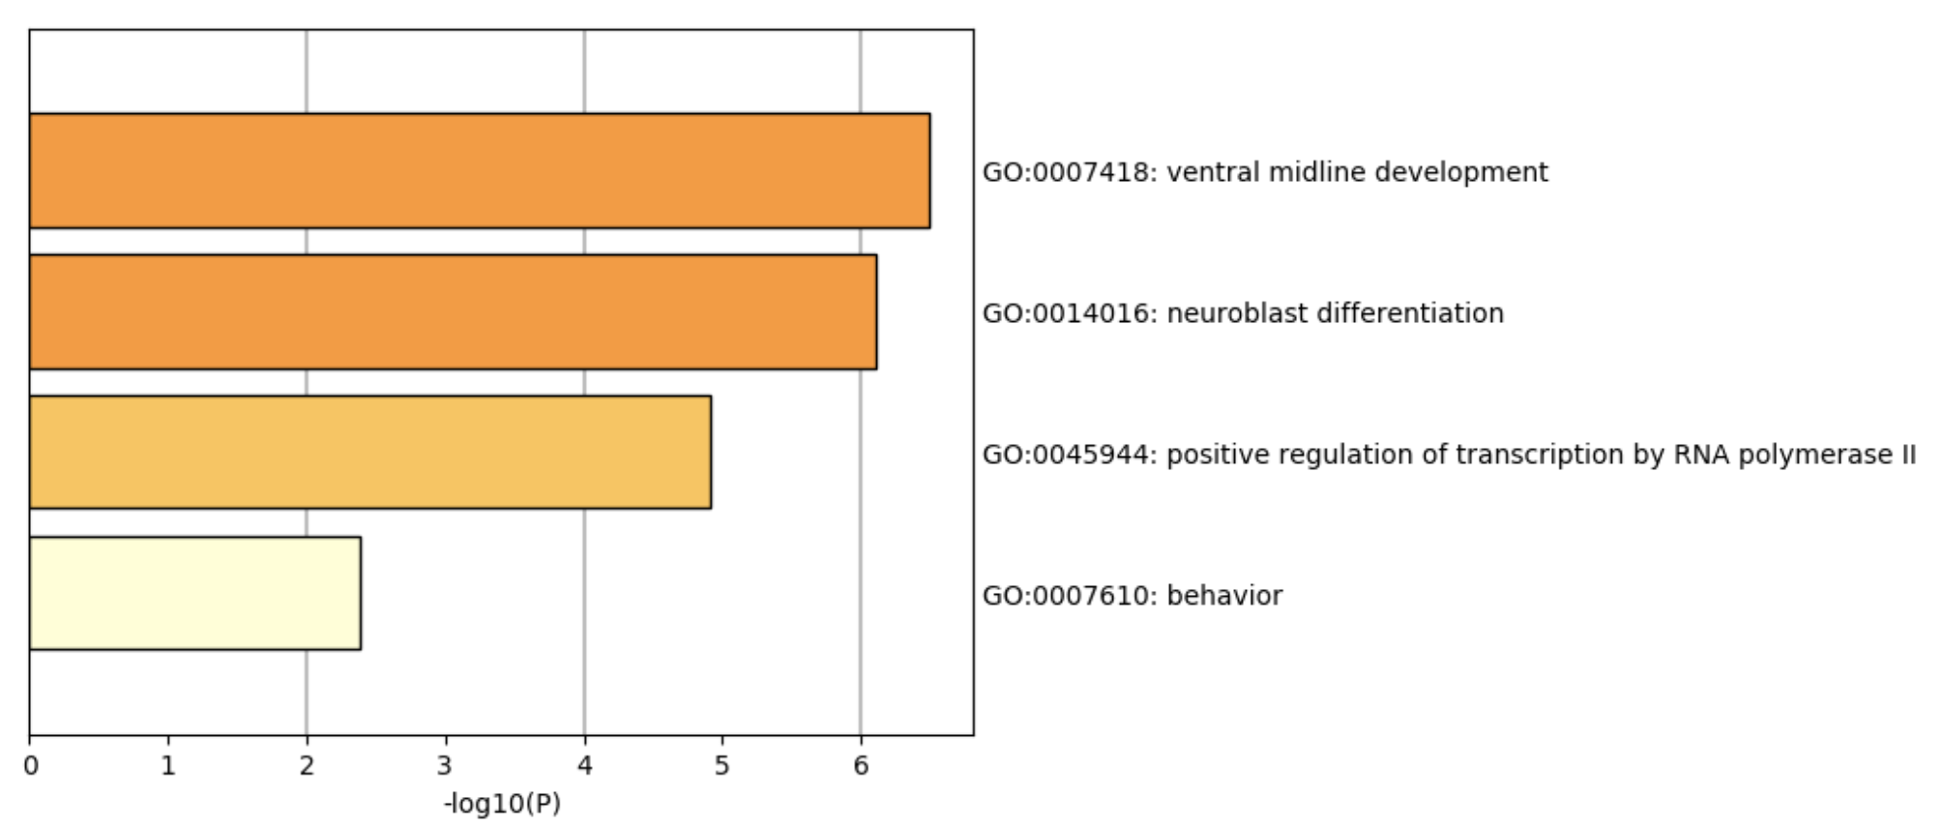
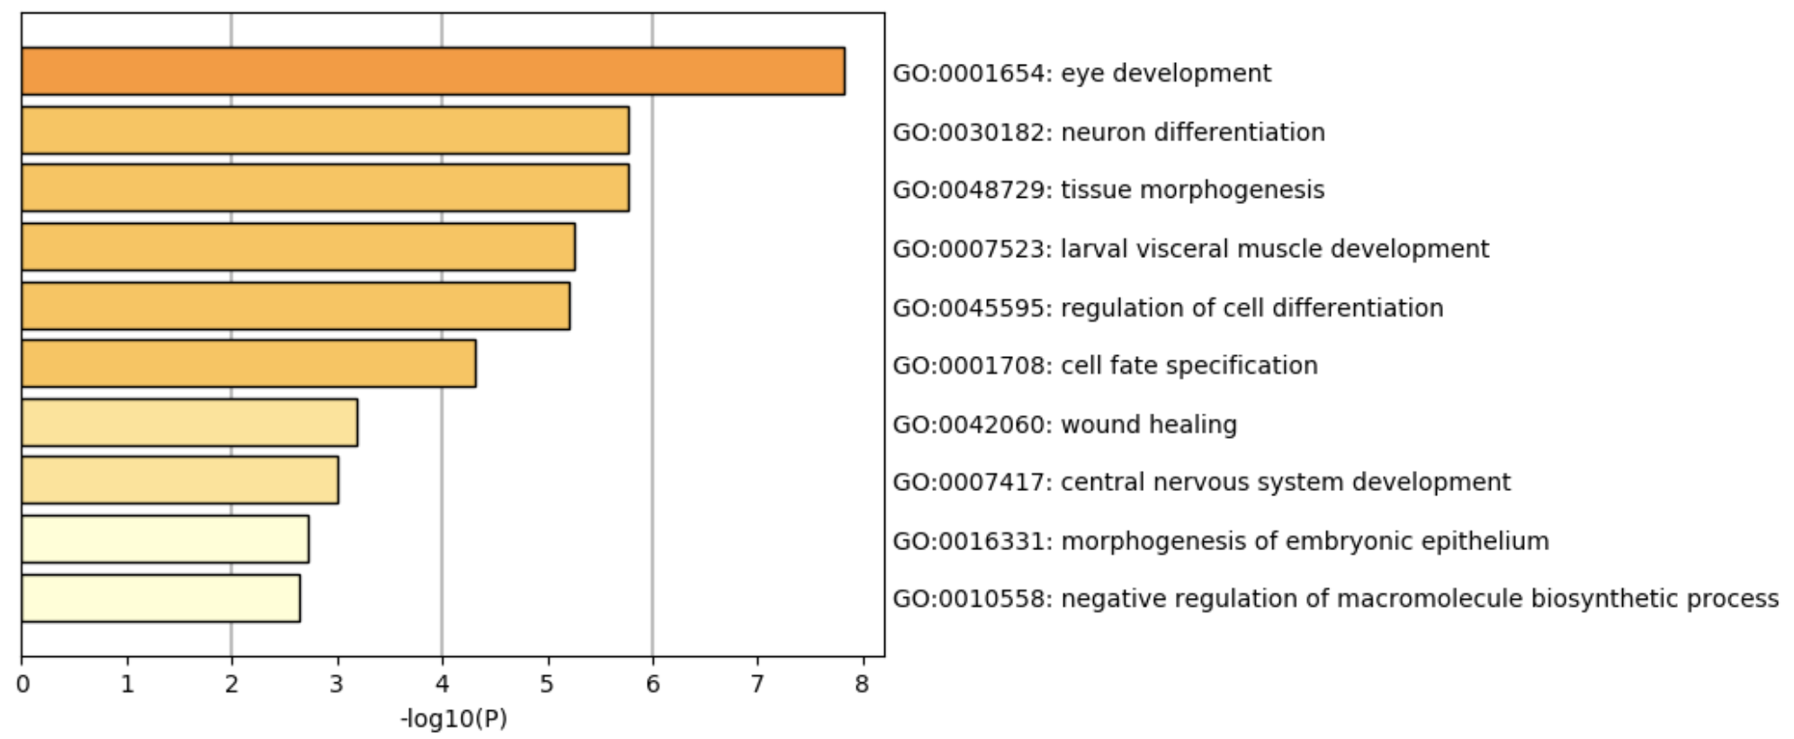
Gene ontology of differential peaks of Wing vs Eye
Wing specific peaks
Eye specific peaks

