Slide 1


PRODUCT AUTHENTICATION USING BLOCKCHAIN (Project Presentation, KCS 851)
KIET Group of Institutions, Ghaziabad
(An ISO – 9001: 2008 Certified & ‘A+’ Grade accredited Institution by NAAC)
Guide Name: Ms. Shivani
Project Members
Abhishek Singh Yadav (2000290120011), CS-7A
Aditi Batra (2000290120012), CS-7A
Anurag Tripathi (2000290120036), CS-7A
Kshitij Pal (2000290310092), ECE-7B
PCS24-12

Slide 2
Last time suggestion
Why our project is better??
Tamper-Proof Records
Decentralized Trust
Transparent Transactions
Smart Contracts for Automation

Slide 3
Problem Statement
The problem of counterfeiting is a widespread issue.
Customers can’t distinguish between real and phony goods.
Blockchain is the solution as it is a transparent, immutable, and secure record.

Slide 4
Objectives
To address the problem of counterfeit goods being marketed to unwary customers
Reduce the negative impact on consumers and businesses.
The system aims to:
provide reliable means for consumers
to verify the authenticity of products they are purchasing
businesses to authenticate the products and protect the reputation.
increase transparency in the supply chain, allowing for better monitoring and regulation of counterfeit products.
Producer-consumer relations will be better.

Slide 5
LITERATURE SURVEY
An Overview of Blockchain Technology: Architecture, Consensus, and Future Trends
Authors: Z. Zheng, S. Xie, H. Dai, X. Chen, and H. Wang
Year: 2017
Hyperledger, Ethereum and Blockchain Technology: A Short Overview
Authors: A.H. Mohammed, A. A. Abdulateef and I. A. Abdulateef,
Year: 2021
Blockchain-Enabled Smart Contracts: Architecture, Applications, and Future Trends
Authors: S. Wang, L. Ouyang, Y. Yuan, X. Ni, X. Han and F.-Y. Wang
Year: 2019

Slide 6
LITERATURE SURVEY
A Journey of WEB and Blockchain towards Industry 4.0: An Overview
Authors: AG. Khan, A. H. Zahid, M. Hussain, M. Farooq, U. Riaz and T. M. Alam
Year: 2019
Framework for Product Anti-Counterfeiting using Blockchain Technology
Authors: P. William, D. Jadhav, P. Cholke, M. A. Jawale and A. B. Pawar
Year: 2022

Slide 7
Technology used
BACKEND
Blockchain
Ganache: personal blockchain
FRONTEND
HTML
CSS
JAVASCRIPT

Slide 8
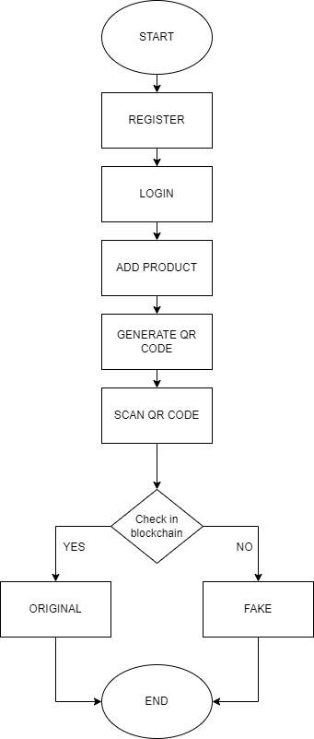
WORKFLOW
DIAGRAM

Slide 9
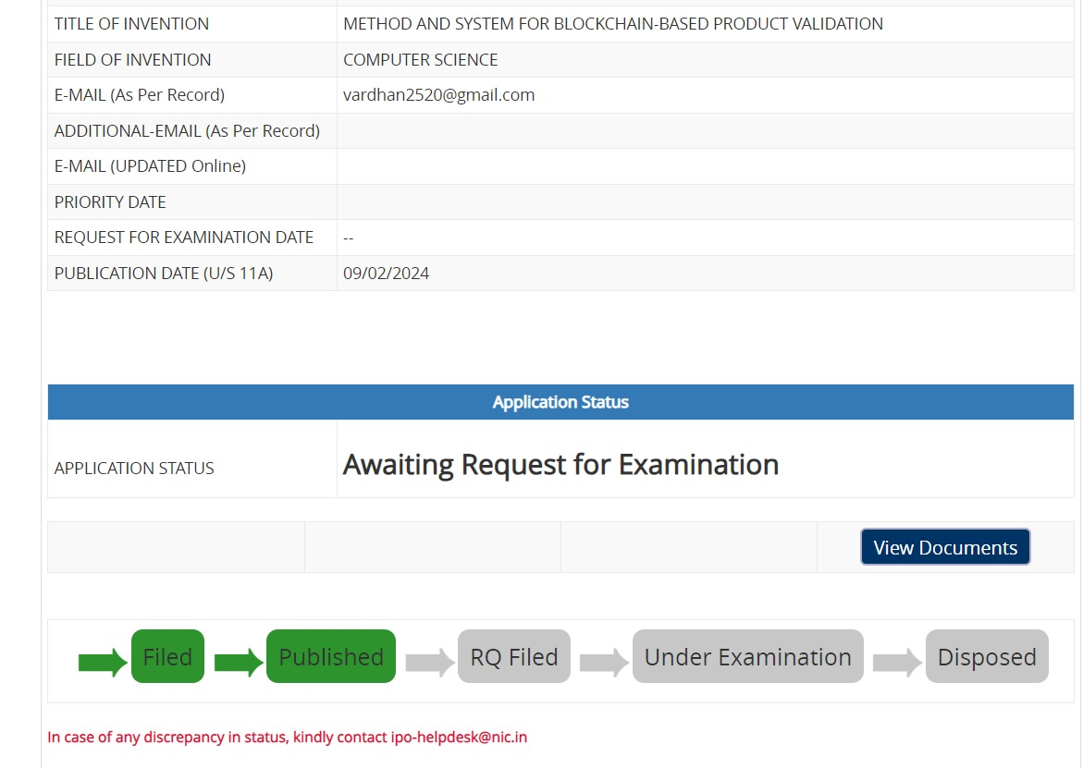
Patent Status
Published

Slide 10
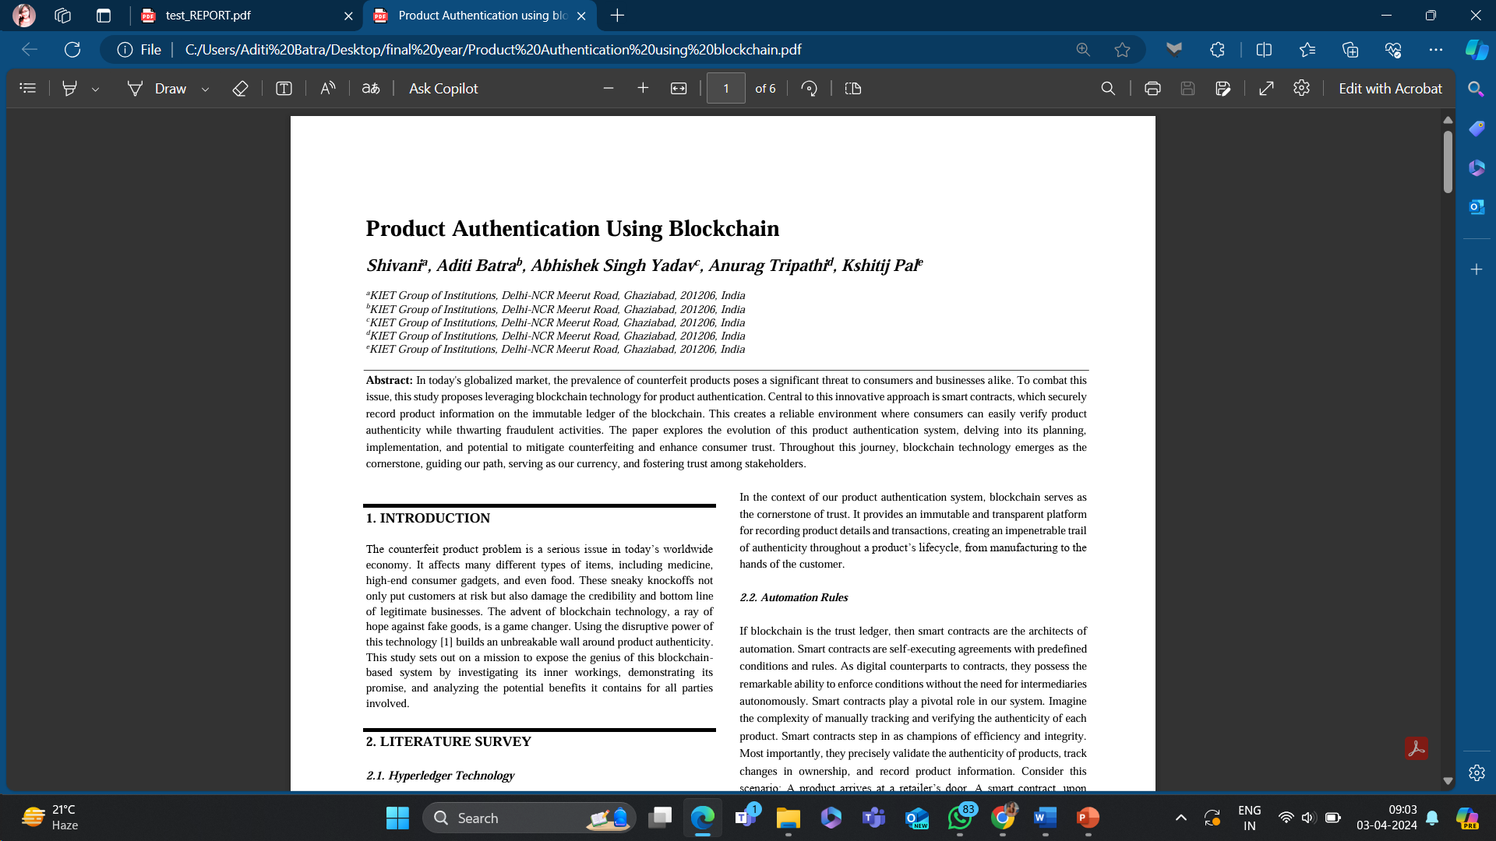
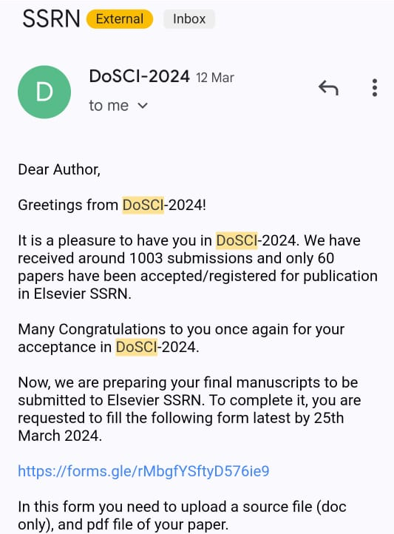
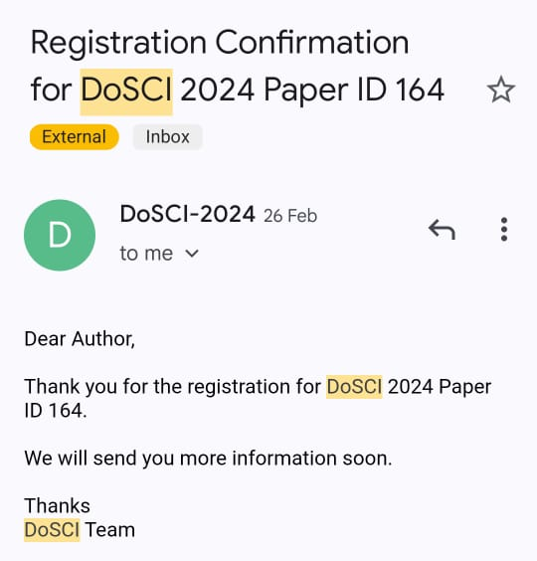
Research Paper Status

Slide 11
Snapshots of the Project
PRODUCT AUTHENTICATION USING BLOCKCHAIN

Slide 12
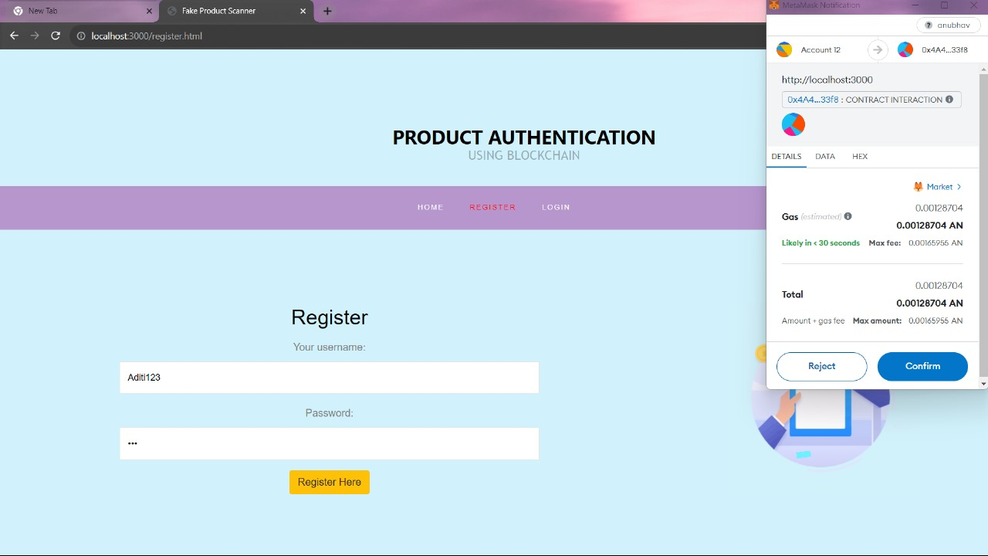

Slide 13
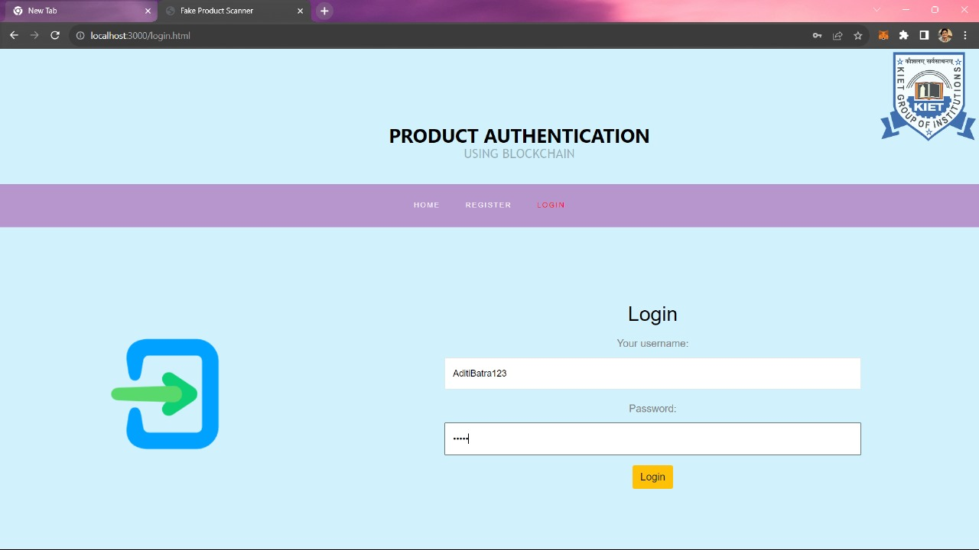

Slide 14
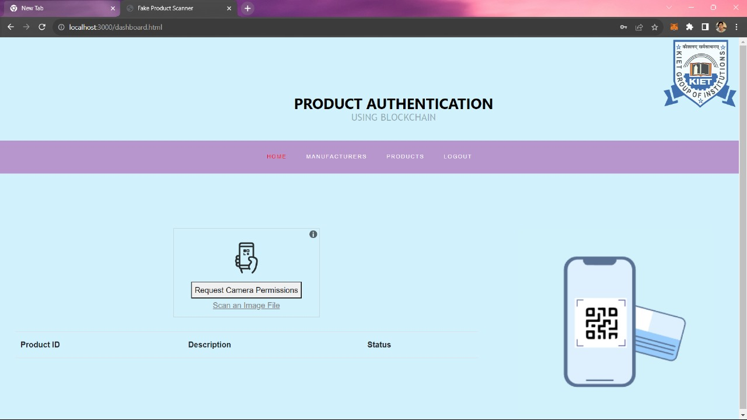

Slide 15
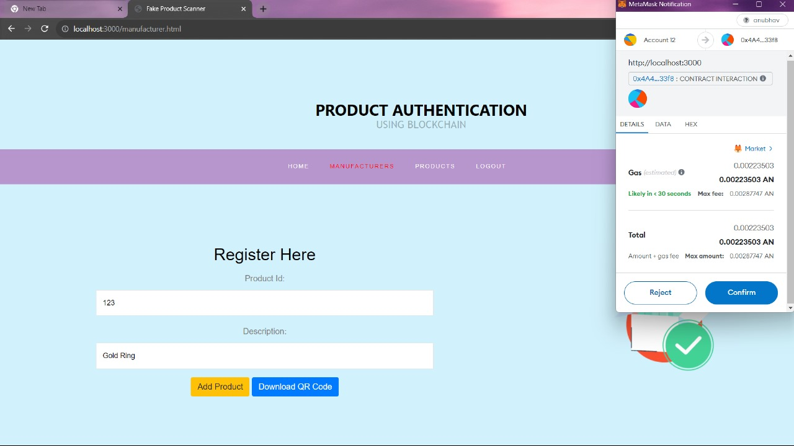

Slide 16
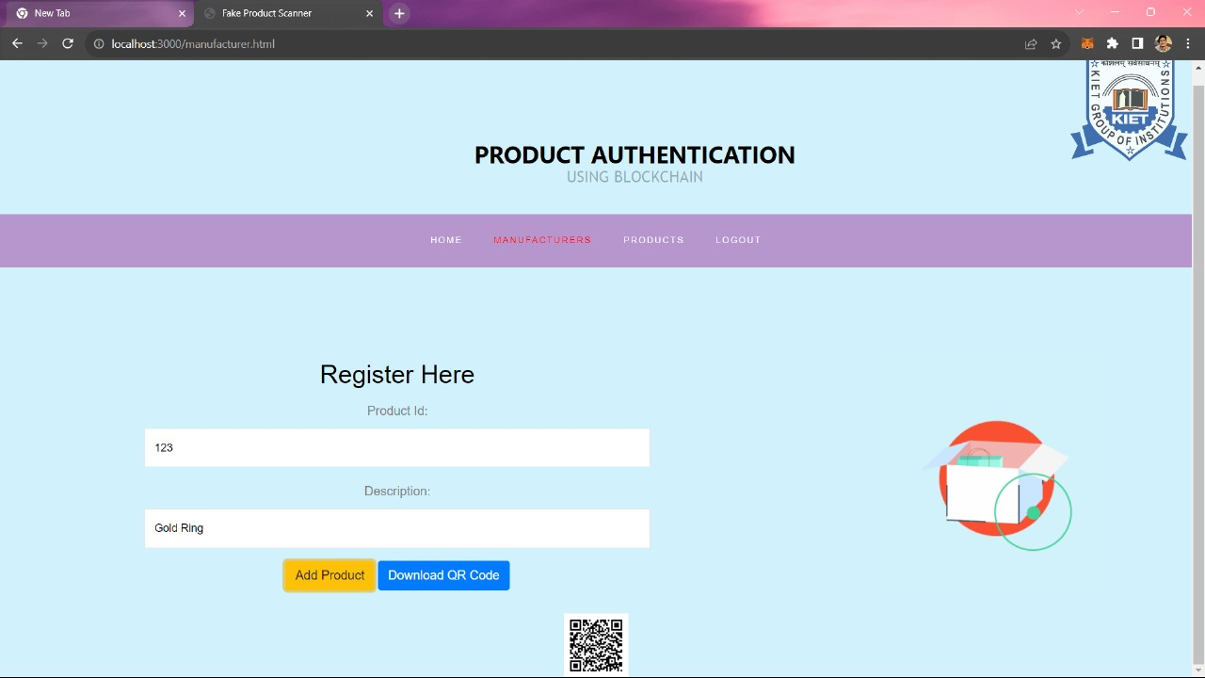

Slide 17
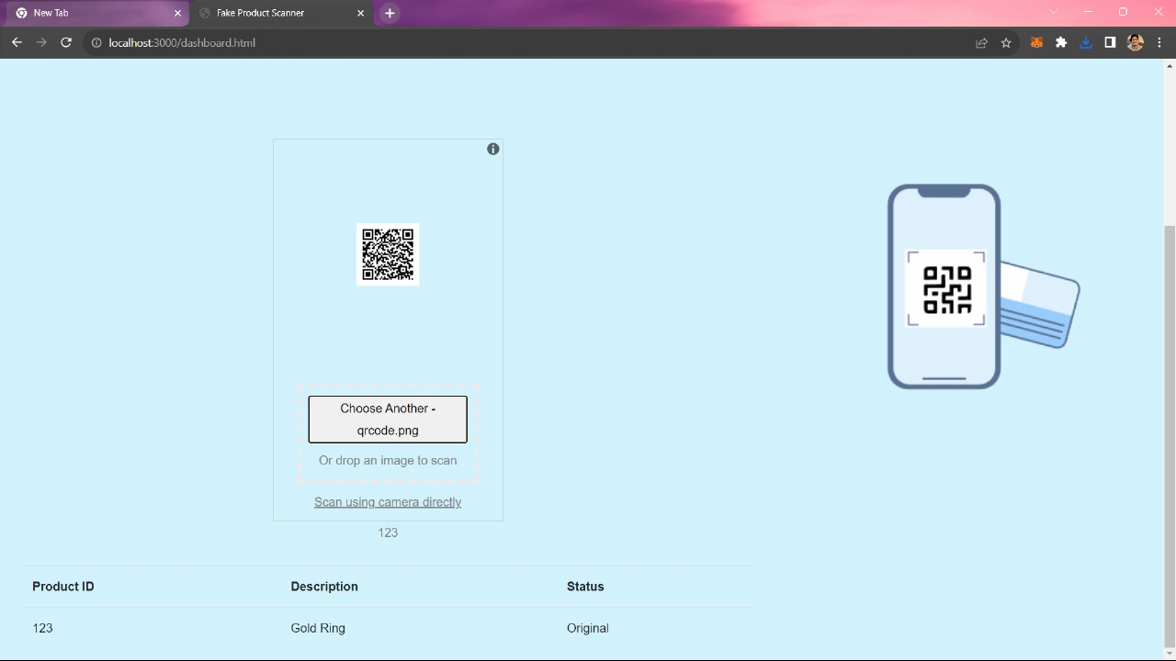

Slide 18
THANK YOU
Guide Name: Ms. Shivani
Project Members
Abhishek Singh Yadav (2000290120011), CS-7A
Aditi Batra (2000290120012), CS-7A
Anurag Tripathi (2000290120036), CS-7A
Kshitij Pal (2000290310092), ECE-7B

