Slide 1


KIET Group of Institutions, Ghaziabad
(An ISO – 9001: 2008 Certified & ‘A+’ Grade accredited Institution by NAAC)
I Project Presentation (KCS 751)
XML BASED FEED FORMATE
Guide Name : Mr. Anurag Mishra
Raj Aryan (2000290120124)( Sec: 8 B)
Rajveer Mishra (2000290120125) (Sec :8 B)
Monika Sharma (2000290120097) ( Sec : 8 B)

Slide 2
Problem Statement
I read a lot of blogs. As a writer, staying up to date on what blogs—in both the industry I work in and those I write about—are publishing is a great way to learn new things, come up with new ideas for topics to write about, and find studies that are worth linking to in the posts I write.
Subscribing to the blogs I follow in an RSS reader delivers each of those benefits. Rather than having to visit each publication's blog individually to see if new content has been published, I see all of the new content from all of the blogs I'm interested in within a single interface .

Slide 3
Objective
The author of your favorite website or podcast creates an RSS feed that maintains a list of new updates or notifications. You can check this list on your own, or you can subscribe to the feed so updates will show up in your own feed reader. This keeps you apprised of updates immediately. XML validation is a process done to check for a syntax error in an XML document to ensure that the document is well-written with the standard rules using either DTD or schema. A complete XML file is considered to be valid XML document unless it has correct syntax and constraints defined in it. With the RSS the user won’t need to give out an e-mail address for a subscription to a site’s RSS feed. There is no fear of spam outside of what may be published in the feed. Nothing is sent to the user via e-mail. Lastly, it’s easy to delete any feeds the users find boring or useless. No messy email process—just a click of the mouse or keyboard, and the RSS feed is gone.

Slide 4
Technology Used
Frontend Technologies:
HTML 5
CSS 3
JAVA SCRIPT
Backend Technologies:
XML
XSLT
JAVA
XPath
XML Parser

Slide 5
Literature Survey
RSS Feeds and its Implementation at INFLIBNET
Mr. Rajeev Kumar, Scientist - B (CS)
Year of Publishing : 2008

Slide 6
Summary of Paper
This project presents a web-based platform that leverages XML-based RSS (Really Simple Syndication) feed formats to empower users to access and aggregate information from multiple websites seamlessly. In a digital era marked by information diversity, our platform offers an efficient means for users to curate and retrieve data from their chosen web sources.
Our project's core functionality revolves around the synthesis and presentation of data from diverse websites, eliminating the need for users to individually browse multiple sites. By harnessing the capabilities of XML-based RSS feeds, we enable users to effortlessly stay informed and updated on topics of their choice.
Throughout this paper, we delve into the technical aspects of our platform, explaining its data aggregation process, the central role of XML, and the user benefits it offers. By providing a user-friendly gateway to cross-website information access, our project has the potential to revolutionize how users interact with online content.

Slide 7
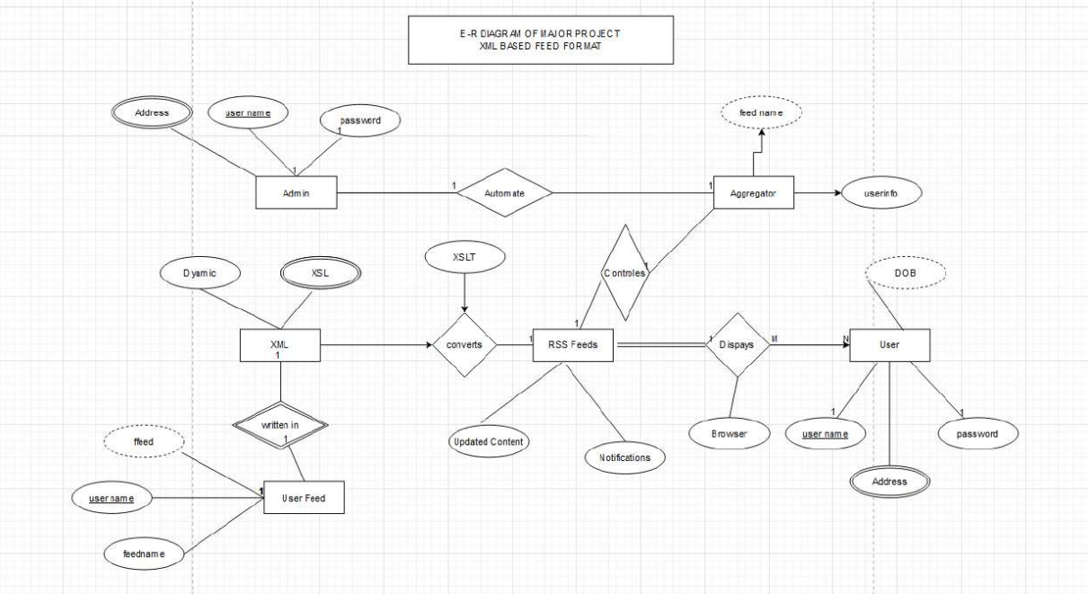
ER Diagram

Slide 8
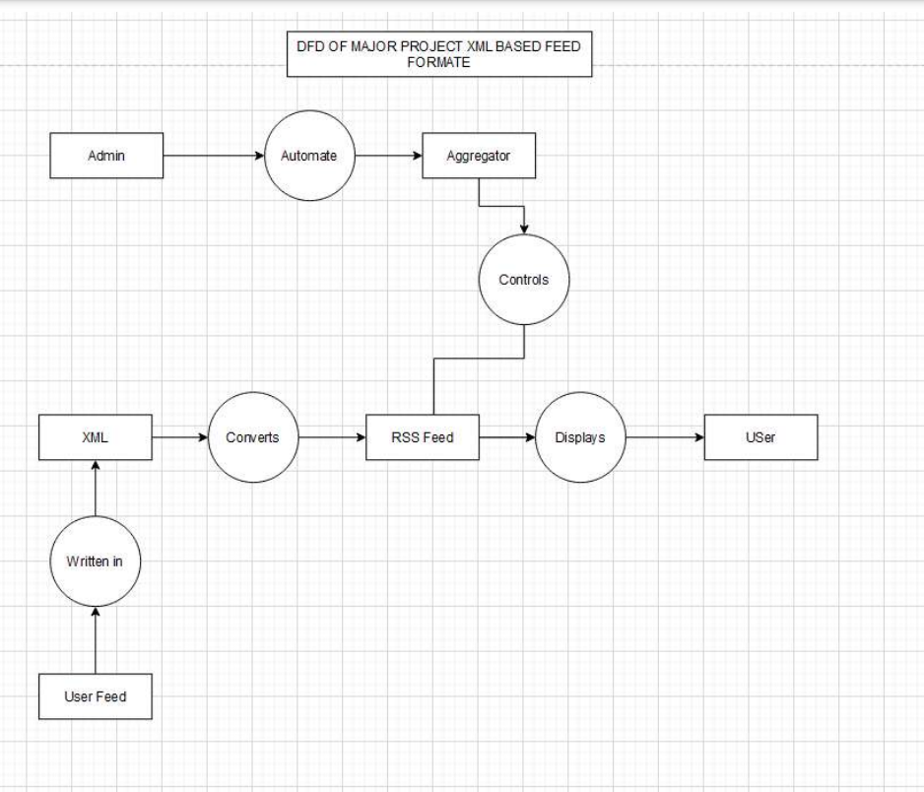
DFD

Slide 9

Patent Status

Slide 10
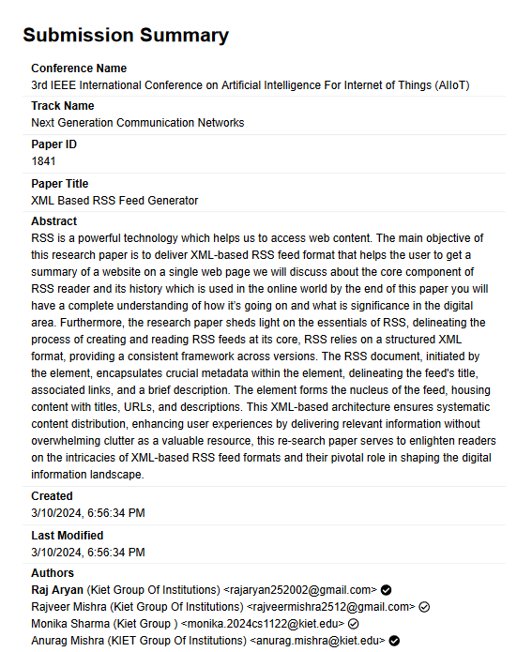
Research Paper Status

Slide 11
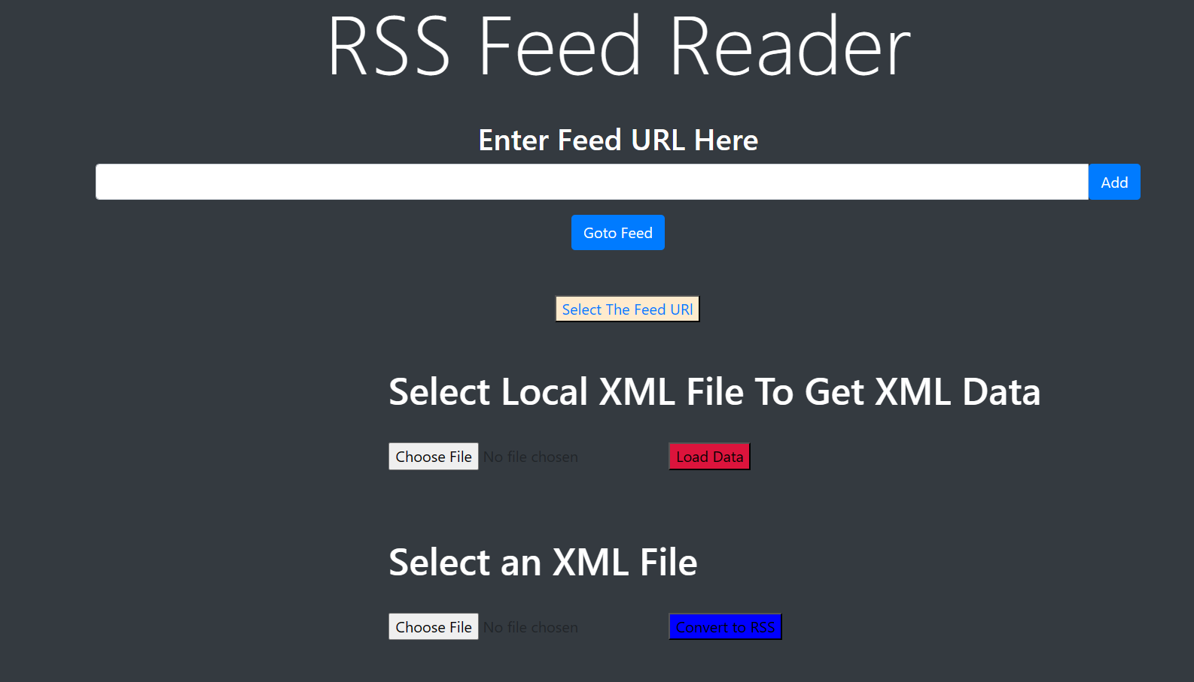
Result Screen Shot

Slide 12
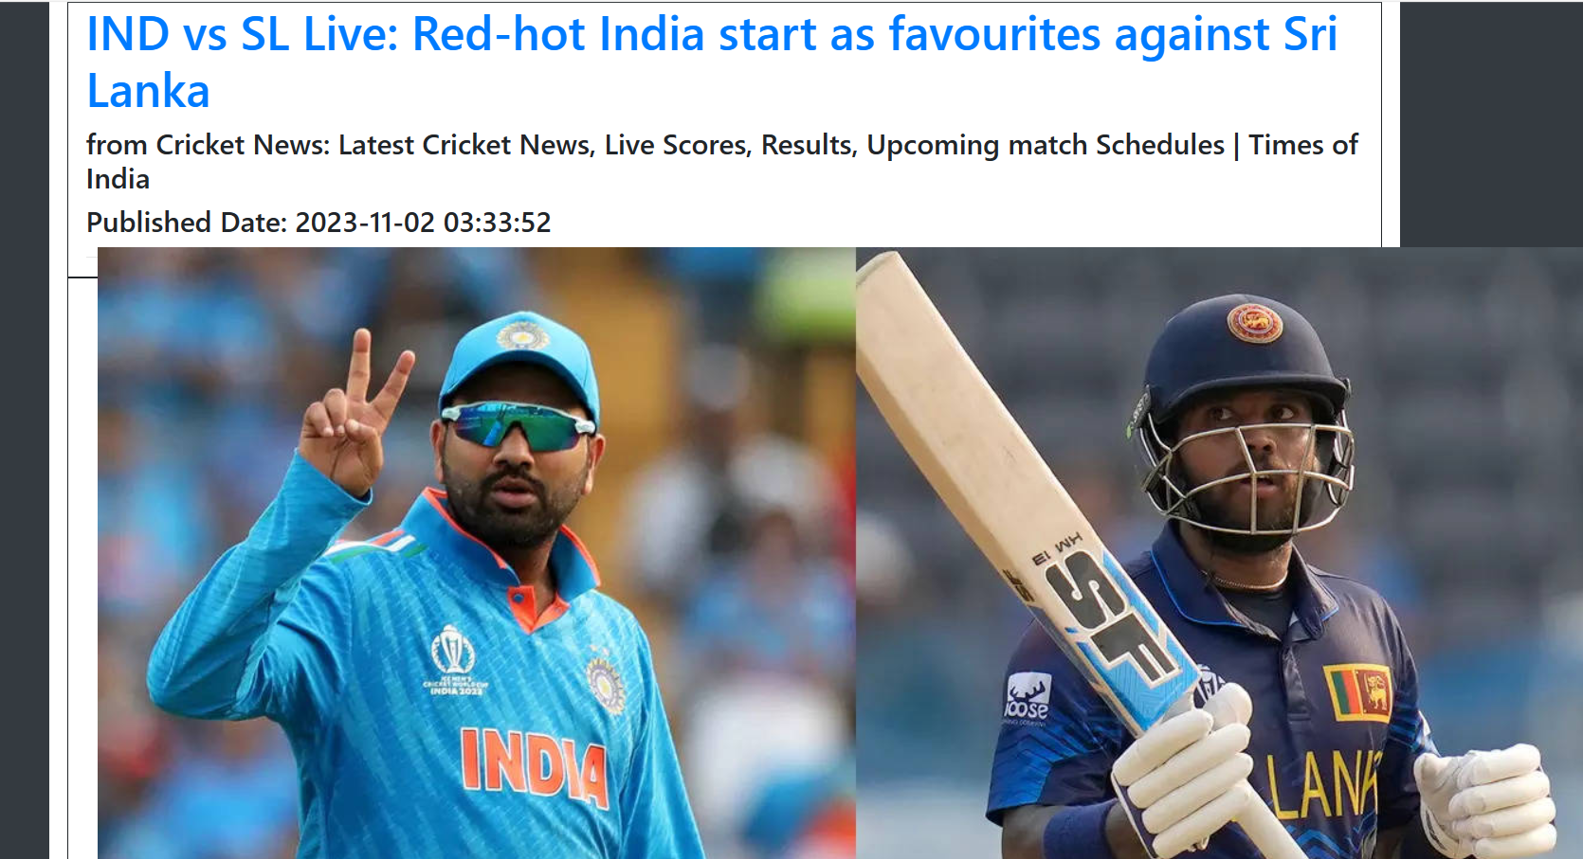

Slide 13
REFERENCES
Snyder R. "A Practical Introduction to the XML, Extensible Markup Language, By Way of Some Useful Examples." Proceedings of the 2004 ASCUE Conference, www.ascue.org, June 6 – 10, 2004, Myrtle Beach, South Carolina, 239.
Sakr, Sherif. "XML Compression Techniques: A Survey and Comparison." Journal of Computer and System Sciences, vol. 75, no. 5, 2009, pp. 303-322, ISSN 0022-0000, https://doi.org/10.1016/j.jcss.2009.01.004.
Gupta S, Kaiser G, Neistad D, Grimm P. "DOM-based Content Extraction of HTML." Columbia University Dept. of Comp. Sci. New York, NY 10027, US.
Kumar Rajeev. "RSS Feeds and its Implementation at INFLIBNET." In PLANNER 2008, published by Inflibnet Center, November 6, 2008. Available at: http://hdl.handle.net/1944/1168. ISBN: 978-81-902079-7-3.
Wang J, Uchino K. "EFFICIENT RSS FEED GENERATION FROM HTML PAGES." Fujitsu R&D Center Co., Ltd., B306, Eagle Run Plaza No.26 Xiaoyun Road, Beijing 100016, China. Fujitsu Laboratories, Ltd., 4-1-1 Kami-kodanaka, Nakahara-Kawasaki, Kanagawa 211-8588, Japan.
Ma D. "Use of RSS Feeds to Push the Online Content to Users." Singapore Management University Institutional Knowledge at Singapore Management University Research Collection School Of Computing and Information Systems School of Computing and Information Systems Decision Support Systems, vol. 54, no. 1, 2012, pp. 740-749, ISSN 0167-9236, https://doi.org/10.1016/j.dss.2012.09.002.
Holman GKen. "XSLT." Published on XML.com, http://www.xml.com/pub/a/2000/08/holman/index.html. "What Is XSLT."

