Slide 1

SKIN N SENSE
PCS24-57
Department of Computer Science
Guide- Prof. Pawan Kumar Pal
Presented by:
Tryamb Sachan
2000290120175(7C)
Shivam Singh
2000290120151(7C)
Suryansh Awasthi
2000290120170(7C)

Slide 2
problem statement
Prevalence of Skin Conditions:
Impacting 1.8 billion people globally.
Poses a significant health concern.
Mental Health Challenges:
Rising rates of stress and depression.
Affecting an estimated 264 million adults worldwide.
Contributes to the growing burden on mental health.
Integrated Approach Proposal:
Objective:
Address challenges posed by skin conditions and mental health issues.
Solution:
Develop an Android application.

Slide 3
OBJECTIVE
TO EVALUATE EMOTIONAL STATES, CONTRIBUTING TO MENTAL
HEALTH MONITORING, PROVIDING VALUABLE INSIGHTS INTO EMOTIONAL WELL-BEING.
TO PROVIDE USERS WITH AN ACCURATE DIAGNOSIS OF THEIR SKIN ISSUES USING MACHINE LEARNING ALGORITHMS.
LISTING THE NEARBY HEALTHCARE SERVICES TO HELP THE USER

Slide 4

Technology used
FRONTEND
XML
HTML/CSS3
CANVA
BACKEND
KOTLIN
JAVA
FIREBASE
GOOGLE APPS SCRIPT
MACHINE LEARNING
Convolutional neural network (CNN)

Slide 5
Literature survey
Paper Title | Author Name | Journal Name | Year of Publishing | Summary
Skin Disease Detection using Machine Learning | Kritika Sujay Rao, Pooja Suresh Yelkar, Omkar Narayan Pise, Dr. Swapna Borde | International Journal of Engineering Research & Technology (IJERT) | 2020 | CNN and back propagation method is used to classify skin disease
Application of Machine Learning Methods in Mental Health Detection | ROHIZAH ABD RAHMAN , KHAIRUDDIN OMAR, MOHAMMED ALI AL-GARADI | IEEE | 2020 | Support Vector Machines (SVM), Decision Tree (DT), ANN.

Slide 6
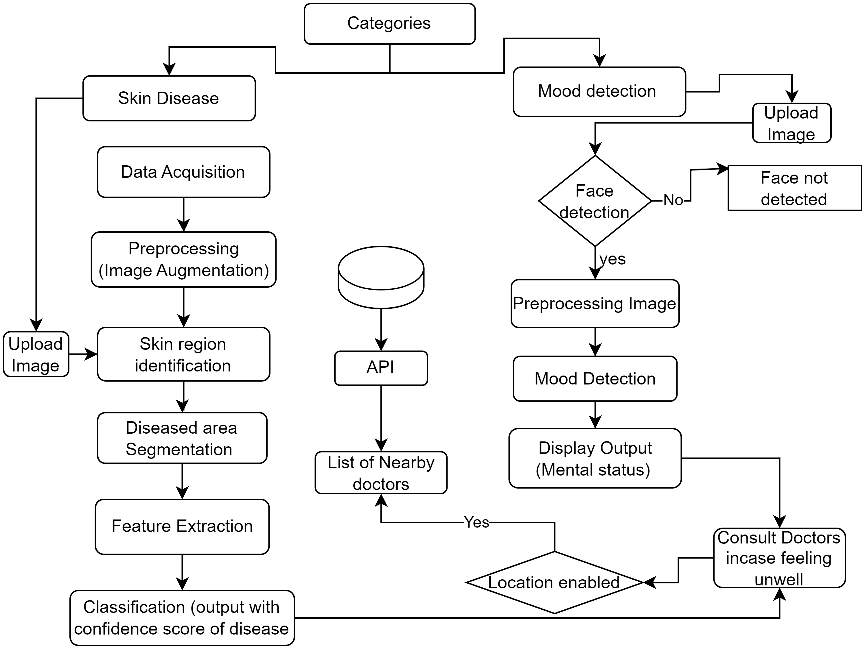
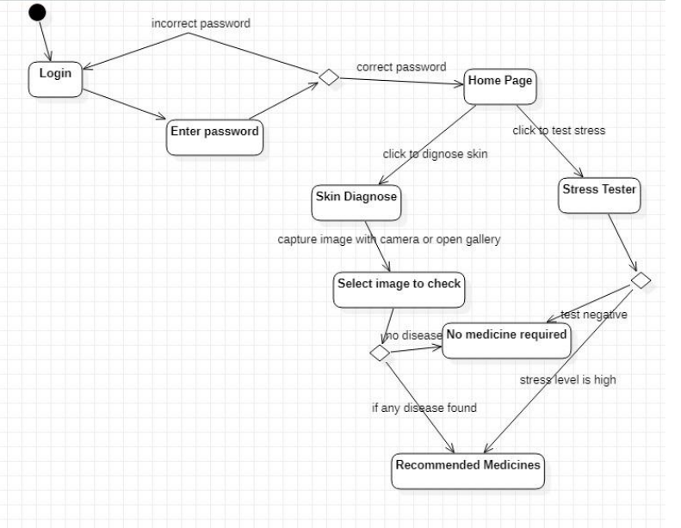
Workflow diagram

Slide 7
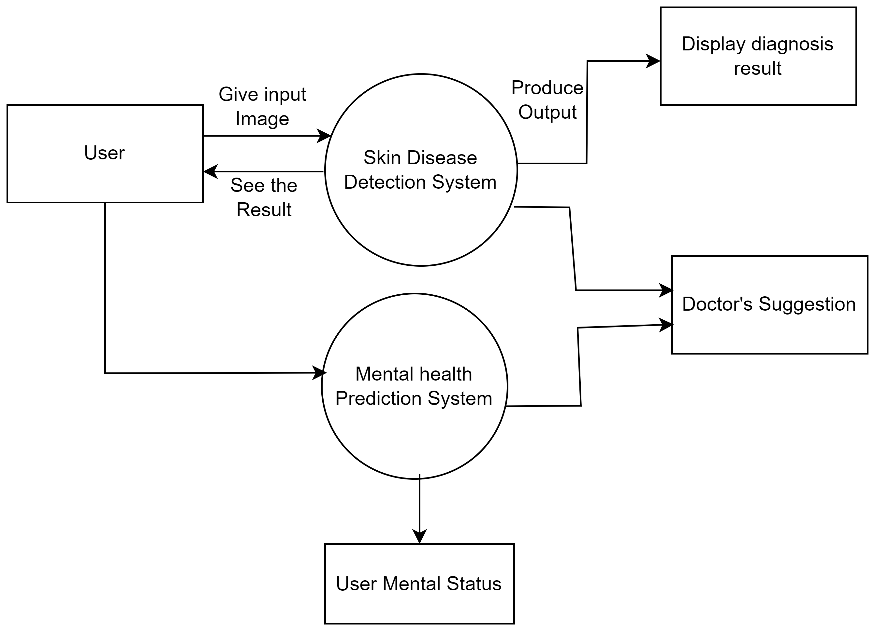
dFD

Slide 8
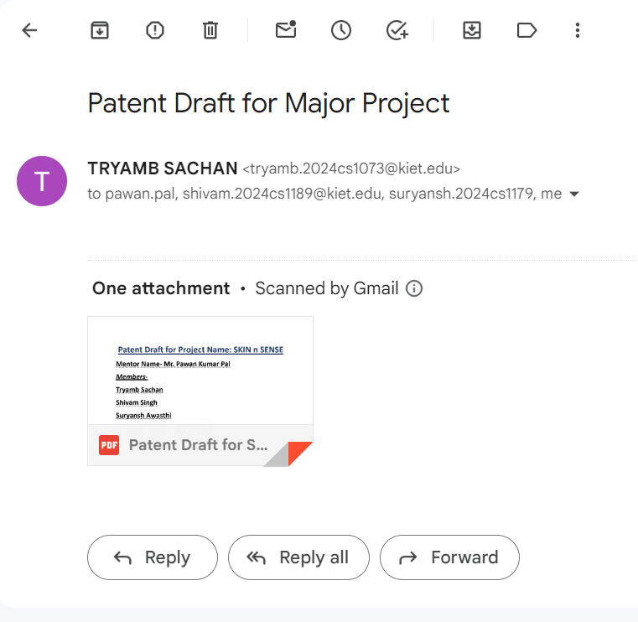
Patent status
Patent draft has been submitted to guide.

Slide 9
Research paper status
Research paper has been submitted to guide.

Slide 10
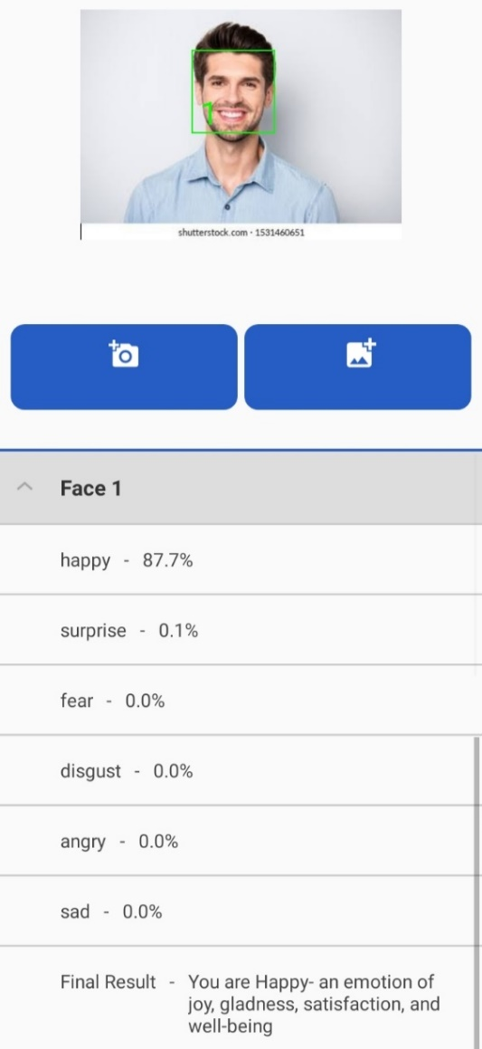
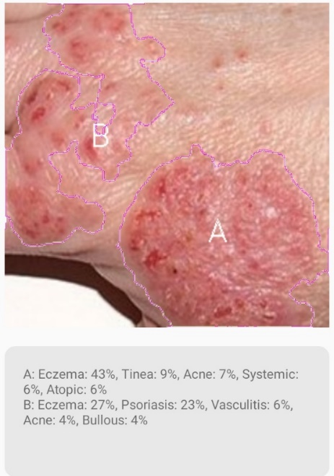
Project status
95% completed

Slide 11
Testing report
https://drive.google.com/drive/folders/1IyHgOCFWM03RNKq50evs5Ts8EVVeKjN0?usp=sharing

Slide 12
THANK YOU
Tryamb Sachan​
Suryansh Awasthi
Shivam Singh

