Slide 1


Project Presentation (KCS 753) E- voting system
KIET Group of Institutions, Ghaziabad
(An ISO – 9001: 2008 Certified & ‘A+’ Grade accredited Institution by NAAC)
Guide Name: Ms. Akanksha
Project Members Name with Roll Number & Section
1. Utkarsh Mishra (2000290120180) CS-C
2. Surya Pratap Singh (2000290120169) CS-C
3. Adrika Tripathi (2000290120015) CS-A

Slide 2
Problem Statement
Electronic voting carries significant risks, if compromised, all cast votes can probably be manipulated and misused.
A viable solution to overcome the risks of electronic voting, is blockchain technology.
Shortcomings fixed: clear and accessible, stopped illegal voting, strengthened data protection, checked the outcome of polling.

Slide 3
Objectives
People will be able to vote anywhere, anytime.
Faster and decentralized.
Casting of votes will be fully transparent.
Votes are immutable.
Anonymity
Singularity and Vote Privacy

Slide 4
Technology Used
For developing an E-voting machine using blockchain we used Ethereum – a popular platform for creating distributed blockchain applications that support smart contracts.
Software Requirements
1. ReactJS
2. Truffle framework
3. Ganache
4. MetaMask
5. Coding language; solidity, HTML, CSS, JavaScript.

Slide 5
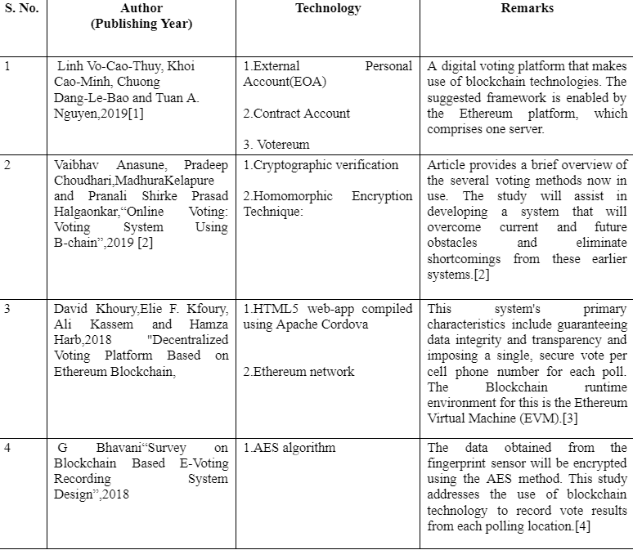
Literature Survey

Slide 6
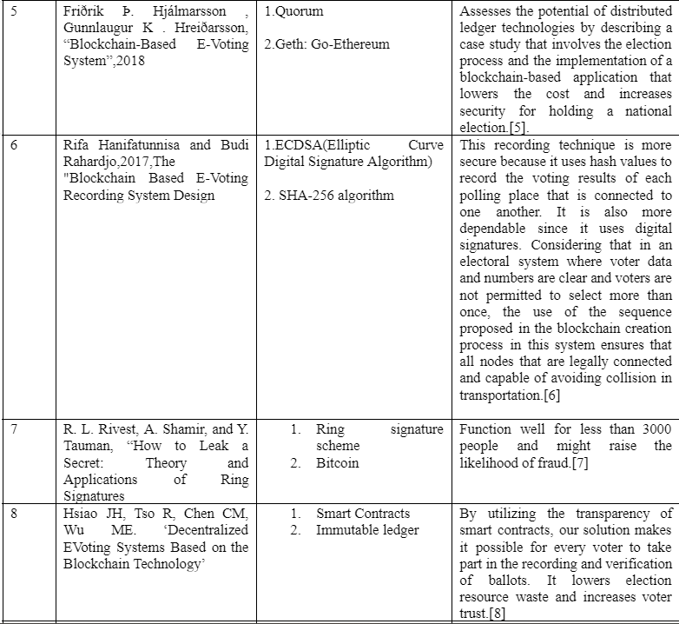

Slide 7
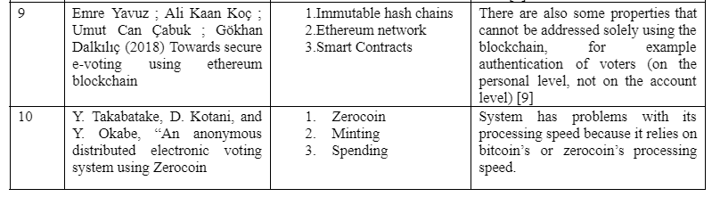

Slide 8
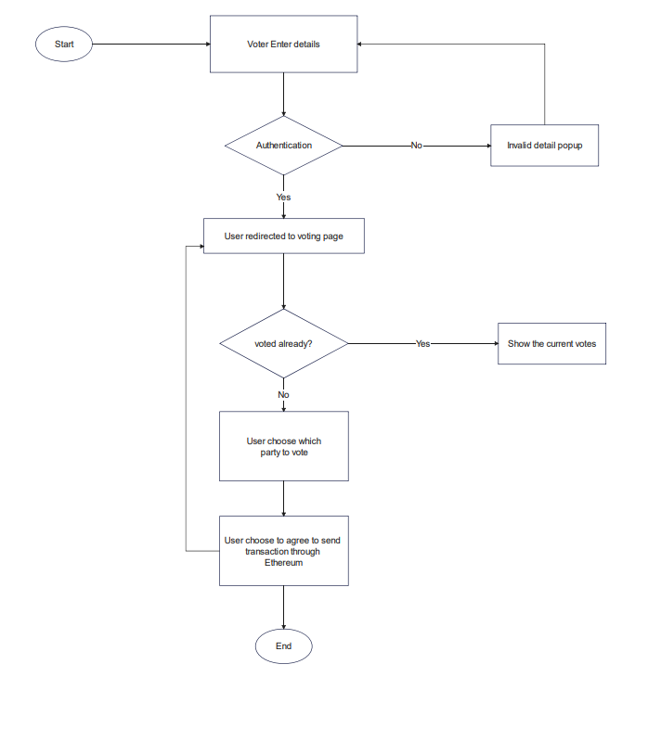
Workflow Diagram
.

Slide 9
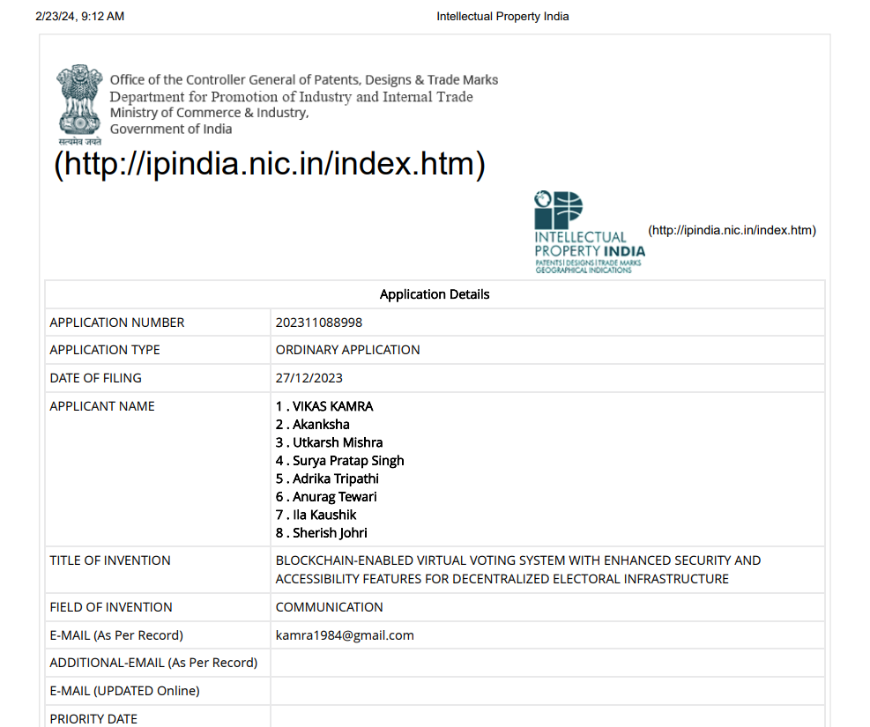
Patent Status

Slide 10
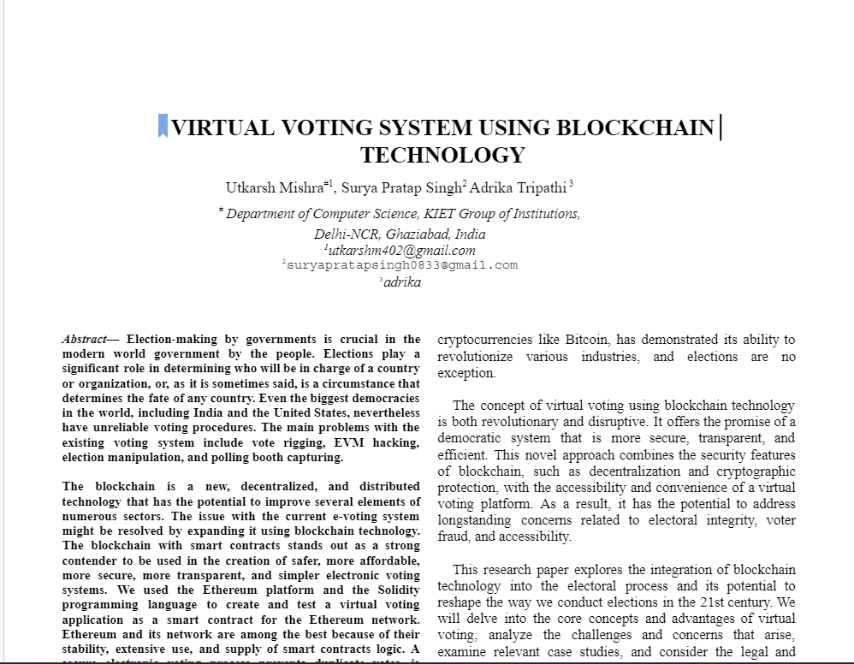
Research Paper Status
Completed

Slide 11
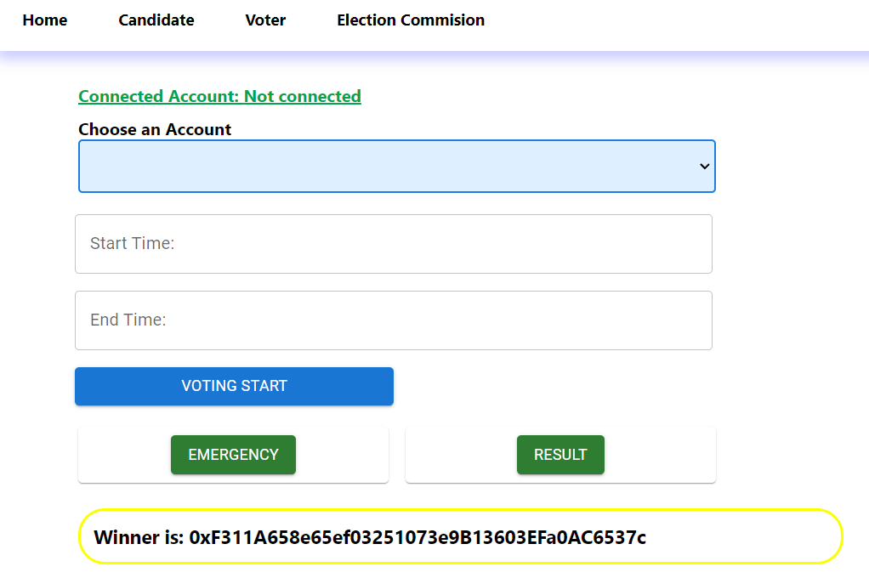
Project Status

Slide 12
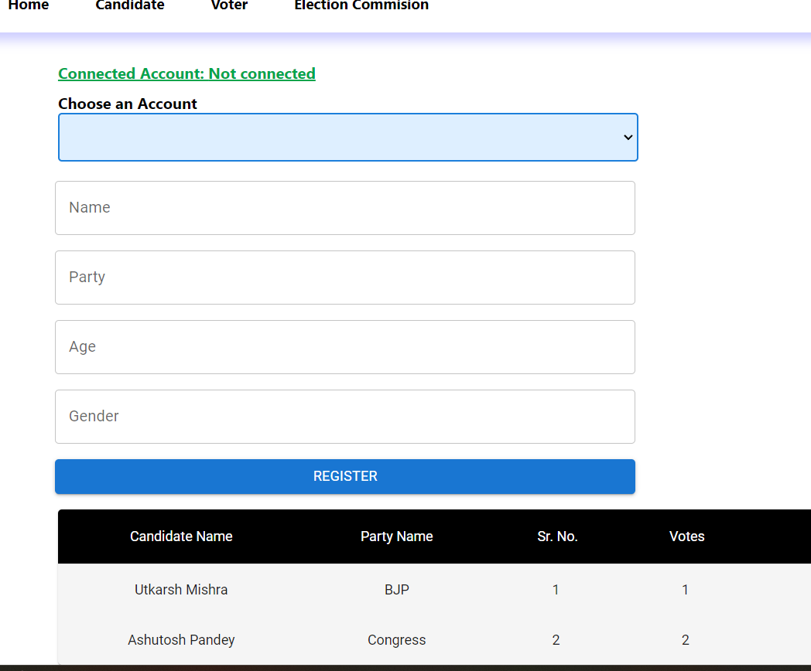

Slide 13
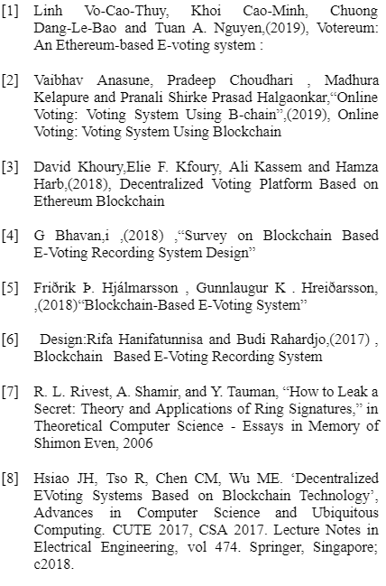
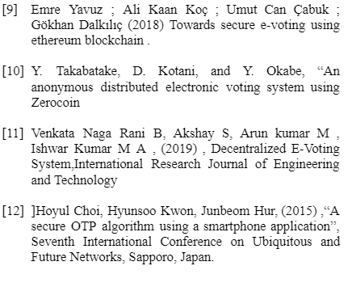
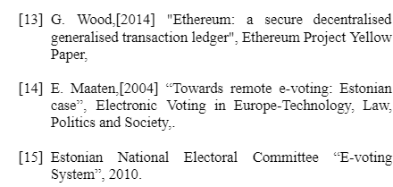
References

