Slide 1
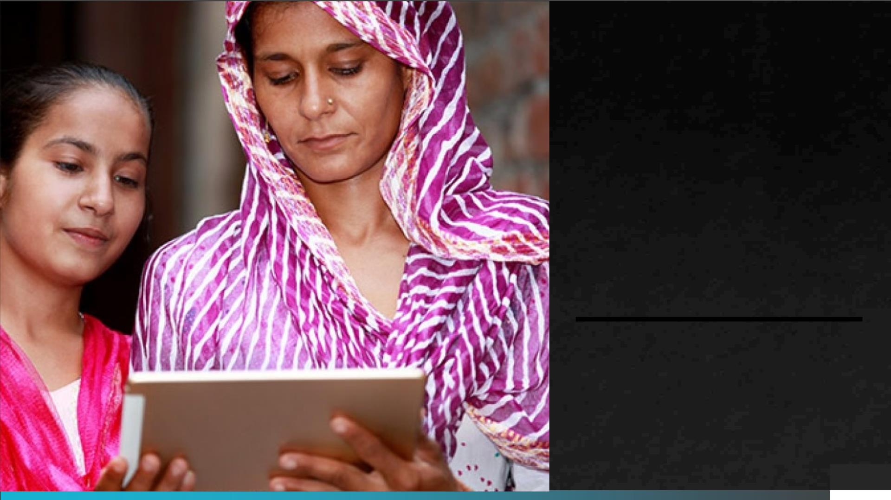
Kanchi
Empowering women
PAGE 1

Slide 2

Azure
women’s
Hackathon
hosted by
Microsoft
Corporation
PAGE 2

Slide 3

Project- Kanchi
By Team -Blue Bird
Team members :
Pragati Tomar
Palak Singh
Ragini Rani
PAGE 3

Slide 4

Acknowledgement
§ We would like to express our gratitude to Microsoft Azure for
conducting this amazing hackathon. We also feel thankful and express
our kind gratitude towards online tutorials which provide lots of
knowledge and content for making this project successful. We thank
all our team members for their positive support and great teamwork.
§ We are thankful to our college staff for giving us information about this
opportunity. We believe we will enroll in more such events in the
coming future. We ensure that this project was done by us and is not
copied.
PAGE 4

Slide 5

Problem
Statement
§ Women are an underrepresented group in
the STEM field. Only 20% of tech jobs are
being held by women. And 84% women
feel upskilling is key to unlocking
leadership opportunities in tech. 55% of
women express that enrolling in relevant
upskilling courses and programs staying
abreast with new-age technologies,
building a diverse skill set as well as
actively seeking new projects are
important at an individual level to
holistically develop and avail a leadership
role in the tech industry.
PAGE 5

Slide 6

Idea
§ In rural areas most women get married at
a very young age due to this reason they
have to leave their education due to lack
of money, support, and social pressure
even though they don’t know their basic
rights.
§ Our idea is to make a website in which we
teach the English language from basic to
advanced to rural women.
§ As we know that English is a global
language and in our society, if a person
knows English then he/she will feel
confident.
PAGE 6

Slide 7

Idea
§ So on our website we collaborate with some volunteers who will provide
online English classes to women which is beneficial in their day-to-day
life.
§ We also included a practice session in which we include some interesting
games through which they can learn through entertainment.
§ Through education, we are improving the livelihood opportunities of
rural women by providing English training.
§ We are also connecting NGOs to our websites through which they can
seek help for any problem they are having.
PAGE 7

Slide 8

About Project
§ ꢀA woman is entitled to live in dignity and freedom. Empowering women
is also an indispensable tool for advancing development and reducing
poverty so our project is about Women’s empowerment.
§ Our website consists of three sections first is the learning section, the
second is practice section and the third one is the NGO section.
PAGE 8

Slide 9

§ In the learning section we include three levels: level 1, level 2, and level
3.
§ In Level one we include some basic English words which they can use in
their day-to-day life.
§ In Level two we teach some basic sentences through which they can
easily communicate.
§ In Level three we teach professional level English which will help them
in their jobs.
§ The Second one is practice sessions in which we include some
interesting games which will also give entertainment to our learners.
PAGE 9

Slide 10
§ In the third section we include an NGO page in which we connected to
some NGOs like Guria India, Action Aid India, and Majlis manch.
§ If women need any help or want to help some other women who are
currently facing some problems, they can easily find the nearest NGO
to them and help themselves and others.
§ Our primary purpose is that through this project we can make women
more independent and confident and also they can face any problems
in any situation.
PAGE 10

Slide 11
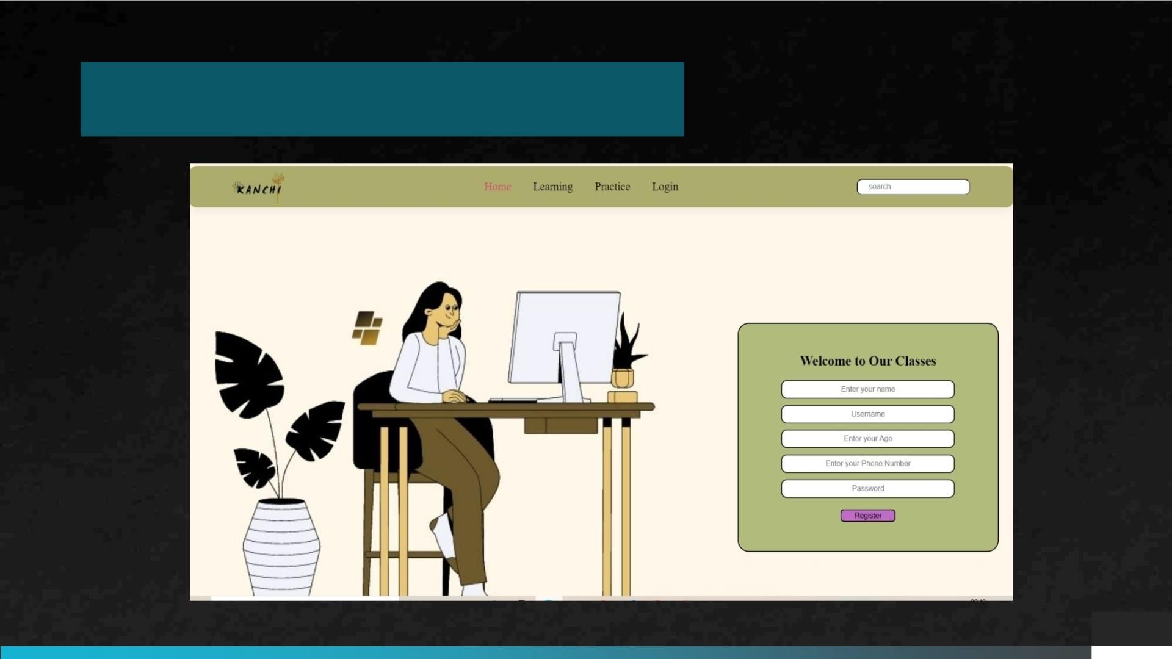
Home page
PAGE 11

Slide 12
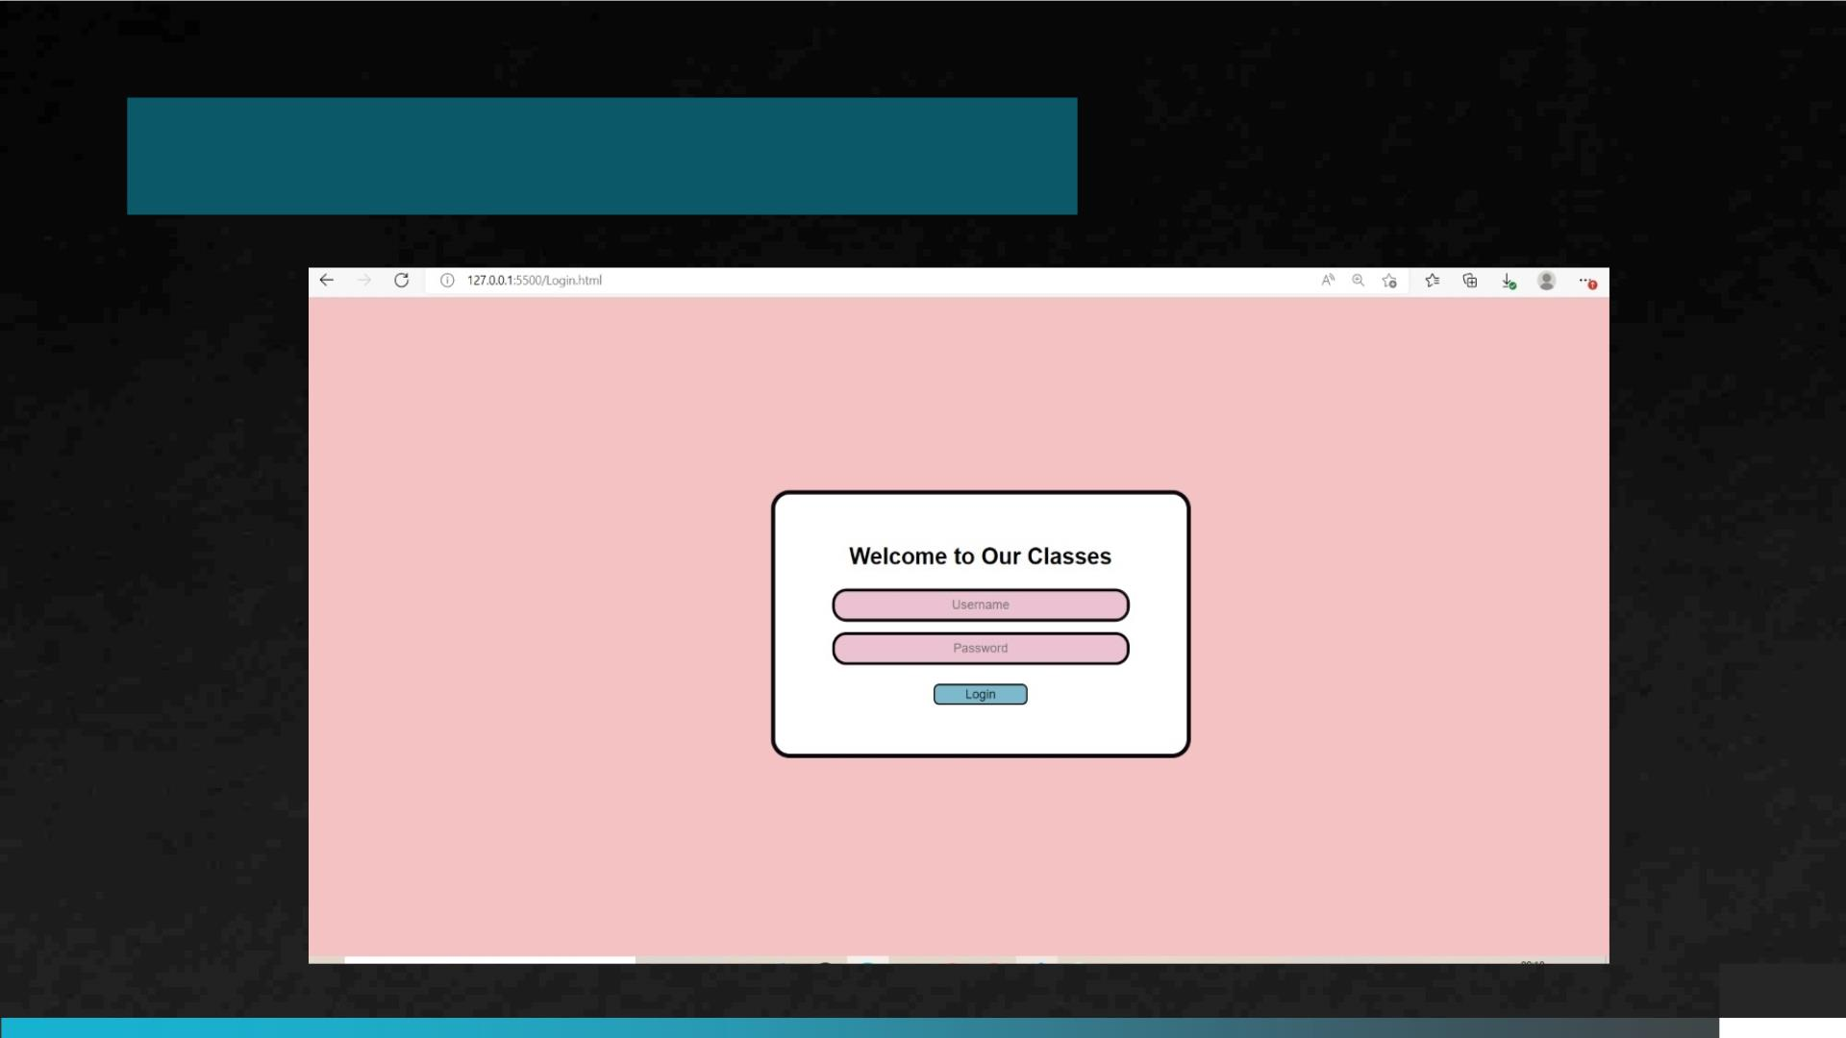
Login page
PAGE 12

Slide 13
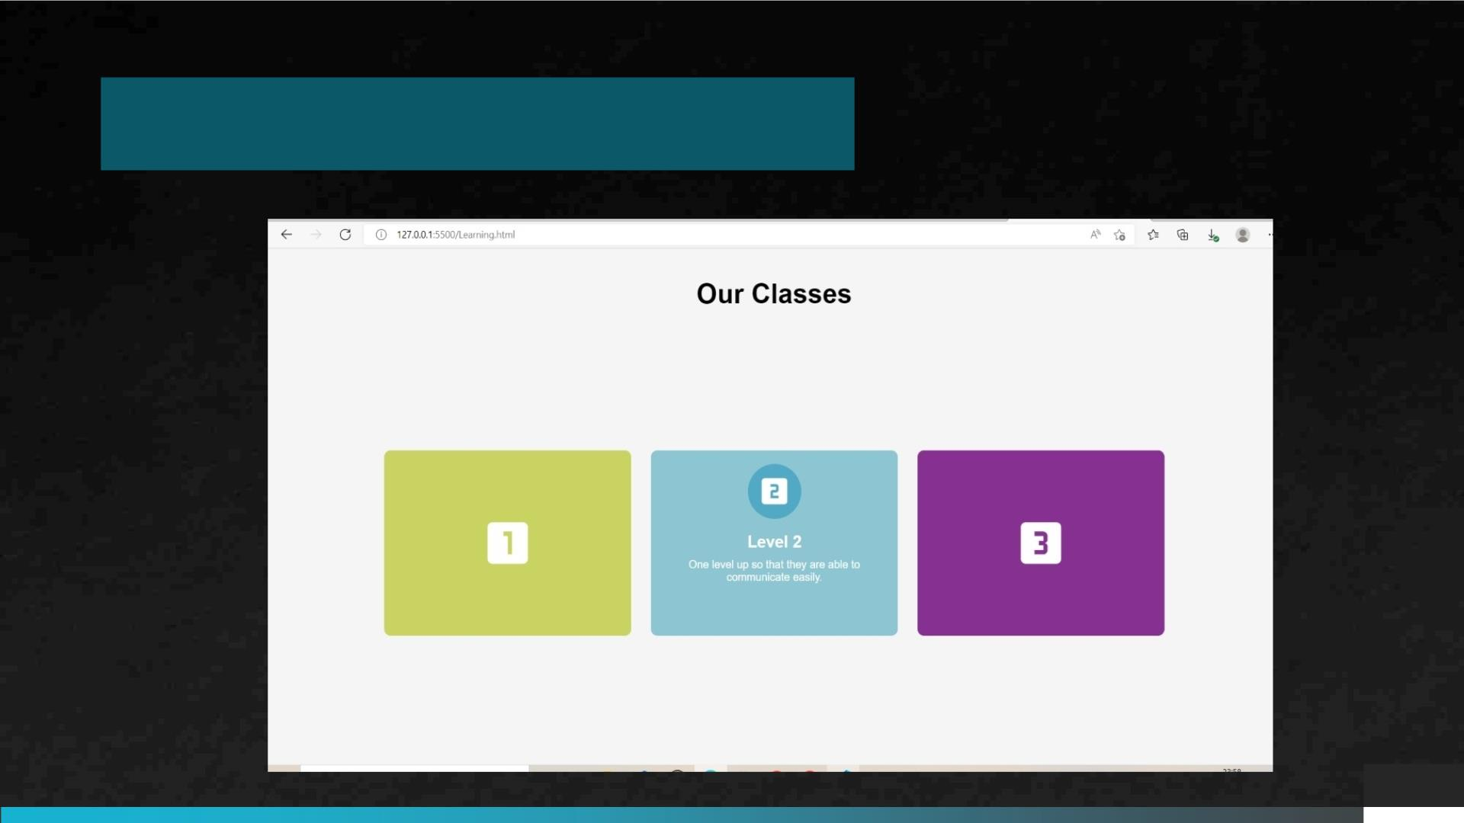
Learning page
PAGE 13

Slide 14
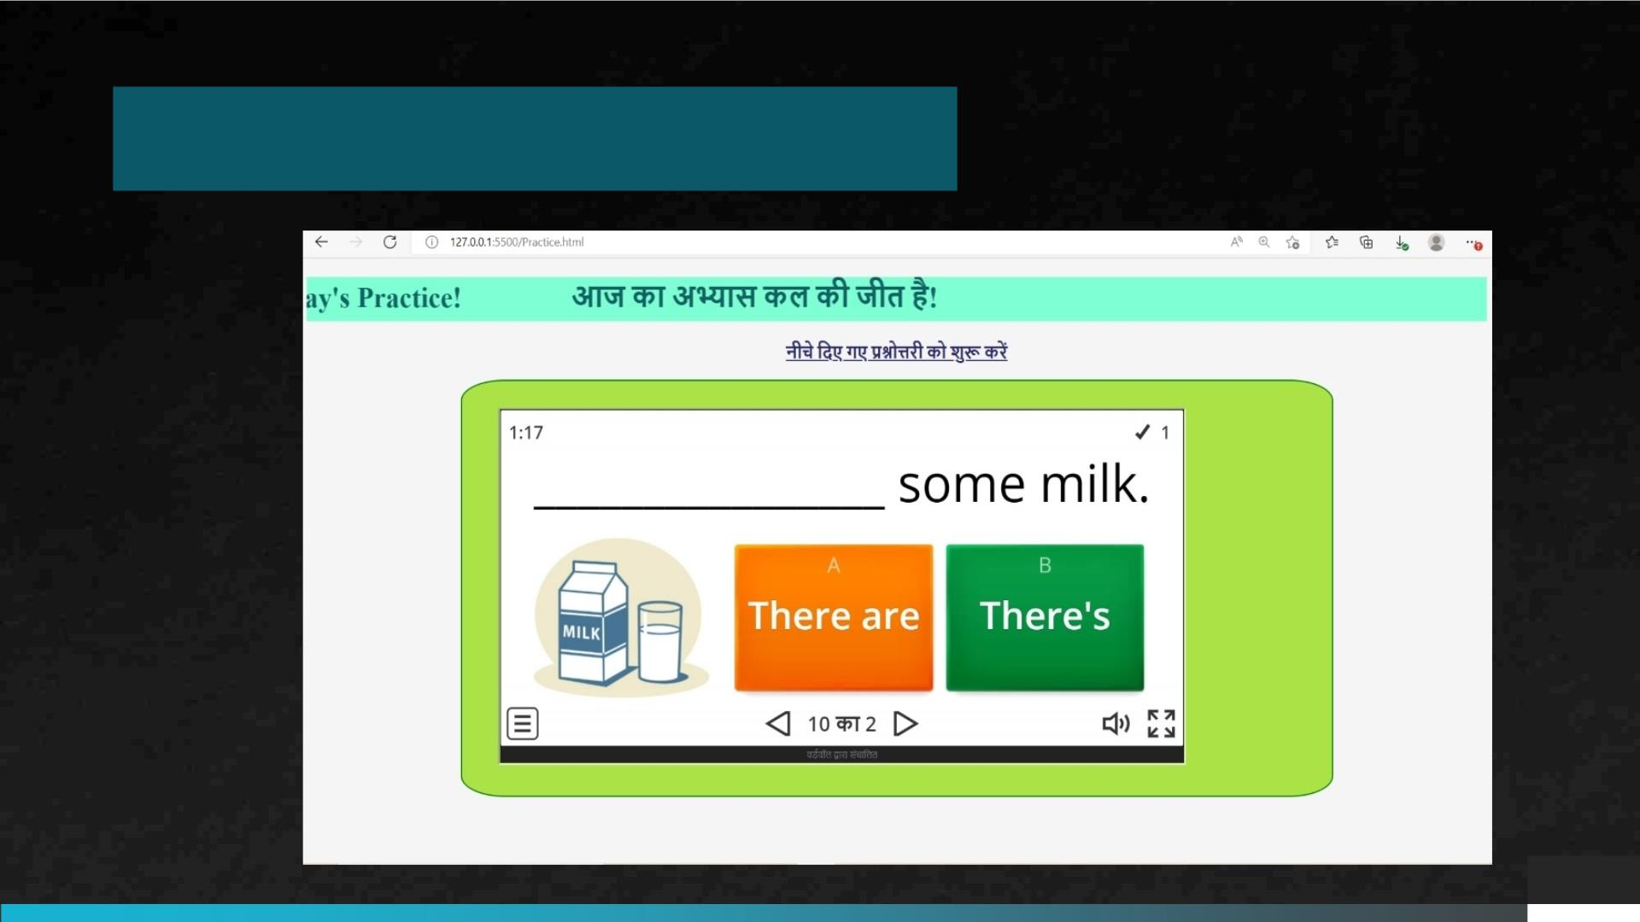
Practice page
PAGE 14

Slide 15
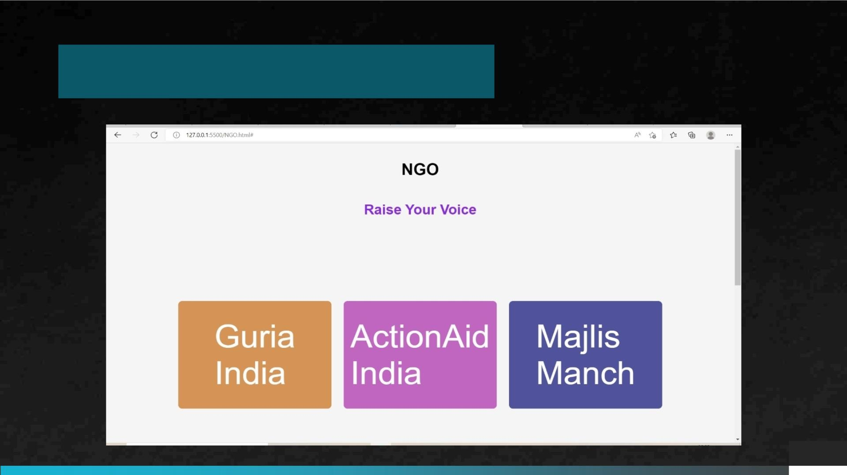
NGO Page
PAGE 15

Slide 16
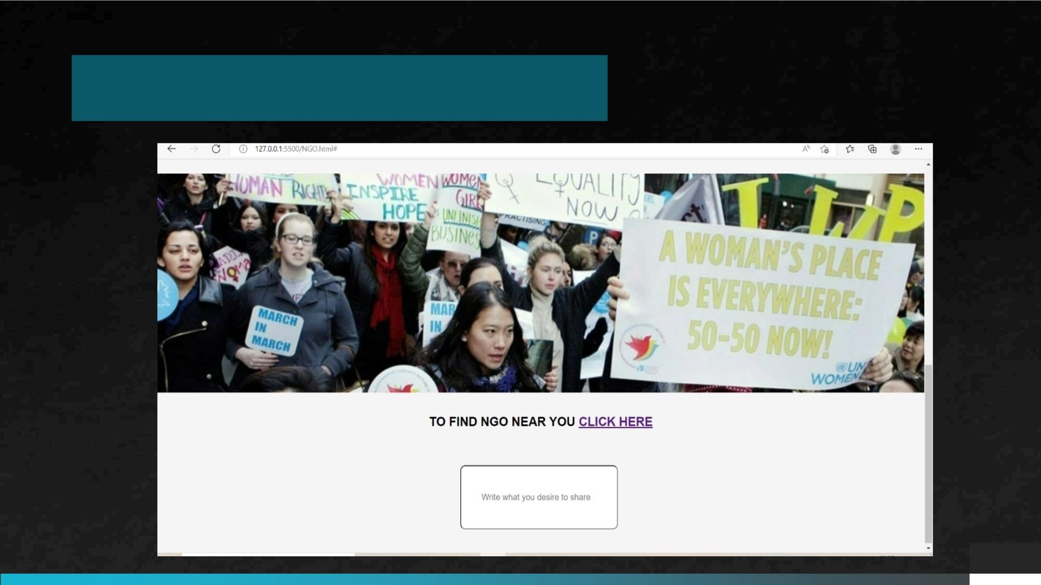
NGO Page
PAGE 16

Slide 17
References
§ file:///C:/Users/JAI%20SINGH/Downloads/Women_Empowerment_through_English_Langua%20(
1).pdf
§ https://www.researchgate.net/publication/330508754_Women_Empowerment_The_English_La
nguage_is_Killer_or_Contributor/link/5c44b147a6fdccd6b5bbc44a/download
§ http://www.guriaindia.org/
§ https://www.giveindia.org/blog/threats-are-a-part-of-their-work-profile%e2%80%8a-
%e2%80%8aat-guria/
§ https://www.giveindia.org/nonprofit/actionaid-association
§ https://www.giveindia.org/nonprofit/majlis-manch
PAGE 18

Slide 18

Thank
you
☺
PAGE 19

