Slide 1

Employability Outcome of Engineering Graduates
names

Slide 2
Employability outcomes of Engineering Graduates
Aspiring Minds’ Employability Outcomes 2015 (AMEO 2015) is a unique dataset which contains engineering graduates’ employment outcomes. http://research.aspiringminds.com/resources/#ameo
It contains standardized assessment scores in three fundamental areas - cognitive skills, technical skills and personality and the salaries and job titles offered right after graduation.
This dataset gives an insight on the factors that decide success after graduating college.
College grades, candidate skills, specialization done by the candidate are studied in order to understand how the weigh into a candidate’s employability.
Hypothesis Question

Slide 3

Summary of Dataset
It includes the Train Dataset which contains :
5 dependent variables: Salary, Designation, date of joining, date of leaving and city in which the candidate is offered the job.
32 dependent variables: Candidate biodata, AMCAT assessment scores, college GPA, 10th Board and 12th Board percentage, etc.
AMCAT is a computer adaptive test that measures job applicants on critical areas like communication skills and logical reasoning, thus helping recruiters identify the suitability of a candidate.

Slide 4
Data Cleaning
The dataset contains incomplete, incorrect and incomplete records. Typos and missing values reduce the quality of the dataset.
Typos, inconsistencies and redundant data:
Some of the features in the dataset are self-reported and they are not the same across subjects. JobCity have spelling errors and such discrepancies are handled manually.
Inconsistent capitalization is handled. Some columns(College ID, CollegeCity ID) were considered to not contribute in our study and were thus dropped.
Date of joining and leaving could be combined as Active Working Period

Slide 5
2. Handling Missing Data:
The missing data is informative and therefore cant be dropped.
NaN values in Salary column are replaced with the mean Salary. Similar operation is employed for numeric values in 10th and 12th Boards.
Scores in one of the sections Personality Test are sampled from a distribution of mean 1 and variance 0. Missing Values are replaced with the mean scores.
10Boards and 12Boards columns which specify the Education Board from which the student has graduated contains categorical data.
Hence Missing Values can be imputed by the mode(most frequent value)

Slide 6
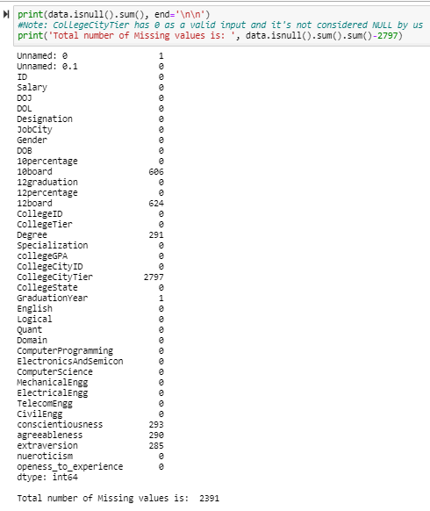
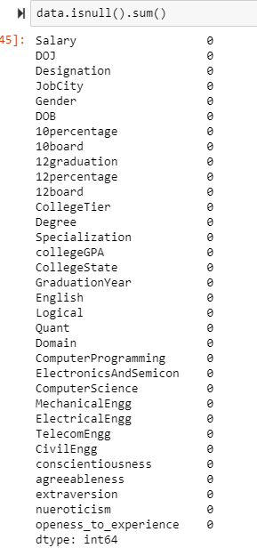
Data Cleaning
Original dataset with 2391 missing values
Cleaned and improved data

Slide 7
Data visualization
Dataset is put through various visualization tools in order to recognize distribution patterns and choose appropriate statistical analysis methods.
To study the various factors that affect the salaries of candidates.
Choosing suitable methods of visualization such as:
Bar Graph : What is the wage gap between women and men in the labour market?
Scatter Plot: Does experience and prior industry knowledge result in higher pay packages?
Violin Graph: How much does a candidates soft skills and personality traits decide their success in the market?

Slide 8
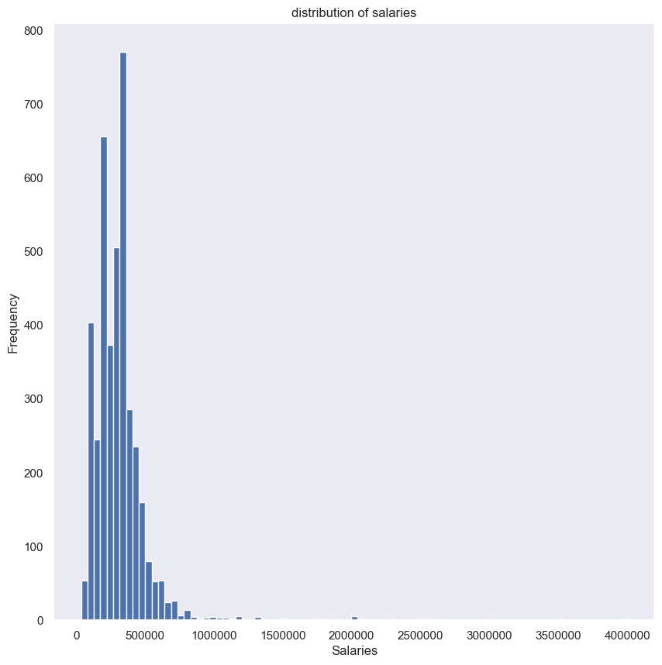
Histogram
By dividing the entire range of values into a series of intervals, Histograms can give an approximate representation of the distribution.
The adjacent graph shows the higher frequency of the salary bracket falling between 1-5lacs

Slide 9
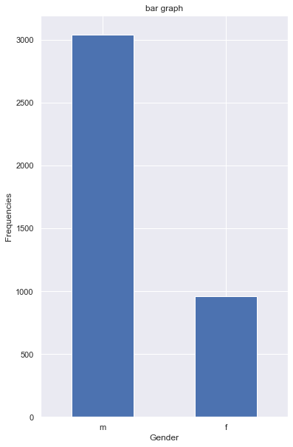
Bar Graph
The Bar Graph presents categorical data with rectangular bars with heights or lengths proportional to the values that they represent.
The adjacent graph shows the disparity in the frequency of men being chosen over women.

Slide 10
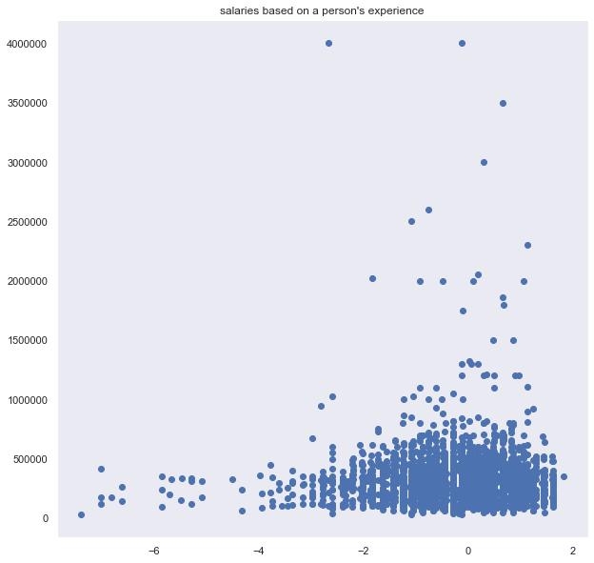
Scatter plot
Scatter plots are used to plot data points on a horizontal and a vertical axis in the attempt to show how much one variable is affected by another.
Please write an inference from this graph, im not too sure : )

Slide 11
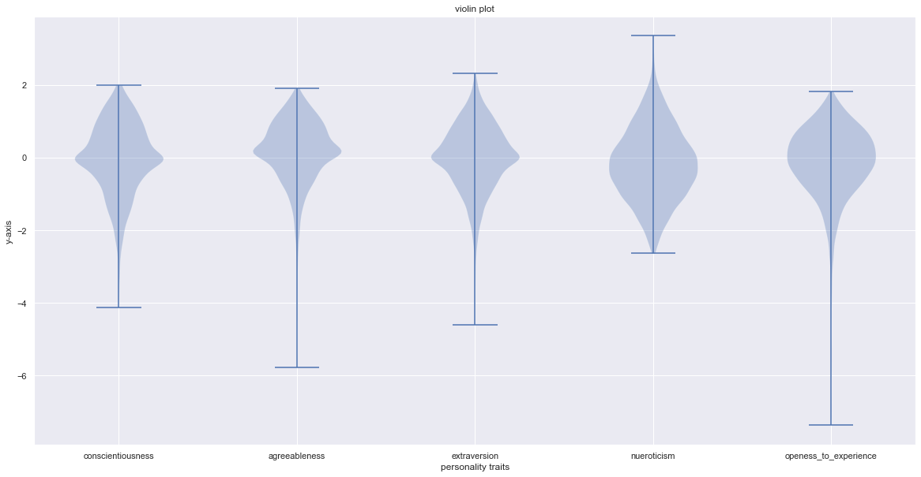
Violin Plot
Being similar to box plots, violin plots also show the probability density of the data at different values. While a box plot only shows summary statistics such as mean/median and interquartile ranges, the violin plot shows the full distribution of the data.

Slide 12
Identifying outliers
Outliers are extreme values that deviate from other observations on data
Most common causes of outliers on a data set:
Data entry errors (human errors)
Measurement errors (instrument errors)
Experimental errors (data extraction or experiment planning/executing errors)
Data processing errors (data manipulation or data set unintended mutations)
Sampling errors (extracting or mixing data from wrong or various sources)

Slide 13
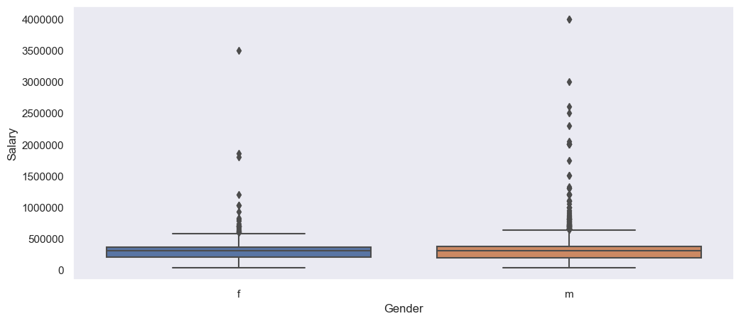

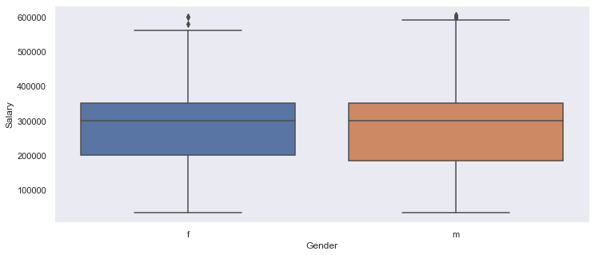
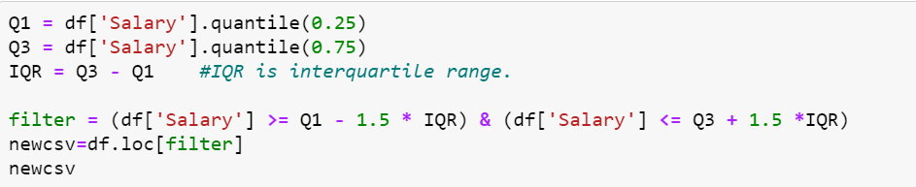
Employing Box Plot shows the outliers when comparing salaries of men and women

Slide 14
Normalization
Normalization entails scaling a variable to have a value between 0 and 1.
The goal of normalization is to change the values of numeric columns in the dataset to a common scale, without distorting differences in the ranges of values.
required only when features have different ranges.
Standardization
transforms data to have a mean of zero and a standard deviation of 1
Important when we compare measurements that have different units.

Slide 15
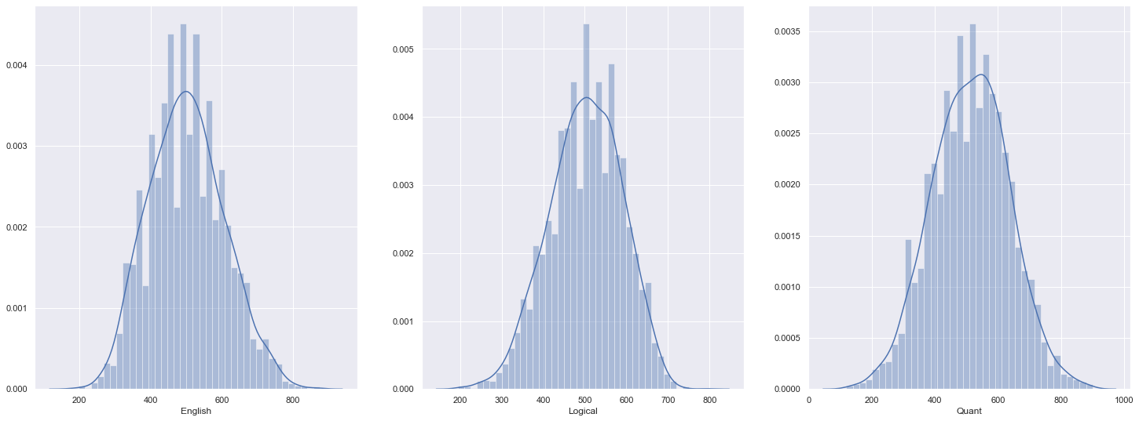
Plotting histogram to show normality of data

Slide 16
Hypothesis testing
Involves an assumption about a population parameter.
The mean score of 70 scores in Computer Programming section of the AMCAT test is 366.4 with standard deviation of 205.32. A hypothesis test is performed to check if the average scores is higher than the passing grade of 420.
Null Hypothesis:
H0: mu <= 420
Alternate Hypothesis:
H1: mu > 420
Since it is a large sample and standard deviation is known, we assume the distribution is normal and use Z-Test.

Slide 17
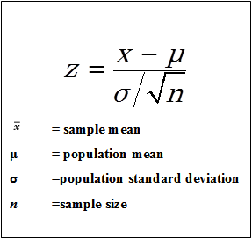
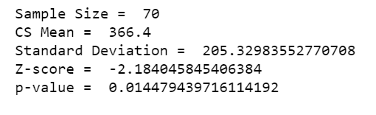
We assume the Null Hypothesis is true and consider μ ₀ = 420.
X‾ will follow a normal distribution with mean = 420 and variance = 205.32 ² / 70.
Using the following formula to calculate Z- score
P-value is calculated using the Standard Z-Table

Slide 18
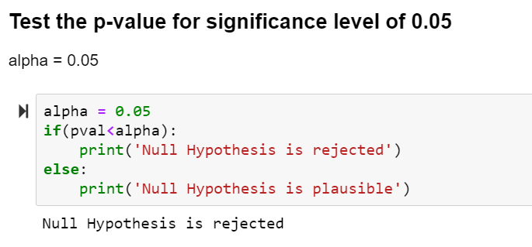
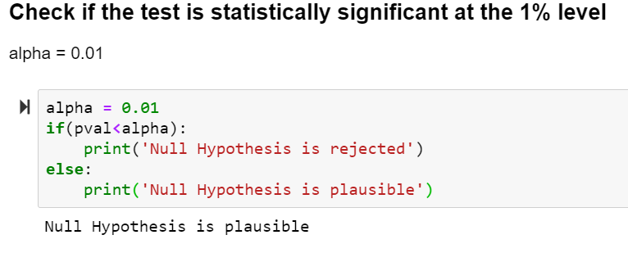
Significance level, α = 5%
Is test statistically significant at 1%?

Slide 19
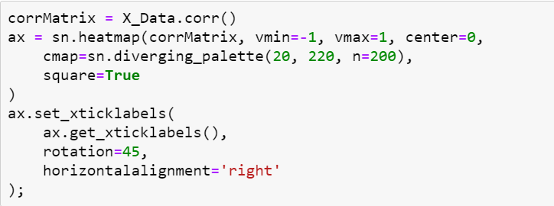
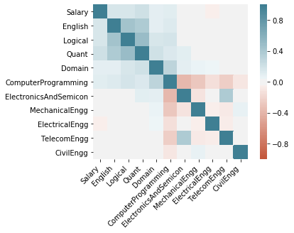
Correlation Matrix
A statistical relationship between two variables constitutes a correlation.
By constructing a table one can summarize data, as an input into a more advanced analysis
Visualizing the correlation matrix as a heat map.
In the adjacent graph, stronger the color, larger the correlation magnitude
Observation from the graph: Computer Programming scores have an important role in higher salaries

