Slide 1
SKYRESOLVE
Customer-Facing
Resolution Agent
1
UNDERSTAND
Assignment 3 — Airline Disruption Resolution
2
DECIDE
3
RESPOND
Palak Kansal • 23csu230

Slide 2
Problem Statement
02
Why an airline resolution agent needs guardrails
CORE REQUIREMENT
Airlines need a support agent that can resolve customer disruption requests (cancellations, delays, refunds) without a human for every case
Key risk: a free-form chatbot could promise things outside policy — need guardrails, not just good phrasing
Goal: build an agent that's grounded in real booking data and cannot say yes to anything the policy doesn't allow
Never let the
conversation itself
become the policy.

Slide 3
Design Philosophy
03
Separate language understanding, entitlement decisions and phrasing
01
02
03
Core decision: separate "understanding the customer" → "deciding what they're owed" → "saying it out loud"
Only the middle stage has authority to grant/deny anything — and it's pure deterministic code, not an LLM
Whatever the language-understanding stage gets wrong, it can only mis-tag a request — it can never itself grant something outside policy

Slide 4
Architecture — 3-Stage Pipeline
04
The decision-making core is deterministic and isolated
STAGE 1 — INTENT NLU
Pattern matching → fixed tags
1
DATA SOURCE
rebook • refund • hotel_full_night • legal_threat • fare_change
knowledge_base.json
• Customer profiles
• Booking / transaction data
• Service rules
• Allowed + prohibited actions
STAGE 2 — RULES ENGINE
Booking lookup → ALLOW / DENY / ESCALATE
2
Pure code • no LLM • exact policy reason
STAGE 3 — REPLY PHRASING
3
Decision → constrained template
No generative step • no invented promises

Slide 5
Three-Way Decision Logic
05
A deliberate distinction between explainable denials and escalations
ALLOW
DENY_WITH_POLICY
ESCALATE
request is within policy, action taken directly
A "no" the agent explains itself (e.g., delay under 5h doesn't qualify for hotel)
a "no" reserved for the Prohibited list or a stated numeric threshold being crossed (e.g., fare difference above ₹1,500)
FAIL-SAFE DEFAULT
any unrecognized intent tag escalates automatically — system defaults to "get a human," never "say yes"

Slide 6
Privacy-First Customer Identification
06
No customer picker or exposed customer list in the UI
CUSTOMER MESSAGE
MATCH
RESULT
“Hi, I'm Priya.
My flight was cancelled.”
Knowledge base
Proceed
Agent identifies the customer from their name typed in the message.
If no name is recognized:
ask the customer to identify themselves.
NAME IN MESSAGE

Slide 7
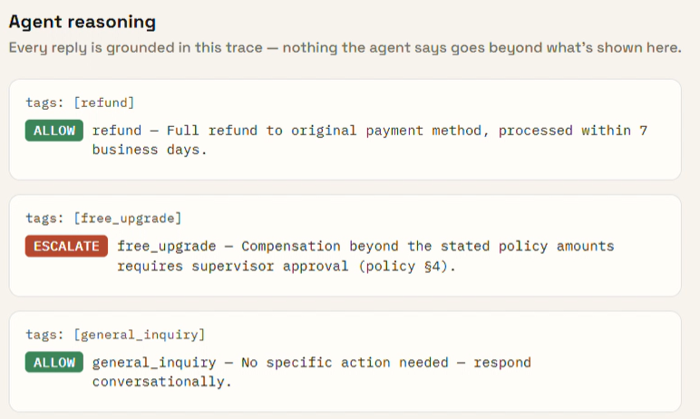
Scenario 1 — Priya Nair (Gold)
07
MID-CONVERSATION
Cancellation → refund allowed; unsupported upgrade → escalation
“I also want a free business-class upgrade for the trouble.”
REFUND
ESCALATE
Flight SK-204 cancelled
Not on the allowed action list → routed for human handling.
“I want a full refund.”
ALLOW
Refund processed to the original payment method within 7 business days.

Slide 8
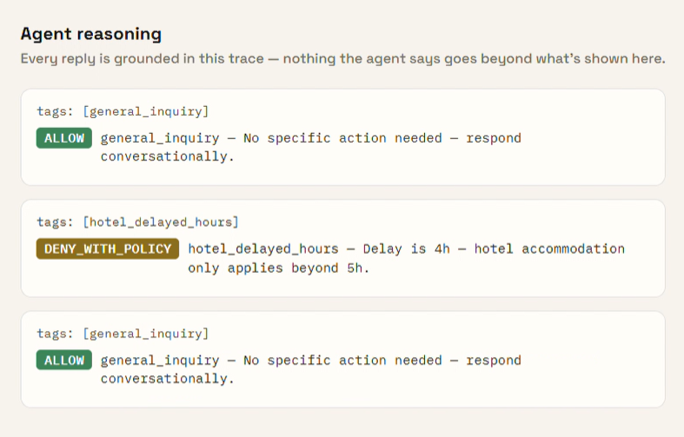
Scenario 2 — Arvind Kulkarni (Silver)
08
4-hour delay → hotel denied by threshold; alternatives offered
WHAT THE AGENT CAN OFFER
✓
Meal voucher
Flight SK-118
Delay: 4 hours
✓
Lounge access
HOTEL REQUEST
“Can I get a hotel?”
DENY_WITH_POLICY
Under the 5-hour threshold, hotel accommodation does not qualify.

Slide 9
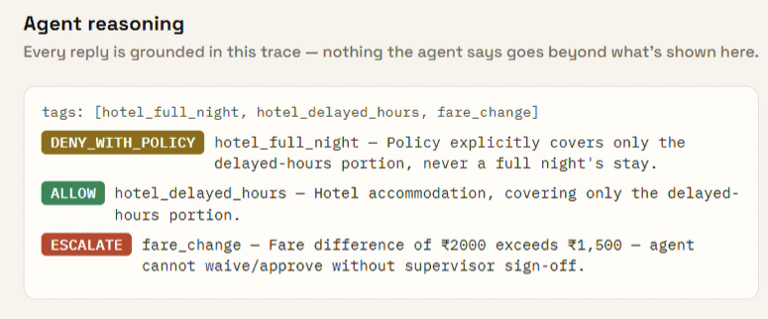
Scenario 3 — Meher Kaur (Platinum)
09
FARE CHANGE
Full-night hotel request + ₹2,000 fare difference
Alternate flight difference: ₹2,000
HOTEL
Agent waiver limit: ₹1,500
Flight SK-305 delayed 6 hours
ESCALATE
Requests a full night's stay.
Threshold exceeded → human review.
DENY_WITH_POLICY
Policy provides delayed-hours coverage, not a full-night stay.

Slide 10
Key Assumptions
10
What was modeled for the prototype
01
Data-pack conversations
Sample conversations in the data pack were used only to calibrate tone, never as a source of policy
02
One live disruption
Only one live/disrupted booking per customer is modelled; return/unaffected legs stored but not part of the disruption flow

Slide 11
Limitations & Honest Tradeoffs
11
Why the prototype is intentionally simple
LIMITATION
UPGRADE PATH
Rule-based NLU
An optional LLM-backed version of Stage 1/3 is included, swappable without touching the rules engine
• Pattern matching only catches phrasings the rules were written for.
• Unexpected wording may fall through to general_inquiry.
• This is an accepted tradeoff for a free, zero-dependency prototype.

Slide 12
Tech Stack & AI Tools Used
12
Zero-cost default runtime + optional LLM upgrade
AI DESIGN PARTNER
BACKEND
FRONTEND
Node.js + Express
Vanilla JS / HTML / CSS
Claude
(Anthropic)
Used for architecture, rules-engine iteration, NLU patterns, and project documentation.
DEFAULT AI
DATA
Rule-based NLU + templates
knowledge_base.json
NO API KEY BY DEFAULT

Slide 13
CONCLUSION
A safer support agent
starts with the policy gate.
READY FOR REVIEW
ALLOW
Built a support agent where the risky decision-making is small, readable, deterministic code — not a black box
Demonstrated correct behaviour across all 3 required scenarios: allow, deny-with-explanation, and escalate
Runnable in one command, no cost, no signup — ready for review
DENY
ESCALATE
Thank you

