Slide 1
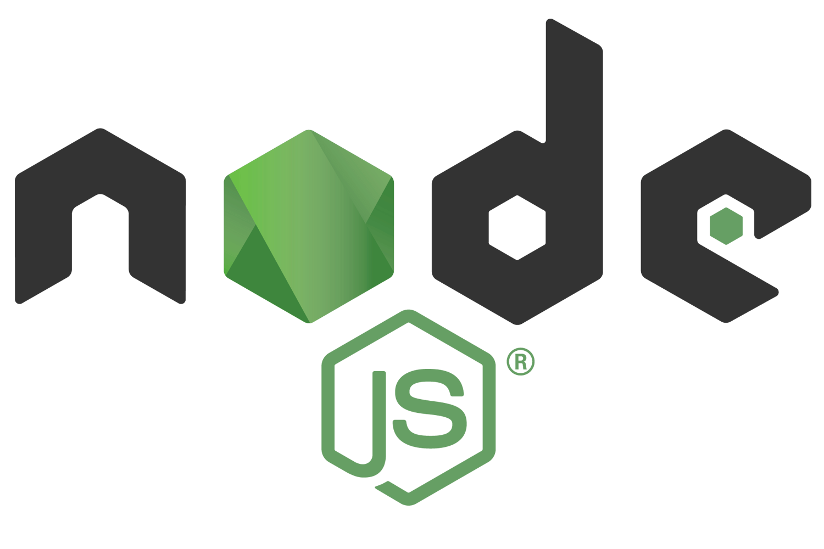
Title: “How Node.js is Asynchronous, Single-Threaded, Event-Driven Architecture at same time."
Subtitle:Brief introduction to Node.js.

Slide 2
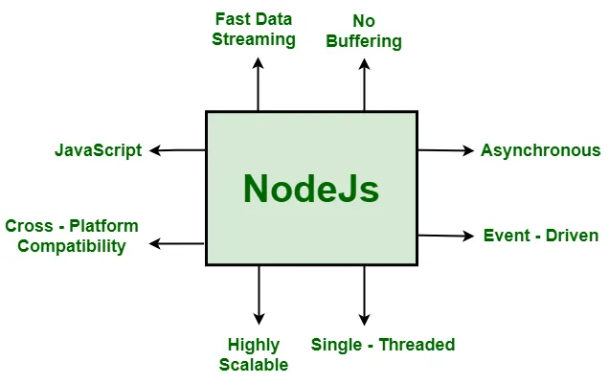
Introduction to Node.js
Node.js is a powerful runtime environment
built on Chrome's V8 JavaScript engine.
It is widely used for developing scalable network
applications. What makes Node.js unique is its
combination of being single-threaded, asynchronous,
and event-driven, which enables it to handle many
tasks efficiently without the need for multiple threads.

Slide 3
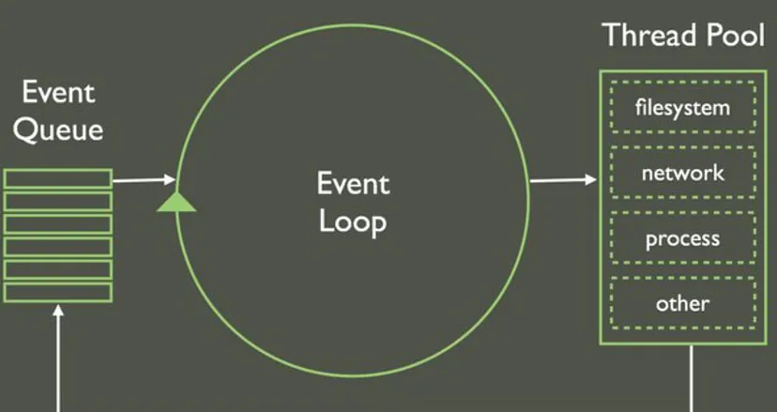
Single-Threaded Nature of Node.js
Node.js uses a single main thread to execute JavaScript code.
This means:
All user code runs on a single thread.
The single-threaded design minimizes the overhead of thread
management, making it lightweight and efficient.
However, this doesn’t mean Node.js is limited to handling one task at a time. Its asynchronous and event-driven nature allows it to manage multiple tasks concurrently.

Slide 4
Asynchronous programming in Node.js
Node.js achieves asynchronous behavior through non-blocking I/O operations. Instead of waiting for a task to complete, it:
1.Delegates the task (e.g., file reading, database query) to the system.
2.Continues executing the next line of code.
3.Uses callbacks, promises, or as`ync/await to handle the result once the task is done.
Example of Asynchronous Code
const fs = require('fs');
fs.readFile('file.txt', (err, data) => {
if (err) throw err;
console.log(data.toString());
});
console.log('Reading file...’);
Output:
Reading file...
<File content here>
This demonstrates how Node.js continues execution without waiting for fs.readFile to complete.

Slide 5
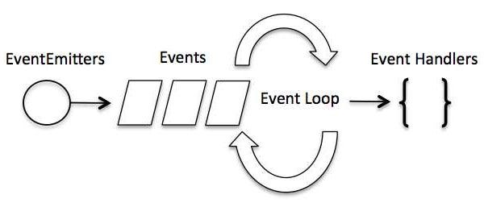
Event-Driven Architecture
Node.js operates on an event-driven model, where actions are triggered by events. This model is powered by the EventEmitter class and is used extensively in handling tasks such as:
Incoming HTTP requests.
File system operations.
Timers and intervals.
Example of Event-Driven Code
const EventEmitter = require('events’);
const emitter = new EventEmitter();
emitter.on('greet', (name) => { console.log(`Hello, ${name}!`);
});
emitter.emit('greet', 'Alice’);
Output:
Hello, Alice!
Events allow Node.js to efficiently manage asynchronous tasks by delegating actions to listeners.

Slide 6
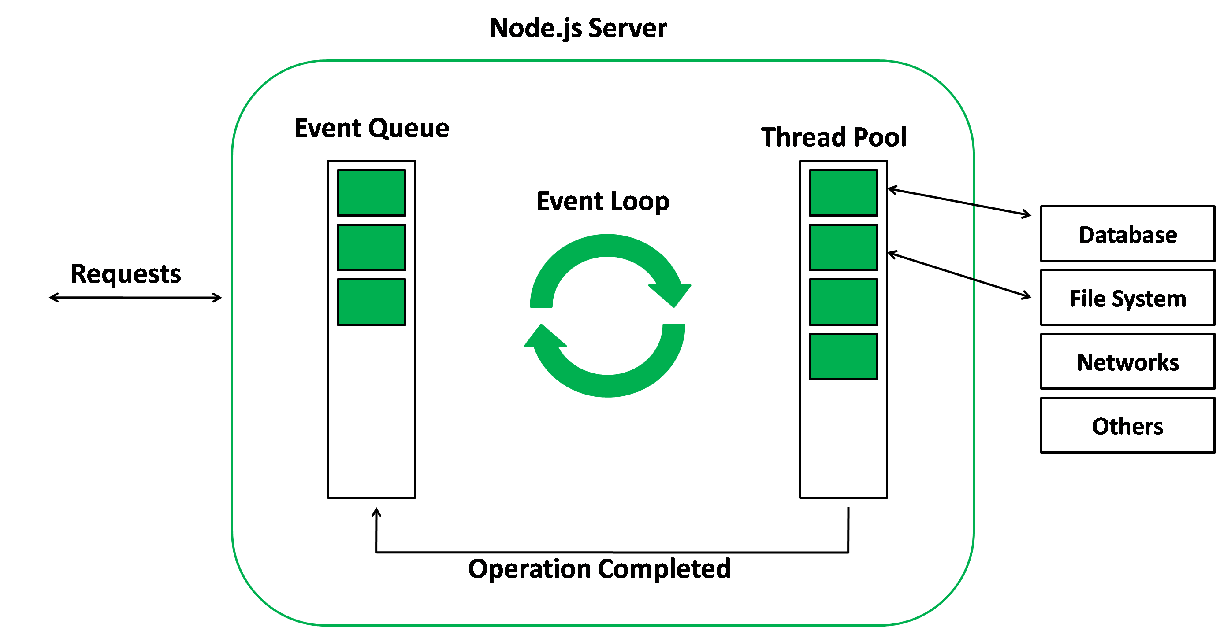
The Event Loop: Heart of Node.js
The event loop is the core mechanism enabling Node.js to be asynchronous and single-threaded. It:
Handles all asynchronous operations.
Listens for events and delegates tasks to the appropriate handlers
Phases of the Event Loop
1.Timers: Executes setTimeout and setInterval callbacks.
2.I/O Callbacks: Handle deferred I/O operations.
3.Poll: Retrieves I/O events.
4.Check: Executes setImmeditate callbacks.
5.Close Callbacks: Handles tasks like socket closures.
Visualizing the Event Loop
Tasks enter the event queue.
The event loop processes these tasks.
Completed tasks are removed, and the loop continues to the next task.

Slide 7
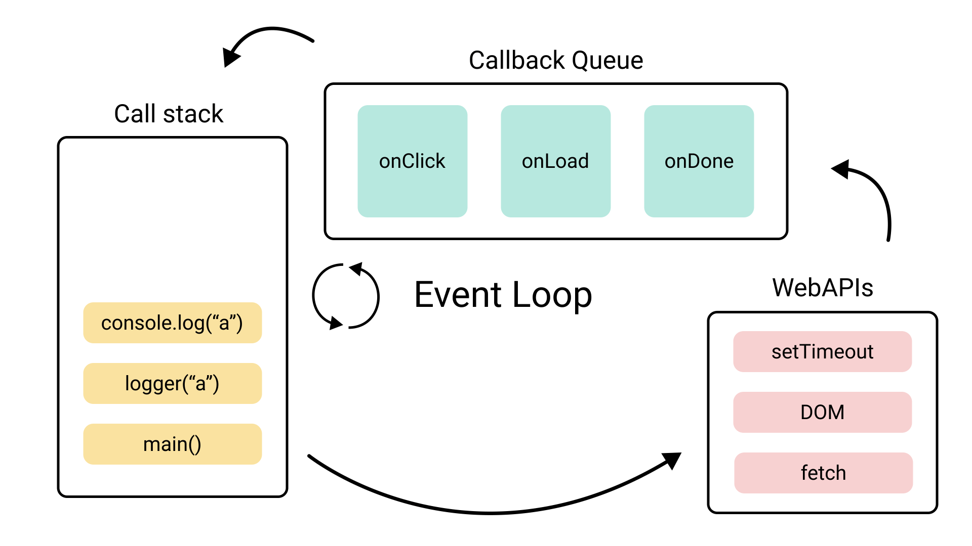
How These Concepts Works Together
Single Thread: Executes JavaScript code.
Asynchronous Nature: Delegates I/O tasks to the system, avoiding blocking.
Event-Driven Model: Listens for events and executes associated callbacks.
Example: Handling HTTP Requests
const http = require('http’);
const server = http.createServer((req, res) => {
res.end('Hello, World!’);
});server.listen(3000, () => {
console.log('Server is running on port 3000’);
});
The server listens for incoming requests (event-driven).
Each request is processed asynchronously, ensuring non-blocking performance.

Slide 8
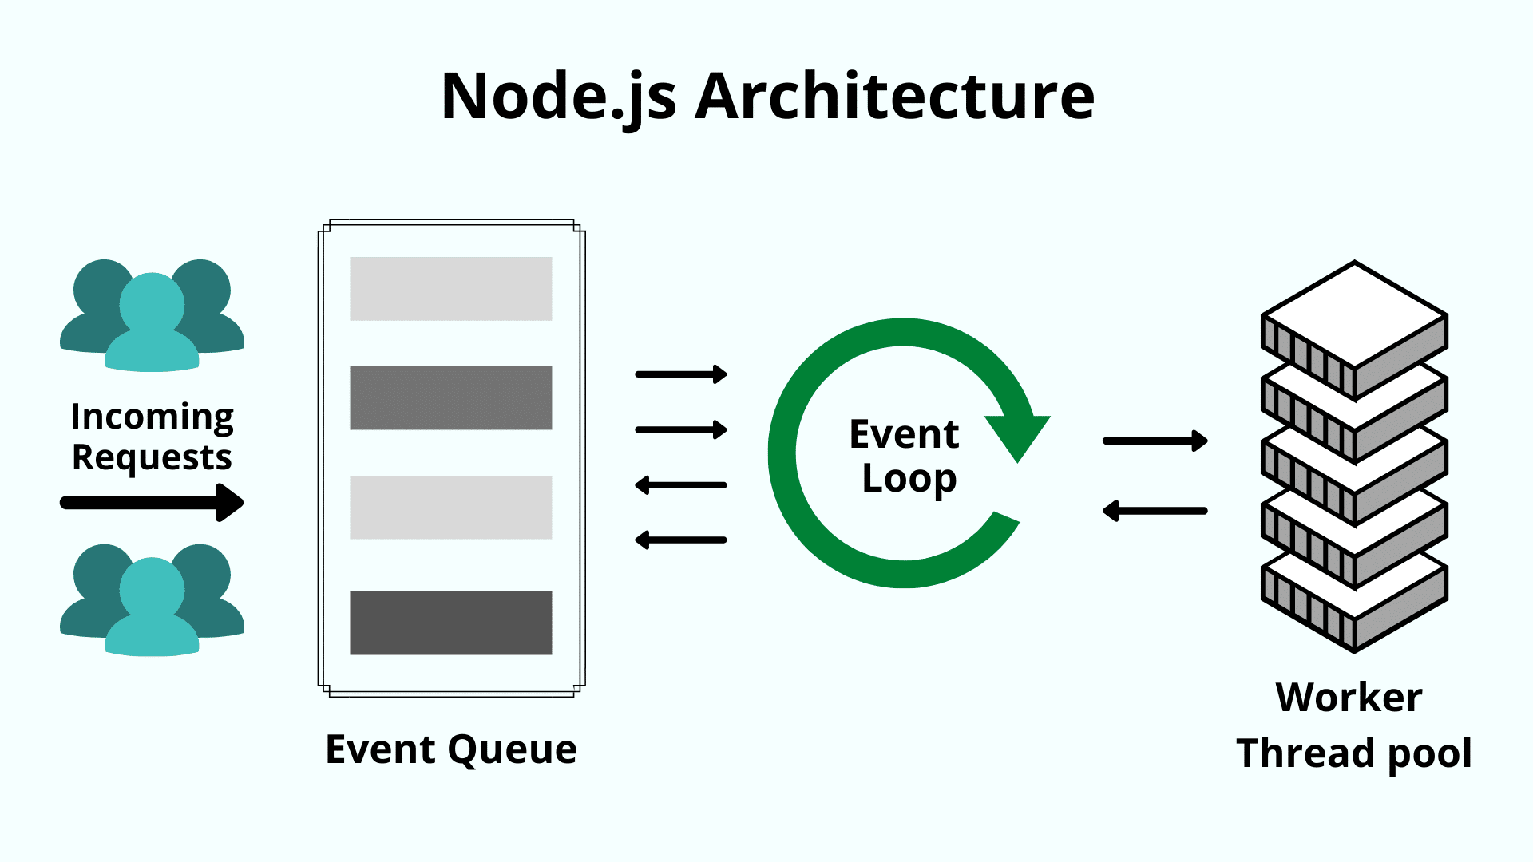
Advantages of Node.js Architecture
Scalability: Efficiently handles thousands of concurrent connections.
Performance: Non-blocking I/O improves speed.
Lightweight: Single-threaded design reduces resource usages.

Slide 9
Limitations
Not suitable for CPU-intensive tasks: Tasks like heavy computation can block the event loop.
Requires careful error handling: Asynchronous code can lead to unhandled errors if not properly managed.
Example: Blocking the event loop with a heavy computation.

Slide 10
Conclusion
Node.js’s unique combination of being single-threaded, asynchronous, and event-driven allows it to:
andle high-throughput applications with ease.
Handle high-throughput applications with ease.
Efficiently manage tasks without blocking the main thread.
This architecture is ideal for I/O-intensive applications like web servers, real-time chat apps, and APIs.

