Slide 1
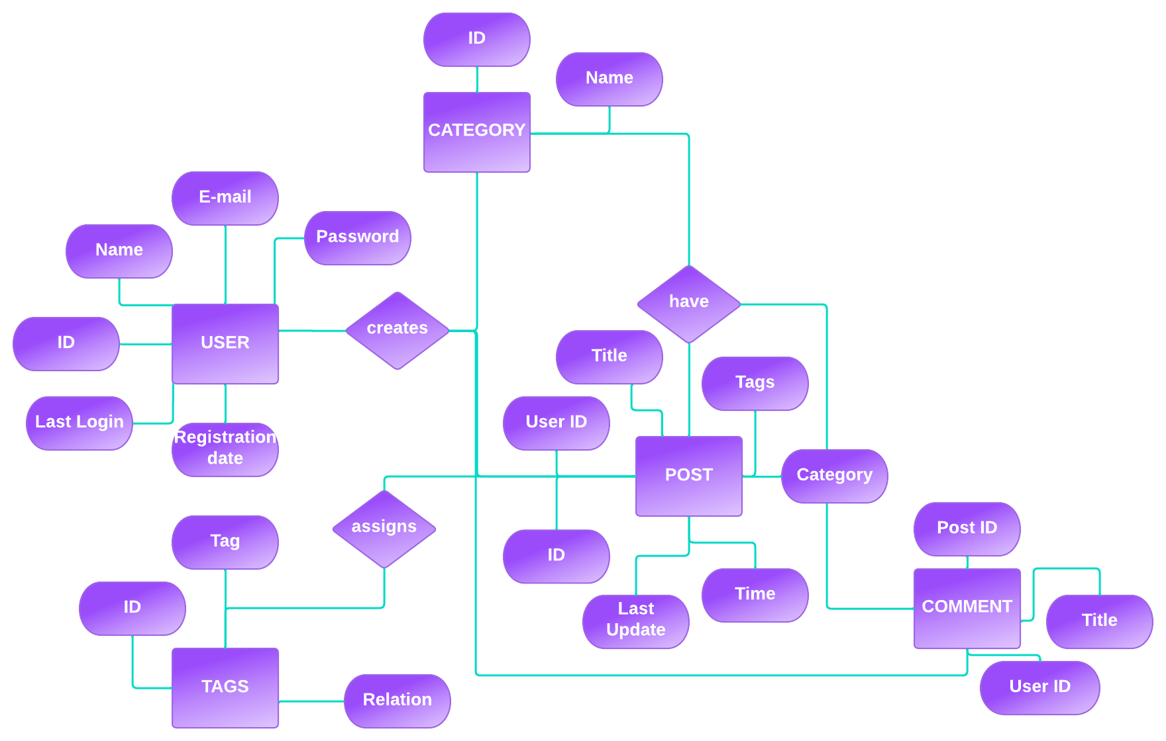
Technologies Used -
E-R
DIAGRAM
D
Express
NodeJS
65%
OUR IDEA
C
COMMUNITY PORTAL
DEMONSTRATION
Node.js
Framework
JavaScript
web server
B
TYPE YOUR TEXT
TYPE YOUR TEXT
A
"Connecting Communities, Empowering People."
MongoDB
Blog-like website for coders to connect and share their experiences, insights, and knowledge.
Goal to create a community-driven platform that fosters collaboration and learning among coders.
Implemented Google OAuth login system for secure and efficient user sign-in.
Allow multiple users to access the website simultaneously
User-friendly, with an intuitive interface for easy browsing and searching of content.
85%
React
25%
Document
database
Javascript
Framework
TYPE YOUR TEXT
TYPE YOUR TEXT
A
B
C
Team - 22

