Slide 1
“Civil Registry System” (8th Semester Industrial Project)
Palak Agarwal
CSE – B - 090

Slide 2
Civil Registry Law
According to the Act No. 3753,
Civil Registry is a continuous, permanent and compulsory recording of vital events occurring in the life of an individual such as birth, marriage, and death, as well as court decrees, and legal instruments affecting his civil status in appropriate registers.

Slide 3
Objective(s) of the Proposed System
Establish CRVS as a public good
Give awareness about the government or legal documents and its registration details as well as to help to register or apply for those documents.
Create a data source for the compilation of vital statistics.
Develop the technical approach for operationalization of these relationships.

Slide 4
Scope of the Proposed System
Building a well-functioning CRVS IS remains a non-trivial challenge, given its multisectoral nature. The CRVS IS needs thus to span systems of systems, involving design approaches that are different from what is used for individual systems.
Problem definition
Most low and middle income countries have CRVS IS that are primarily paper based , thus , a proper well-functioning CRVS IS needed which is a key ingredients in strengthening CRVS activity in general.

Slide 5
Need Of the Project – Why ?
Within the domain of public health, information obtained from civil
registration and vital statistics (CRVS) is critical, allowing tracking of
individual births and building profiles of mortality and causes of
death.
Use of Project
Recording of all details related to the vital event.
Notification of the event to the authorities.
Registration of the event and,
Generation of VS

Slide 6
Technologies to be used
Software Eclipse IDE for Java EE Developers
Heidi SQL as a Database
Apache Tomcat 7.0 Servers
Microsoft Windows 7 Home Basic
Higher-order language requirements
Proper Knowledge of Java, HTML, CSS, JavaScript, MVC and JSP are required.

Slide 7
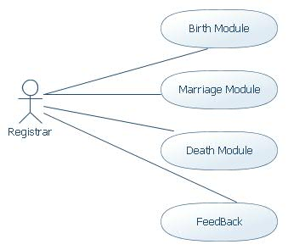
Product Functions
Birth Module – To register and maintain all the records of the Babies born.
Death Module – To register and maintain all the details of the Deceased persons of the country.
Marriage Module – To register and maintain all the details and records of all the marriages happening in the country.
Feedback Module – To register Complaints, Comments or Compliments by the registrar or citizens and to get back on complaints.

Slide 8
E R Diagram

Slide 9
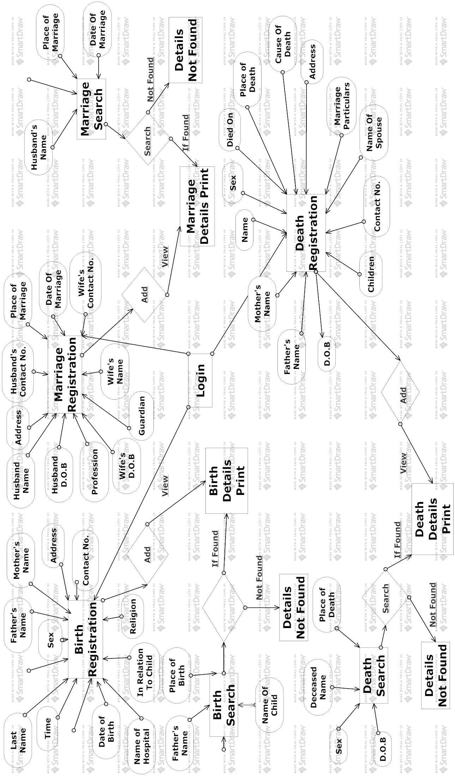

Slide 10
Some Module Use Cases

Slide 11
Requirement Specifications
Operating Platform : Microsoft Windows 7 Home Basic
Data Base : HeidiSQL
Software : Apache Tomcat Server (web server)
Front End Tool : Eclipse IDE for Java EE Developers
Programming Language : Java, JSP, HTML, CSS, JavaScript
Document Tool : Microsoft Windows 7

Slide 12
Installation Instructions
First of all we will have to install Eclipse IDE for Java EE Developers software.
Secondly, install Heidi SQL Database for the storage and access of vital statistics of information.
Thirdly, we will have to install MySQL server to connect to the localhost of your computer.
Backup Instructions
Daily backup of the SQL Database should be done so as to have an updated database always handy. And thus, in case of any errors or power ups, the database will not be harmed.

Slide 13
Contribution(s) of the Project
Civil registration brings multiple benefits.
An individual’s right to be counted at both extremes of life is fundamental to social inclusion.
In the absence of insurance or inheritance, death registration and certification are often required prerequisites for burial, remarriage, or the resolution of criminal cases.
For health agencies like WHO, civil registration systems are the most reliable source of statistics on births and deaths, and causes of death.
Civil registration is the way by which countries keep a continuous and complete record of births, deaths and the marital status of their people.

Slide 14
Assumptions and Dependencies
Proper Computer Knowledge to the Registrar is highly important and center of our registration process.
Assumption is made that there will be total discrepancy in the registration system and collection of vital statistics.
Constraints of the Project
If the ministry responsible for maintaining the civil registry is either unwilling or unable to keep it current, accurate or complete to acceptable, pre-determined standards, the authority is forced to start with poor data as the basis for the citizen’s welfare.

Slide 15
Outcome Expected of the Project
Mechanism of Registration of Birth , Marriage and Deaths of Citizens in a Country.
Availability of Country Wide Data.
Uses of proper Stats for the Welfare Schemes.
Scientific Way of Monitoring & Analysis towards Development of the Projects.
Transparency in operations of Registration.
Government Official Record brings Fair & Justice for Citizens.

Slide 16
Summary
This report has analyzed the current state of play in CRVS IS existing technological and institutional trends, and has also sketched some future directions on the strengthening of these systems.
A point of departure in this analysis is the argument that CRVS IS is currently by and large unsatisfactory and needs to be strengthened urgently.
There are various developmental priorities such as reinforcing the health of citizens, improving human rights of citizens which bring into focus the urgent need to strengthen CRVS IS particularly in low and middle income countries.
The report is a step in this direction, in trying to identify some of the existing limitations and also the best practices from both developed and other country contexts to extract lessons from them and help define an agenda for strengthening CRVS IS.

Slide 17
Limitations of the Project
This project was aimed at developing a civil registry system that is of importance to a country to maintain its statistics and census.
The registration cannot be done online by the citizens itself because of the security reasons.
Thus they have to go to the nearby registration office to get them registered. This is a big limitation which is needed to be addressed in the future.
Future Work
The future work for this project Civil Registry system is to cover up the limitation i.e. to at least start a module or portal so they can view their details online without going to the registrar office.
Work on upgrading the system to accommodate more modules like registration of divorces, adoptions, changes in name etc., will be kept in mind after the success of the system.

Slide 18
Thanks

