Slide 1
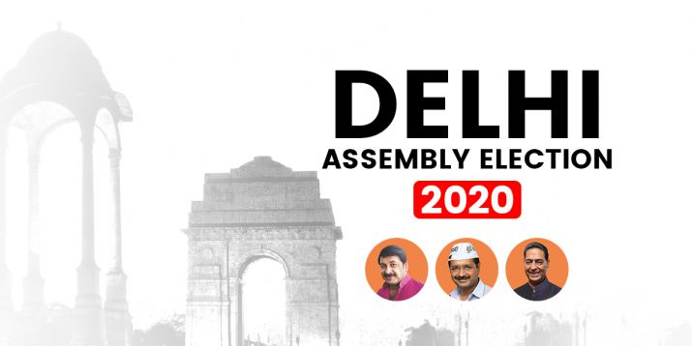
Exploratory Data Analysis Of Delhi Vidhan Sabha Elections 2020 & Model building

Slide 2
Under The Guidance Of Prof. Rushi Kumar
Presented by
1. Anudeep Sidhanthi (21MDT0032)
2. Palak Goel(21MDT0041)
Department Of Mathematics,
Vellore Institute Of Technology, Tamil Nadu , India

Slide 3
ABSTRACT
The Delhi Legislative Assembly, also known as the Delhi Vidhan Sabha, is a unicameral legislature of the union territory of Delhi in India. At present, it consists of 70 members, directly elected from 70 constituencies
Through this project, we will analyze 2020 Vidhan Sabha Election results for state Delhi which depends on various features. We will perform Exploratory Data Analysis (EDA) which includes techniques like data extraction, data cleaning and selecting major features from the data. We identify the data types, perform scaling on data, label encoding for converting categorical data. We also predict the results of upcoming Vidhan Sabha Elections in Delhi by using Machine Learning Algorithm i.e Random Forest Regressor.

Slide 4
OBJECTIVE
Detailed exploratory analysis of Vidhan Sabha 2020 Election for Delhi to understand the dataset in more depth
What is the distribution of Constituencies over the district in Delhi State
Sunburst image of all the District and Constituencies
Which Parties have been present in most constituencies and district
What has been the general Win vs Loss relationship for the Parties in 2020?
What is the Gender Ratio of the Contestants? Also the Gender Ratio of the Winners?
What is the Educational Qualification of our politicians?
What is the relationship of Age and Politics?
What relation does the Politician category have with the election results?
Have the politicians been involved with criminal activities?
Plotting the Assets vs Liabilities amount for Winning Politicians
Which party has won the most constituencies?
Prediction of upcoming election by using Random forest, SVM, LOGISTIC REGRESSION, DECISION TREE, KNN

Slide 5
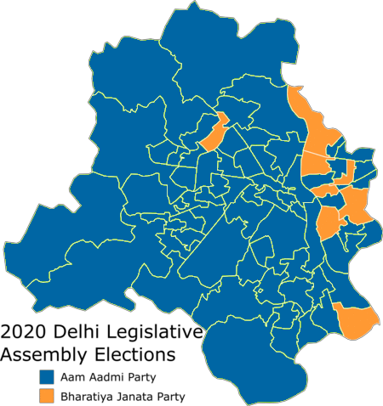
INTRODUCTION
Legislative Assembly elections were held in Delhi on 8 February 2020 to elect 70 members of the Delhi Legislative Assembly. Voters turnout was recorded at 62.82%,[1] a decline of 4.65% from the previous assembly election in Delhi but 2.2% more than the 2019 Indian general election in Delhi. The term of the assembly elected in 2015 expired on 22 February 2020. The Aam Aadmi Party, led by Arvind Kejriwal won 62 seats to claim an absolute majority in the elections. The previous Assembly elections were held in February 2015. After the election, the Aam Aadmi Party formed the state government, with Arvind Kejriwal becoming Chief Minister.

Slide 6
Parties and Alliances
Alliance | Parties |  | Number of candidates running | Chief Ministerial Candidate
None |  | Aam Aadmi Party | 70^{[7][8]} | Arvind Kejriwal
NDA^{[9]} |  | Bharatiya Janata Party | 67
 |  | Janata Dal (United) | 2
 |  | Lok Janshakti Party | 1
UPA^{[10]} |  | Indian National Congress | 66 (list)
 |  | Rashtriya Janata Dal | 4
None |  | Bahujan Samaj Party | 70^{[11]}
 |  | Others | 388
Total |  |  | 668^{[12]}

Slide 7
LITERATURE SURVEY
Exploratory data analysis was done by Paramartha Sengupta on Lok Sabha Elections (The General Elections) for the year 2019.
Detailed Exploratory Data Analysis Uttar Pradesh Elections was performed by Bukun from Kolkata in the year 2017. The election to the 17th Uttar Pradesh Legislative Assembly was held from 11 February to 8 March 2017 in 7 phases. An phase wise analysis has been conducted.
For Uttar Pradesh State: UP Analysis, District Analysis, Phase wise Analysis, Party Analysis, Winner Analysis, Region wise Analysis was conducted by Manish Kumar from Hyderabad in the year 2017.
Univariate Analysis, Bivariate Analysis was done on Tamil Nadu 2021 State Assembly Elections by Praveen from Singapore in 2021.
How India Voted in 2019? - EDA & Prediction (96.3%) by Liston Tellis uses the Random Forest Classifier to predict the winners of the election. In order to know the optimum number of trees required to predict the result with highest accuracy, they plotted the accuracy score for various values of k and selected k value that gives highest accuracy. They have achieved an accuracy of about 96.3% using Random Forest Classifier.

Slide 8
METHADOLOGY
This section presents a brief explanation of the data used and the methodology followed to accomplish results.
This will be achieved by collecting data from various sources. After that, we can analyze the data and propose a possible solution to the problem question.

Slide 9
Contd…
NO | ATTRIBUTE
8 | ASSETS
9 | ASSETS_in num
10 | QUALIFICATION
11 | CRIMINAL CASES
12 | AGE
13 | CATEGORY
14 | PARTY
15 | SYMBOL
16 | GENERAL
17 | POSTAL
18 | TOTAL
19 | % VOTES POLLED
20 | %OVER TOTAL ELECTORS
21 | TOTAL ELECTORS
NO | ATTRIBUTE
1 | STATE
2 | DISTRICT
3 | AC NO
4 | AC NAME
5 | CANDIDATE NAME
6 | WINNER
7 | SEX

Slide 10
TECHNICAL SPECIFICATION
We have took ANACONDA NAVIGATOR 2.1.1
CMD.exe Prompt 0.1.1
JUPYTER NOTEBOOK 6.4.11 (Python ) as our analytics tool.
Python includes some packages like Pandas, NumPy, Matplotlib, Seaborn, sklearn, etc.
Importing the Libraries which contains in-build function
Treating missing values by fillna and interpolation
Visualizing the missing values by heat map
EDA for Data Extraction and to visualize the dataset in clear form.

Slide 11
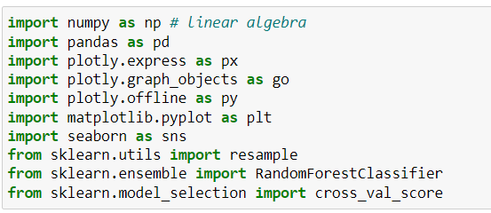
IMPORTING LIBRARIES

Slide 12
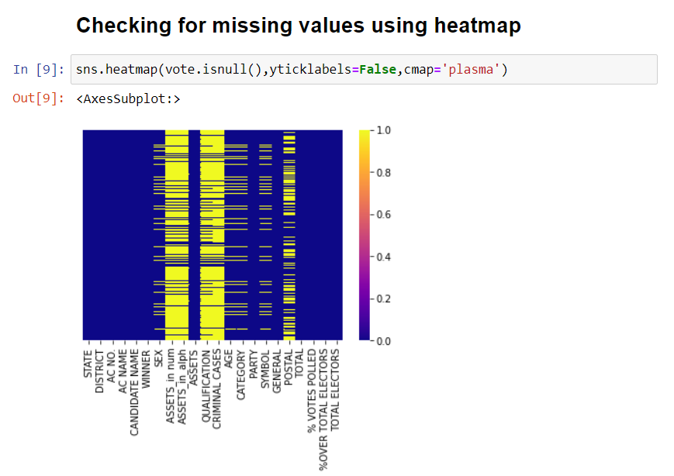
DATA SET PREPRATION FOR EDA
We can see that we have missing values in SEX, ASSETS_in num, ASSETS_in alph, Qualification, Criminal Cases, Age, Category, Symbol, Postal columns of our dataset.
Our Objective first is to treat the missing values

Slide 13
MISSING VALUES TREATMENT
Treating missing values of postal votes by fillna() function
Treating missing value of Assets_in num by mean imputation.
Treating null values of Criminal cases using interpolation technique.
Since our dataset contains Election details, we have NOTA in it. NOTA, or "None of the Above", is the option which enables the voter to officially register a vote of rejection for all candidates who are contesting. If a voter chooses to press NOTA it indicates that the voter has not chosen to vote for any of the party. NOTA does not have Gender, Category, Age, Symbol.
So presence of missing values in that columns does not take any effect on our data.

Slide 14
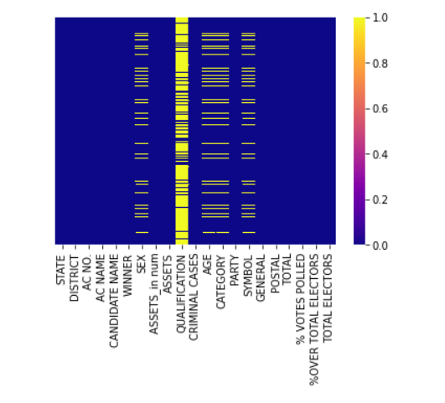
Heat map after treating missing values
Only missing value which is left untreated is Educational Qualification of the Candidates. Since the type of the missing value is categorical, we are left with little imputation options. So that missing values cannot be treated. Our data set has Educational Qualifications of the Candidates who have won the Elections and we performed EDA on the winning candidates only.

Slide 15
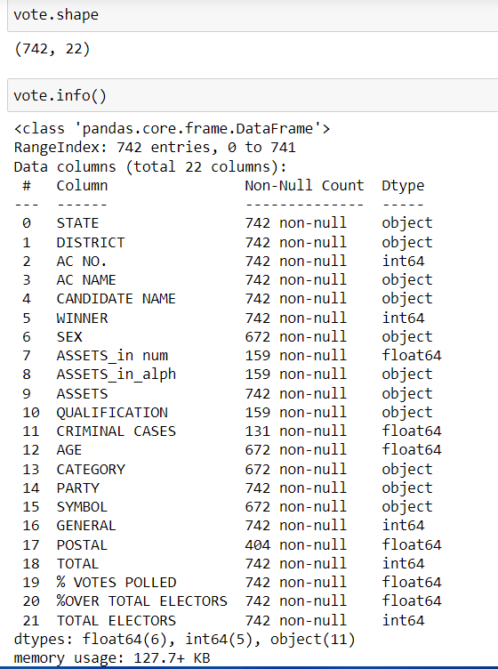
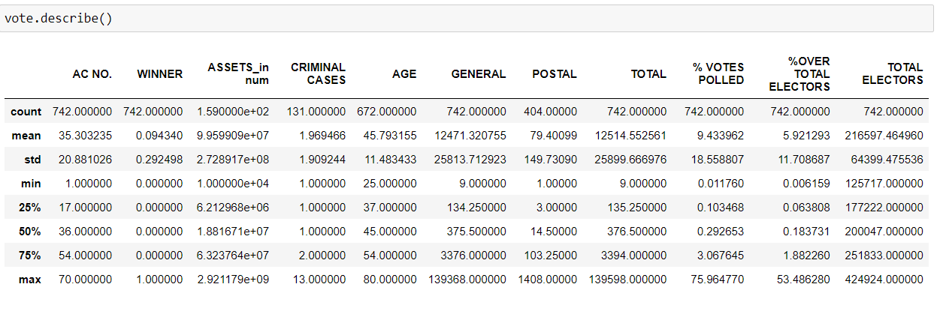
DATA SET INFORMATION

Slide 16
VISUALIZATIONS

Slide 17
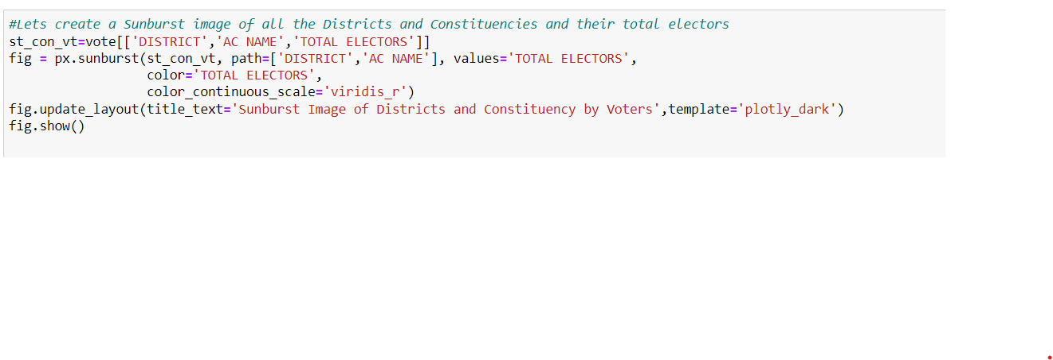
SUNBURST IMAGE OF ALL DISTRICTS AND CONSTITUENCIES AND THEIR TOTAL ELECTORS

Slide 18
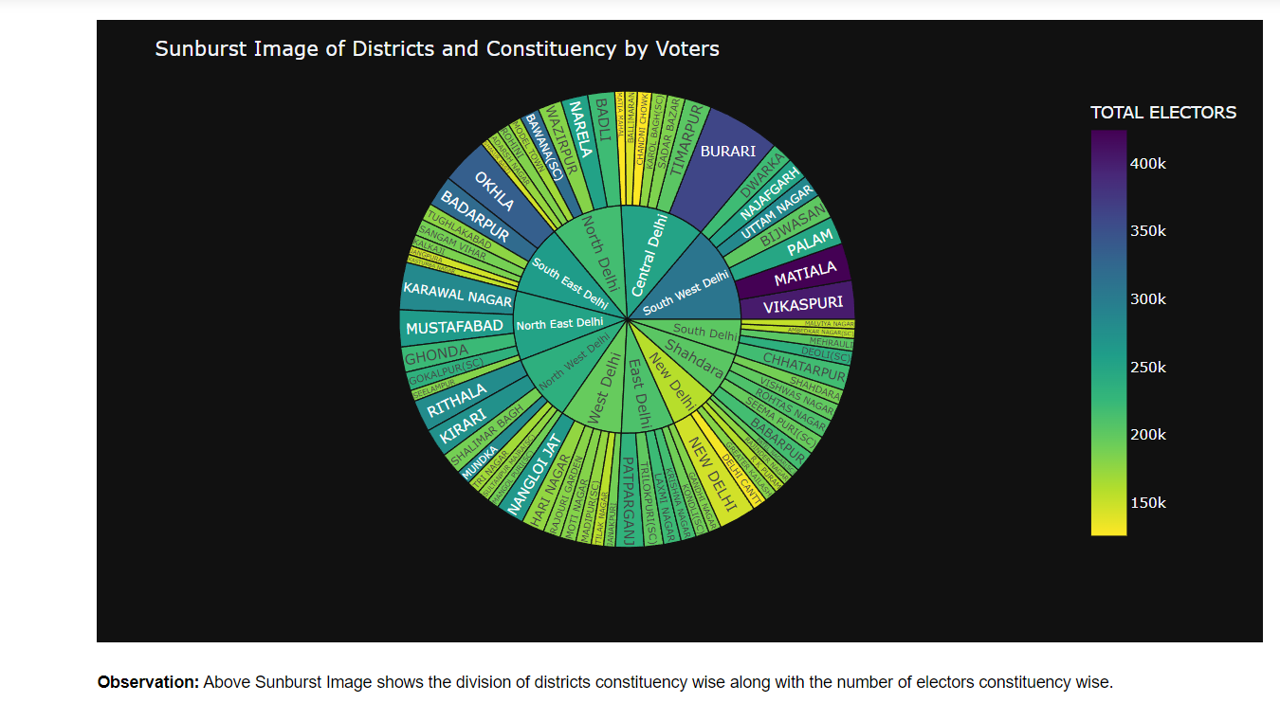
Contd..
Sunburst Plot Sunburst plots visualize hierarchical data spanning outwards radially from root to leaves. Similar to Icicle charts and Treemaps, the hierarchy is defined by labels and parents attributes. The root starts from the center and children are added to the outer rings.

Slide 19
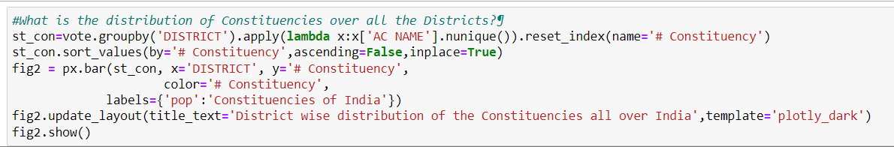
DISTRIBUTION OF CONSTITUENCIES OVER ALL DISTRICT

Slide 20
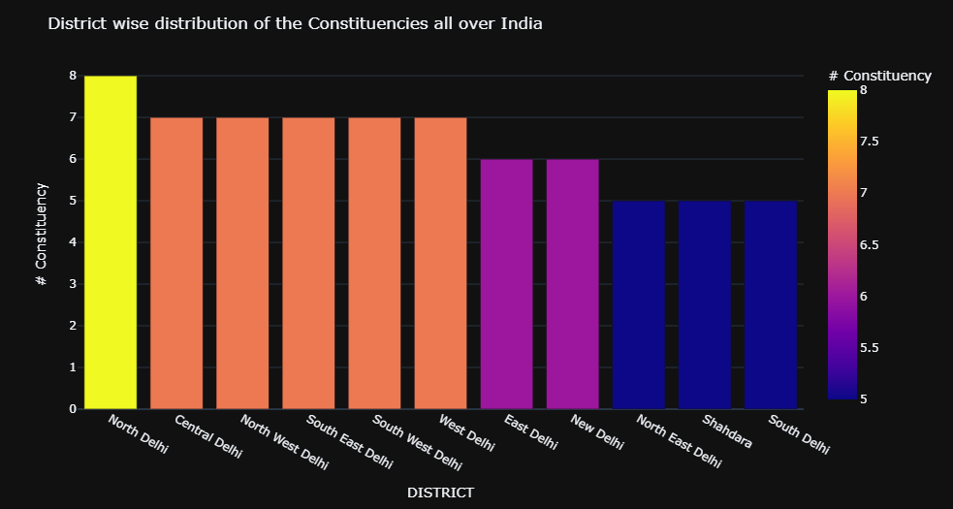
Observation: North Delhi District has the most number of constituencies followed by Central, NorthWest, South East South West and West Delhi. Number of constituecies are directly proportional to the population of that district. North Delhi has the highest population since it has most(8) constituencies

Slide 21
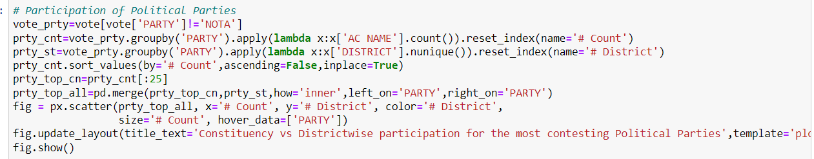
CONSTITUENCIES VS DISTRICT WISE PARTICIPATION

Slide 22
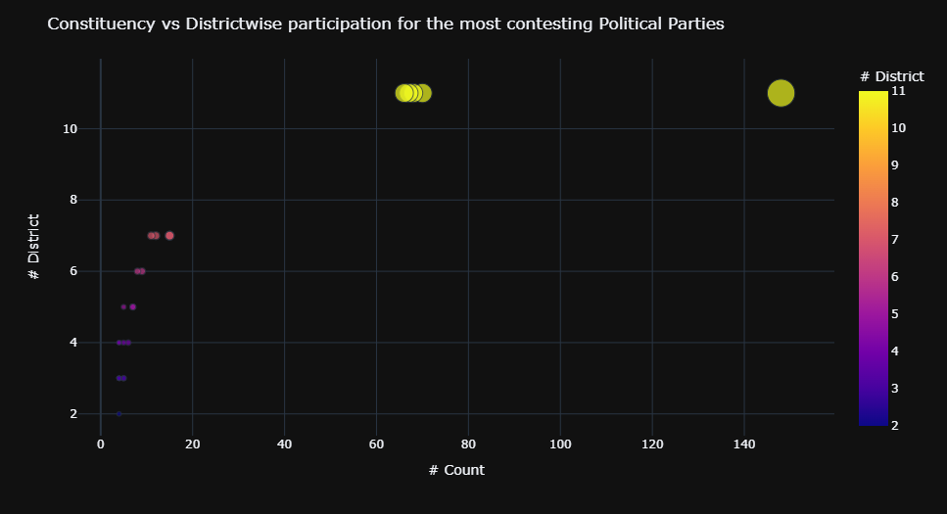
Observation : The Aam Aadmi Party(AAP) has participated in all the constituencies over Delhi, followed by Bahujan Samaj Party who contested in 68 Constituencies and third party in the list is Bharatiya Janata Party. AAP, BSP and BJP contested in all 11 districts of Delhi. One of the Major Political Party in India is Indian National Congess Party, it contested in 66 constituencies covering 11 Districts of Delhi. While these are the major parties to contest almost all over Delhi, we see the rest of the parties have restricted themselves to a handfull of districts

Slide 23
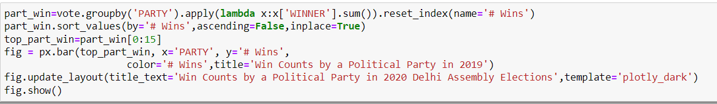
WIN COUNTS BY A POLITICAL PARTY IN 2020 DELHI ASSEMBLY ELECTION

Slide 24
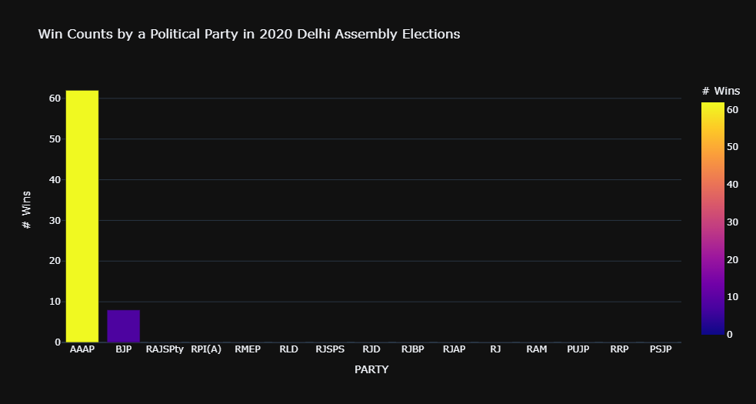
Graph
Observation: As seen from the data, In 2020 Delhi Assembly Elections, AAP has won the maximum constituencies all over Delhi. The above Bar Chart also suggests the same. The distribution of the other parties contested is also presented. BJP, which is the only party other than AAP to win a constituency stood 2nd in the number of victories with only 8 constituency wins, which is practically 1/8th of the constituencies won by AAP.

Slide 25
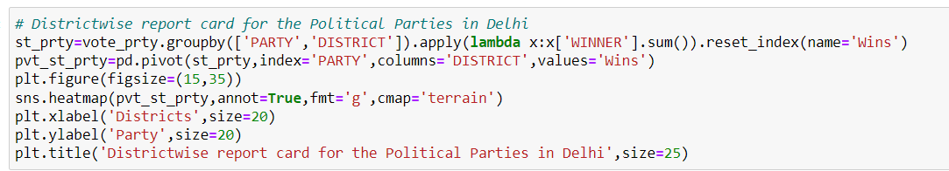
DISTRICTWISE REPORT CARD FOR ALL THE PARTIES

Slide 26
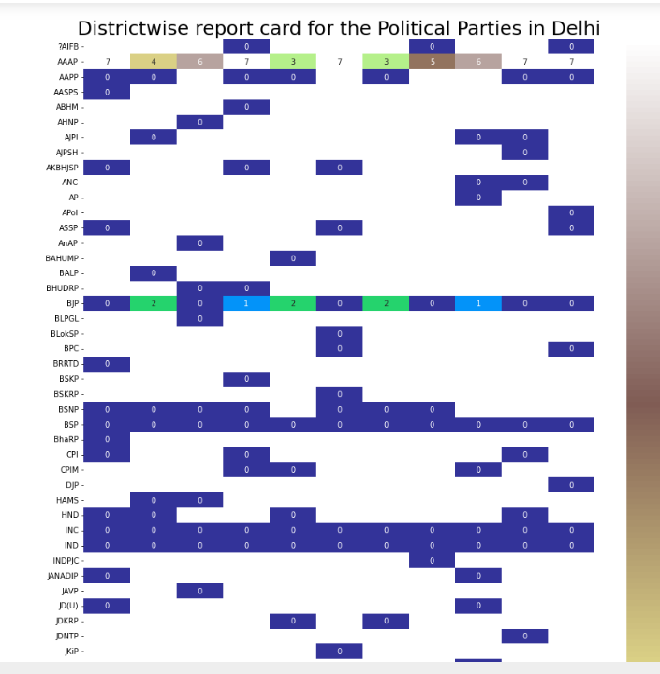
Graph
Observation: This heatmap shows the report card of the Political parties district wise i.e., how many constituencies they have won in a district. AAP won in all districts but their lowest percentage of wins districtwise is in North East Delhi and Shahdara where they have won 3 out of 5 constituencies contested respectively. Whereas BJP have won only in 5 out of 11 Districts contested in which they got victory in 8 constituencies. The INC didn't open the account in the assembly this year, too Having the same performance in the previous election, the Indian National Congress is considered perished in Delhi. Other Parties are in the same situation.

Slide 27
WINNING CANDIDATES PER PARTY

Slide 28
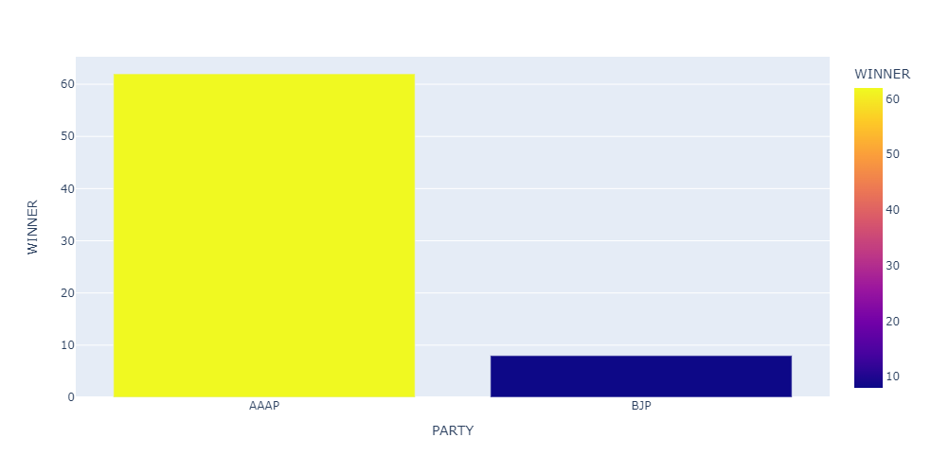
Graph
Observation: Arvind Kejriwal's Aam Aadmi Party (AAP) won 62 seats in the 70-member Delhi Assembly election.
From its strong performance in 2015, the party lost only five seats and less than a percentage point in vote share.
Despite a hard-fought and frequently contentious campaign in which major names such as Prime Minister Narendra Modi and Union Home Minister Amit Shah addressed rallies, the BJP won only eight seats, up three from its 2015 result.
The Congress failed to open its account again , and the party's candidates were destined to forfeit their deposits on 63 of the 66 seats at stake.
Only AAP and BJP candidates represented their parties in the Assembly.

Slide 29
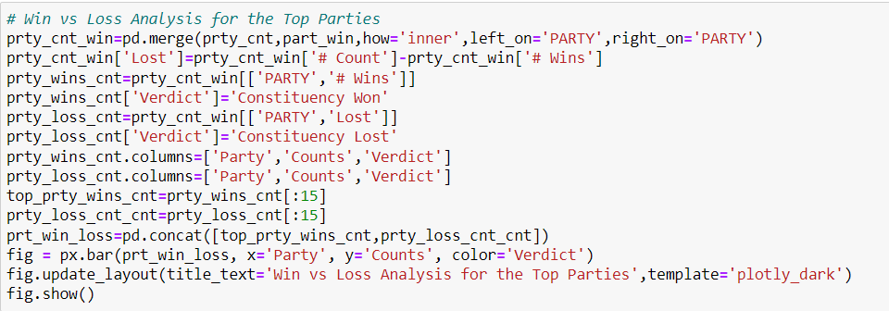
WIN AND LOSS ANALYSIS FOR TOP PARTIES

Slide 30
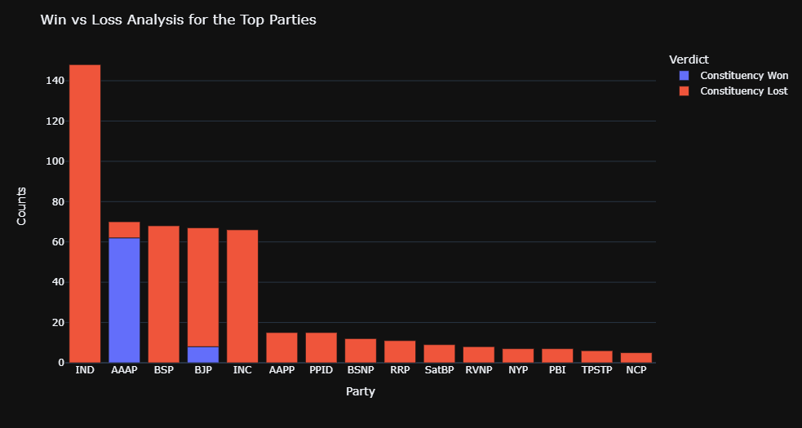
Observation: As seen in the above chart, the 2020 Delhi Assembly elections have been extremely unlucky for the Independent Candidates as none of the contested 148 Candidates have won. Same is the case with INC,BSP and other parties who saw a major failure. AAP has won 88.57% winning ratio where as BJP's win to loss ratio is 11.42%. Only Successful party other than AAP is BJP

Slide 31
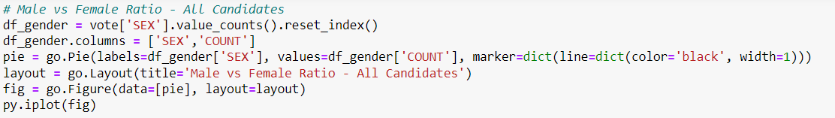
Male VS Female Ratio- All Candidates

Slide 32
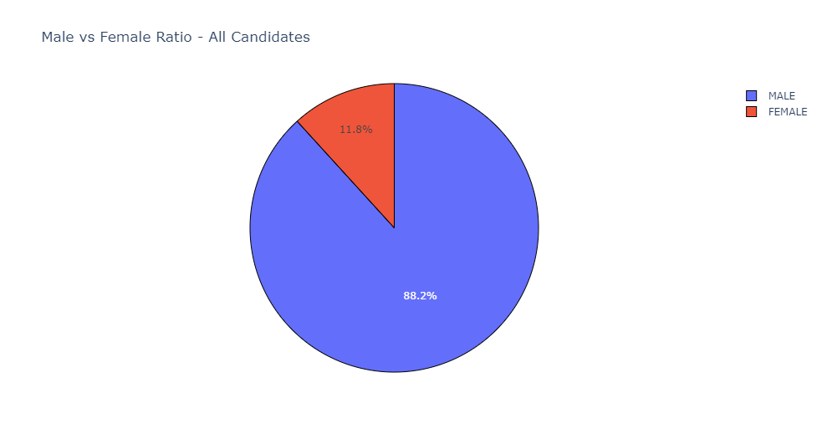
Pie Chart

Slide 33
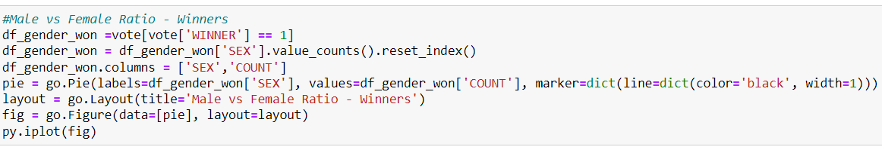
MALE VS FEMALE RATIO – WINNERS

Slide 34
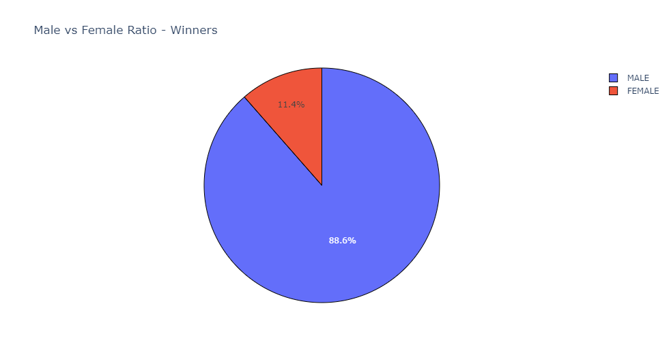
Pie Chart
Observation: Only 11.8 percent (79 out of 672) of the complete list of participants are female politicians, while 88.2 percent (593 out of 672) are male. When it comes to the winners, female politicians account for 11.4 percent (8 out of 70), whereas male politicians account for 88.6 percent (62 out of 70). As can be seen from the graph above, the gender ratio is not evenly spread. Fact: The AAP had nine women candidates, and eight of them won.

Slide 35
AGE COUNTS DISTRIBUTION AMONG THE POLITICIAN

Slide 36
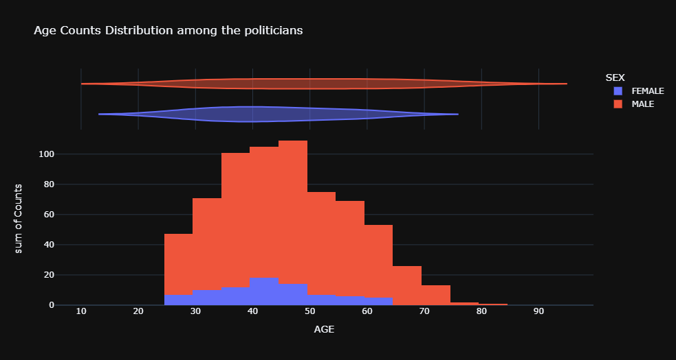
Observation: Most Number of female politicians have their average age between 40-44, while for male politician, it ranges from 45-49 range. The average age of male politicians is more as compared to female politicians contesting for the Delhi Assembly elections 2020.

Slide 37
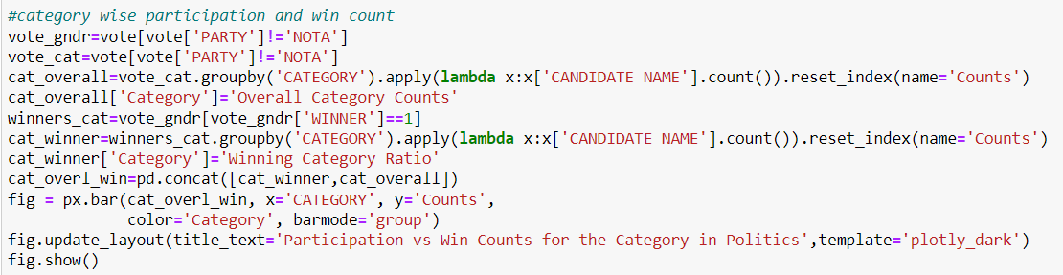
CATEGORY WISE WIN COUNT

Slide 38
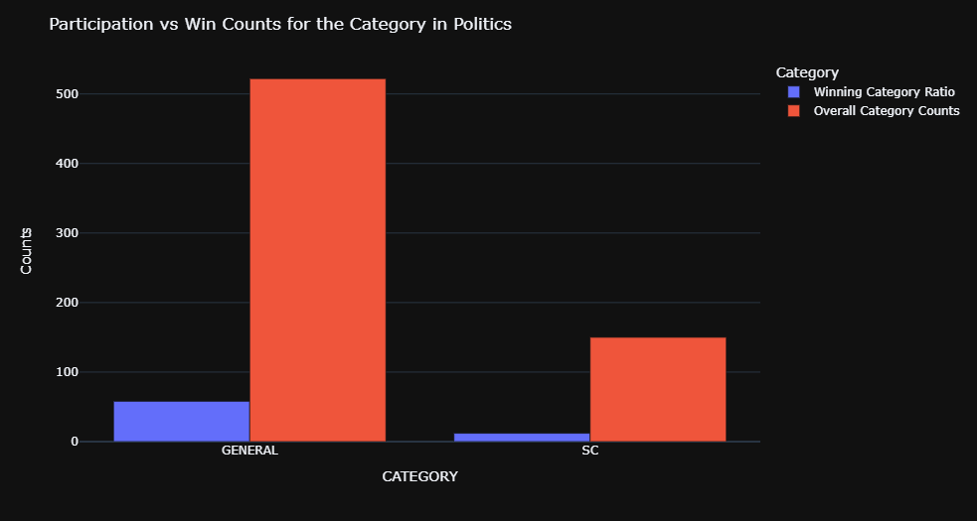
Graph
Observation The Category participation of General-SC have been in the ratio of 522:150- while as of the winners, the ratios have been modified to 58:12 Fact::The Aam Aadmi Party won all 12 seats allocated for SC candidates, with a winning margin of about 12,000 votes.

Slide 39
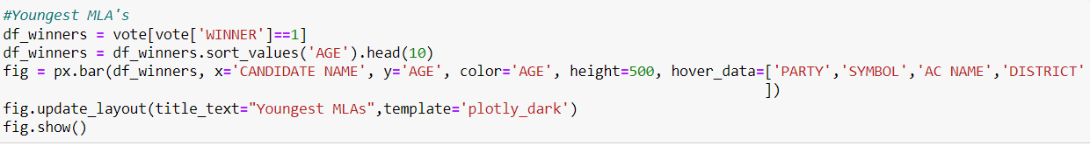
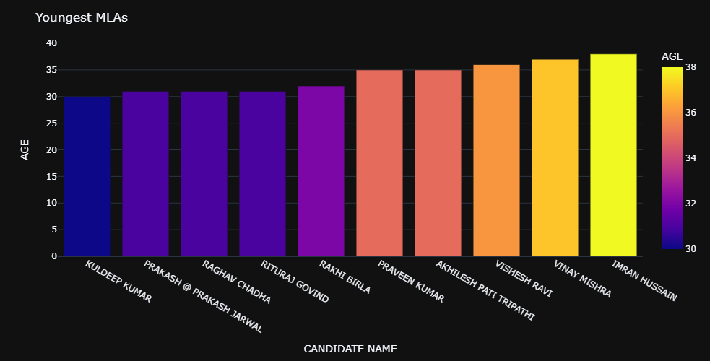
YOUNGEST MLAs

Slide 40
Cont..
Observation: Kuldeep Kumar , Delhi's youngest MLA(30) , was elected from the Kondli (SC) Assembly seat, which is part of the East Delhi parliamentary seat.
Raghav Chadha , a 31-year-old chartered accountant, is one of the Delhi Assembly's youngest members. Chadha, an AAP spokesman for many years and one of the party's most amiable faces, defeated BJP candidate Sardar R P Singh by 20,058 votes in the Rajinder Nagar seat.
Next three youngest MLA's Prakash Jarwal, Rituraj Govind and Rakhi Birla.
Fact: The freshly elected members of the Delhi Assembly (MLAs) are roughly five years older on average than the previous Assembly members. This is hardly surprising given that three of the five youngest members of 2015 are still among the five youngest, although with a five-year age difference. The youngest MLA this time is about five years older than the youngest in 2015, as is the oldest.

Slide 41
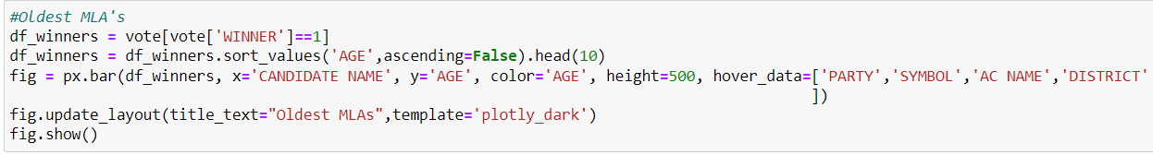
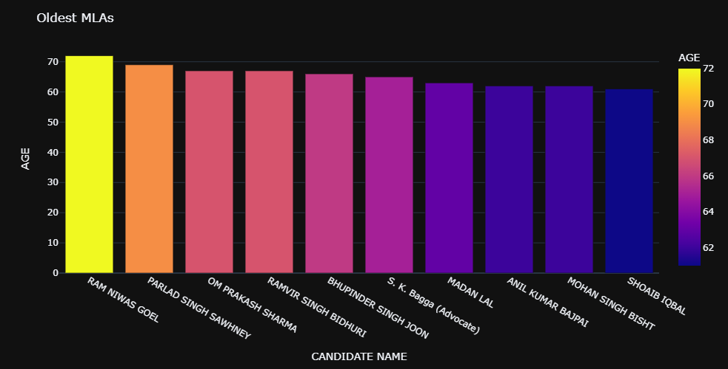
OLDEST MLAs

Slide 42
Cont..
Observation: Ram Niwas Goel the Oldest MLA aged 72 is an Indian politician serving as Speaker of the Delhi legislative assembly since 2015. He serves as a Member of Delhi Legislative Assembly for Shahdara.
Parlad Singh is next oldest(69) MLA. He is an Experienced Politician who has represented 5 times in Delhi Assembly.

Slide 43
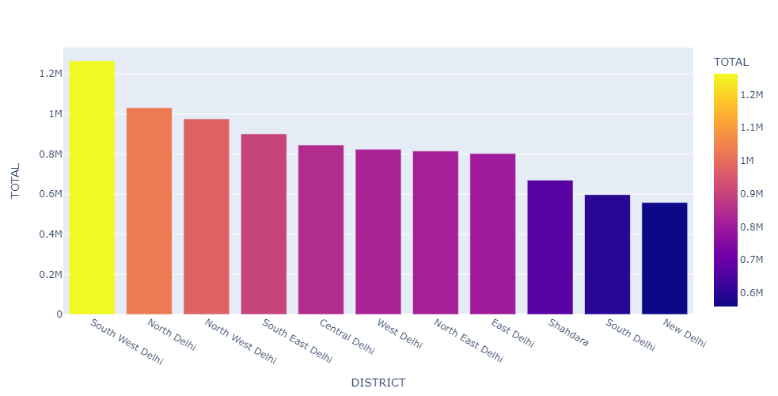
VOTERS DISTRIBUTION OVER DISTRICT
Observation: South West Delhi District has highest number of voters followed by North Delhi which has almost 13.6% of total Delhi voters. New Delhi district has least number of voters which counts to 6.01% of total Delhi voters

Slide 44
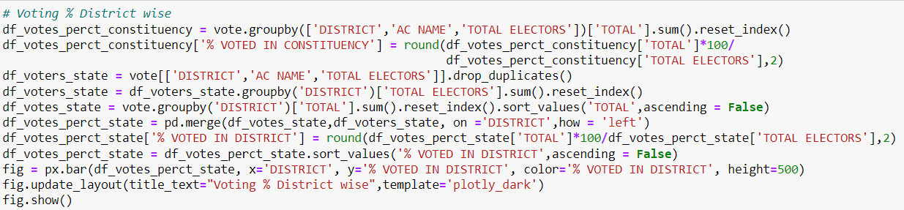
CODE FOR VOTING % DISTRICT WISE

Slide 45
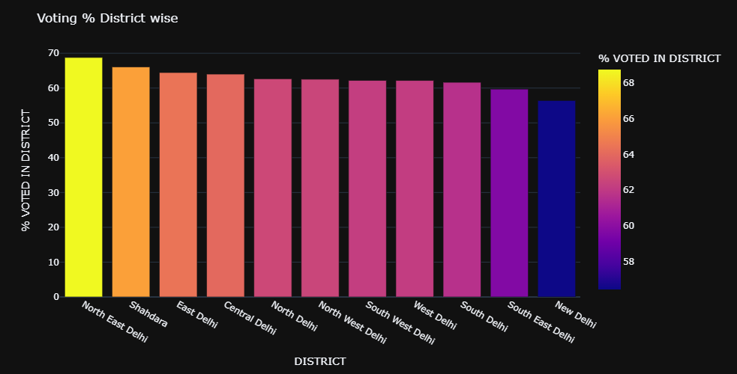
Cont..
Observation: Even though South West Delhi has highest number of voters but North East Delhi voters turned out the most on the voting day. It has 68.78 voting percentage. New Delhi stands last in the voting percentage. Only 56.42% of its total voters have casted their votes.

Slide 46
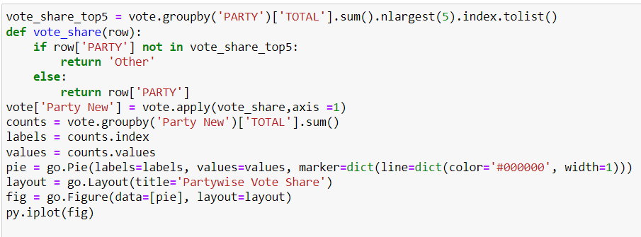
PARTY WISE VOTE SHARE

Slide 47
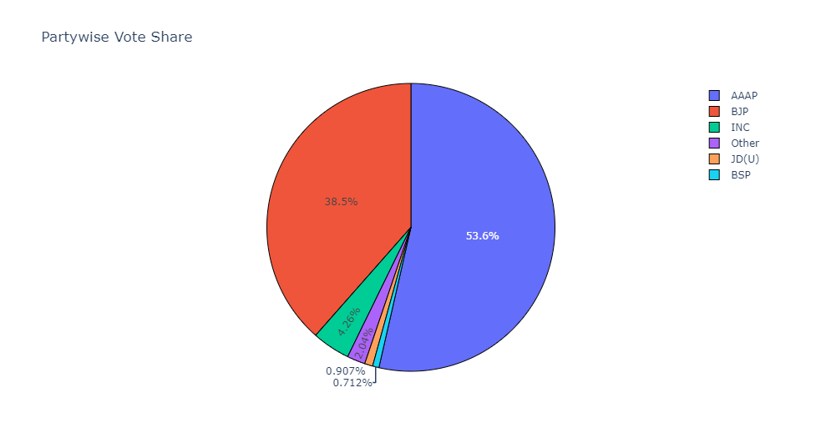
Cont..
Observation: The Aam Aadmi Party received over 54 percent support in 2020 legislative assembly elections in Delhi, followed by the Bharatiya Janata Party with around 39 percent. The AAP achieved a landslide win, taking 62 of the 70 seats, with the BJP taking the remaining eight.

Slide 48
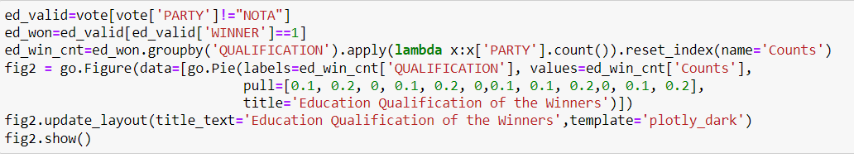
EDUCATIONAL QUALIFICATION OF THE WINNERS

Slide 49
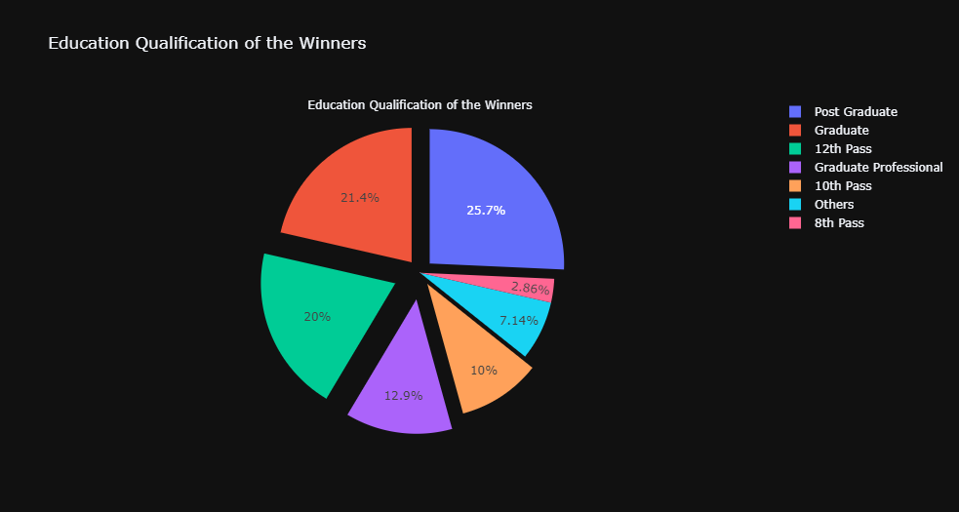
Cont..
Observation: The overall proportion of persons with a Bachelor's degree or above who won the election is 60.12%. This is an excellent statistic, because educated politicians are a critical component of a country's progress. However, over 40% of politicians do not have a professional degree. I hope that as time goes on, we improve on this element and make educational qualifications a main consideration while voting!
Fact: There are 23, down from 24 in 2015, MLAs who have disclosed their educational level between 8th and 12th pass. However, the number of MLAs who have indicated that they hold a bachelor's degree or more has decreased from 43 to 42. The number of MLAs who have declared degrees has increased from three in 2015 to five this year.

Slide 50
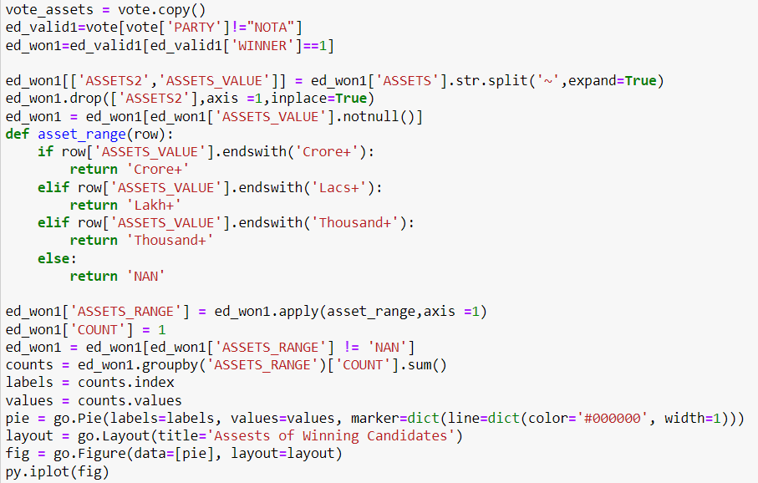
ASSETS OF WINNING CANDIDATE

Slide 51
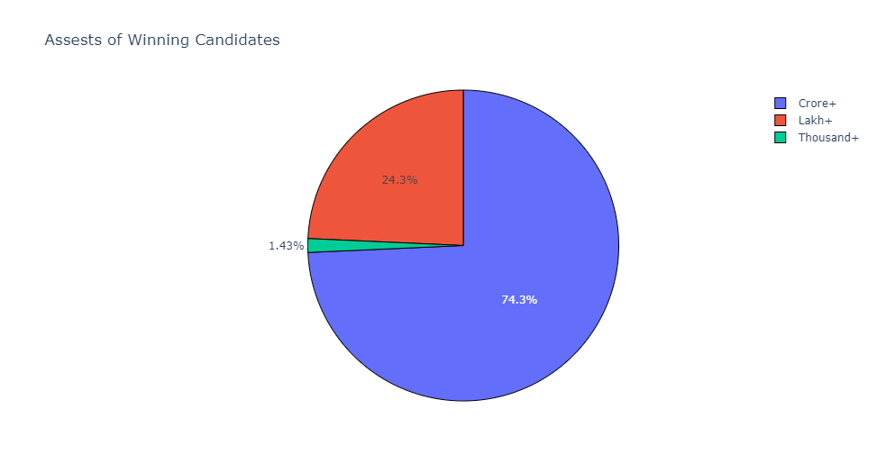
Observation: 74.3% of Delhi MLA's assets worth more than a crore.
Fact : The Delhi Assembly 2020 MLAs are wealthier than the last one. Delhi has elected 52 crorepatis for 2020, up from 44 in 2015.
A Delhi MLA's average net worth is Rs 14.3 crore.
Aam Aadmi Party MLA from Mundka, Dharampal Lakra — seem to be to responsible for the upward trend in average assets of MLAs. In his self-sworn declaration, Lakra, a first-time MLA, disclosed assets of Rs 292.1 crore, making him the richest Delhi legislator ever.
With assets around Rs 18,000, AAP's Rakhi Bidlan remained the poorest MLA. She was also one of the youngest and poorest members in the 2015 Delhi assembly. She has disclosed assets of Rs 76,421, including Rs 40,000 cash on hand this time.

Slide 52
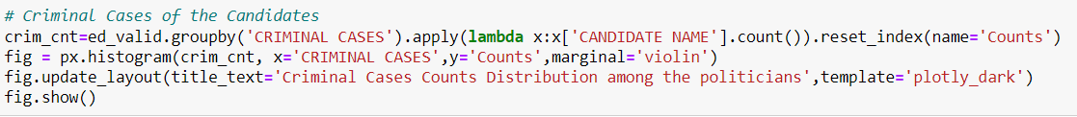
CRIMINAL CASES COUNT AMONG THE POLITICIAN

Slide 53
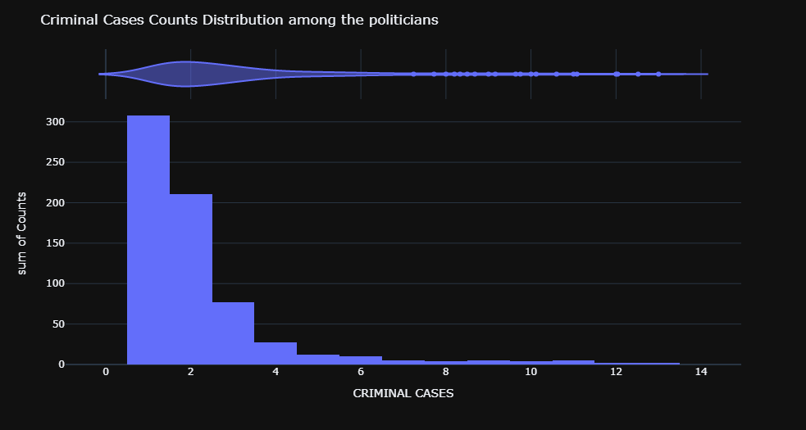
Observations Many politicians have been associated with criminal activities. Majority of the candidates have an average of 3 criminal cases. Always these cases pressed need not be genuine, but obviously, when its multiple- this is a serious issue. We must take the responsibility while voting, as its our duty to choose the right person- as a duty towards the nation.

Slide 54
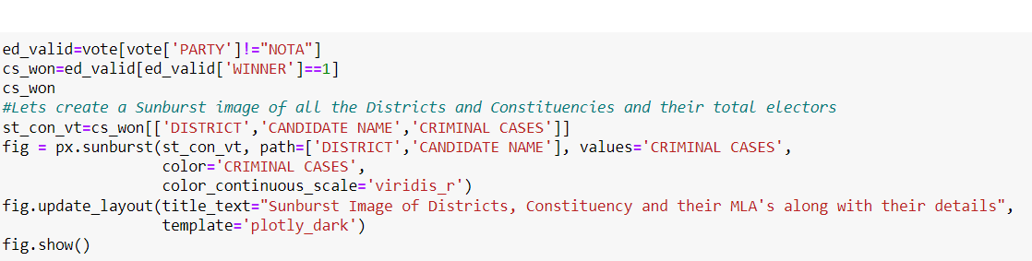
Sunburst Image of Districts and their MLA's along with their criminal cases count

Slide 55
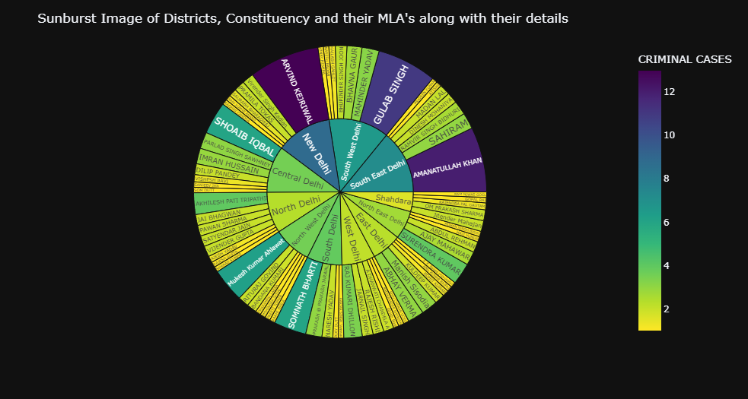
Observation: Above Sunburst image beautifully shows details of all the candidates who have registered win in Delhi Assembly Elections 2020. It shows the winners constituency wise and also district wise. Along with it it depicts their Criminal Cases.
Fact: Thirty-seven of Delhi's freshly elected MLAs have declared severe criminal charges against themselves, including attempted murder and at least one rape case. According to the statements made by these MLAs, 43 of them are facing criminal accusations, with 37 of them declaring severe crimes such as rape, attempted murder, and crime against women.

Slide 56
PREDICTION

Slide 57
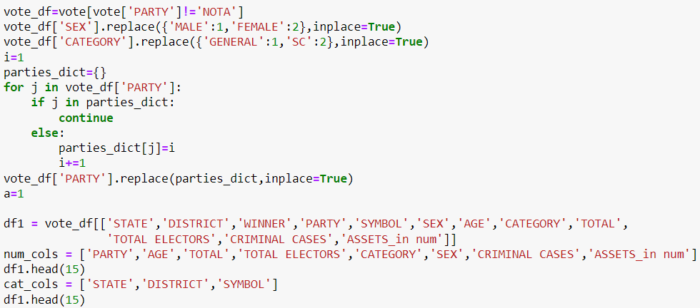
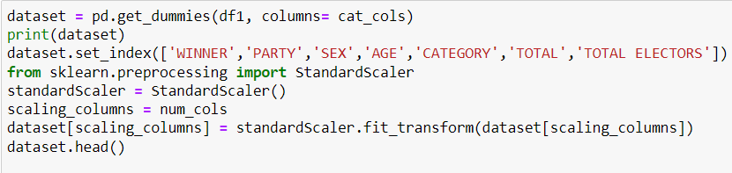
PREDICTION
We have done Prediction using:
Random Forest Classifier
Logistic Regressor
Support Vector Machine
K Nearest Neighbor
Decision Tree
Firstly, we have converted the categorical data into numbers by replacing using get dummy function to treat the categorical data.
Next we have performed data preprocessing to scale the data

Slide 58
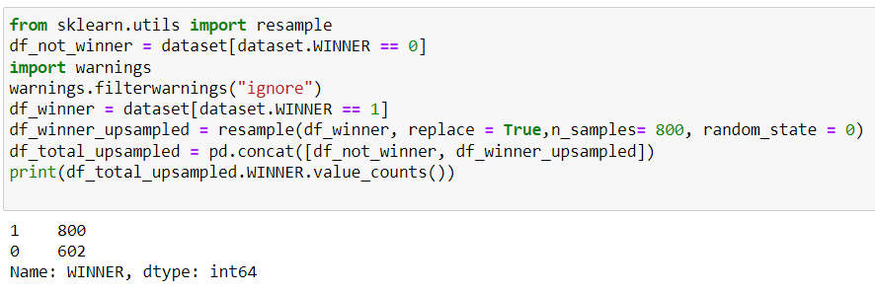
RESAMPLING THE DATA FOR PREDICTION

Slide 59
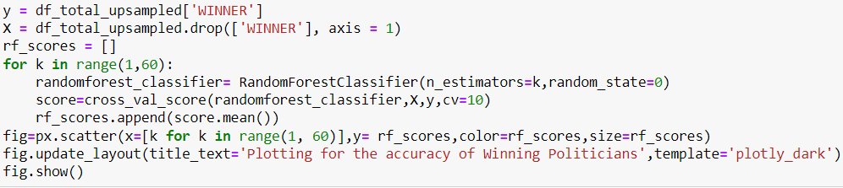
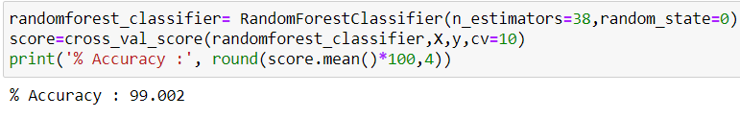
RANDOM FOREST CLASSIFIER
In order to know the optimum number of trees required to predict the result with highest accuracy, they plotted the accuracy score for various values of k and selected k value that gives highest accuracy. They have achieved an accuracy of about 96.3% using Random Forest Classifier.

Slide 60
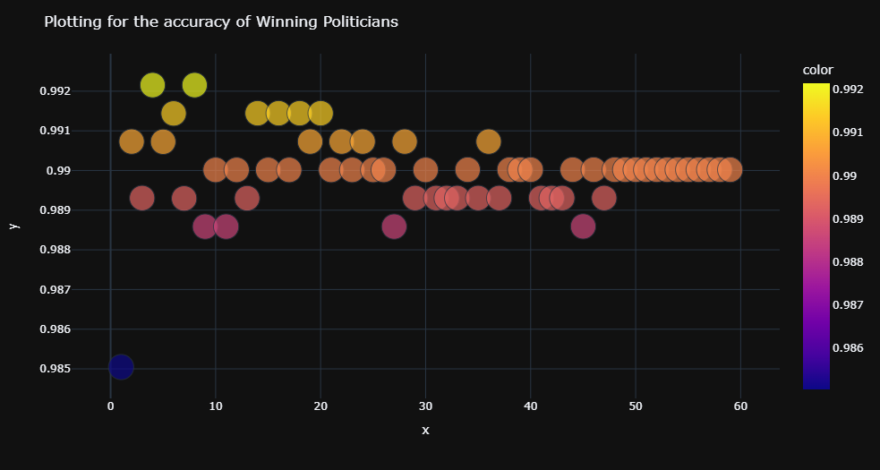
PLOT OF ACCURACY FOR RANDOM FOREST CLASSIFIER
ACCURACY =99.002%

Slide 61


LOGISTIC REGRESSOR
ACCURACY=98.42%

Slide 62


SUPPORT VECTOR MACHINE
ACCURACY=98.07%

Slide 63


K NEAREST NEIGHBOR
ACCURACY=96.64%

Slide 64


CODING FOR DECISION TREE
ACCURACY=99.002

Slide 65

PLOT OF DECISION TREE

Slide 66
LIMITATION
We do not have data for ASSETS , QUALIFICATION AND CRIMINAL CASES details for all the Candidates, so this lead to some biased prediction as these attributes are more important for prediction so it’s a major limitation of our project.
We have treated these missing values by using various imputations which might not be 100% accurate to predict the results.

Slide 67
CONCLUSION
Defeating the Modi-Shah juggernaut in Delhi, twice in a row with a landslide, the AAP’s achievement is a rarity. Not many opposition leaders have been able to survive Narendra Modi’s popularity or Amit Shah’s machinations. Modi is so popular that he won more than 50 per cent votes for the BJP in much of north India, including Delhi, in the 2019 Lok Sabha election
Through our Project we have performed detailed Exploratory Data Analysis on Delhi State Assembly Elections 2020. We have found out various insights and patterns using the dataset through our project.
We have also performed various Prediction techniques for predicting the results with the given variables.

Slide 68
REFERENCES
General Legislative Election 2020 DELHI election-> https://eci.gov.in/files/file/12027-general-legislative-election-2020/
FOR CRIMINAL CASES-> https://www.oneindia.com/delhi-mlas-with-criminal-cases/
FOR QUALIFICATION-> https://www.oneindia.com/educational-qualification-of-delhi-mlas/
FOR ASEESTS-> https://www.oneindia.com/assets-details-of-delhi-mlas/
FOR TECHNICAL SUPPORT -> https://www.kaggle.com/paramarthasengupta/eda-plotly-prediction-indian-elections-2019#What-has-been-the-performance-of-the-Parties-Statewise

Slide 69

THANK YOU

