Slide 1
PCA & CLUSTERING ASSIGNMENT

Slide 2
Problem Statement
Categorising the countries using some socio-economic and health factors that determine the overall development of the country. Then suggest the countries which the CEO of HELP International needs to focus on the most.

Slide 3
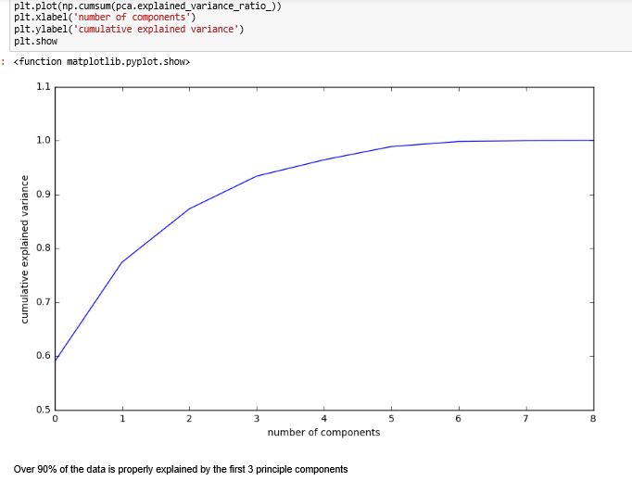
PCA
Below is the scree plot for plotting the cumulative variance against the number of components.

Slide 4
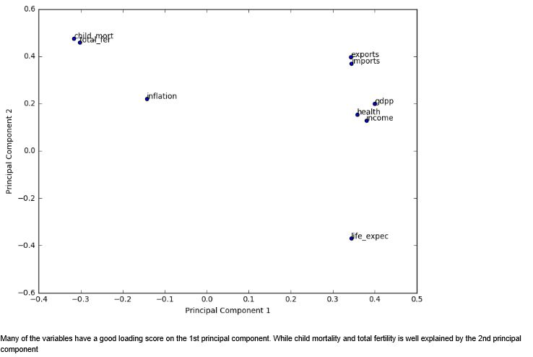

Slide 5
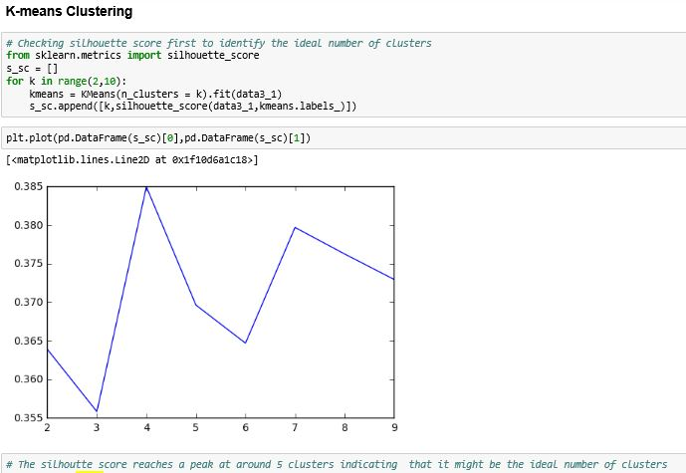
Clustering
From K-Means clustering we found that there are 5 clusters.

Slide 6
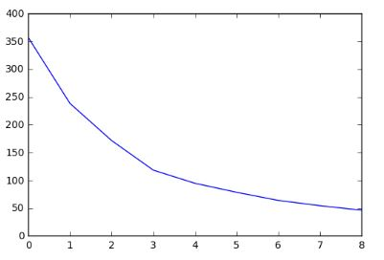
Elbow Curve
From elbow curve we found that the ideal number of clusters are 3.

Slide 7
Values associated with each cluster according to KMeans Clustering
Cluster Number : Value
0 : 51
1 : 24
2 : 7
3 : 19
4 : 18

Slide 8
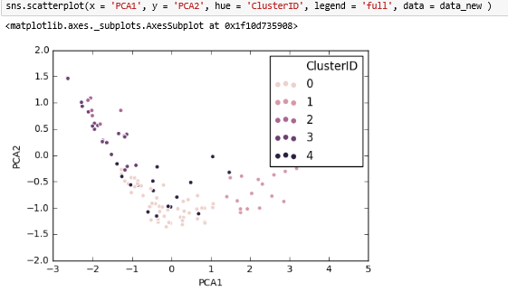
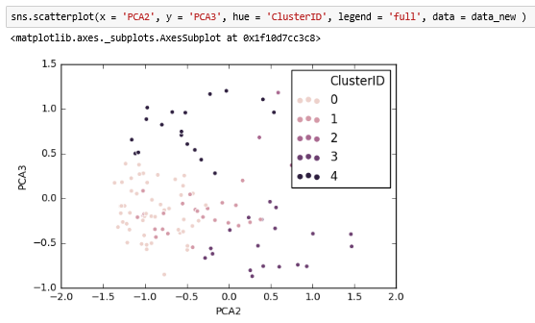
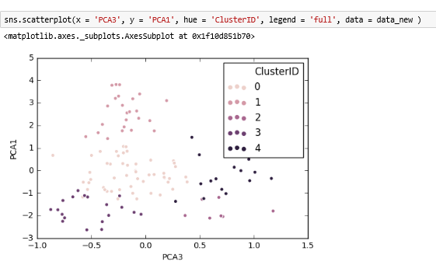
Visualizing Cluster on original PCAs

Slide 9
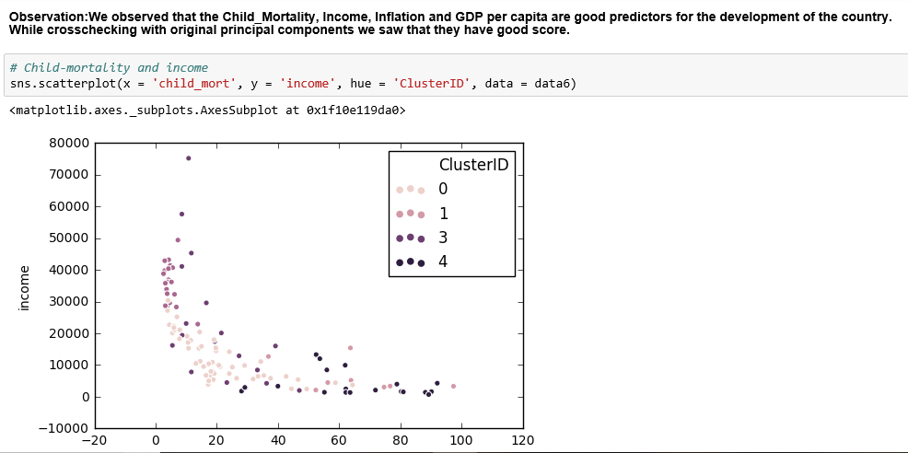
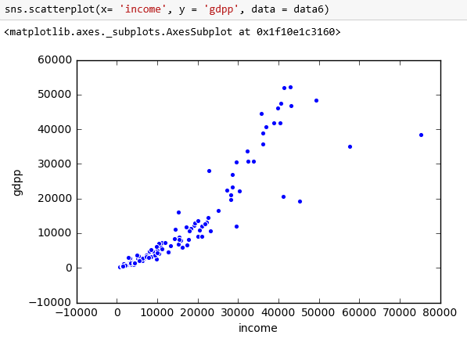
Observation:

Slide 10
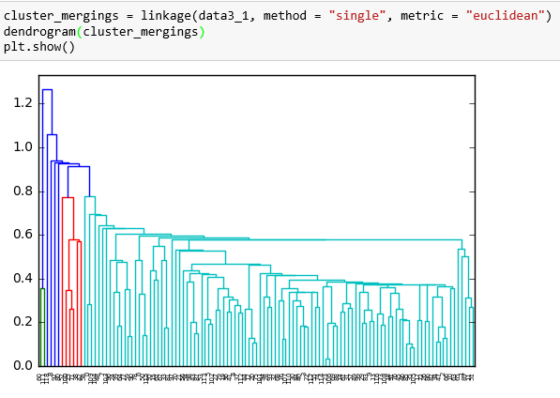
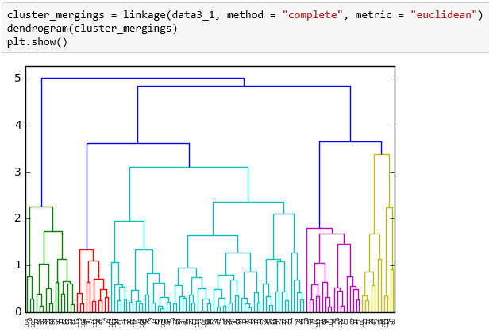
Hierarchical Clustering

Slide 11
Values associated with each cluster according to Hierarchical Clustering
0 : 16
1 : 18
2 : 63
3 : 11
4 : 11

Slide 12
Result
From K-means clustering we analyse that cluster 2 and 4 might be the one which has a proper need of aid. While from Hierarchical Clustering we found that cluster 0 and 1 is more appropriate.

Slide 13
Final List of Countries
1) Afghanistan
2) Benin
3) Burkina Faso
4) Burundi
5) Cameroon
6) Central African Republic
7) Chad
8) Comoros
9) Congo, Dem. Rep.
10) Cote d'Ivoire
11) Gambia
12) Guinea
13)Guinea-Bissau
14) Haiti
15) Lesotho
16) Liberia
17) Malawi
18) Mali
19) Mozambique
20) Niger
21) Sierra Leone
22) Togo
23) Uganda

