Slide 1
GDP Assignment

Slide 2
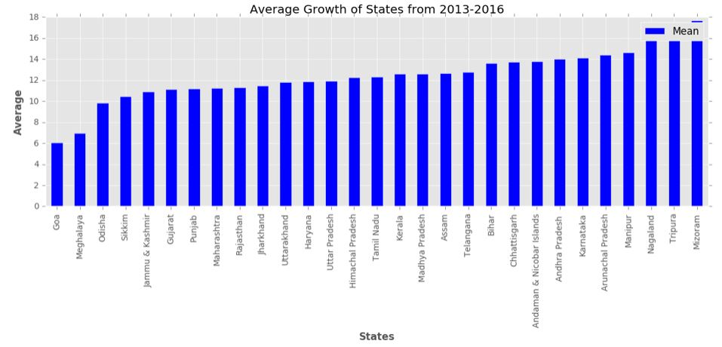
Data 1-A 1) Average growth of states for the duration 2013-14, 2014-15 and 2015-16

Slide 3
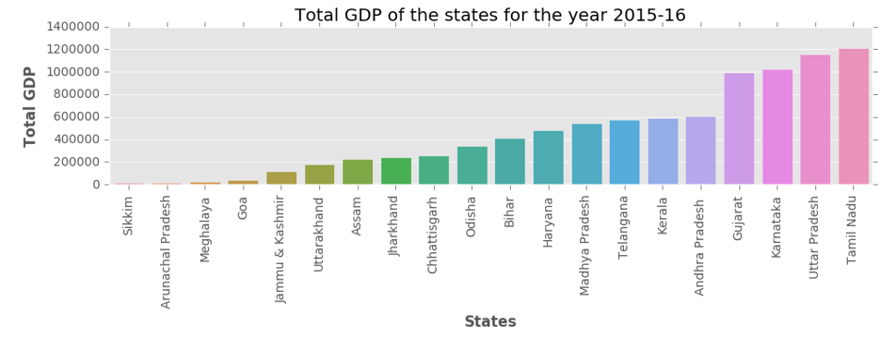
From the above graph we can conclude that
MIZORAM is growing consistently fast while GOA is struggling.
The average growth rate of Uttar Pradesh(my state) is 11.94 it is in the middle which signifies that it is increasing consistently compared to the national average over this duration.
2) Total GDP of the states for the year 2015-16

Slide 4
Based on the above plot :
top 5 performing states are
1)Tamil Nadu
2)Uttar Pradesh
3)Karnataka
4)Gujrat
5)Andhra Pradesh
Bottom 5 performing states are
1) Sikkim
2)Arunachal Pradesh
3)Meghalaya
4)Goa
5)Jammu & Kashmir

Slide 5
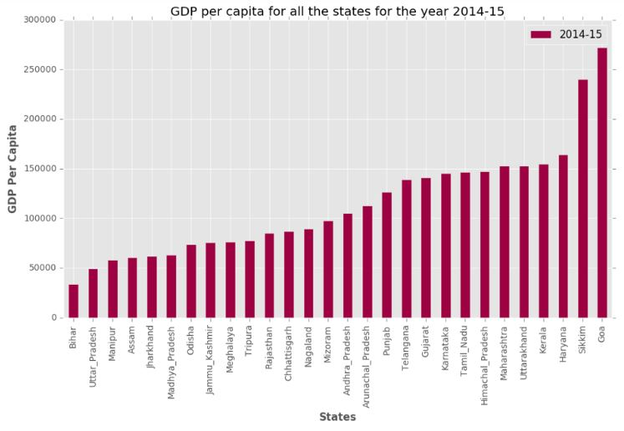
Part 1-B
GDP per capita for all the states

Slide 6
From the above graph:
top 5 GDP's are
1) Goa
2) Sikkim
3) Haryana
4) Kerala
5) Uttrakhand
Bottom 5 GDP's are
1) Bihar
2) Uttar Pradesh
3) Manipur
4) Assam
5) Jharkhand
Ratio of Highest per capita to lowest per capita is 271793 : 33954

Slide 7
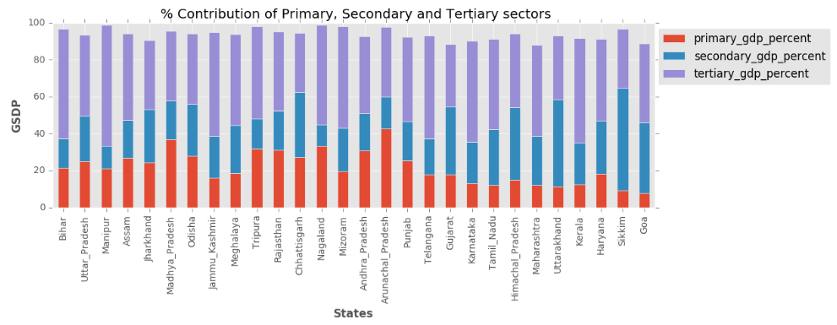
2) % Contribution of the primary, secondary and tertiary sectors as a percentage of the total GDP for all the states

Slide 8
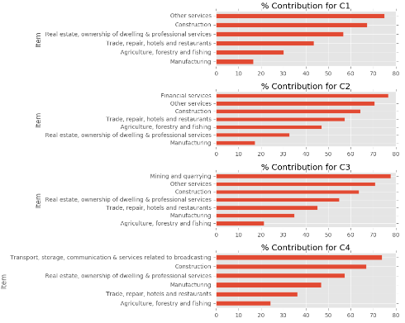
3) Top sub-sectors which contribute to approximately 80% of the GDP

Slide 9
1) How does the GDP distribution of the top states (C1) differ from the others?
Answer: In C1 other services is highly contributing.
2) Which sub-sectors seem to be correlated with high GDP?
Answer: Construction, Real-state, ownership of dwelling & professional services are correlated with high GDP.
3) Which sub-sectors do the various categories need to focus on?
Answer: Other Services, Construction and Real States are the subsectors to be focused on.

Slide 10
Recommendations for each category to improve the per capita GDP
1) Focus mainly on the construction, real state, ownership of dwelling and professional services.
2) Second thing to focus on are trade, repair, hotels and restaurants.
3) There are mainly 6-7 sub sectors which are contributing 80% GSDP

Slide 11
Data -2
Correlation between GDP per capita with dropout rates in education (primary, upper primary and secondary) for the year 2014-2015

Slide 12
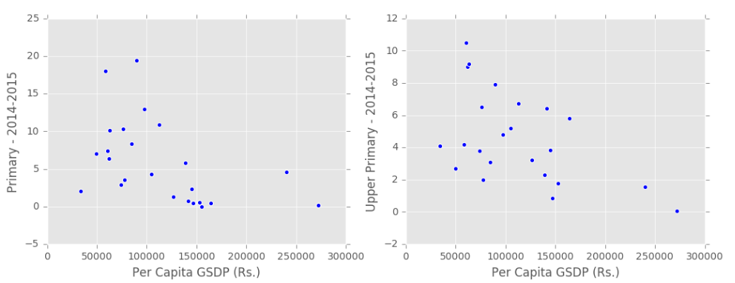

Slide 13
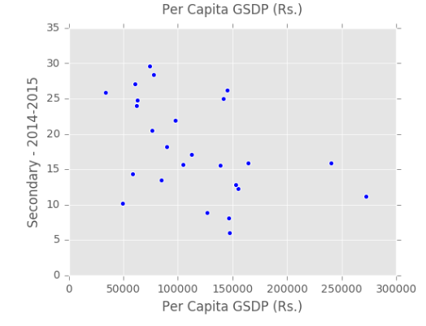

Slide 14
Key Insight
From the above scatter plots we can say that in 2014-15 the primary, upper primary and secondary sectors were negatively correlated with per capita GSDP i.e. as the GSDP increases profit in these sectors decreases.

