Slide 1


Language Detection using Python
Shri Ramswaroop Memorial college
of Engineering and management
Project presented by :
1. Lovelish Chauhan (2101220130045)
2. Palak Patel (2101220130054)
3. Akanksha Srivastava (2101220130005)

Slide 2
Contents :-
What is language detection ?
Objectives
Significances
Libraries
Code Explanation
Naïve Bayes Model
Input/Output
Dataset Visualization
Conclusion

Slide 3
Introduction
What is Language Detection ?
Language detection is the process of automatically identifying the language in which a given text or piece of content is written. There are several methods and techniques for language detection, ranging from simple rule-based approaches to more advanced machine learning algorithms.
This technology has wide-ranging applications in fields such as natural language processing (NLP), machine learning, and information retrieval.

Slide 4
Objective and its significance
Objectives:
1. Develop robust language detection model.
2. Explore real world application for the model.
3. Achieve high accuracy amoung multiple languages.
Significances:
1. Multilingual Content Customization
2. Multilingual Customer Support
3. Cross-Language Communication
4. Data Analysis and Insights

Slide 5
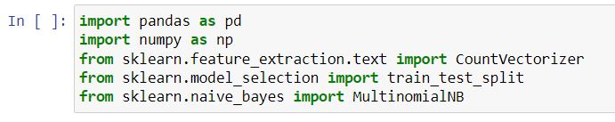
Loading Python Libraries
Press Shift+Enter to execute the jupyter cell

Slide 6
Reading data using pandas
Note: The above commands has many optional arguments to fine-tune the
date import process
There is a number of pandas command to read other data formats:
data = pd.read_json('your_file.json’)
data = pd.read_csv(url)
data = pd.read_clipboard()
data = pd.read_excel('your_file.xlsx')

Slide 7


Data Preparation
The code extracts two columns from the DataFrame:
x contains the text data (input features).
y contains the language labels (target variable).
Text Vectorization
It creates a CountVectorizer object cv to convert the text data into a numerical format suitable for machine learning.
cv.fit_transform(x) converts the text in the x array into a matrix X

Slide 8

Splitting the Dataset
The dataset is split into training and testing sets using the train_test_split function.
67% of the data is used for training (X_train and y_train), and 33% is used for testing
(X_test and y_test).
Creating and Training the Multinomial Naive Bayes Model
It creates an instance of the MultinomialNB classifier as model.
model.fit(X_train, y_train) trains the model on the training data.
model.score(X_test, y_test) calculates the accuracy of the model on
the testing data and prints the result.

Slide 9
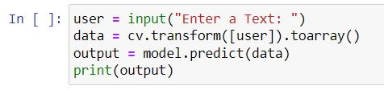




User Input
Output

Slide 10
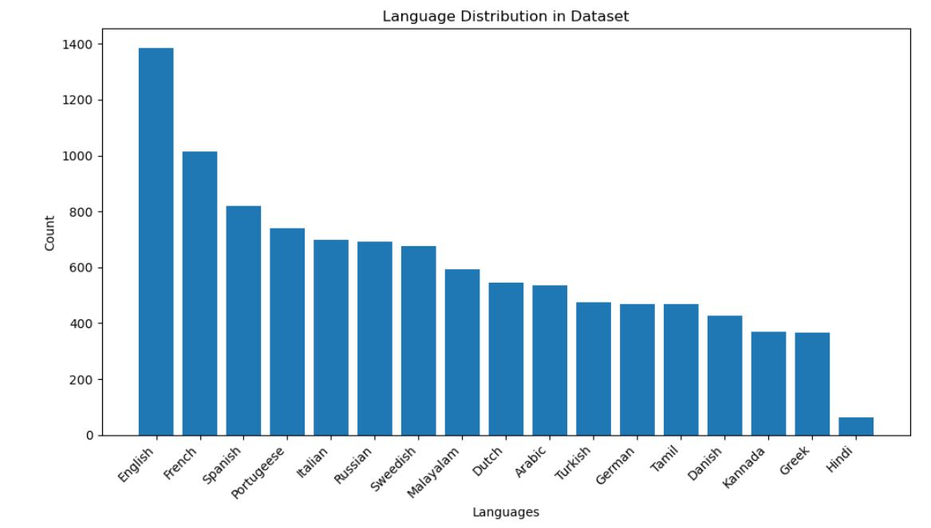
Dataset Visualization

Slide 11
Conclusion
Python, coupled with data science techniques, empowers us to harness the potential of language detection, making it accessible and powerful for a wide range of applications.
Language detection is an important tool for businesses and organizations
Python and data science make language detection accessible and powerful
Language detection is a rapidly evolving field

Slide 12


