Slide 1
Unit -V
Chi-Square Test

Slide 2
Introduction
Some test are based on the assumption that the samples were drawn from normally distributed populations. Since the testing procedure requires assumption about the type of population, these test are known as ‘parametric tests.’
There are many situations in which it is not possible to make any rigid assumption about the distribution of the population from which the samples are being drawn. This limitation has led to the development of a group of alternative techniques known as non-parametric tests are used, no assumption about the parameters of the population from which we draw our sample are made. Chi-square test is one of a non-parametric test.

Slide 3
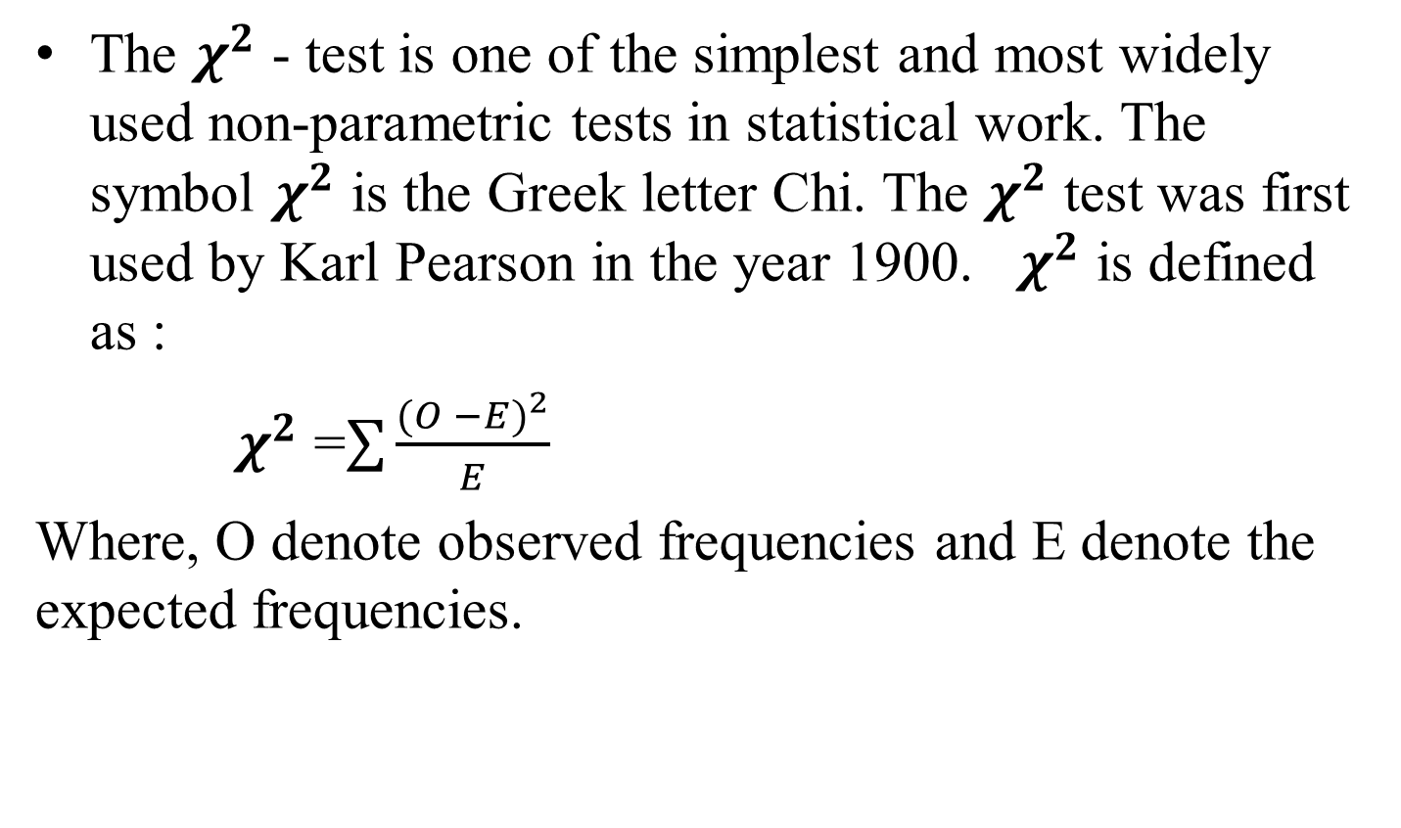

$χ^{2}$ Defined
The $χ^{2}$ - test is one of the simplest and most widely used non-parametric tests in statistical work. The symbol $χ^{2}$ is the Greek letter Chi. The $χ^{2}$ test was first used by Karl Pearson in the year 1900. $χ^{2}$ is defined as :
$χ^{2}$ =$\sum{\frac{{(O −E)}^{2}}{E}}$
Where, O denote observed frequencies and E denote the expected frequencies.

Slide 4
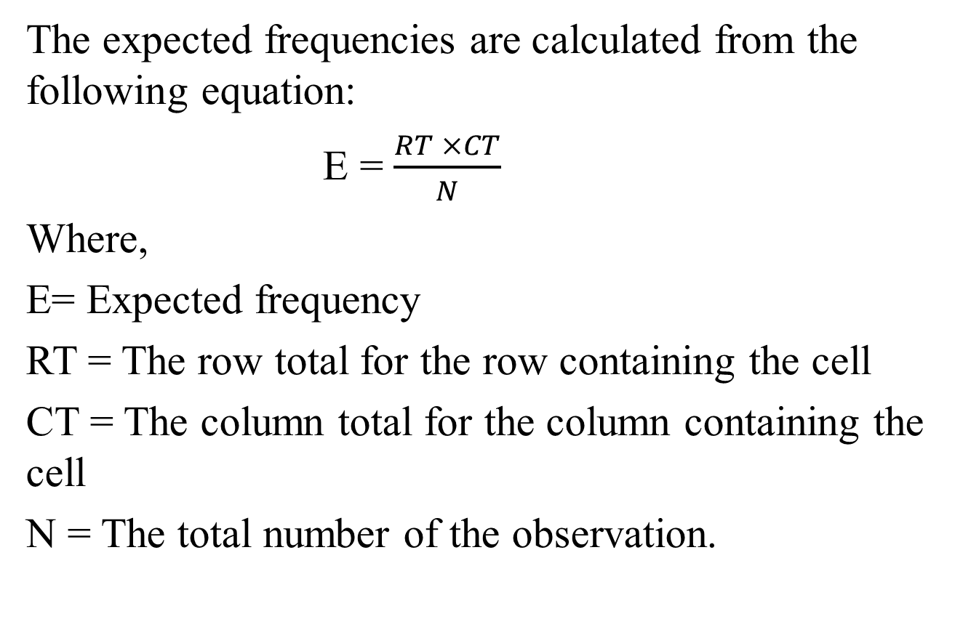
The expected frequencies are calculated from the following equation:
E = $\frac{RT ×CT}{N}$
Where,
E= Expected frequency
RT = The row total for the row containing the cell
CT = The column total for the column containing the cell
N = The total number of the observation.

Slide 5
Hypothesis are of two types:-
Null Hypothesis
Composite Hypothesis
(i) Null Hypothesis:- A null hypothesis is a hypothesis which is tested for possible rejection under the assumption that it is true.
This null hypothesis is denoted by H₀ .
For example, in a clinical trial of a new drug, the null hypothesis might be that the new drug is no better, on average, than the current drug. We would write H₀ : there is no difference between the two drugs on an average.
(ii) Composite or alternative Hypothesis:- Composite hypothesis is complementary or alternative to null hypothesis, we shall denote it by H₁.

Slide 6
Level of Significance:- The probability level below which we reject the hypothesis is known as the level of significance.
The accepted levels of significance are 0.05 and 0.01.
The probability with which we will accept a null hypothesis when it is true is the confidence level.

Slide 7
Chi-square Test
Chi-square test is used to test the difference between the actual and expected frequencies in case of two attributes. It is known as -test of independence.
Procedure of Chi-square Test:-
Assumption of null hypothesis
Calculation of
Testing the hypothesis
This distribution is a distribution which enable us to compare a whole set of sample values with a corresponding set of hypothetical ones also applied it as a test of ‘goodness of fit’.

Slide 8
Definition:- Assume be the observed frequency and
be the expected frequency of a class interval, then
is defined by
Interpretation:-
If calculated value of is less than table value, the difference is not significant. In this situation we say the fit is good.
When calculated value of is more than table value, the difference is significant. In this situation we say the fit is not good.

Slide 9
Conditions of :-
Total frequencies should be greater than 50. If total frequencies (N) is small then are not normally distributed.
No theoretical (expected) freq. should be very small. We shall take no freq. less than 10 otherwise apply the grouping method.
Sum of observed frequencies should be equal to sum of expected frequencies.
Sample observations should be independent.

Slide 10
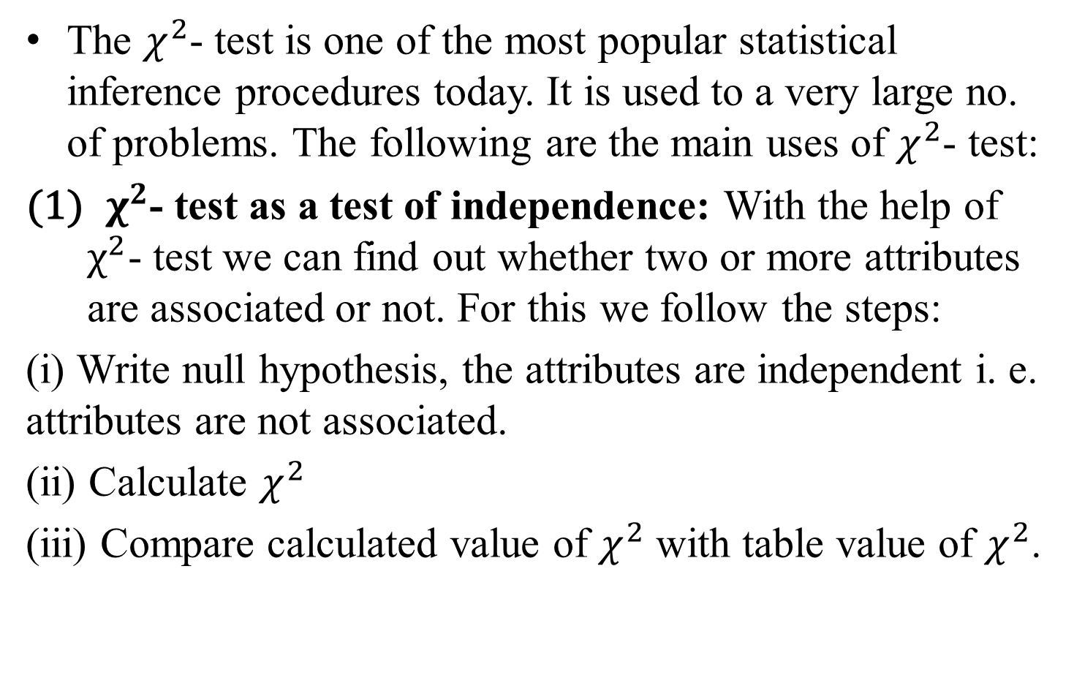
Uses of $χ^{2}$- test
The $χ^{2}$- test is one of the most popular statistical inference procedures today. It is used to a very large no. of problems. The following are the main uses of $χ^{2}$- test:
${ χ}^{2}$- test as a test of independence: With the help of $χ^{2}$- test we can find out whether two or more attributes are associated or not. For this we follow the steps:
(i) Write null hypothesis, the attributes are independent i. e. attributes are not associated.
(ii) Calculate $χ^{2}$
(iii) Compare calculated value of $χ^{2}$ with table value of $χ^{2}$.

Slide 11
Q. In an anti malarial campaign in a certain area, quinine was administered to 812 persons out of a total population of 3,248. The number of fever cases is shown below:
Discuss the usefulness of quinine in checking malaria.
Treatment | Fever | No Fever | Total
Quinine No quinine | 20 220 | 792 2,216 | 812 2,436
Total | 240 | 3,008 | 3,248

Slide 12
Q. Based on information on 1,000 randomly selected fields about the tenancy status of the cultivation of these fields and use of fertilizers, collected in an agro-economic survey, the following classification was noted:
Would you conclude that owner cultivators are more inclined towards the use of fertilizers at 5% level?
 | Owned | Rented | Total
Using fertilizers Not Using fertilizers | 416 64 | 184 336 | 600 400
Total | 480 | 520 | 1,000

Slide 13

Q. In an experiment on immunization of cattle on tuberculosis, the following results are obtained:
Calculate $χ^{2}$ and discuss the effect of vaccine in controlling susceptibility to tuberculosis (5 % value of $χ^{2}$ for one degree of freedom = 3.84).
 | Affected | Not affected
Inoculated Not inoculated | 12 16 | 26 6

Slide 14

Q. 1,000 students at college level were graded according to their I.Q. and the economic conditions of their homes. Use $χ^{2}$ test to find out whether there is any association between economic condition at home and I.Q.
(Given that 5 % value of $χ^{2}$ for one degree of freedom = 3.84)
Economic Condition | I.Q.
 | High | Low | Total
Rich | 460 | 140 | 600
Poor | 240 | 160 | 400
Total | 700 | 300 | 1000

Slide 15
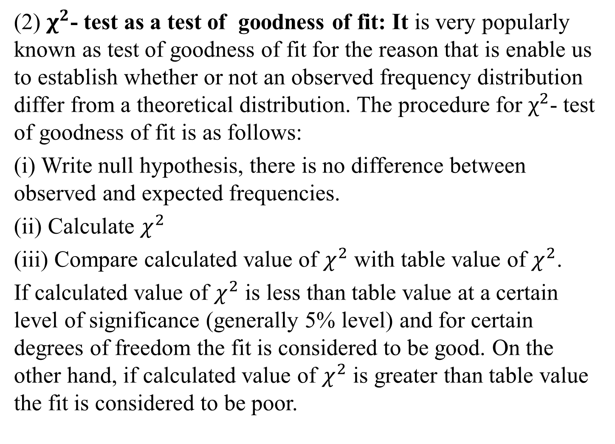
(2) $χ^{2}$- test as a test of goodness of fit: It is very popularly known as test of goodness of fit for the reason that is enable us to establish whether or not an observed frequency distribution differ from a theoretical distribution. The procedure for $χ^{2}$- test of goodness of fit is as follows:
(i) Write null hypothesis, there is no difference between observed and expected frequencies.
(ii) Calculate $χ^{2}$
(iii) Compare calculated value of $χ^{2}$ with table value of $χ^{2}$.
If calculated value of $χ^{2}$ is less than table value at a certain level of significance (generally 5% level) and for certain degrees of freedom the fit is considered to be good. On the other hand, if calculated value of $χ^{2}$ is greater than table value the fit is considered to be poor.

Slide 16
Q1. Suppose a coin is tossed 200 times with the following results:
Is this a fair coin?
Event | Frequency
Head Tail | 90 110
Total | 200

Slide 17
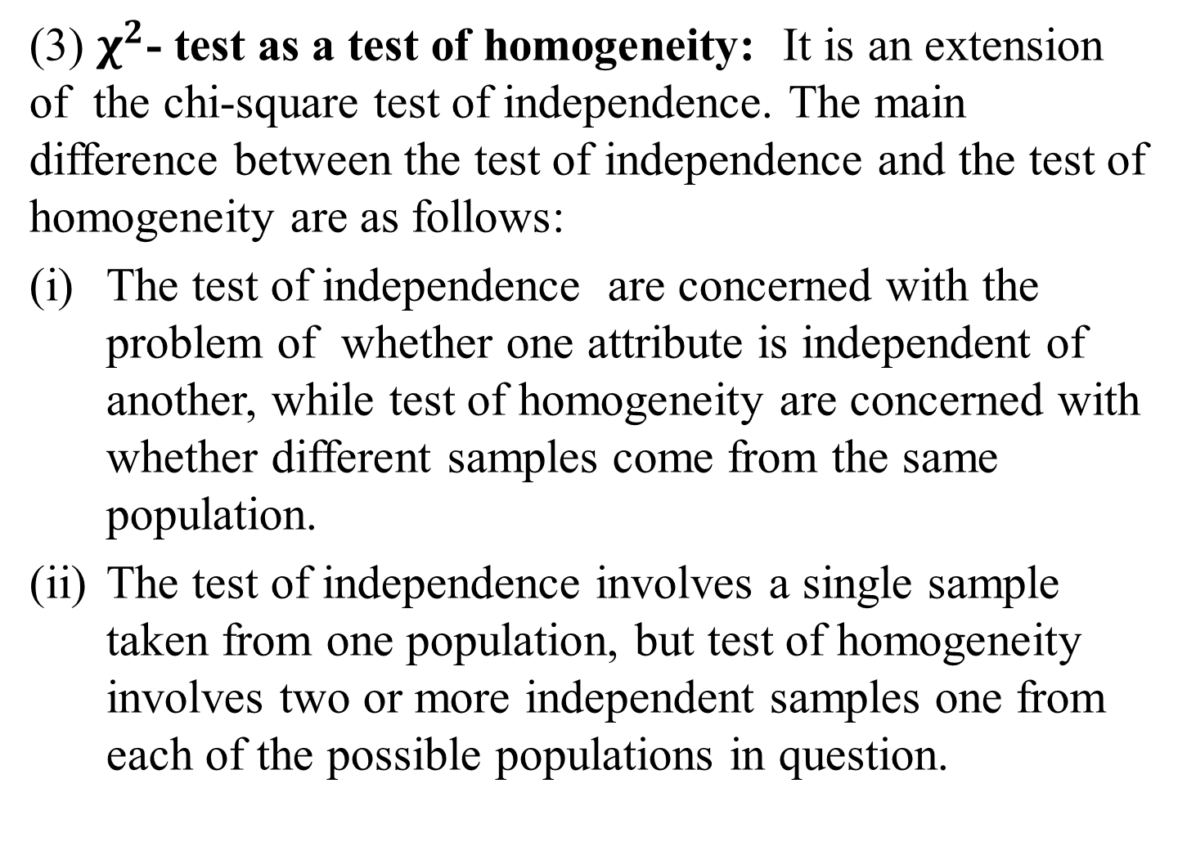
(3) $χ^{2}$- test as a test of homogeneity: It is an extension of the chi-square test of independence. The main difference between the test of independence and the test of homogeneity are as follows:
The test of independence are concerned with the problem of whether one attribute is independent of another, while test of homogeneity are concerned with whether different samples come from the same population.
The test of independence involves a single sample taken from one population, but test of homogeneity involves two or more independent samples one from each of the possible populations in question.

Slide 18
Q2. From the data given in the following table, find out whether there is any relationship between gender and the preference of colour.
Colour | Male | Female | Total
Red Blue Green | 30 50 40 | 40 20 20 | 70 70 60
Total | 120 | 80 | 200

Slide 19
Q3. A company has introduced a new drug B to cure common cold. It is being compared against an existing drug A. The relevant data are shown below:
Is the new drug more effective in curing cold?
Drug | Helped | Harmed | No effect | Total
A B | 44 52 | 10 10 | 26 18 | 80 80
Total | 96 | 20 | 44 | 160

Slide 20
Q4. A company has two factories- one located in Delhi and another in Mumbai. It is interested to know whether its workers are satisfied with their jobs or not at both places. To get proper and reliable information, it has undertaken a survey at both the factories, and the data obtained are shown as follows:
 | Delhi | Mumbai | Total
Fully satisfied Moderately satisfied Moderately dissatisfied Fully dissatisfied | 50 90 160 200 | 70 110 130 190 | 120 200 290 390
Total | 500 | 500 | 1,000

