Slide 1
Backtracking Approach On Hamiltonian Cycle
Group no. : M
Groups name : Vidhi
Palak
Bhavana

Slide 2
Content
Introduction
Applications of Backtracking
Theory & Explanation
Applications of Hamiltonion
Example
Time complexity Analysis
Conclusion
References
Thank you

Slide 3
Introduction
The backtracking approach for finding a Hamiltonian cycle explores all possible paths, recursively building paths and "backtracking" if a path doesn't lead to a valid cycle, until a solution is found or all possibilities are exhausted.

Slide 4
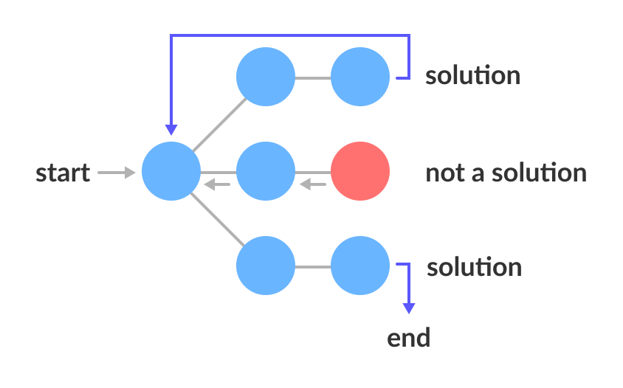
What Is Backtracking Algorithm
Backtracking is a problem-solving technique that explores potential solutions incrementally, abandoning a candidate solution if it's determined that it cannot lead to a valid outcome, and then trying alternative paths.

Slide 5
How Backtracking Algorithms Work?
The following is a general outline of how a backtracking algorithm works:
Choose an initial solution.
Explore all possible extensions of the current solution.
If an extension leads to a solution, return that solution.
If an extension does not lead to a solution, backtrack to the previous solution and try a different extension.
Repeat steps 2-4 until all possible solutions have been explored.

Slide 6
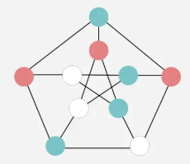
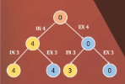
Applications Of Backtracking
Subset Sum Problem.
Graph Coloring.
N-Queen Problem.
Hamiltonian Cycle.

Slide 7
Advantage Of Backtracking Algorithm
Simple and Intuitive: Easy to understand and implement for a wide range of problems.
Flexibility: Can be applied to many types of problems, especially combinatorial and constraint satisfaction problems.
Exhaustive Search: Guarantees finding a solution if one exists by exploring all possible options.
Effective Pruning: Can reduce the search space significantly by eliminating paths that cannot lead to a solution.
Handles Complex Problems: Suitable for problems with complex constraints that other algorithms may struggle with.

Slide 8
Disadvantages Of Backtracking Algorithm
High Time Complexity: Can be very slow due to the need to explore all possible solutions, leading to exponential time complexity in many cases.
Memory Intensive: Uses a lot of memory, especially for deep recursion and large decision trees.
Inefficient for Large Problems: Not practical for large-scale problems due to the combinatorial explosion of possibilities.
Non-Optimal Solutions: While it finds a solution, it may not be the most efficient or optimal one without further optimization.
Requires Careful Pruning: Effective use of backtracking depends on good pruning techniques, which can be complex to implement correctly.

Slide 9
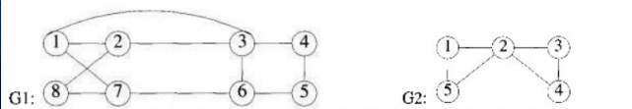
Hamiltonian Cycle
Hamiltonian Cycle: Hamiltonian Cycle or Circuit in a graph G is a cycle that visits every vertex of G exactly once and returns to the starting vertex.
Problems Statement: Given an undirected graph, the task is to determine whether the graph contains a Hamiltonian cycle or not. If it contains, then prints the path.

Slide 10
Backtracking Algorithms To Find Hamiltonian Cycle
This is a brute force approach where you attempt to construct a cycle by visiting all vertices.
If you find a vertex that cannot be visited without breaking the cycle's rules, you backtrack and try another path.
While simple, this algorithm is computationally expensive and typically used for small graphs.

Slide 11
Steps To Solve This Algorithms
choose a vertex to start with(usually vertex 0).
At each step, choose a vertex that has not been visited yet and that is connected to the previously chosen vertex (based on the graph’s adjacency matrix).
If adding a vertex leads to an invalid solution (i.e., the vertex doesn’t lead to a valid path or cycle), backtrack by removing the last added vertex and trying another one.
Once all vertices have been visited, check if there is an edge from the last vertex back to the starting vertex to form a cycle.
If this condition holds, a Hamiltonian cycle is found.

Slide 12
aPPliactions
Logistics and Transportation:
Traveling Salesman Problem (TSP): Finding the shortest route that visits each city exactly once and returns to the starting city is a classic example of a Hamiltonian cycle application.
Delivery Route Optimization: Hamiltonian cycles can help optimize delivery routes by finding the most efficient paths for delivery vehicles to cover a set of locations.

Slide 13
Computer Networks and Data Routing:
Network Optimization: Hamiltonian cycles can be used to optimize data routing in computer networks, ensuring efficient use of network resources and minimizing packet loss.
Circuit Design: Hamiltonian paths can be used to design efficient circuit layouts, minimizing the number of traces on circuit boards.
Path Planning: Hamiltonian paths can be used to plan collision-free paths for robots, ensuring they cover an area without retracing steps.

Slide 14
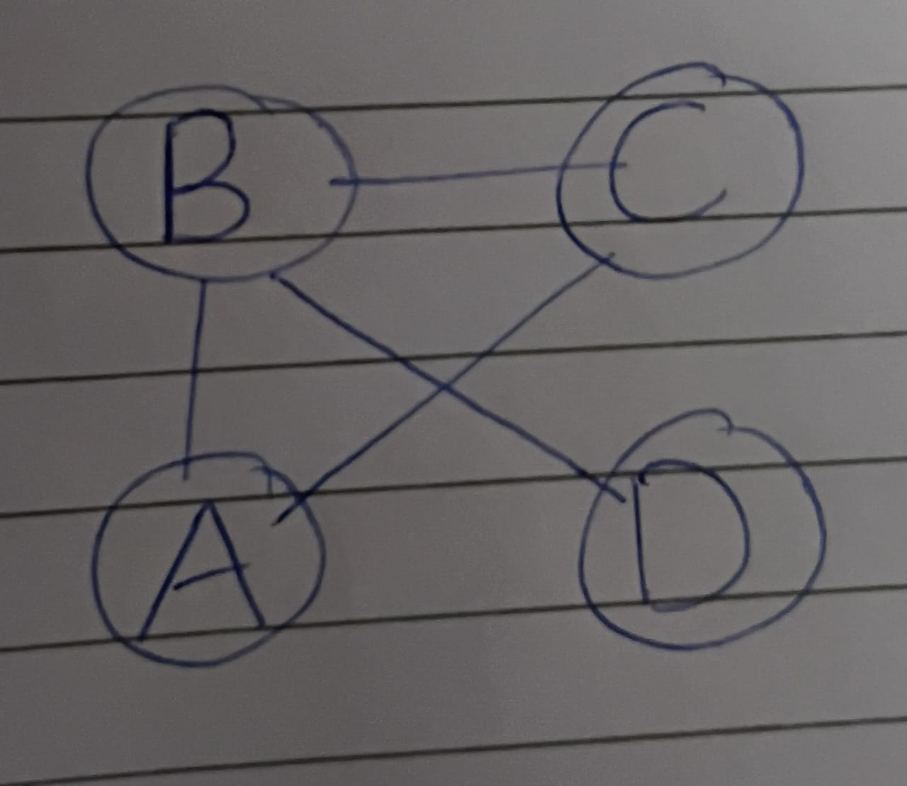
Example
Q. Let's see how the backtracking algorithm works to find a Hamiltonian cycle in an example graph. Consider the following undirected graph with 4 vertices:

Slide 15
Solution:-
We start at vertex A and recursively explore all possible paths:
1. Path: [A]
Unvisited neighbors: B, D
Choose B, Path: [A, B]
2. Path: [A, B]
Unvisited neighbors: C, D
Choose C, Path: [A, B, C]
3. Path: [A, B, C]
Unvisited neighbors: D
Choose D, Path: [A, B, C, D]
4. Path: [A, B, C, D]
All vertices visited & last vertex D has an edge to starting vertex A
Hamiltonian cycle found: [A, B, C, D, A]

Slide 16
Time Complexity Analysis
Time Complexity: Generate all possible configurations of vertices and print a configuration that satisfies the given constraints. There will be n! (n factorial) configurations. So the overall Time Complexity of this approach will be O(N!).

Slide 17
Conclusion
The backtracking approach is a systematic and efficient method for finding Hamiltonian cycles in graphs. By recursively exploring all possible paths and backtracking from incorrect solutions, the algorithm can effectively identify Hamiltonian cycles in graphs with a large number of nodes.
While the backtracking approach has a high time complexity of O(n!), making it inefficient for very large graphs, its simplicity and ease of implementation make it a popular choice for solving the Hamiltonian cycle problem.

Slide 18
References
References:1 file:///C:/Users/sahoo/Downloads/117-PDF%20file-177-1-10-20120107.pdf
On two problems regarding the Hamiltonian cycle game.
References:2 https://genbase.iiep.unesco.org/applis/epidoc/fichiers/EPIDOC/20264_G020264.pdf#page=287
On the implementation of backtracking approach in computer sciences and its education.

Slide 19
Thankyou

