Slide 1
Battery Bay Battery
SIMULATION EXERCISE
PALAKK SHRIVASTAVA
PXS176530
MIS 6375

Slide 2
SIMULATION STRATEGY
VISION
As the President, my responsibility is to make decisions around the R&D, investments and cost price of the batteries – Lithium and Ultracapacitor spread across 3 product types. The goal is to maximize the profit of the organization, sustaining and navigating through the sales trends across the years 2013 to 2020.
STRATEGY
My strategy is to invest in R&D for the optimized products that can serve the customer demands and maintain the company’s profits. To propel towards growth and innovation follow best pricing, strategizing and adapting to the changing market trends.

Slide 3
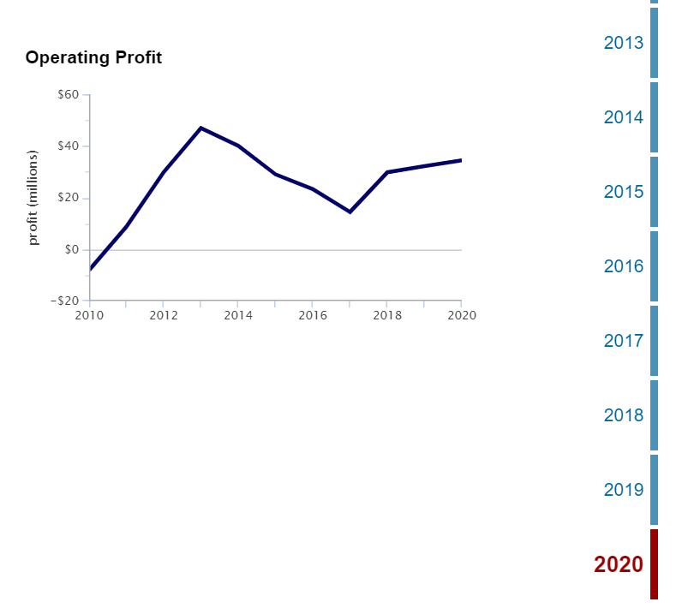
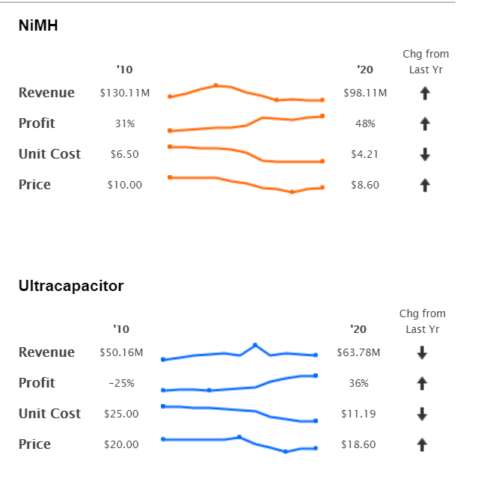
BEST RUN
By maintaining a good sales variance and pricing, I completed the run up to year 2020 and achieve a cumulative profit of $250.02 M
Investing well in the process improvement helped gauge the benefits of developed products
By continuously tracking the market changes and adjusting the prices, I was able to tap into the customer base
Price sensitivity was addressed at every step which helped increase converting the potential consumer base.

Slide 4
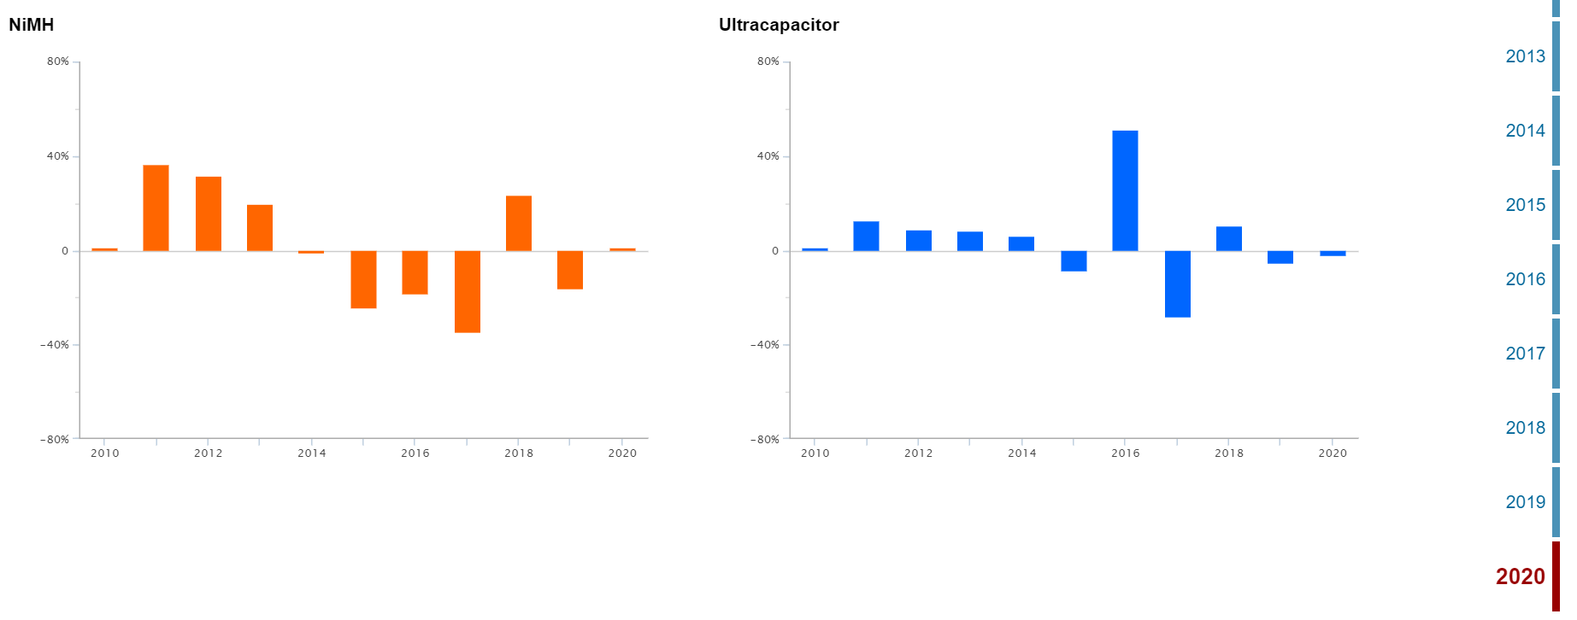
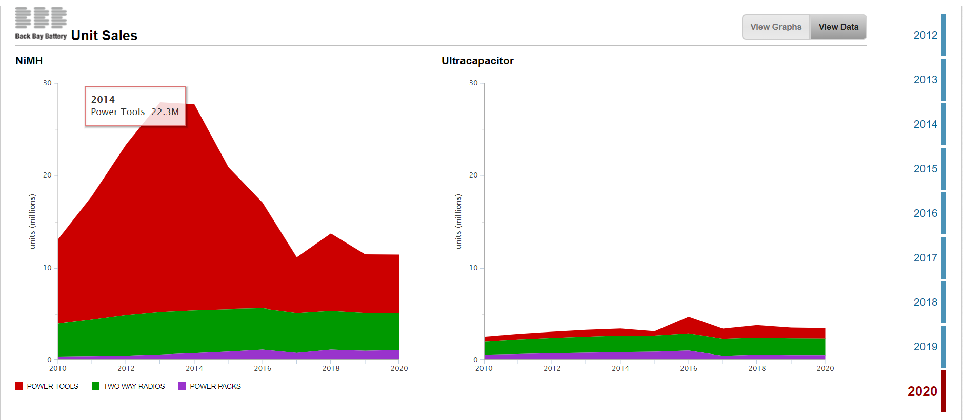
BEST RUN
The figures shows the key parameters that helped make the decisions.
The unit sales helped assess the changing market trends
Strategy was to reduce the price when sales were declining and vice-a-versa
The sales variance helped track the projected and actual sales
The negative sales variance was due to the competition
The goals were achieved by adjusting the pricing of the batteries

Slide 5
SUCCESS
  Success was achieved after 31 trials
News helped in constantly tracking the update about the market trends which gave me the idea of what is the customer demand.
Combining the news with own strategies proved beneficial
  For the later years of the simulation, I was able to figure out the range of prices that worked well and reduced the prices accordingly
When prices were to be cut down to $6.75 I kept the estimate between $8 -$9
  By tracking the demand, I could plan my actions to achieve a stable business
Investing in Process Improvement is crucial for success
  Interpretation of available data formed the backbone to support the decisions
Holistic review is required to sustain a business inclusive of customers, changing market trends, product, price and R&D
  This I continued investing some budget in Recharge Time for optimization which was fruitful

Slide 6
FAILURE <> IMPROVEMENT AREA
Paying attention to the news at every step is absolute necessary to adapt to changing market.
  Initially I just surfed through the news whereas it was the news that majorly helped me in completing the simulation.
This got me stuck at year 2018 and would get fired with the cumulative profit in the range of $50 -$100M
  Impact of not decreasing the prices on the revenue is massive
Two-way radios and power tools still saw maximum potential customers but Power packs still had scope.
  Use maximum R&D budget in the feature improvisation
I did not utilize all the R&D budget in the beginning

Slide 7
INFLUENCE ON THINKING PROCESS
Analytical thinking
Simulation helped brush up my analytical skills and reinforced the importance of data driven decision making.
Problem-solving
There are various ways to get through the end of 8 years, but finding the optimum way is the goal. This is synonymous to a complex problem solving which I was able to learn
Conceptual understanding
My understanding of the various concepts of business-like variable cost, income, sales variance had a good foundation built as I did not have a prior knowledge of these

Slide 8
TAKEAWAYS
The simulation re-established the value of customer perspective and choices.
Major demand trends are necessary to follow in a business.
The prices/features/services must be in synchronization with the company’s goals
The balance between retaining customers amidst competition and hitting the mark with profit goals that helps a company flourish.
The dashboards and graphs reading are a skill that develops with practice and simulations was a start for me

Slide 9
MY VIEWS
I was able to gain a good understanding of aspects that must be considered while running a business as an executive managing a portfolio of products across an organizational platform.
I learnt a lot by being in the shoes of a decision maker and realizing how much impact a decision taken now can have in the future
Business requires having a horizontal view of the landscape
This simulation was a perfect combination of strategizing based on decisions

Slide 10
CONCEPTS INTEGRATED
01
customer potential in power packs could not be tapped
02
Customer preferences, market trends and improving efficiency
Design Dominance
New Product Development
03
Maintaining Competitive Advantage
04
Ambidexterity
Company was adapting into new innovation as well
keeping lower prices of the batteries

Slide 11
Thank You!

