Slide 1
A CBI Implementation for Students with Autism Senior Project
Tyler Romasco
Justin Gordon

Slide 2
What is Austim
Autism spectrum disorder (ASD) and autism are both general terms for a group of complex disorders of brain development.
Characterized by difficulties in social interaction, verbal and nonverbal communication and repetitive behaviors.
ASD can be associated with intellectual disability, difficulties in motor coordination and attention and physical health issues such as sleep and gastrointestinal disturbances.
Some persons with ASD excel in visual skills, music, math and art.
Source: http://www.autismspeaks.org/what-autism

Slide 3
What is ABA?
Applied behavior analysis
Scientifically validated approach to understanding behavior and how it is affected by the environment
Principles and methods of behavior analysis have helped many different kinds of learners acquire many different skills
Can can improve communication, social relationships, play, self care, school and employment
Source: http://www.autismspeaks.org/what-autism/treatment/applied-behavior-analysis-aba

Slide 4
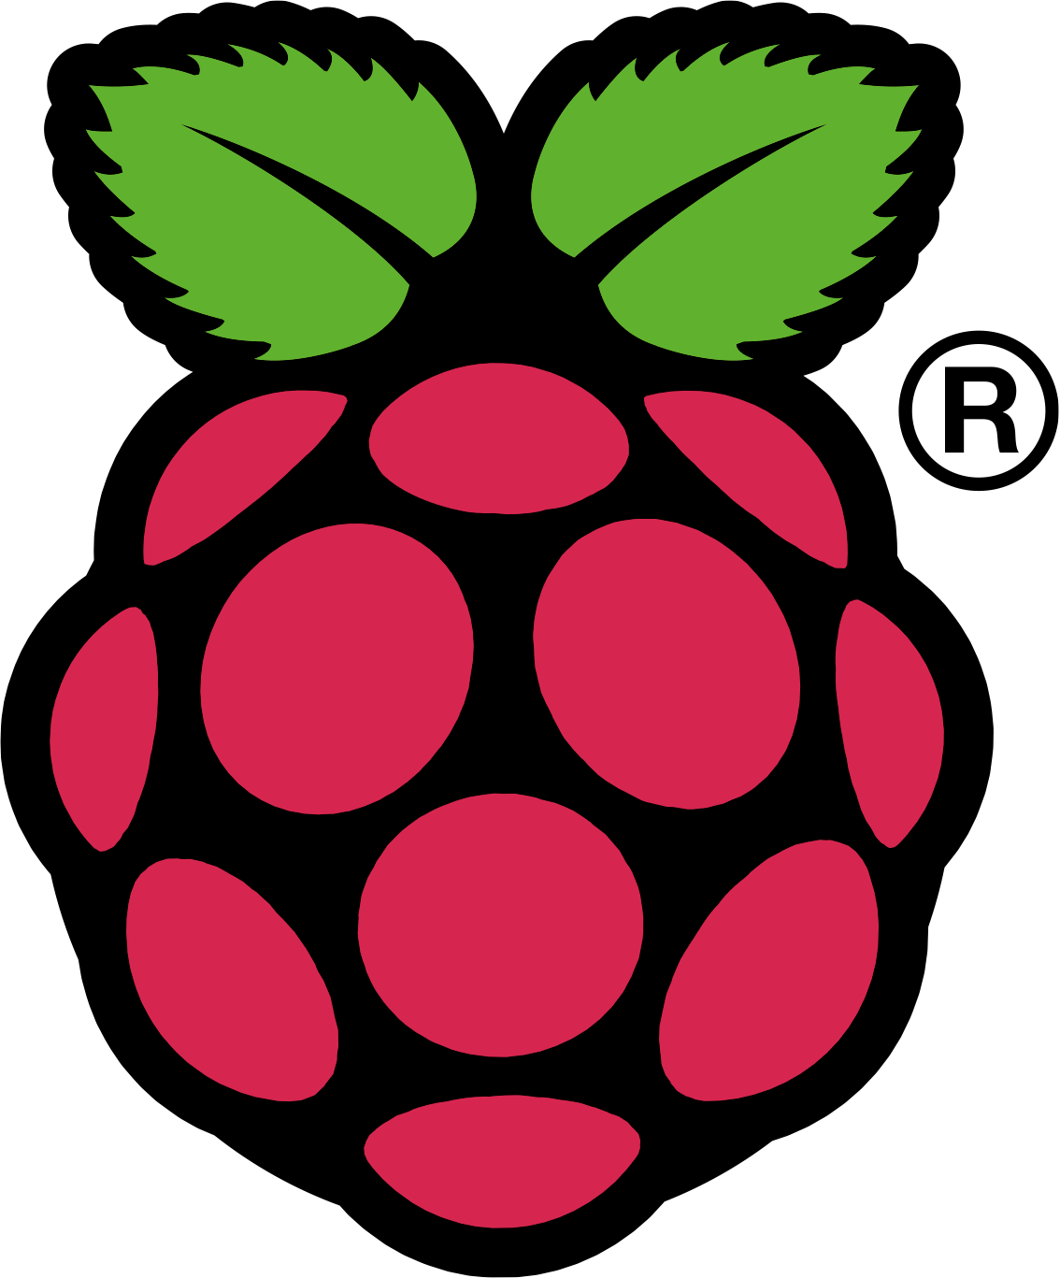
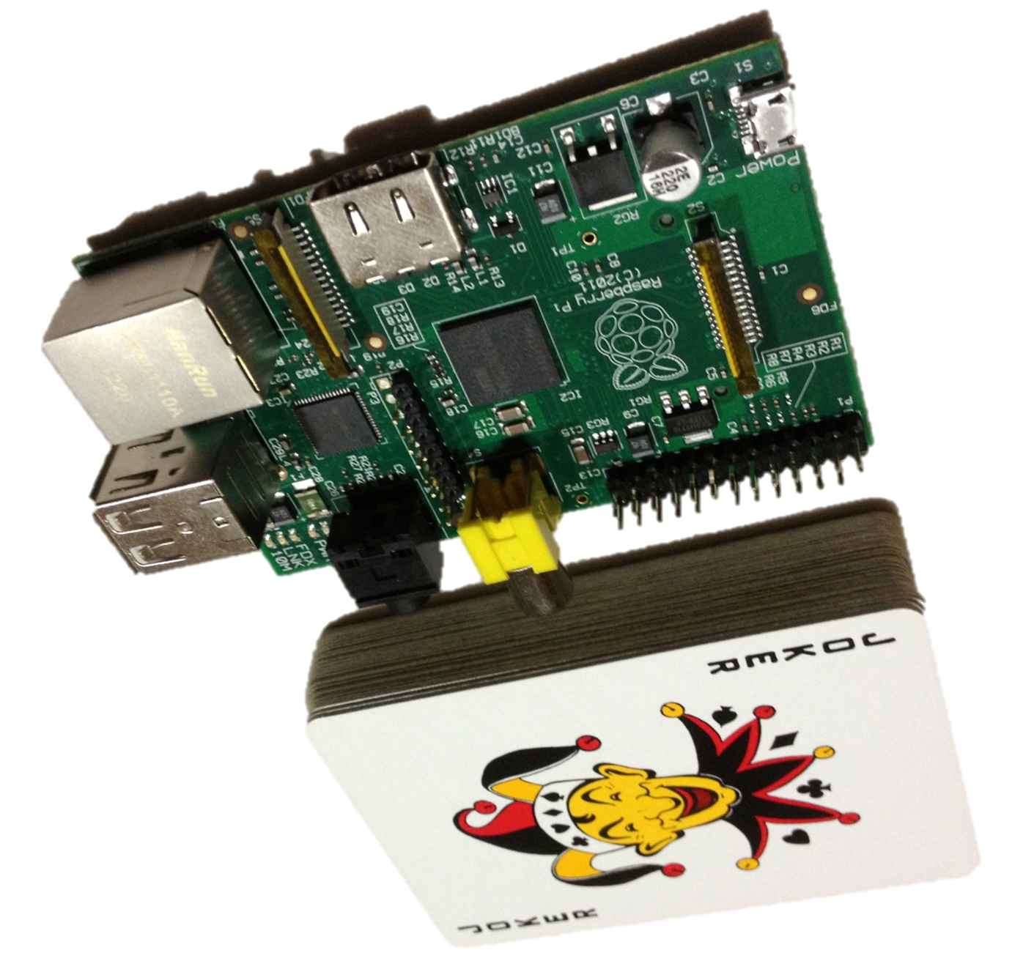
What is the Raspberry Pi?
A computer the size of a deck of cards that costs $25 or $35

Slide 5
Who made the RiPi? Why?
Raspberry Pi Foundation (designed the RiPi) is a non-profit based in the UK whose goal is to promote accessible programming tools to grade-school students and schools.

Slide 6
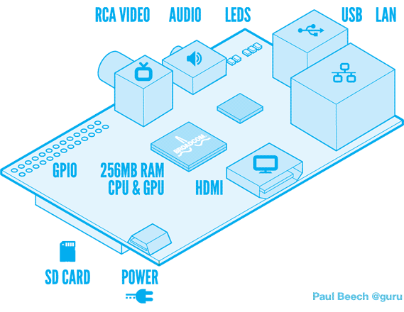
Raspberry Pi Model B Tech Specs
700 MHz ARM1176JZFS CPU (1 GHz bursts)
Videocore 4 GPU
H.264, 40 Mbit/S Decoding (Blu-ray quality)
Usable with OpenGL ES2.0 and OpenVG
256 MB RAM
2 USB ports
10/100 Ethernet
HDMI / Composite video out
HDMI / 3.5 mm audio out
Powered by micro USB
700 mA @ 5V, ~ 2 watts
Boots off removable SD card
Source: raspberrypi.org
Diagram courtesy Paul Beech

Slide 7
What can it run?
Linux, of course!
Raspbian Linux based on Debian
Can use LXDE windowing system
Includes gcc and Python
Other distributions:
Arch Linux ARM
QtonPi (embedded Linux optimized for Qt 5)

Slide 8
Potential Uses
Intended:
Personal programming environment for every student
Possible Uses:
Media center (for TV)
Low-powered NAS server
Small Minecraft server
Robot controller

Slide 9
What do we want to teach?
Non-verbal reading skills
Typically developing children learn that letters form sounds
For children with autism, words do not coressond to anything
This instruction makes words correspond to objects.
This is NOT 'reading’ (think shapes rather than words)

Slide 10
How does one combine Autism and a humble Raspberry Pi?
We are going to build a teaching assistant on top of the Raspberry Pi platform
Build app(s) on top of Raspbian that incorporate CBI concepts

Slide 11
Techniques
Word Walls
Multiple choice

